Slide 1
Agenda
Introduction & Objectives
Criminal Incidents, Recorded Offences (Antoinette)
Victim Reports & Family Incidents (Jacqueline)
Crime status & Police Service Areas (Kelvin)
Victoria Crimes Trends from September 2012 to 2021 (Anh)

Slide 2


Overview Victoria Crimes & Family Incidents
From September 2012 to September 2021

Slide 3
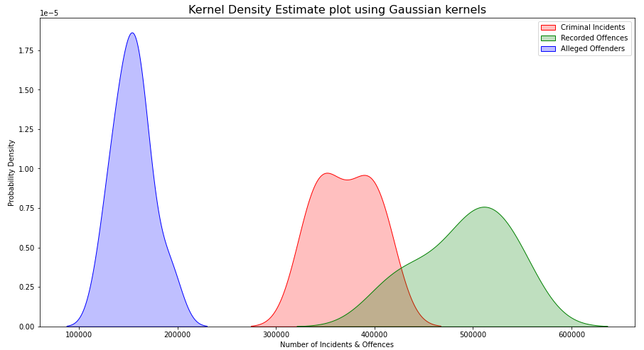
Criminal Incidents, Recorded Offences and Alleged Offenders
Kernel Density Estimation (KDE)
In statistics, Kernel Density Estimation (KDE) is a non-parametric way to estimate the Probability Density Function (PDF) of a random variable.
The graphs uses Gaussian kernels with automatic bandwidth determination based on “scotts_factor” formula: n**(-1./(d+4))

Slide 4
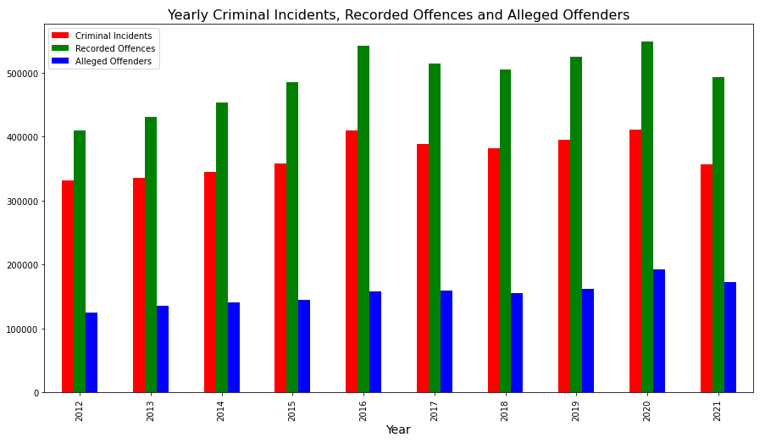
Criminal Incidents, Recorded Offences and Alleged Offenders
Yearly Percentage Changes
Year | Criminal Incidents | Recorded Offences | Alleged Offenders | Population
2012 | (Baseline) | (Baseline) | (Baseline) | (Baseline)
2013 | 0.012099 | 0.054790 | 0.090524 | 0.017587
2014 | 0.029842 | 0.052259 | 0.040208 | 0.024388
2015 | 0.039363 | 0.068144 | 0.028308 | 0.018456
2016 | 0.141908 | 0.116527 | 0.084495 | 0.021263
2017 | -0.051259 | -0.050605 | 0.008406 | 0.018048
2018 | -0.018528 | -0.018061 | -0.020907 | 0.029002
2019 | 0.035609 | 0.040722 | 0.043626 | 0.015371
2020 | 0.040523 | 0.044216 | 0.189915 | 0.021673
2021 | -0.131986 | -0.100593 | -0.105169 | -0.007842

Slide 5
Criminal Incidents, Recorded Offences and Alleged Offenders
Ten Years Overview Statistics
 | Criminal Incidents | Criminal Incidents Rate | Recorded Offences | Recorded Offences Rate | Alleged Offenders | Alleged Offenders Rate | Total
count (number of years) | 10.0 | 10.0 | 10.0 | 10.0 | 10.0 | 10.0 | 10.0
mean | 371,030.6 | 23,614.45 | 490,620.5 | 31,240.43 | 154,560.7 | 9,955.12 | 1,016,211.8
standard deviation | 29,772.09 | 1,304.28 | 46,454.24 | 1,856.8 | 19,499.59 | 713.94 | 92,297.04
min | 330,923.0 | 21,248.43 | 408,983.0 | 28,472.58 | 124,409.0 | 8,828.47 | 864,315.0
1st Quartile - 25% | 347,828.75 | 23,052.66 | 461,668.25 | 29,749.42 | 142,124.75 | 9,619.61 | 952,109.25
2nd Quartile - 50% (median) | 369,846.0 | 23,453.34 | 498,991.0 | 31,448.79 | 156,385.5 | 9,827.37 | 1,031,891.5
3rd Quartile - 75% | 393,172.5 | 24,177.39 | 522,423.75 | 32,315.31 | 161,301.75 | 10,256.3 | 1,076,898.0
max | 410,764.0 | 26,304.42 | 548,465.0 | 34,796.25 | 192,965.0 | 11,485.34 | 1,152,194.0
Observation:
Year 2016 has the highest Crime Incidents (26,304 incidents) and Recorded Offences (34,796 offences) rate per 100,000 population.
Year 2021 has lowest Crime Incidents (21,248.43) rate per 100,000 population.

Slide 6
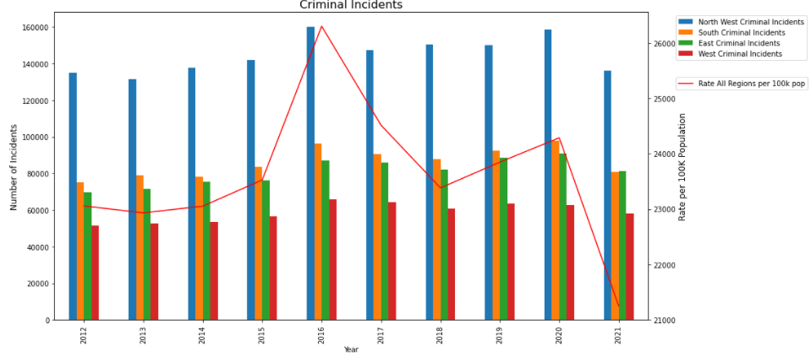
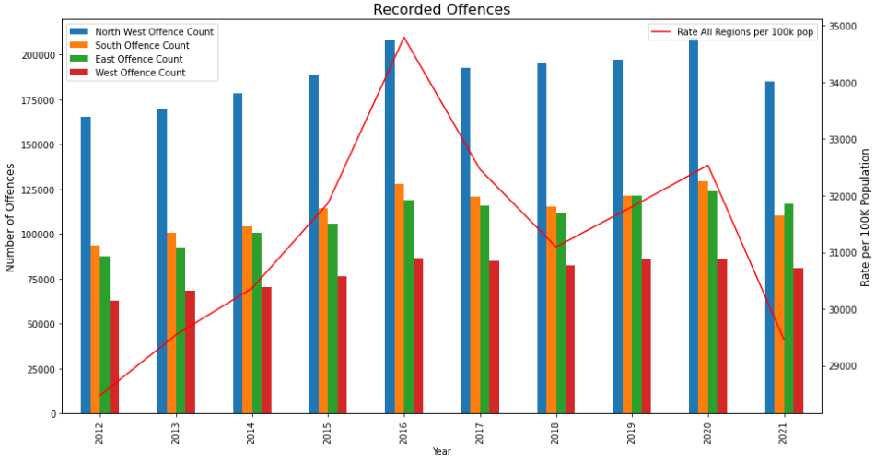
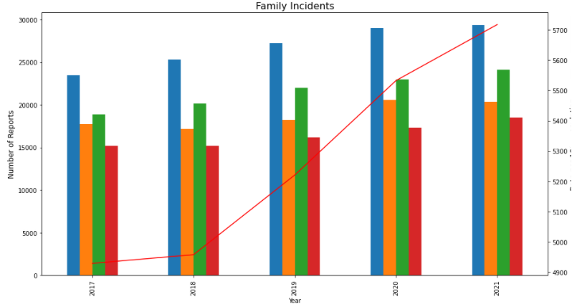
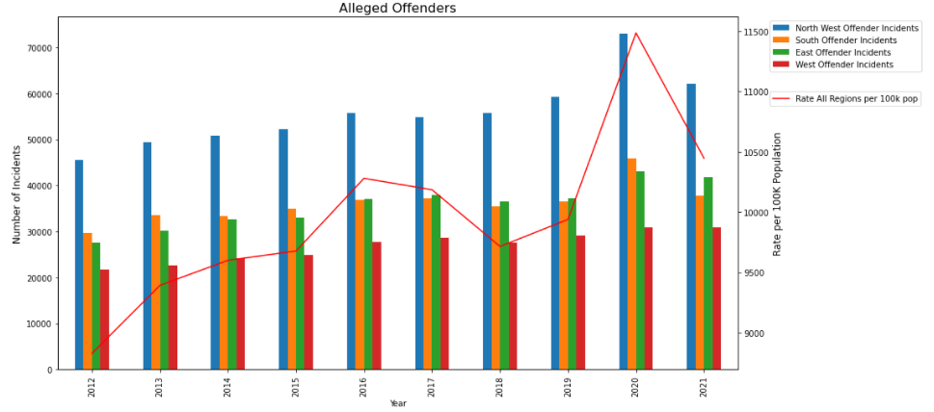
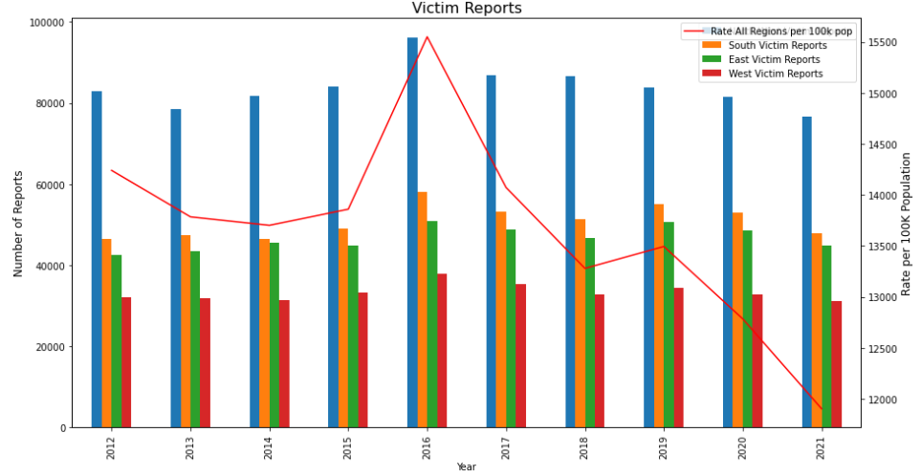
Victoria Crimes Trends by Police Service Region

Slide 7
Yearly Crimes Trends by Police Service Region
Percentage Changes of Number of Incidents and Offences by Police Region
Types | Police Service Region | Highest In Year | Highest Yearly Percentage Change
Criminal Incidents | Southern Metro | 2013, 2015, 2020 | Ÿ0.05, Ÿ0.07, Ÿ0.06
 | East | 2014, 2017, 2019 | Ÿ0.05, ”-0.01, Ÿ0.08
Recorded Offence | West | 2013, 2016, 2017, 2021 | Ÿ0.09, Ÿ0.13, ”-0.02, ”-0.06
Alleged Offender Incidents | Southern Metro | 2013, 2015, 2020 | Ÿ0.13, Ÿ0.42, Ÿ0.26
Victim Reports | East | 2013, 2014, 2017, 2019 | Ÿ0.02, Ÿ0.05, ”-0.04, Ÿ0.08
Family Incidents | North West Metro | 2018 | Ÿ0.08
 | East | 2019 | Ÿ0.09
 | Southern Metro | 2020 | Ÿ0.13
 | West | 2021 | Ÿ0.07
Observation:
Year 2019, East region is taking the lead in increasing in Crime Incidents (Ÿ0.06), Victim Reports (Ÿ0.08) and Family Incidents (Ÿ0.09) compares to other Police Service regions.
Year 2020, Southern Metropolitan region is having the highest increase in the Crime Incidents (Ÿ0.06), Alleged Offender Incidents (Ÿ0.26) and Family Incidents (Ÿ0.13) compares to other Police Service regions.

Slide 8
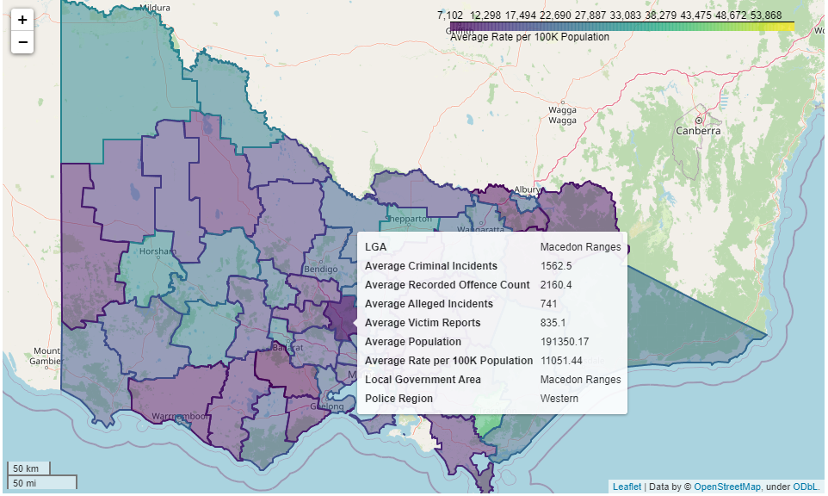
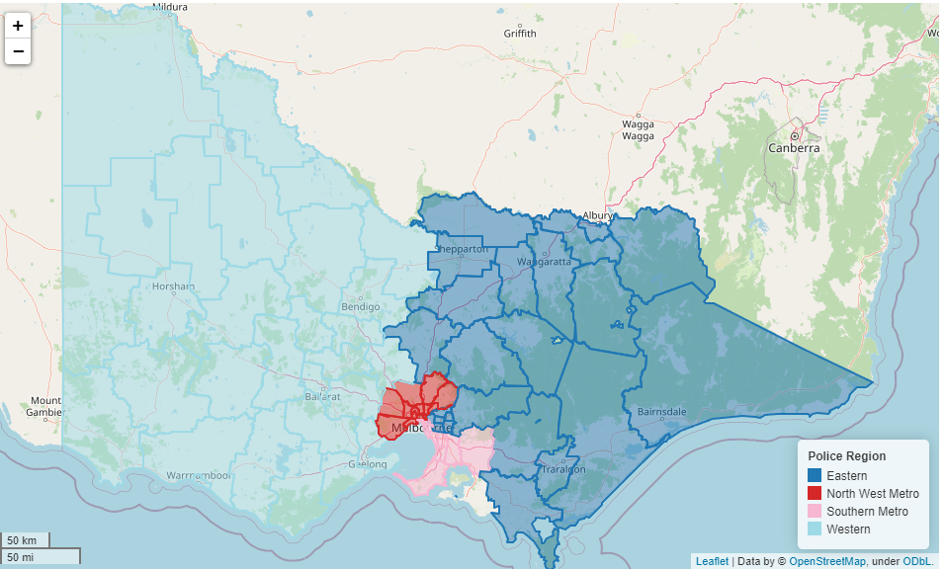
Victoria Crimes Data Maps
Average 10 years data of Criminal Incidents, Recorded Offence Count, Alleged Incidents & Victim Reports
Display By Local Government Area
Display By Police Service Region

Slide 9

Q&A

