Slide 1


Overview Victoria Crimes & Family Incidents
From September 2012 to 2021

Slide 2
Table of Contents
Introduction & Objectives
Overview Victoria Crimes from September 2012 to 2021 (Anh)
Criminal Incidents, Recorded Offences (Antoinette)
Family Incidents (Jacqueline)
Crime status & Police Service Areas (Kelvin)

Slide 3
Terminology
Criminal incident
A criminal event that may include multiple offences, alleged offenders and/or victims, is recorded on a single date and as occurring at one location.
Alleged offender incident
An alleged offender incident is an incident involving one or more offences to which an individual, business or organisation has been linked as an alleged offender.
Victim report
A victim report is counted when an individual, business or organisation reports to Victoria Police that they have been a victim of one or more criminal offences.
Family incident
An incident attended by Victoria Police where a Risk Assessment and Risk Management Report (also known as an L17 form) was completed. The report is completed when family violence incidents, interfamilial-related sexual offences, and child abuse are reported to police.

Slide 4
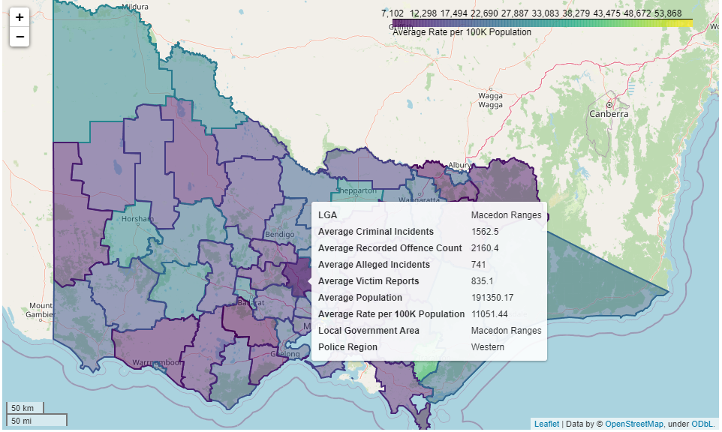
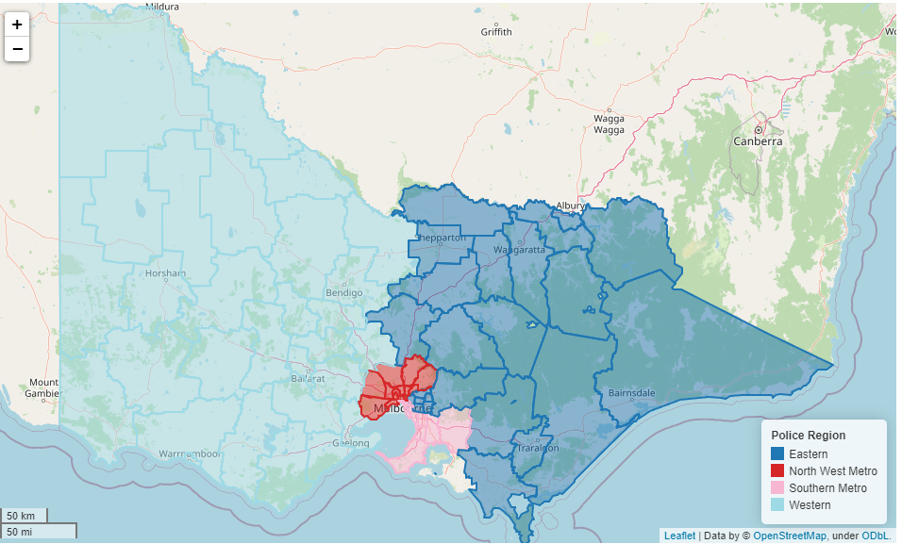
Victoria Crime Data Maps
Average 10 years data of Criminal Incidents, Recorded Offence Count, Alleged Incidents & Victim Reports
Display By Local Government Area
Display By Police Service Region

Slide 5
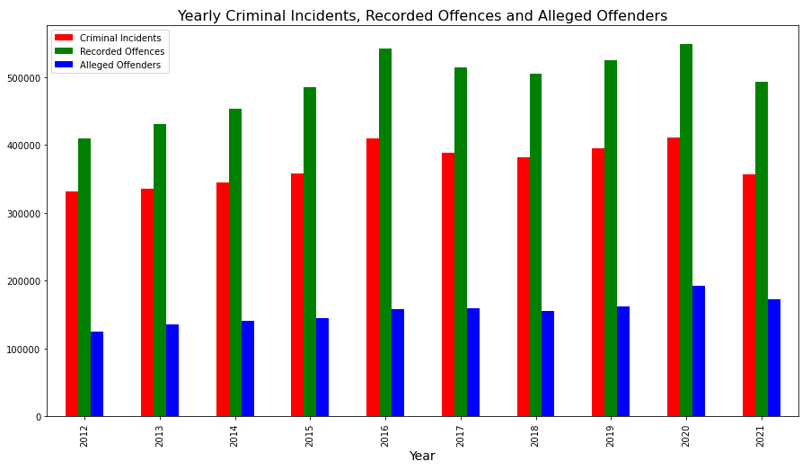
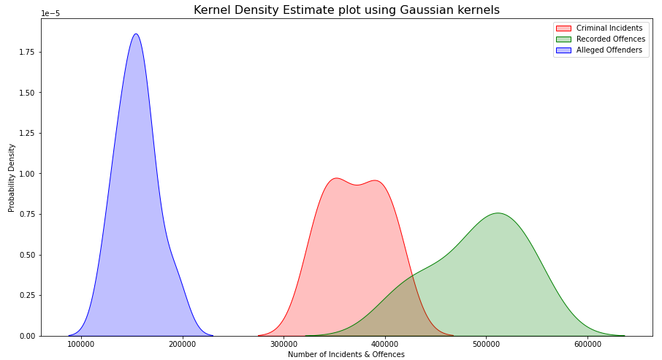
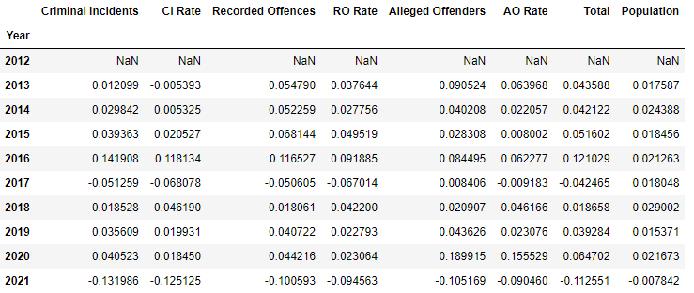
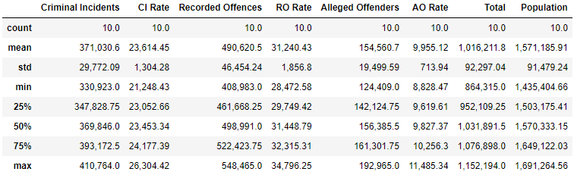
Criminal Incidents, Recorded Offences and Alleged Offenders
Overall Stats
Percentage Changes of Number of Incidents and Offences

Slide 6
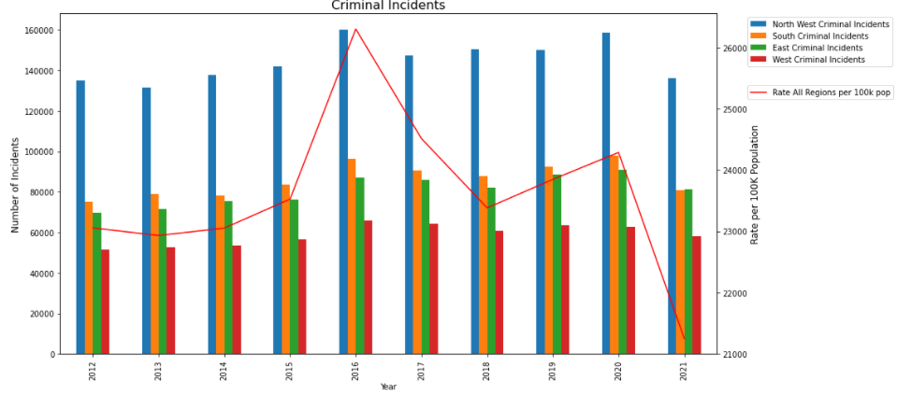
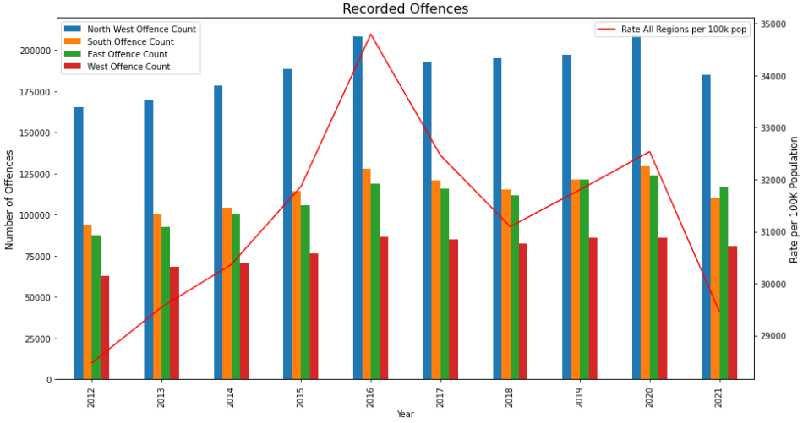
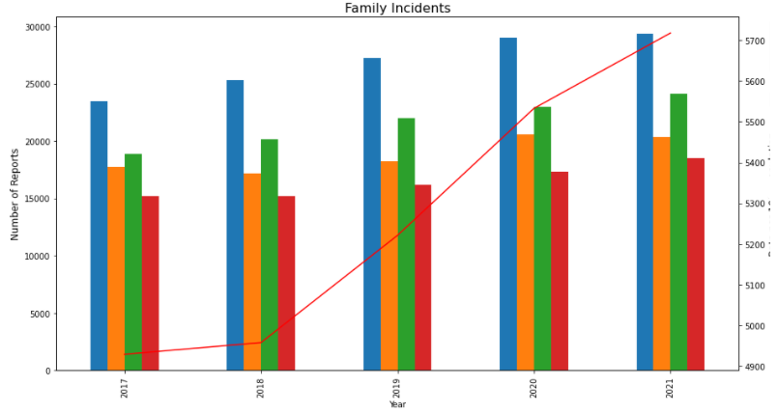
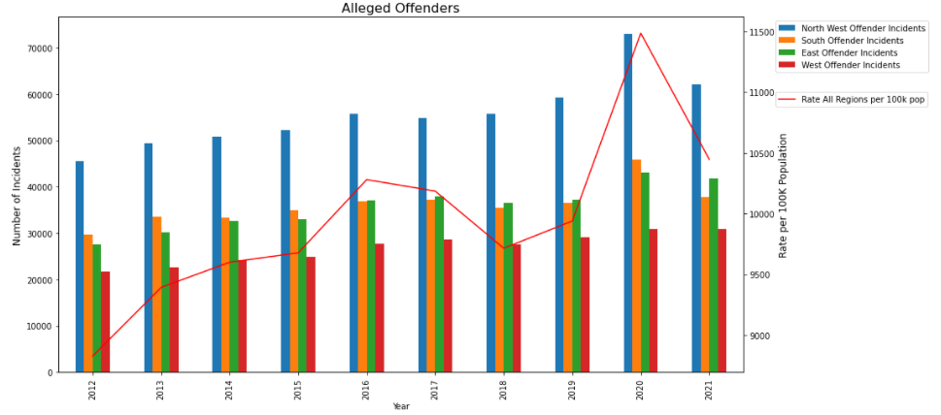
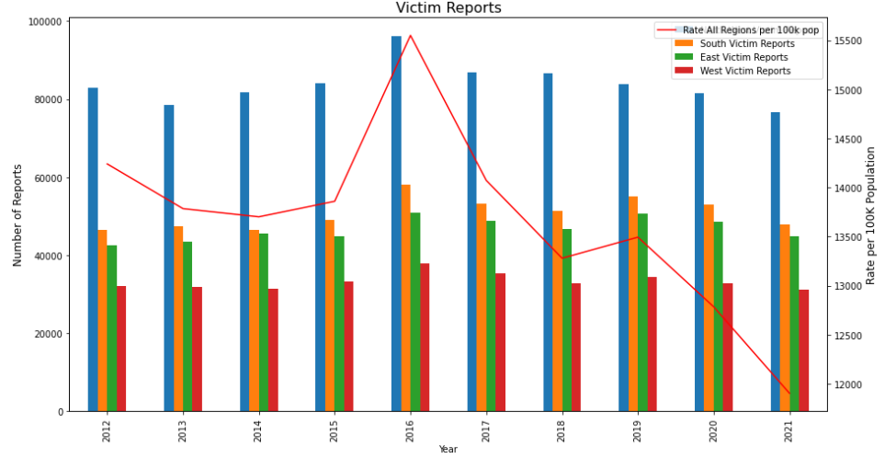
Victoria Crime Trends By Police Service Region

Slide 7
Crime Trends by Police Service Regions (Year by Year Comparison)
Types | Police Service Region | Highest In Year | Highest Yearly Percentage Change
Criminal Incidents | Southern Metro East | 2013, 2015, 2020 2014, 2017, 2019 | Ÿ0.05, Ÿ0.07, Ÿ0.06 Ÿ0.05, ”-0.01, Ÿ0.08
Recorded Offence | West | 2013, 2016, 2017, 2021 | Ÿ0.09, Ÿ0.13, ”-0.02, ”-0.06
Alleged Offender Incidents | Southern Metro | 2013, 2015, 2020 | Ÿ0.13, Ÿ0.42, Ÿ0.26
Victim Reports | East | 2013, 2014, 2017, 2019 | Ÿ0.02, Ÿ0.05, ”-0.04, Ÿ0.08
Family Incidents | North West Metro East Southern Metro West | 2018 2019 2020 2021 | Ÿ0.08 Ÿ0.09 Ÿ0.13 Ÿ0.07
Observation:
In year 2019 East region is taking the lead in increasing in Crime Incidents, Victim Reports and Family Incidents compares to other Police Service regions.
In year 2020 Southern Metropolitan region is having the highest increase in the Crime Incidents, Alleged Offender Incidents and Family Incidents compares to other Police Service regions.

