Slide 1
Agenda
Introduction & Objectives
Criminal Incidents, Recorded Offences (Antoinette)
Victim Reports & Family Incidents (Jacqueline)
Crime status & Police Service Areas (Kelvin)
Victoria Crimes Trends from September 2012 to 2021 (Anh)

Slide 2


Victim Reports & Family Incidents
From September 2012 to September 2021

Slide 3
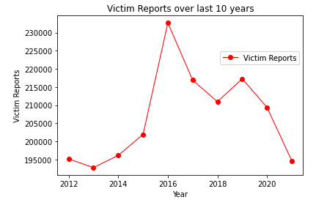
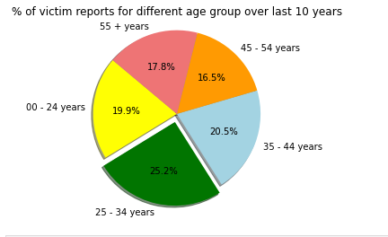
Trend of Victim Reports

Slide 4
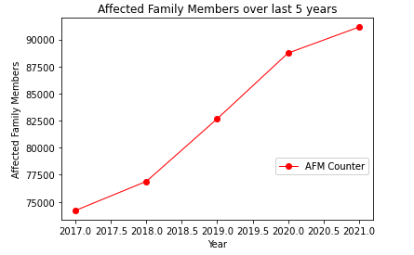
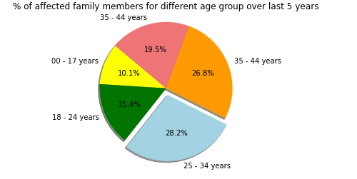
Trend of Affected Family Members

Slide 5
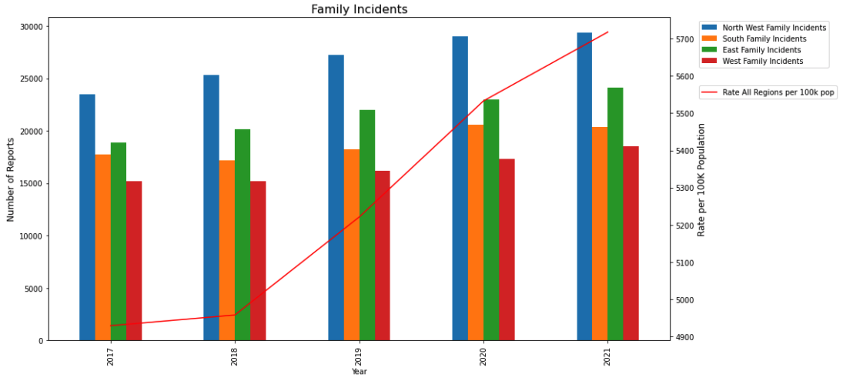
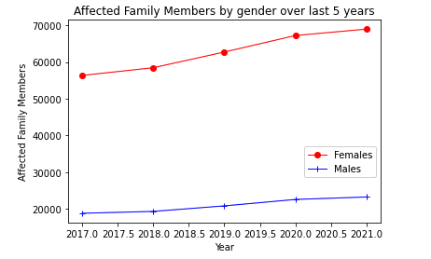
Trend of Affected Family Members

Slide 6
Agenda
Introduction & Objectives
Criminal Incidents, Recorded Offences (Antoinette)
Victim Reports & Family Incidents (Jacqueline)
Crime status & Police Service Areas (Kelvin)
Victoria Crimes Trends from September 2012 to 2021 (Anh)

