Slide 1
Agenda
Introduction & Objectives
Criminal Incidents, Recorded Offences (Antoinette)
Victim Reports & Family Incidents (Jacqueline)
Crime status & Police Service Areas (Kelvin)
Victoria Crimes Trends from September 2012 to 2021 (Anh)

Slide 2
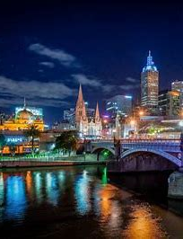
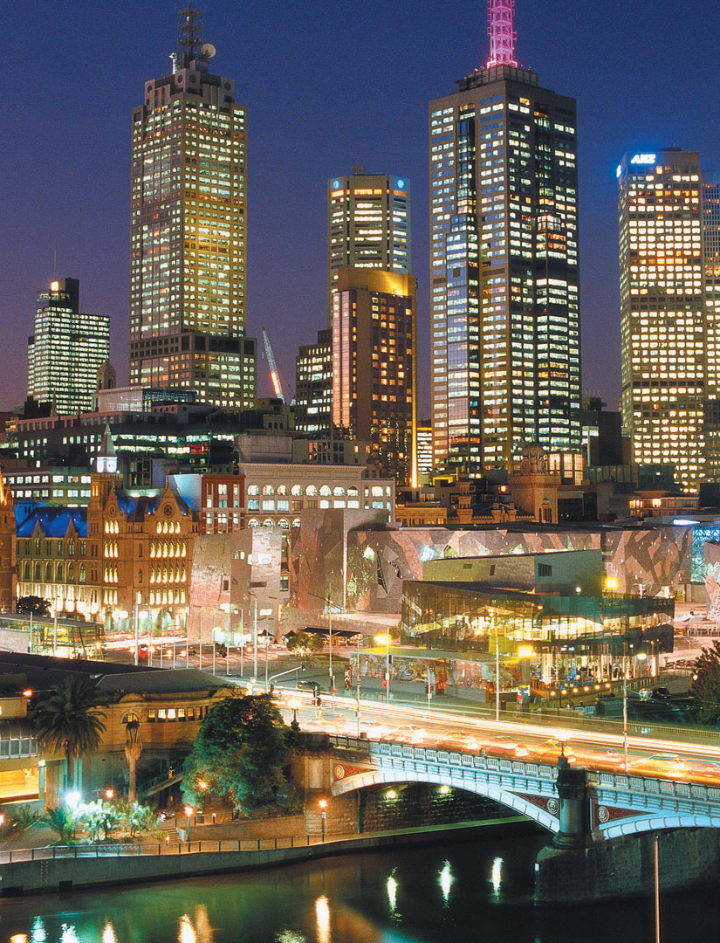
How are police coping with criminal incidents?
CRIMINAL INCIDENTS
Over the LAST Ten Years

Slide 3
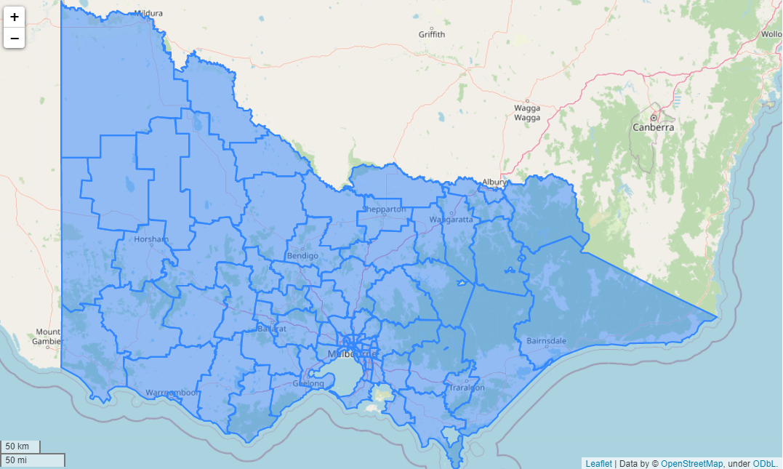
Local government areas (LGAs)
The 79 Victorian LGAs: are classified as cities (34), shires (38), rural cities (6) and boroughs (1).

Slide 4
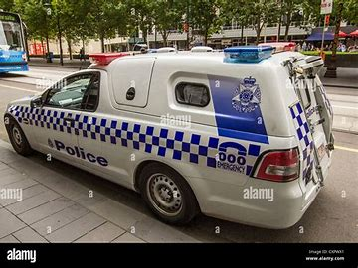
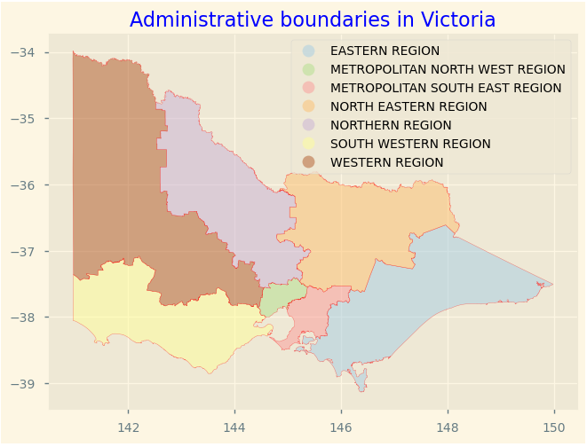
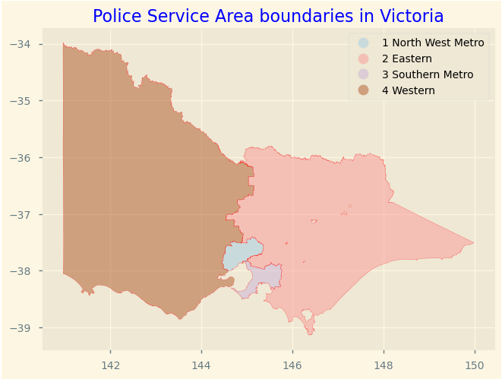
Where are Police Service Areas?

Slide 5
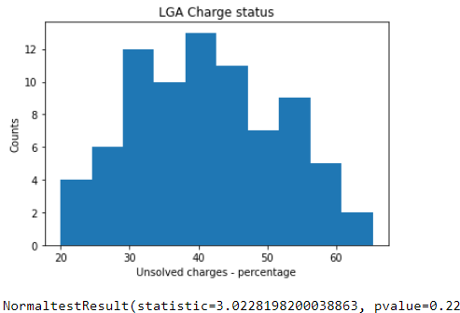
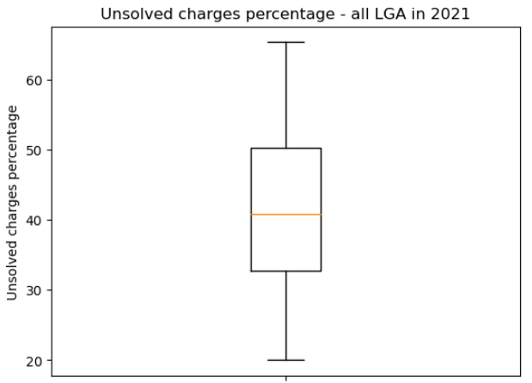
Data is normally distributed, no outliners identified
Unsolved charge percentage - 2021

Slide 6
Solved charge percentage - 2021
Mean unsolved: 41.5%
Median unsolved: 40.8%
Standard deviation: 10.4%
68% of LGA has unsolved charge percentage between 31.1% and 51.9% 95% of LGA has unsolved charge percentage between 20.7% and 62.3% 99.7% of LGA has unsolved charge percentage between 10.3% and 72.7%

Slide 7
Top vs bottom 5 LGA in 2021
Ranking | Local Government Area | Incidents Recorded | Total Incidents | Unsolved Status Percentage
1 | Swan Hill | 362 | 1810 | 20.00
2 | Southern Grampians | 172 | 780 | 22.05
3 | Ararat | 259 | 1134 | 22.84
4 | Wangaratta | 395 | 1631 | 24.22
5 | Northern Grampians | 233 | 879 | 26.51
... | ... | ... | ... | ...
75 | Bayside | 2007 | 3435 | 58.43
76 | Glen Eira | 3276 | 5440 | 60.22
77 | Maribyrnong | 4180 | 6903 | 60.55
78 | Boroondara | 3473 | 5535 | 62.75
79 | Queenscliffe | 47 | 72 | 65.28

Slide 8
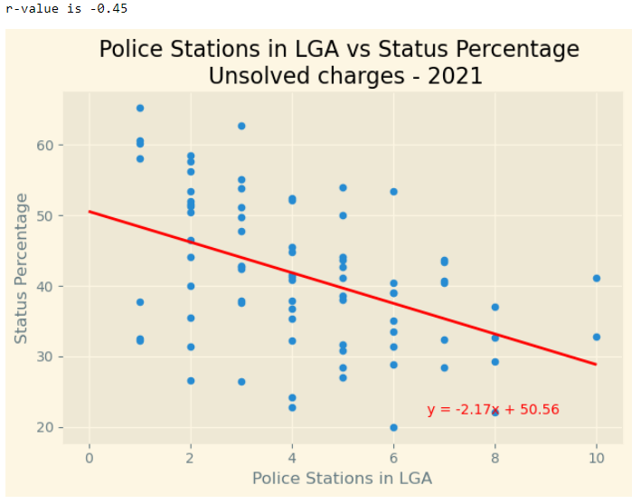

More police stations in each LGA, the lower the unsolved charge percentage
Standard error r² is 20.25%

Slide 9
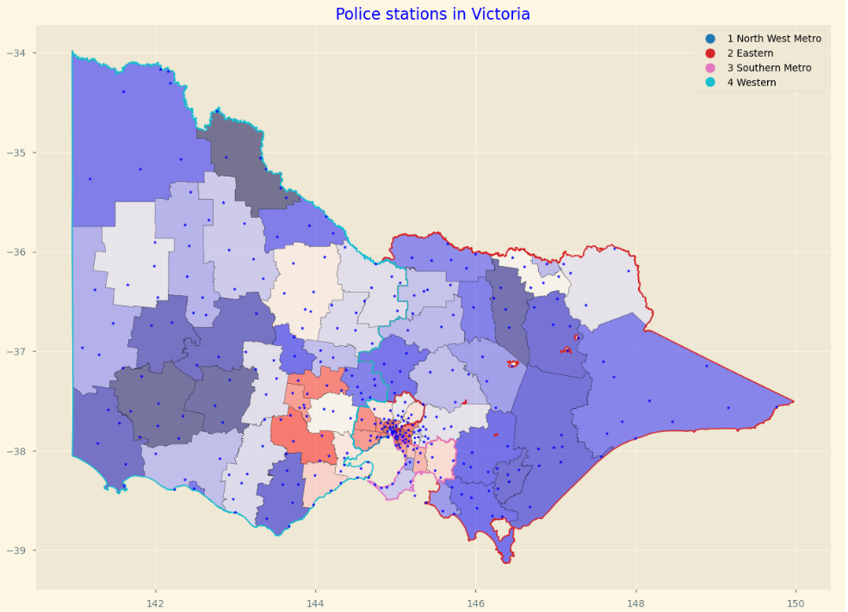


Slide 10
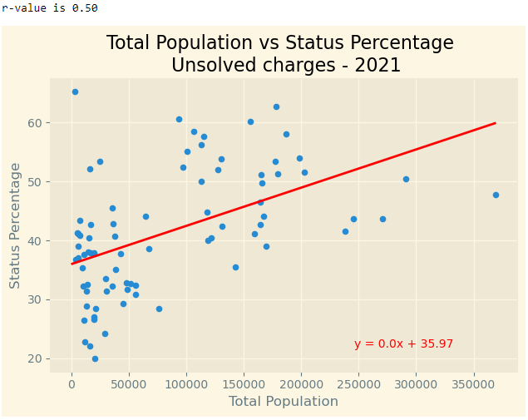

As the population increases in a LGA, the higher the percentage of unsolved charges
Standard error r² is 25%

Slide 11
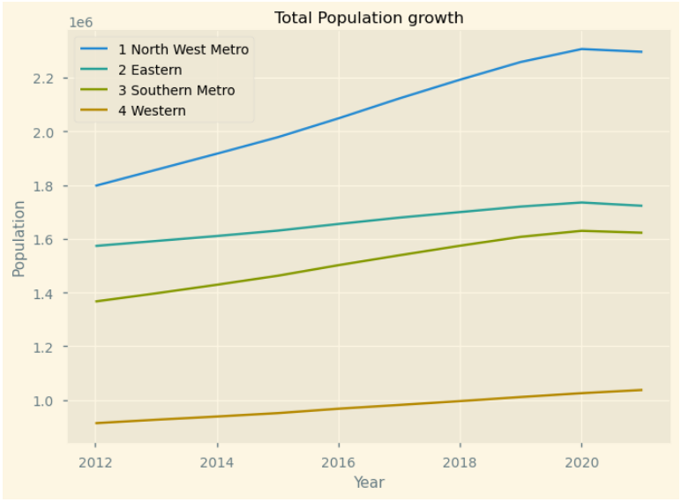
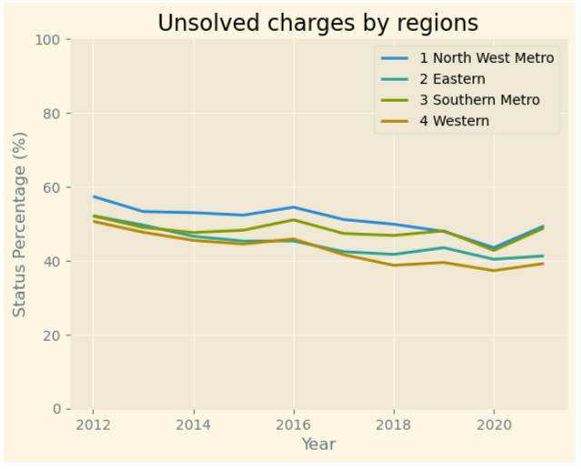


Time series analysis over 10 years

Slide 12
Agenda
Introduction & Objectives
Criminal Incidents, Recorded Offences (Antoinette)
Victim Reports & Family Incidents (Jacqueline)
Crime status & Police Service Areas (Kelvin)
Victoria Crimes Trends from September 2012 to 2021 (Anh)

