Slide 1


How is the police coping with?
CRIMINAL INCIDENTS
Over the LAST Ten Years

Slide 2
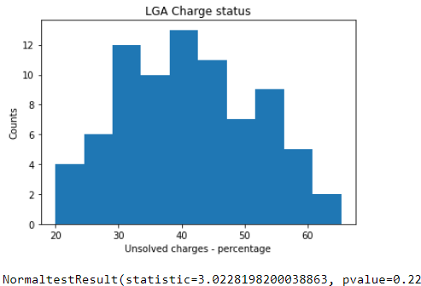
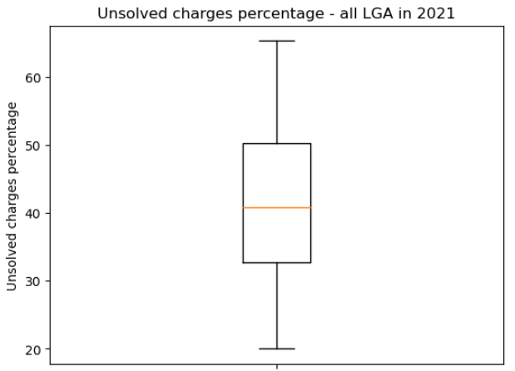
Data is normally distributed, no outliner identified

Slide 3
Solved Charge percentage
Mean solved: 41.5%
Median solved: 40.8%
Standard deviation: 10.4%
68% of LGA has solved charge percentage between 31.1% and 51.9% 95% of LGA has solved charge percentage between 20.7% and 62.3% 99.7% of LGA has solved charge percentage between 10.3% and 72.7%

Slide 4
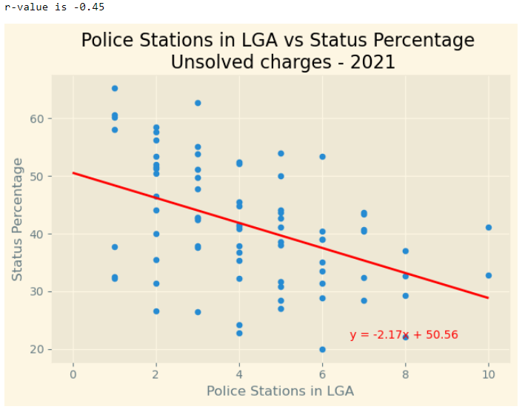
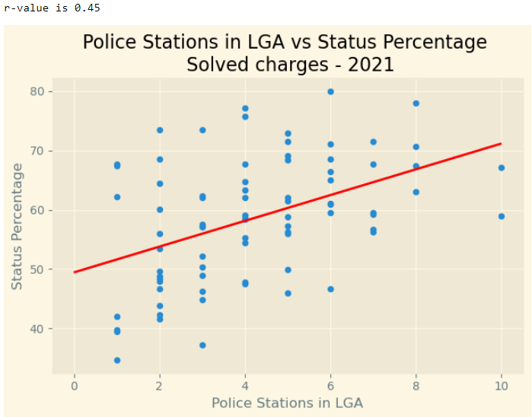
The more police station a LGA has, the less is charge status percentage

Slide 5
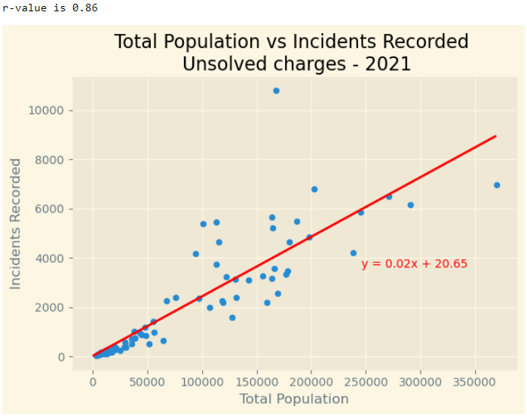
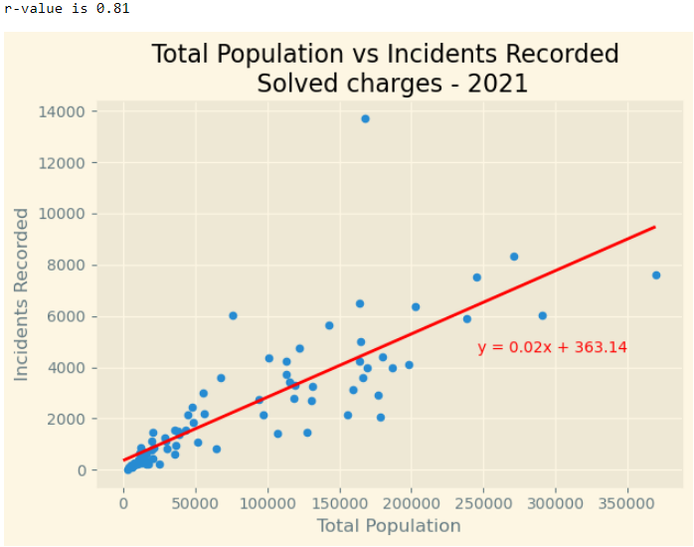
The more population a LGA has, the higher the percentage of unsolved charges

Slide 6
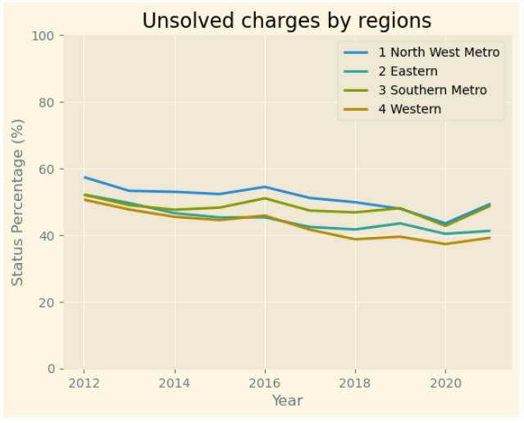
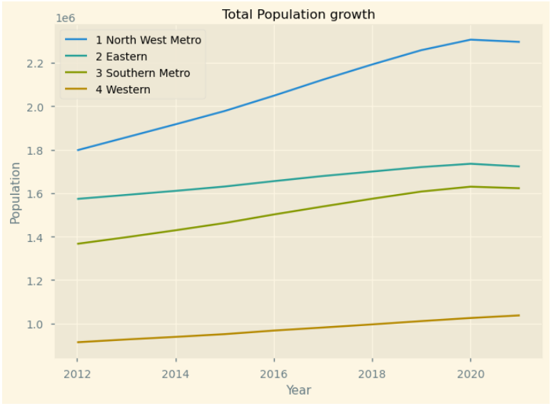

Slide 7
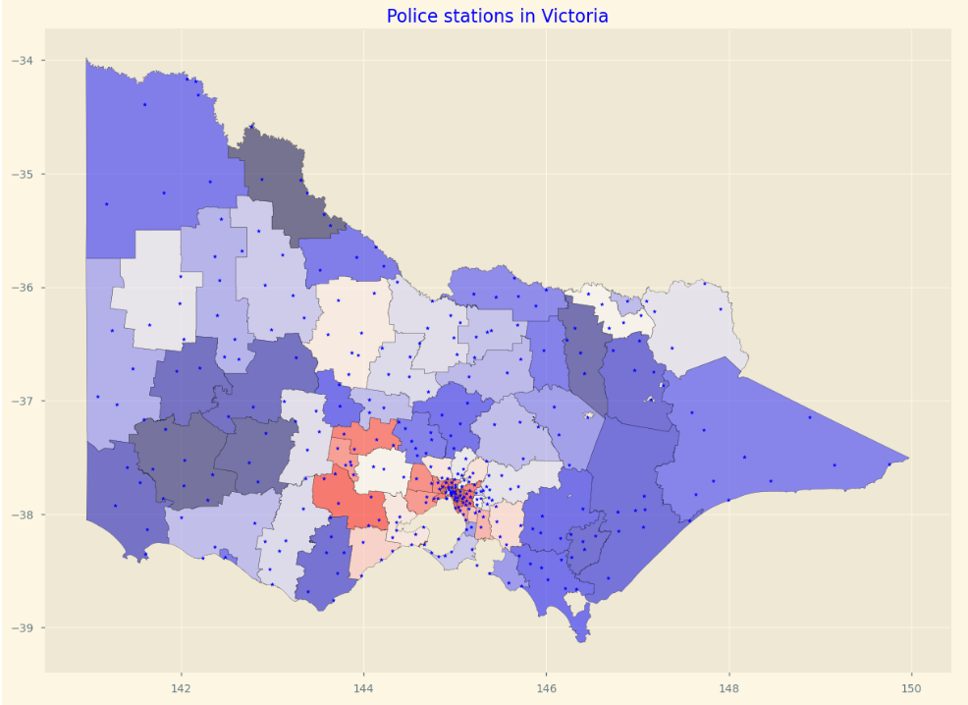


Slide 8
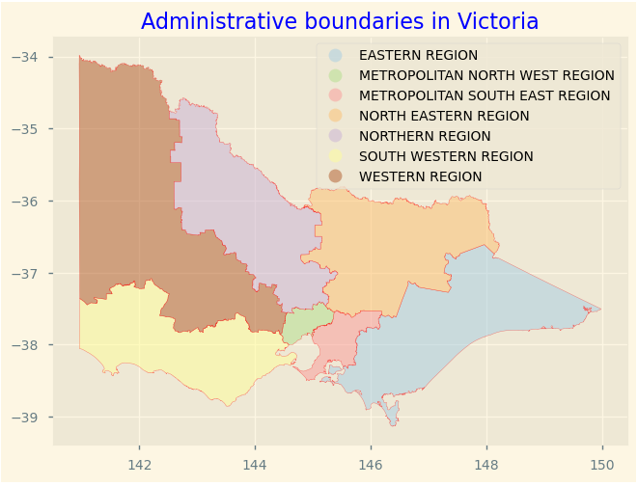
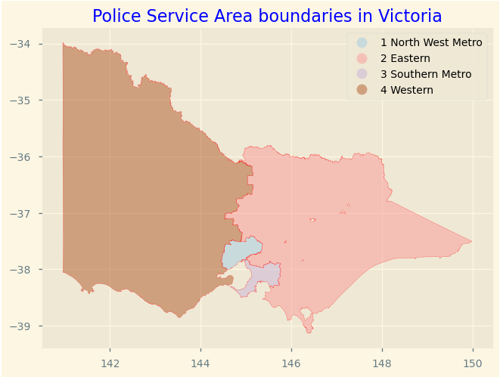

Slide 9
