Slide 1

BANGALORE INSTITUTE OF TECHNOLOGY
K.R.ROAD, V.V.PURAM, BANGALORE - 560004
DEPARTMENT OF INFORMATION SCIENCE AND ENGINEERING
An internship on
“Full Stack Web Development”
At
“Prinston Smart Engineers”
Presented By
Name : Shreyas P
USN: 1BI21IS085
External Guide
.
Internal Guide

Slide 2
CONTENTS
Introduction About the Topic
About the company
Organization of the company
Services provided by the company
Basic Training
Internship Timeline
Describe the Problem statement of the Project
Task Assigned by the company
Technology or Methodology used in the Project

Slide 3
Introduction
An artisan specializing in handmade silver articles wishes to establish a robust online platform for showcasing and selling their creations.
Facing challenges in finding suitable avenues to promote their work, the artisan envisions a dedicated website that provides an organized and professional approach to managing and marketing silver articles.

Slide 4
ABOUT THE COMPANY
Prinston Smart Engineers is a Mechanical, Electrical, Plumbing Design And IT Service Company, we design, build, construct, supply, install, service and upgrade of Electro-Mechanical Systems & Networks, Utilities and Equipment. PSE scope covers Engineering, Documentation, Submittals Approval, Shop drawings, Coordinating Drawings, Commissioning, Start-Up, As-Built ACC as well as IT services and provides a platform for engineering students to learn industry skills by providing live instructor-led interactive online training.
For more than 13 years, Prinston Smart Engineers has offered a wide range of Maintenance & Services in Delhi, many other cities of India we strive to maintain the highest standards while exceeding clients expectations at all level.
In 2016, PSE expanded our services in Skill development and Training program for Engineering students in different domain.

Slide 5
ORGANISATIONAL STRUCTURE of the company
The organization has a right mix of professionals as stakeholders to help serve their clients with best of their capability and at par with industry standards.
They have young, enthusiastic, passionate and creative Professionals to develop technological innovations in the field of mobile technologies, web applications as well as Business and Enterprise solution.
Motto of the organization is “Collaborate with our clients to provide them with best Technological solution hence creating Good Present and Better Future for our client, which will bring a cascading positive effect in their business shape as well”.
Providing a complete suite of technical solutions is not just a tag line, it is the vision for their clients and for themselves. They strive hard to achieve it.

Slide 6
SERVICES provided by the company
• Core Java and Advanced Java
• Web services and development
• Dot Net Framework
• Python
• Selenium Testing
• Conference / Event Management Service
• Academic Project Guidance
• On The Job Training
• Software Training

Slide 7
BASIC TRAINING
As part of the internship, the training on full stack web development covered various essential technologies.
HTML: It is used to create and structure content on the web.
CSS and Bootstrap: Used to style web pages while Bootstrap is used to develop responsive, mobile-first applications.
JavaScript: A programming language for creating interactive and dynamic web pages.
GitHub: A platform for version control and collaboration, allowing multiple developers to work on the same codebase using Git.

Slide 8
BASIC TRAINING
DOM Manipulation: Using JavaScript to dynamically change the content and structure of a webpage by interacting with the DOM.
Node.js: A runtime environment that allows the execution of JavaScript code on the server side, facilitating server-side scripting.
DBMS: Using SQL to query relational databases with CRUD operations.
React.js: A JavaScript library for building user interfaces, through reusable components.
Deployment: The process of making a web application available to users by hosting it on a server or a cloud platform.

Slide 9
INTERNSHIP TIMELINE
The internship on Full Stack Web Development, organised and handled by Prinston Smart Engineers was held from 27th October, 2023 to 1st December, 2023.
The timeline of the internship is as follows:
Week 1: Introduction to Web Development, Client-Server Architecture, HTML5 ,CSS, Bootstrap.
Week 2: JavaScript Fundamentals, DOM Manipulation, GitHub, Node.js.
Week 3: SQL, React.js, Deploying applications.
Week 4: Assigning a group project, Implementation of the project, Review, Conclusion and Next Steps .

Slide 10
Problem statement
Silver article shop
Develop a web app using HTML, CSS, and a JavaScript for artisans to easily sell handmade silver articles with a focus on user-friendly product listing and direct customer communication.

Slide 11
TASKS ASSIGNED
Customer Side Functionalities:
1. View New and Featured Products:
Enable customers to view the latest and featured silver articles on the main page.
2. Browse and Shop:
Allow customers to explore all products on the shop page, with sorting and filtering options.
3. Product Details:
Implement functionality for customers to view detailed information about each product.
4. Shopping Cart:
Allow customers to add products to their cart, view, modify, and remove items.
5. Checkout:
Enable customers to proceed through a secure checkout process.
6. User Account Management:
Allow customers to register, log in, and manage their account details.

Slide 12
BACK END TASKS
TASKS ASSIGNED
1) Database Tables:
Create tables, including a customer table with columns for first name, last name, gender, email, password and phone number.
2) Foreign Key Functionalities:
Establish foreign key relationships where necessary, ensuring data integrity.
3) Insert Data:
Insert initial values into the tables, populating the database with sample or default data.

Slide 13
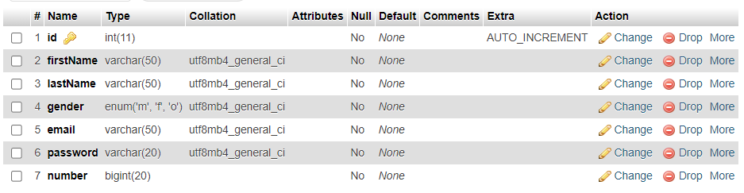
TASKS ASSIGNED

Slide 14
TECHNOLOGIES USED IN THE PROJECT
FRONT-END TECHNOLOGIES
HTML - Hyper Text Markup Language
Hypertext Mark-up Language (HTML) is the standard mark-up language for documents designed to be displayed in a web browser. Web browsers receive HTML documents from a web server or from local storage and render the documents into multimedia web pages.
CSS - Cascading Style Sheets
Cascading Style Sheets (CSS) is a style sheet language used for describing the presentation of a document written in a markup language such as HTML. CSS is a cornerstone technology of the World Wide Web, alongside HTML and JavaScript.CSS is designed to enable the separation of presentation and content, including layout, colours, and fonts.
Javascript
JavaScript often abbreviated as JS, is a high-level language, just-in-time compiled, object- oriented programming language that conforms to the ECMAScript specification

Slide 15
TECHNOLOGIES USED IN THE PROJECT
BACK-END TECHNOLOGIES
XAMPP
XAMPP is a free and open-source cross-platform web server solution stack package developed by Apache Friends, consisting mainly of the Apache HTTP Server, MariaDB database, and interpreters for scripts written in the PHP and Perl programming languages.
MYSQL
MySQL is multithreaded, multi user SQL database management System (DBMS). The basic program run as server providing multiuser access to a number of databases. MySQL is a database. The data in a MySQL is stored in a Database objects called tables. A table is a collection of related data entries and it consists of columns and rows.
PHP
PHP code may be executed with a command line interface (CLI), embedded into HTML code, or used in combination with various web template systems, web content management systems, and web frameworks.

Slide 16
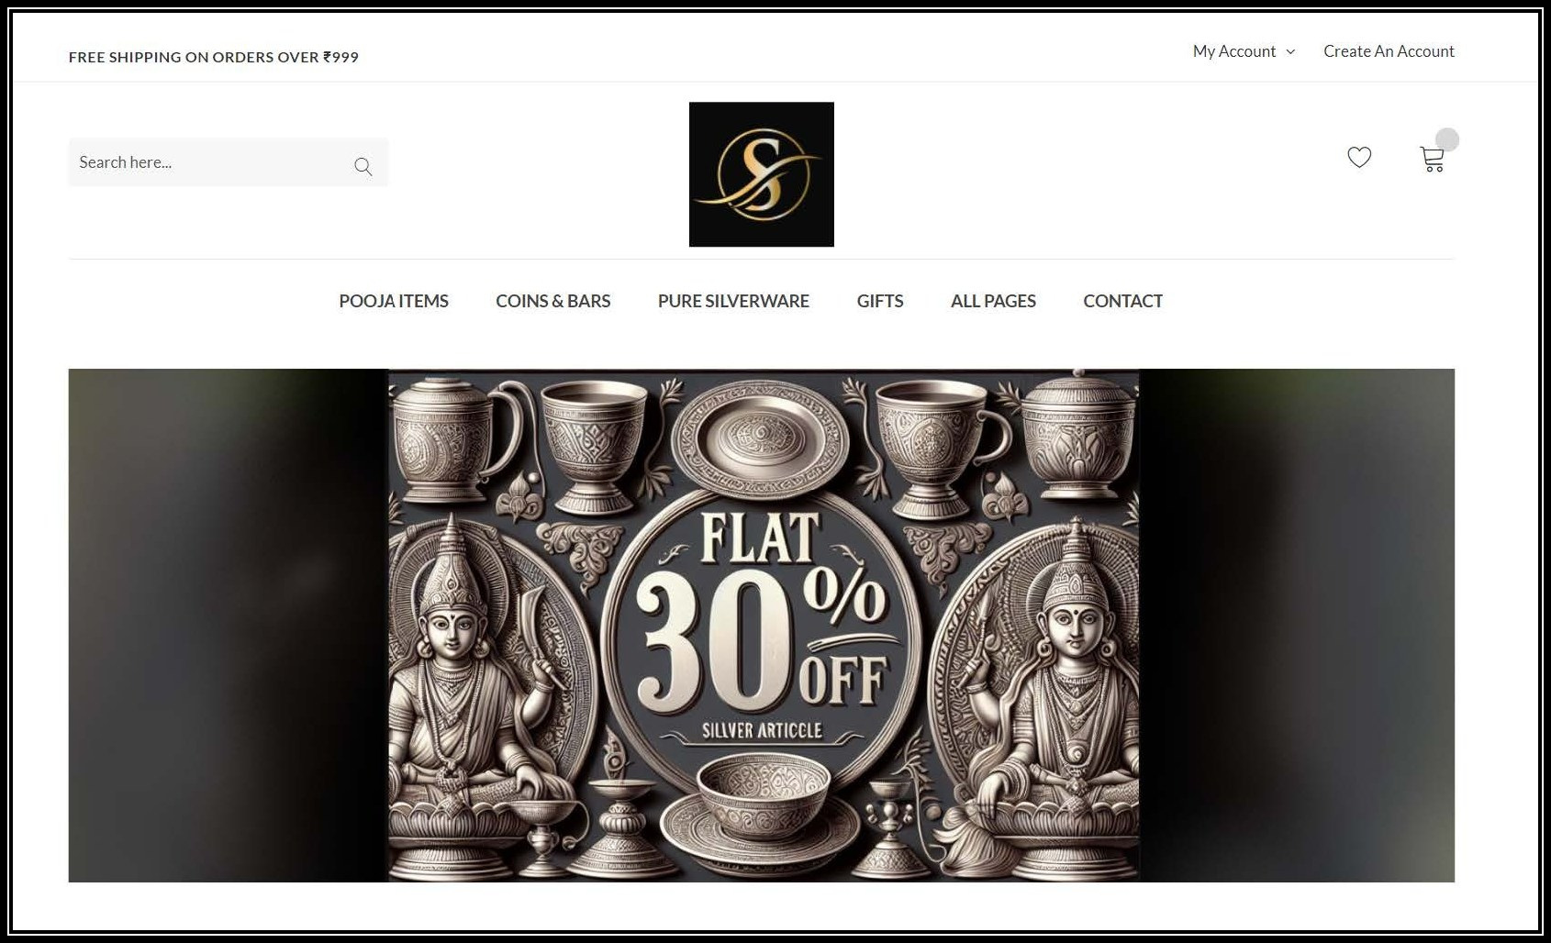
MODULES INCLUDED
Home
Login
Shop
Cart
Contact Us
Product-Details
Checkout
Register
Design Service
User Account

Slide 17


