Slide 1

DEPARTMENT OF INFORMATION SCIENCE AND ENGINEERING
MINI PROJECT PRESENTATION
on
WEALTHIFY : INVESTMENTS AND WEALTH ACCUMULATION
Presented By:
Shreyas P 1BI21IS085
Sourabha D. Bhat 1BI21IS091
T Sritha 1BI21IS098
Varidhi Rathore 1BI21IS105

Slide 2
TABLE OF CONTENTS
1
2
3
4
5
Introduction
Existing System
Problem Statement
6
Objectives
Application
References

Slide 3

1
Introduction

Slide 4
INTRODUCTION
Investing in mutual funds can be a daunting task, particularly for beginners who may feel overwhelmed by the variety of options and the complexity of financial markets.
This project aims to simplify the investment process by providing tailored mutual fund recommendations based on user-specific criteria, such as age, investment amount, risk tolerance, and investment duration.
The scope of this work includes the development of a sophisticated recommendation system that leverages real-time data and advanced algorithms to deliver personalized investment suggestions.
The importance of this project lies in its potential to democratize access to sound financial advice, making it easier for novice investors to make informed decisions.

Slide 5

By incorporating educational materials, the project also addresses the knowledge gap that often hinders new investors, providing them with the necessary tools to understand the basics of mutual fund investments and financial markets.
This project builds on existing financial advisory systems and recommendation algorithms but enhances them with real-time data integration and a user-centric approach.

Slide 6
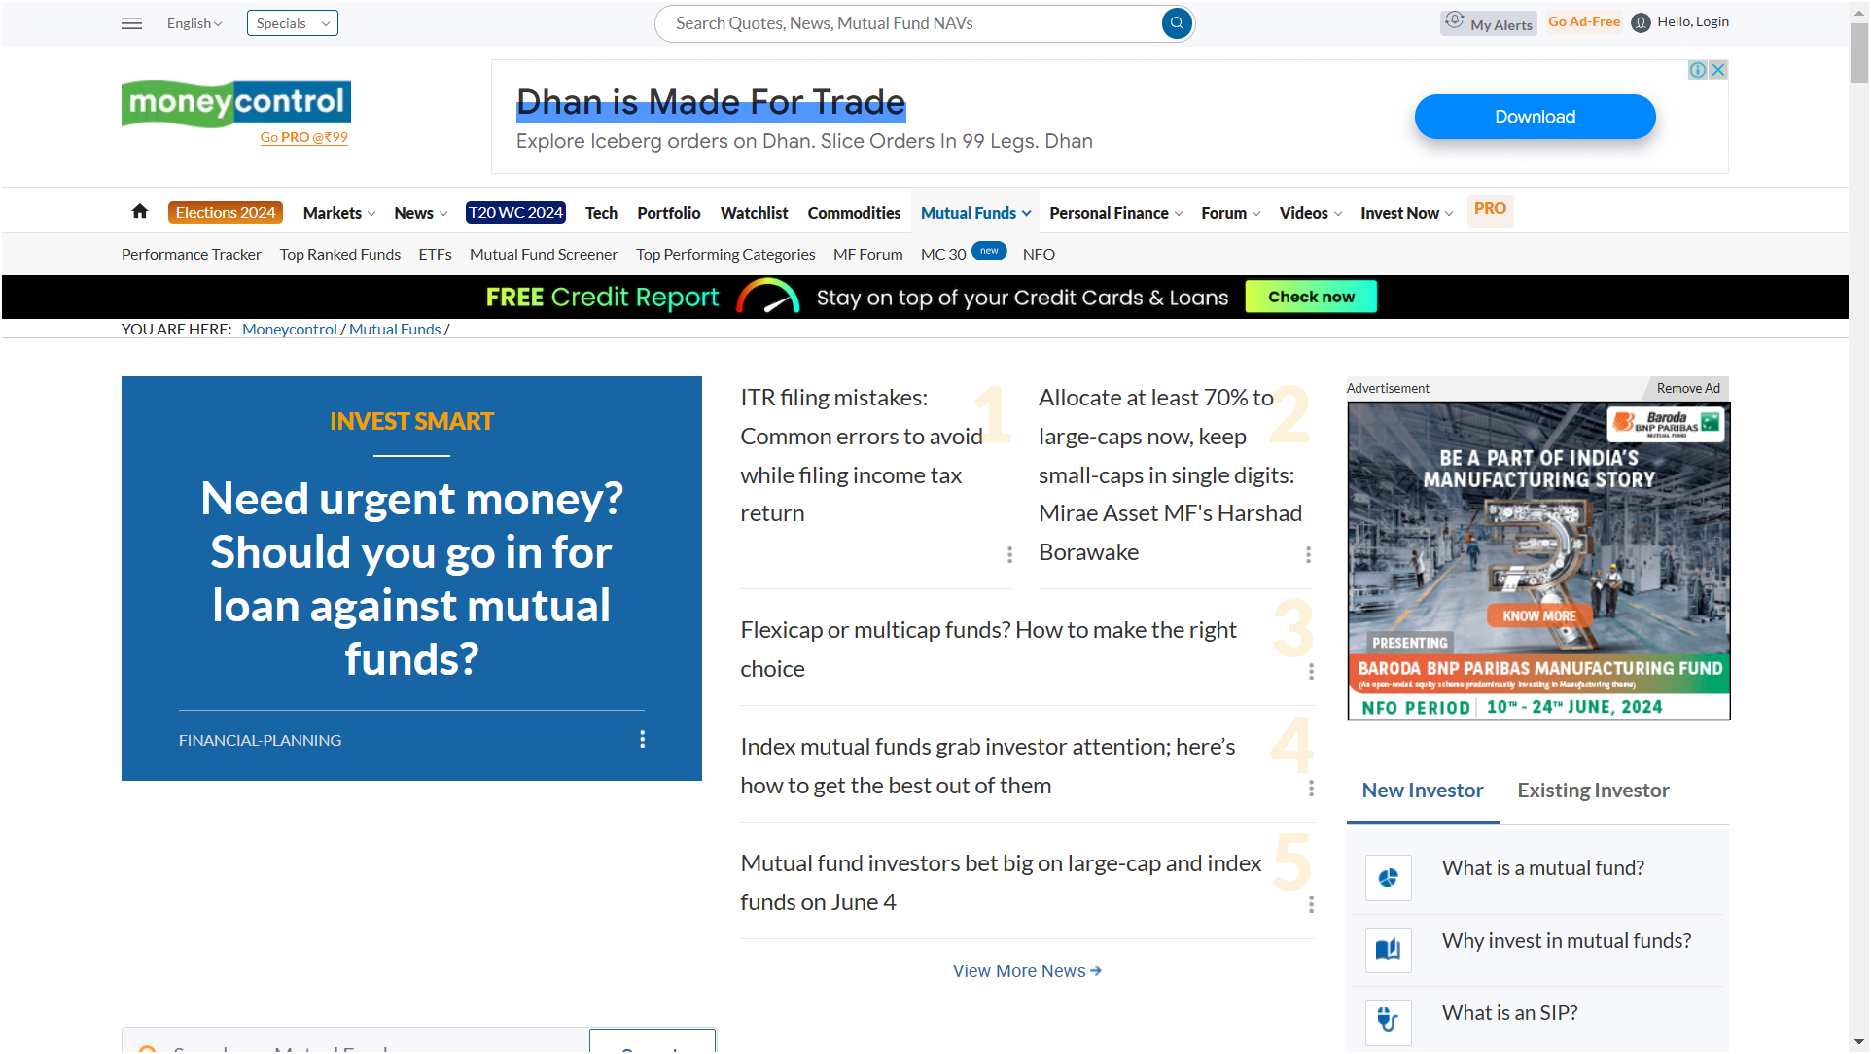
EXISTING SYSTEM
Recent mutual fund recommendation websites often have a confusing UI with many ads, which can overwhelm initial investors.
Image Source: moneycontrol.com
Notes:
Existing System

Slide 7
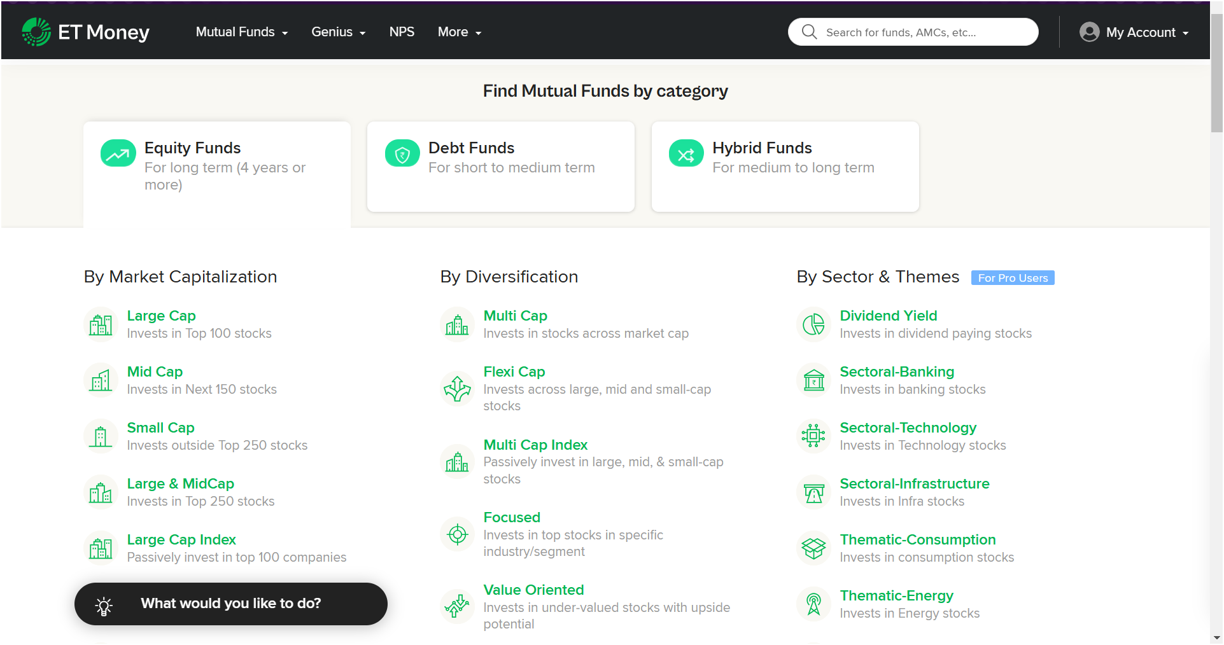
EXISTING SYSTEM
Initial investors often struggle to select the right fund from thousands of confusing options.
Image Source: etmoney.com
Notes:
Existing System

Slide 8

PROBLEM STATEMENT
Choosing the right mutual fund scheme can be challenging due to the variety of options and the need for up-to-date information. The problem statement revolves around the complexity and abundance of mutual fund options, making it daunting for investors to select the most suitable scheme. The challenges stem from the sheer number of available choices and the necessity for current data to make informed decisions. To address this issue, the project should propose the development of a personalized recommendation system that operates in real-time with a simple UI.

Slide 9
OBJECTIVES
To recommend the top 5 mutual fund schemes based on user input: This objective aims to help users make informed investment decisions by providing tailored recommendations that align with their specific criteria, such as age, investment amount, risk tolerance, and investment duration.
To provide real-time updates on mutual fund performances: Keeping users informed with the latest performance data of mutual funds ensures that they have access to the most current information when making investment decisions. Real-time updates help users respond to market changes promptly, thereby maximizing their investment potential and minimizing risks.

Slide 10
To compare mutual funds with other investment options: By offering comparisons between mutual funds and other investment options such as stocks, bonds, and ETFs, the system provides users with a broader perspective on their investment choices. This comparative analysis enables users to evaluate different investment vehicles and choose the ones that best align with their financial goals and risk appetite.
To forecast mutual fund performance using various algorithms: Utilizing different forecasting algorithms to predict mutual fund performance assists users in long-term planning and helps them understand the potential future outcomes of their investments. This objective aims to enhance the predictive accuracy of the system, providing users with insights into how their chosen mutual funds might perform over time.

Slide 11
APPLICATIONS
Personalized Mutual Fund Recommendations:
The platform generates personalized mutual fund recommendations based on user-specific criteria such as age, investment amount, risk tolerance, and investment duration. Users receive tailored recommendations that align with their financial goals and preferences, helping them make informed investment decisions.
Real-time Investment Performance Tracking:
Users can track the real-time performance of their investments through the platform. Access to up-to-date data allows users to monitor the performance of their mutual fund holdings and make timely adjustments to their investment strategies if necessary.

Slide 12

Financial Planning and Forecasting:
The platform provides tools for financial planning and forecasting, enabling users to set investment goals and visualize their progress over time. Users can forecast future investment returns and assess the potential impact of different investment strategies on their financial goals.
User Education on Mutual Funds and Investments:
The platform offers educational resources and content to enhance user’s understanding of mutual funds and investments. Users can access articles, tutorials, and interactive materials that cover topics such as investment basics, risk management, portfolio diversification, and market trends.

Slide 13
REFERENCES
[1]. A. G. Malliaris, and William A. Brock. _Stochastic Methods in Economics and Finance_. North-Holland, 1982.
[2]. Elton, Edwin J., Martin J. Gruber, and Christopher R. Blake. "Predicting the Performance of Mutual Funds." _The Journal of Business_, vol. 69, no. 3, 1996,
pp. 393-410.
[3]. Agrawal, Rashmi, et al. "Predictive Analytics for Mutual Fund Investment Using Machine Learning Algorithms." _Journal of King Saud University- Computer and Information Sciences_, vol. 33, no. 2, 2021, pp. 141-151.
[4]. Cuthbertson, Keith, Dirk Nitzsche, and Niall O'Sullivan. "Mutual Fund Performance: Measurement and Evidence." _Financial Markets, Institutions & Instruments_, vol. 18, no. 2, 2009, pp. 63-98.
[5]. Kaastra, I., and Milton Boyd. "Designing a Neural Network for Forecasting Financial and Economic Time Series." _Neurocomputing_, vol. 10, no. 3, 1996,
pp. 215-236.

Slide 14


