Slide 1
User-Assisted Shadow Detection and Removal Algorithm Based on Thresholding and Region Growing
Yining Jiang, Zhaojun Ni, Lanxuan Zhang
School of Information Science and Technology, Shanghaitech University
2025.1.13

Slide 2


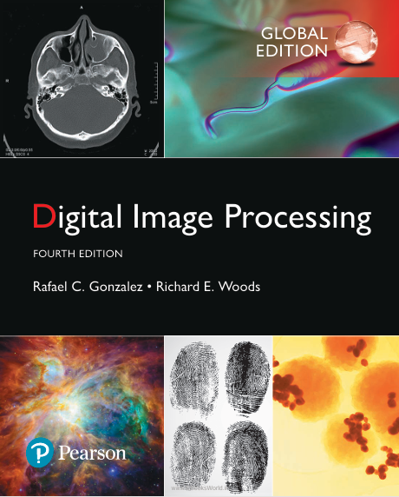


Proposed Solution
Problem
Shadows affect object recognition and scene understanding
Difficulties in separating objects from their shadows
DL approach needs extensive computational resources
Methods We've Learned & Applied
(Lec08) YCbCr color space analysis
(Lec10) Thresholding
(Lec10) Seeded region growing (SRG)
(Lec08) Morphological Image Processing
(Lec06) Gaussian filtering
DL + GPU
User+ Simple Algorithms
1.Shadow Detection
3.Region Growing
4.Boundary Extraction
2.Seed Selection
5.Shadow Removal
Proposed Solution Pipeline

Slide 3
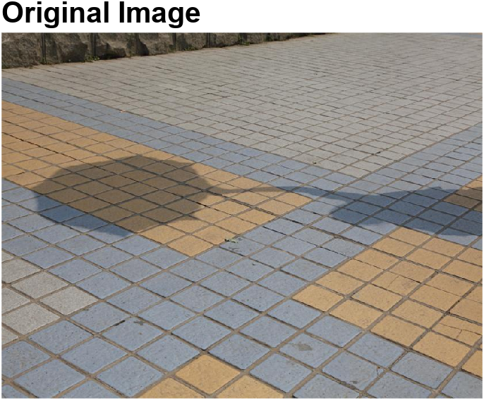
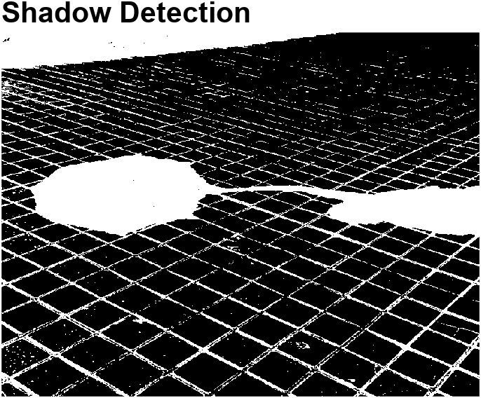

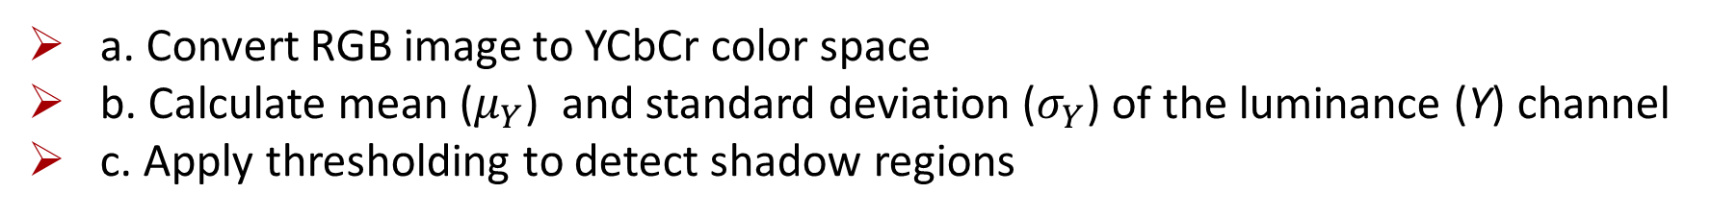
1. Shadow Detection
a. Convert RGB image to YCbCr color space
b. Calculate mean ($μ_{Y}$) and standard deviation ($σ_{Y}$) of the luminance (Y) channel
c. Apply thresholding to detect shadow regions
$Threshold=μ_{Y} −$ $\frac{σ_{Y}}{Ratio}$
$$Shadow Mask=Y<Threshold$$
*Ratio is a user-tunable parameter.

Slide 4
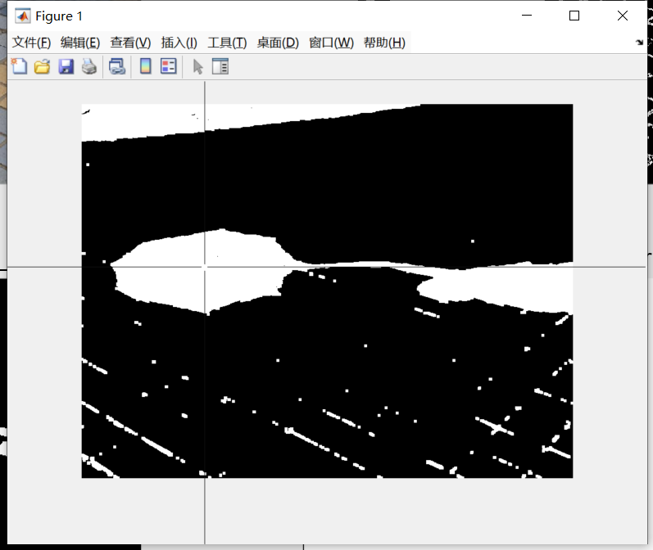
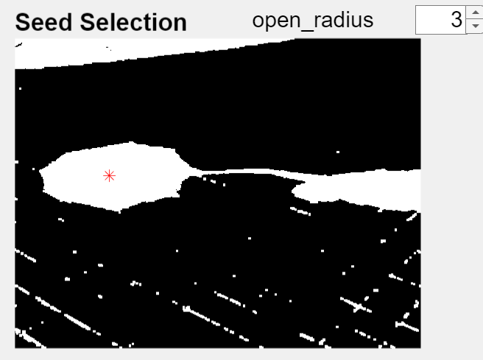
2. Seed Selection
a. Convert RGB image to YCbCr color space
b. Get User-defined seed point(s) via MATLAB’s ginput function
c. Apply thresholding to detect shadow regions
Get User-defined seed point(s) via MATLAB’ s ginput function

Slide 5
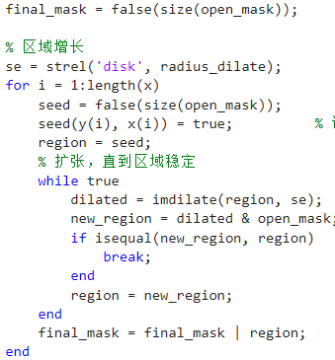
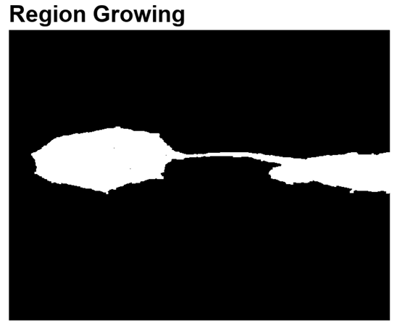
3. Region Growing
For each user-defined seed point (x,y):
a. Begin growing a region from this seed point.
b. Dilate the current region using the disk-shaped structuring element.
c. If the newly grown region remains unchanged compared to the previous iteration, the growth is considered stable, and the loop terminates.
d. Merge all region using OR operation.
Shadow mask after SRG

Slide 6
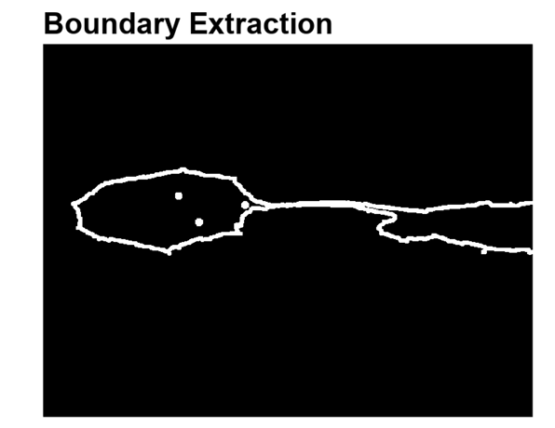
4. Boundary Extraction
a. Use erosion to shrink the shadow region and isolate the inner boundary.
b. Use dilation to expand the boundary region, creating a buffer zone for smoothing.
c. Apply Gaussian filtering to the boundary region for gradual luminance transitions.

Slide 7
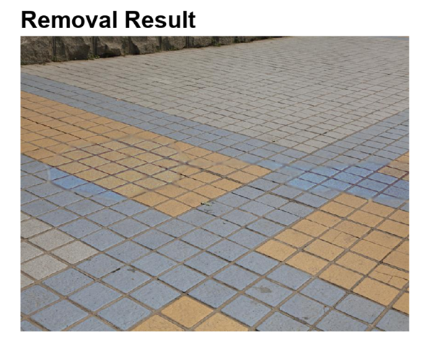

5. Shadow Removal
a. Erode the mask and subtract to extract the boundary region.
b. Dilate the boundary region to create a smooth region.
c. Calculate γ and α, apply the linear transformation below to the RGB channels of the non-boundary region.
d. Recalculate γ and α, then apply the linear transformation to the boundary region.
e. Perform Gaussian smoothing on the smooth region for seamless transitions.
$$γ_{k}=\frac{σ_{lit}}{σ_{shadow}}$$
$$α_{k}=μ_{lit}− γ_{k}μ_{shadow}$$
$$I_{corrected}=α_{k}+ γ_{k}I_{shadow}$$

Slide 8
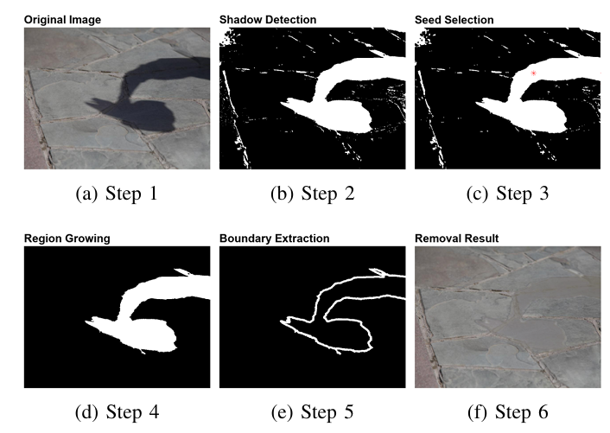
Experimental Results

Slide 9
Limitations
Limitations
Remaining artifacts on sharp/irregular edges
Color bias in shadow regions with distinct chromatic properties
Decreased performance in complex scenes with multiple light sources
Future Work
Improved boundary refinement (e.g., guided filtering, adaptive smoothing)
Contextual information (e.g., object segmentation, material properties)
Integration of deep learning approaches (CNNs, GANs)
Application in real-time video processing and advanced image editing

Slide 10
Conclusion
Effective and interactive framework combining YCbCr, SRG, and Gaussian filtering
Significant improvement in shadow detection and removal
Provides a solid foundation for further advancements in the field

Slide 11
References
[1] K. Deb and A. H. Suny, “Shadow detection and removal based on YCbCr color space,” SmartCR, vol. 4, no. 1, pp. 23–33, 2014.
[2] M. Mary Synthuja Jain Preetha, L. Padma Suresh, and M. John Bosco, “Image segmentation using seeded region growing,” in 2012 International Conference on Computing, Electronics and Electrical Technologies (IC CEET), Nagercoil, India, 2012, pp. 576–583.
[3] F. Liu and M. Gleicher, “Texture-consistent shadow removal,” in Com puter Vision–ECCV 2008: 10th European Conference on Computer Vision, Marseille, France, October 12-18, 2008, Proceedings, Part IV 10, 2008, pp. 437–450.
[4] Y. Shor and D. Lischinski, “The shadow meets the mask: Pyramid-based shadow removal,” in Computer Graphics Forum, vol. 27, no. 2, 2008, pp. 577–586, Wiley Online Library.
[5] C. Xiao, D. Xiao, L. Zhang, and L. Chen, “Efficient shadow removal using subregion matching illumination transfer,” in Computer Graphics Forum, vol. 32, no. 7, 2013, pp. 421–430, Wiley Online Library.
[6] L. Zhang, Q. Zhang, and C. Xiao, “Shadow remover: Image shadow re moval based on illumination recovering optimization,” IEEE Transactions on Image Processing, vol. 24, no. 11, pp. 4623–4636, 2015.

Slide 12
Thanks for listening！

