Slide 1
Road sign detection
Project by Mihalache Mihai & Mițca Dumitru

Slide 2
Goal
Our goal is simple, to detect road signs in pictures.

Slide 3
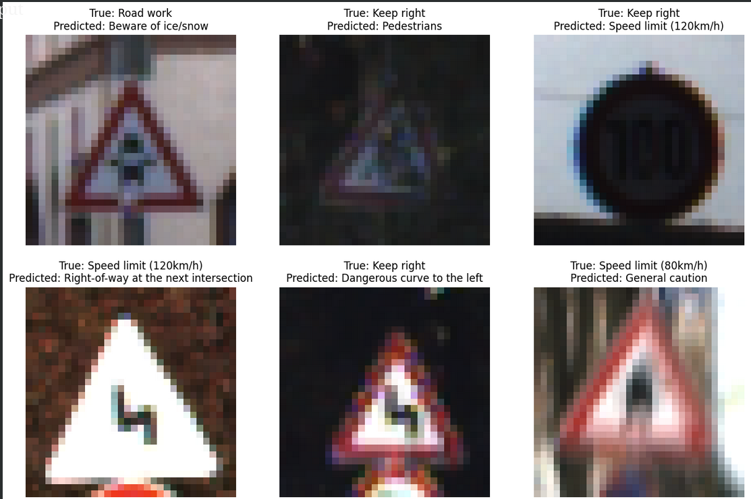
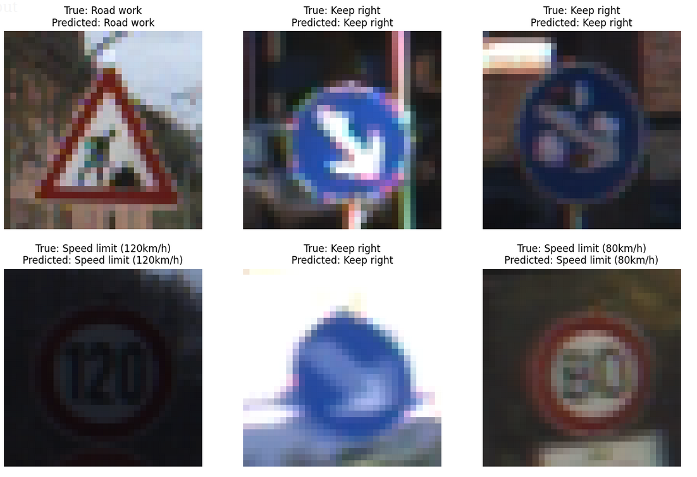
The First Attempt
We trained a custom neural network to classify precut images of road signs and got over 94% accuracy on the test dataset. Success?
W

Slide 4
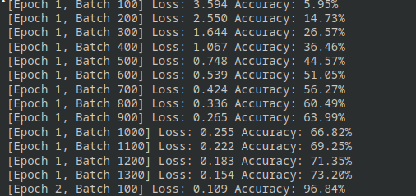
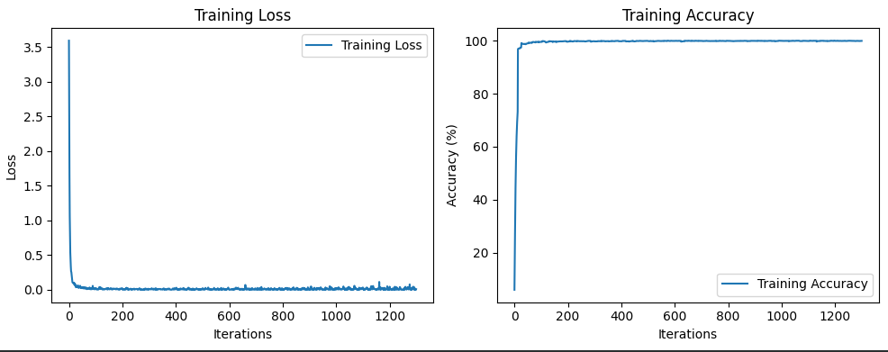
NO

Slide 5
Lesson learned
A custom neural model may not be the best idea since we have basically no experience in designing one that actually performs well.

Slide 6
Second Attempt
We tried to train YOLOV8 on the whole Mapilirary dataset which had over 12000 images. The data set was to large to handle, and to train it it would take a really long time.

Slide 7
Lesson learned
Choose a smaller dataset, if it even means to loose on accuracy.

Slide 8
Third attempt
We tried to trim the Mapilliary dataset, to around 250 images, we trained the AI using YOLOV8, and in the end we got no detections, because the signs used in the test were not included in the trimmed dataset.

Slide 9
Lesson learned
We must make sure that at least some pictures from each class is a part of the dataset.

Slide 10
Fourth attempt
We tried a segmentation dataset of russian road signs, we uploaded it to roboflow and got really promising results, BUT our own tests, which include: showing pictures taken from our phones, showing real time video of a road sign search on google, showing a video of driving in a city, we didn get ANY detection.
“Reality often differs from one’s expectations”

Slide 11
Lesson learned
The dataset may not have been segmented correctly.

Slide 12
Bloopers

Slide 13
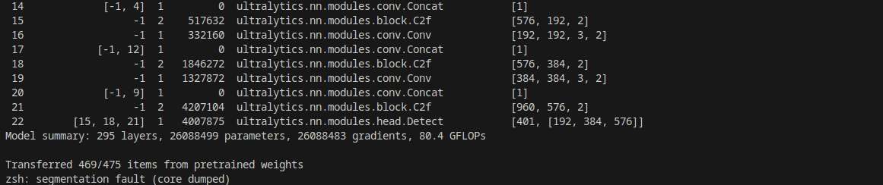
Even Python segfaults sometimes…

