Slide 1
Plant Leaf Disease Detection
Group Number: G13
Members:
Mainak Bose (Roll No. 23EC8082)
Ayush Rai (Roll No. 23EC8081)
Ramala Venkata Vamsi (Roll No. 23EC8080)

Slide 2
Dataset description
Found 16516 images belonging to 15 classes.
Found 4122 images belonging to 15 classes.
📚 Number of classes: 15
📂 Classes in the Dataset:
01. Pepper__bell___Bacterial_spot (index: 0)
02. Pepper__bell___healthy (index: 1)
03. Potato___Early_blight (index: 2)
04. Potato___Late_blight (index: 3)
05. Potato___healthy (index: 4)
06. Tomato_Bacterial_spot (index: 5)
07. Tomato_Early_blight (index: 6)
08. Tomato_Late_blight (index: 7)
09. Tomato_Leaf_Mold (index: 8)
10. Tomato_Septoria_leaf_spot (index: 9)
11. Tomato_Spider_mites_Two_spotted_spider_mite (index: 10)
12. Tomato__Target_Spot (index: 11)
13. Tomato__Tomato_YellowLeaf__Curl_Virus (index: 12)
14. Tomato__Tomato_mosaic_virus (index: 13)
15. Tomato_healthy (index: 14)

Slide 3
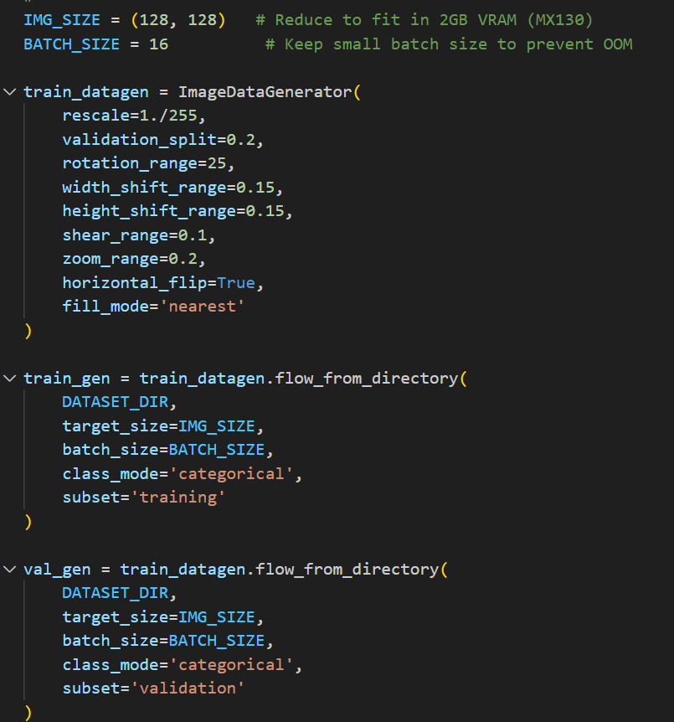
Data Augmentation
(We have it used in all the models)

Slide 4
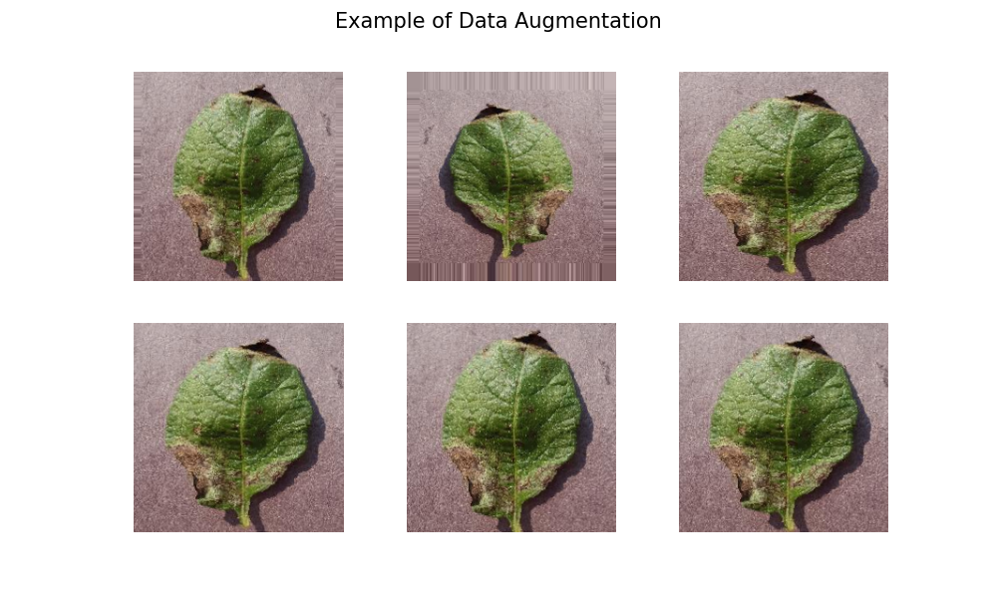

Slide 5
1.Normal CNN- All 15 Classes

Slide 6
Training and Validation data split

Slide 7
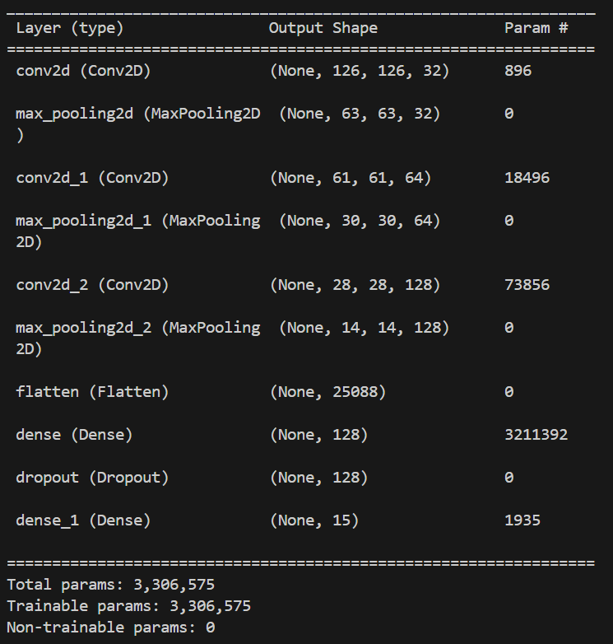
Model Structure

Slide 8
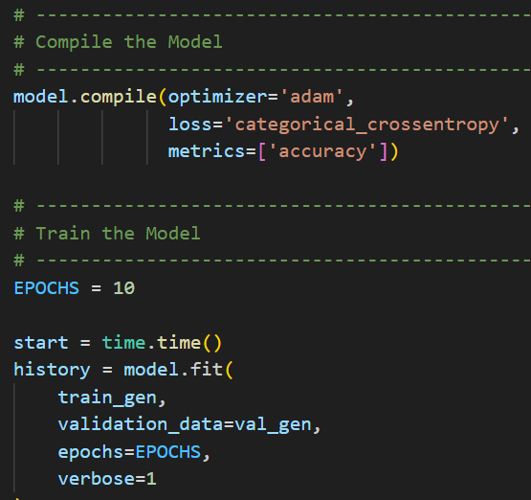
⏱ Training completed in 2380.20 seconds
✅ Validation Accuracy: 87.89%
💾 Model saved as 'plant_disease_cnn_model.h5’

Slide 9
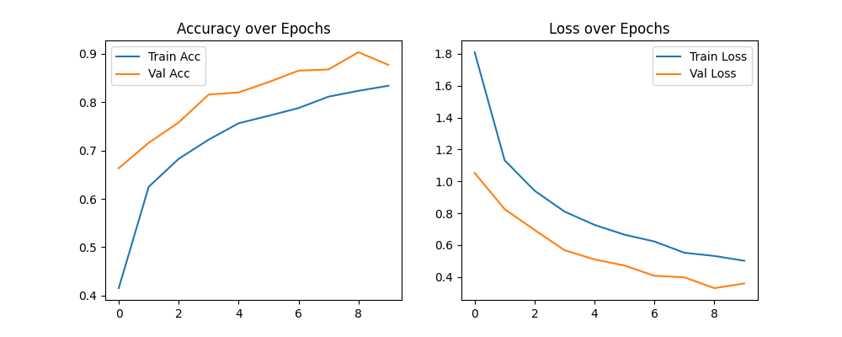
The graphs show that both training and validation accuracy increase while loss decreases steadily over epochs — indicating the model is learning effectively without overfitting. Validation accuracy slightly exceeds training accuracy, suggesting good generalization to unseen data.

Slide 10
Conclusion
Normal CNN performance is quite satisfactory (Accuracy 90% for 15 classes & 10 epochs).

Slide 11
2. Then used 3 Classes (Potato)

Slide 12
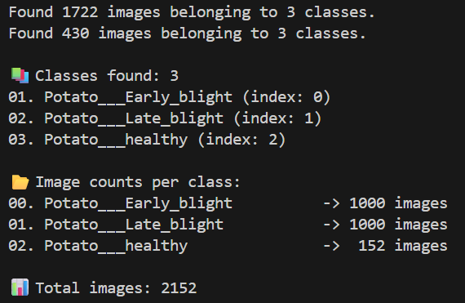
⏱ Training completed in 228.29 seconds
✅ Validation Accuracy: 96.05%
💾 Model saved as 'potato_disease_cnn_model.h5'

Slide 13
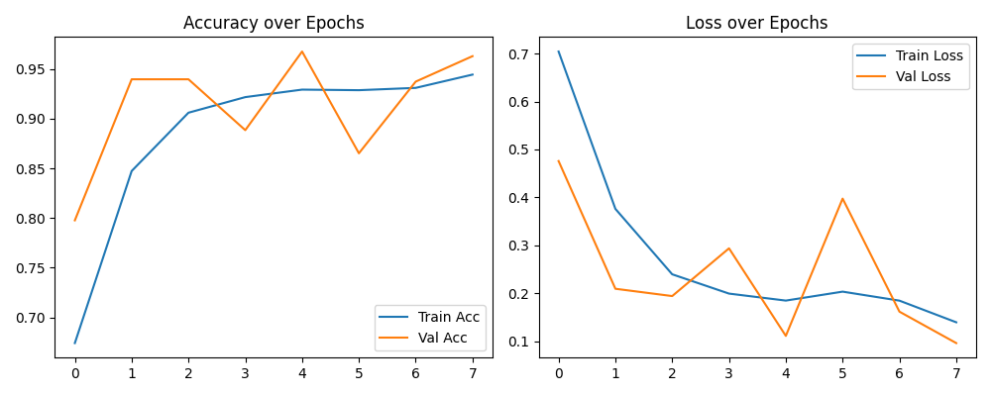

Slide 14
Conclusion
Prediction becomes easy with 3 classes. Hence accuracy increases ~ 96%.

Slide 15
Reducing learning rate

Slide 16
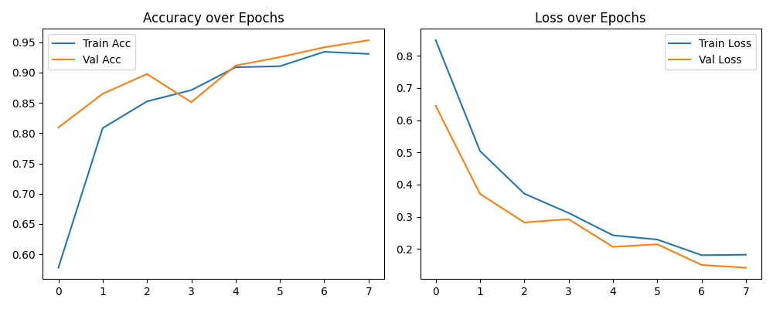
optimizer = tf.keras.optimizers.Adam(learning_rate=1e-4)

Slide 17
Conclusion
Fluctuations in accuracy reduces with reducing learning rate.

Slide 18
3. Transfer Learning (using 10 classes of tomato)
Model Size = 20 MB

Slide 19
3.1 EfficientNetB0

Slide 20
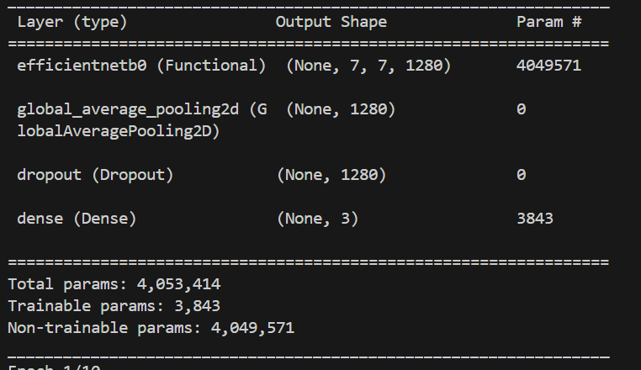
Model Structure
base_model = EfficientNetB0(weights='imagenet',include_top=False, input_shape=img_size + (3,))
base_model.trainable = False # Freeze pretrained layers

Slide 21
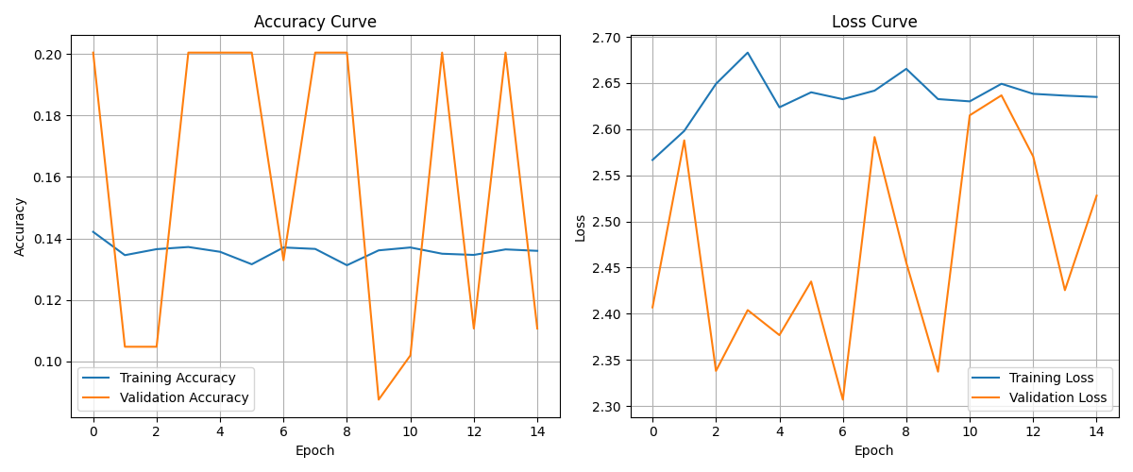

Slide 22
Fine Tuned

Slide 23
print("\nBuilding fine-tuning model...") base_model = EfficientNetB0(weights='imagenet', include_top=False, input_shape=img_size + (3,))
# 1. Unfreeze the base model base_model.trainable = True
# 2. Freeze all layers *except* the last 50 unfreeze_last_n_layers = 50 freeze_until_layer = len(base_model.layers) - unfreeze_last_n_layers print(f"Total layers in base_model: {len(base_model.layers)}") print(f"Freezing all layers up to layer {freeze_until_layer}...") for layer in base_model.layers[:freeze_until_layer]: layer.trainable = False

Slide 24
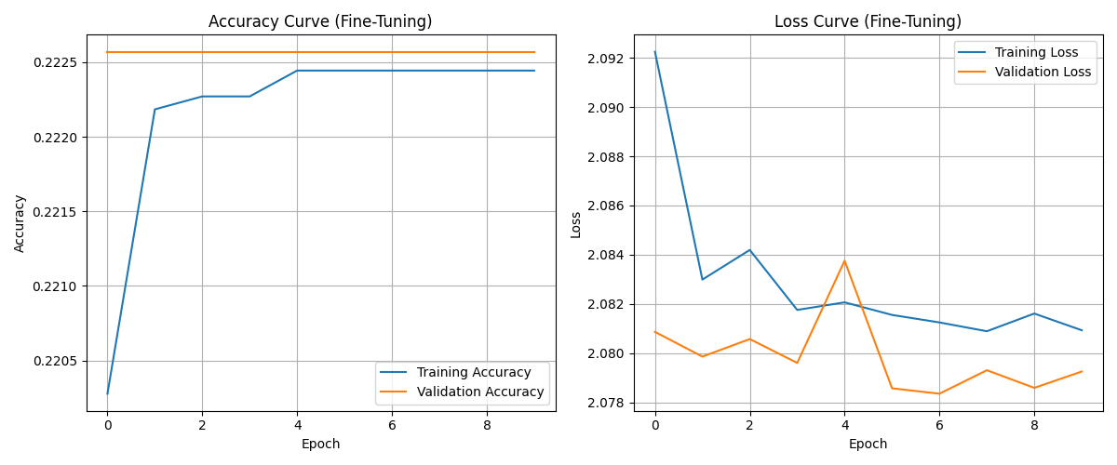

Slide 25
Conclusion
EfficientNet is not at all capable for solving this problem. Fine tuning also doesn’t works.

Slide 26
3.2.MobileNet
(Also incorporated dataset balancing)
Model Size: 8.7 MB

Slide 27
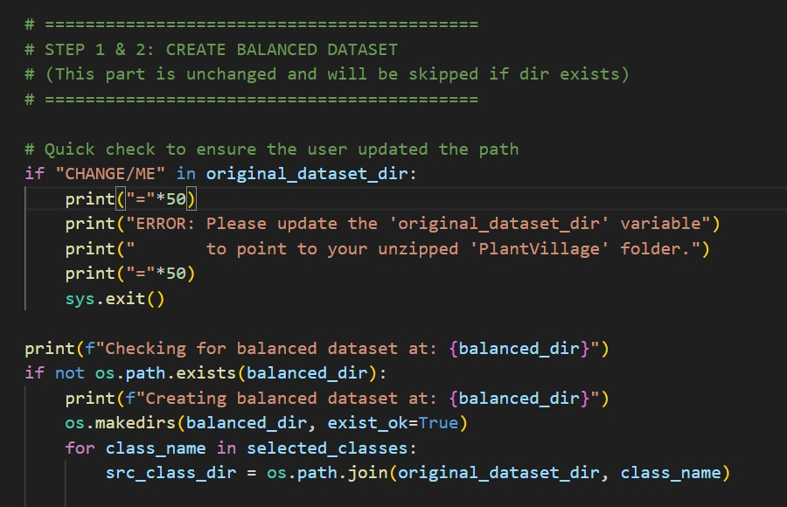
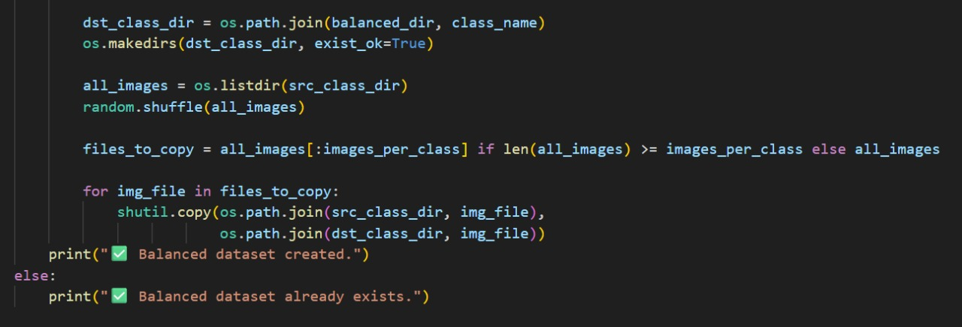

Slide 28
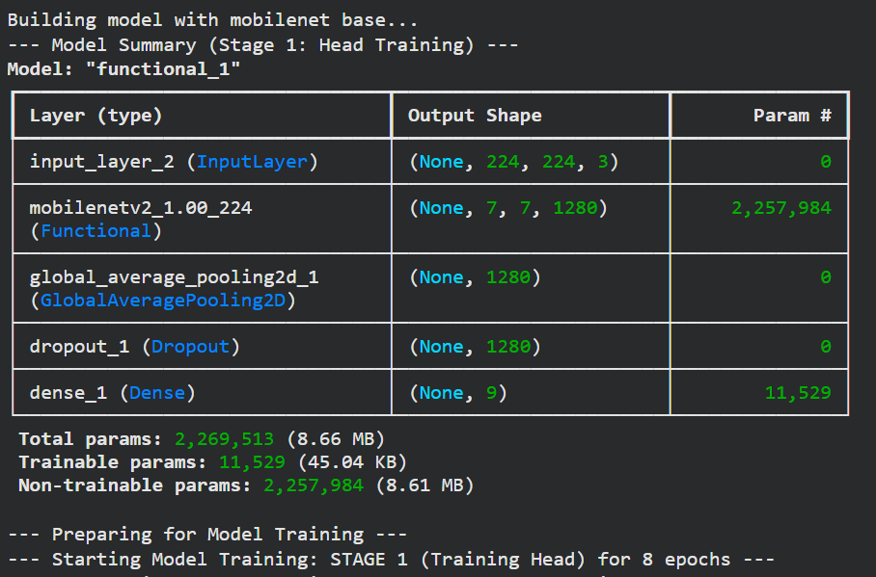
Model Structure for Stage 1

Slide 29
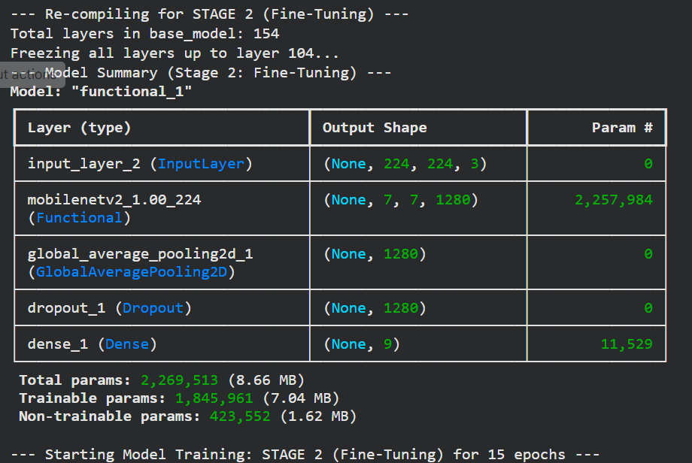
Model Structure for Stage 2
c

Slide 30
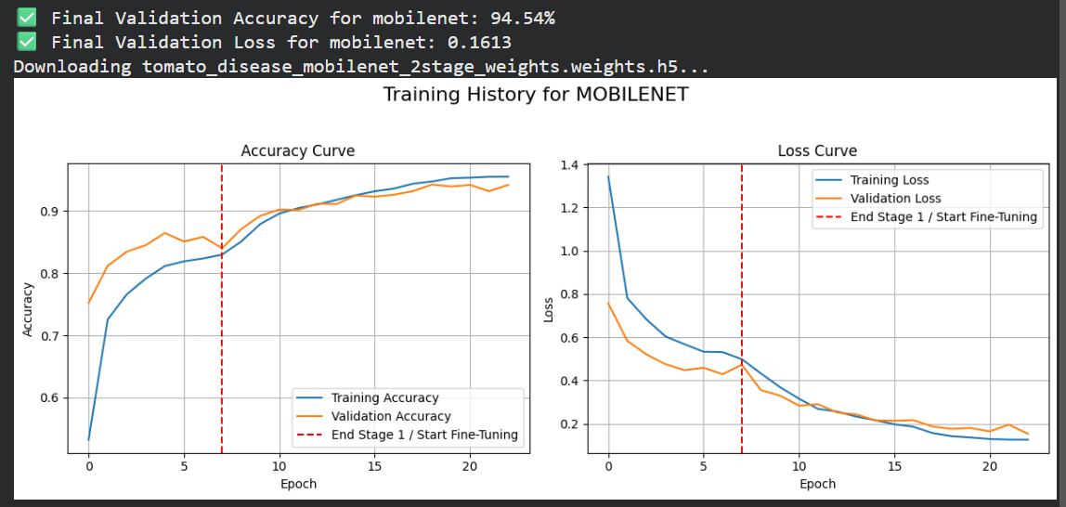

Slide 31
3.3 ResNet
(Also incorporated dataset balancing)
Model Size: 90 MB

Slide 33
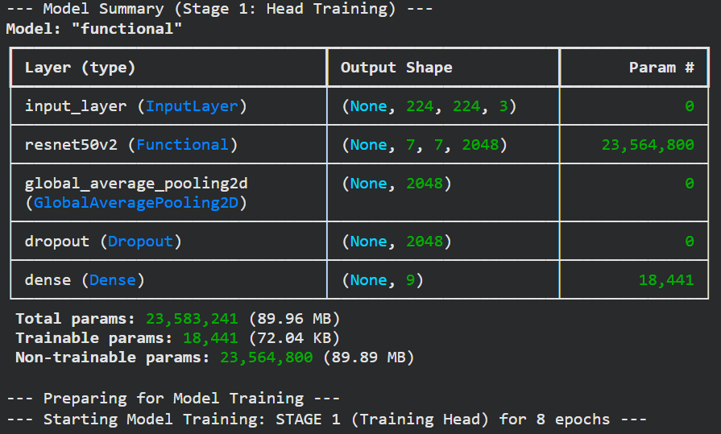
Model Structure for Stage 1

Slide 34
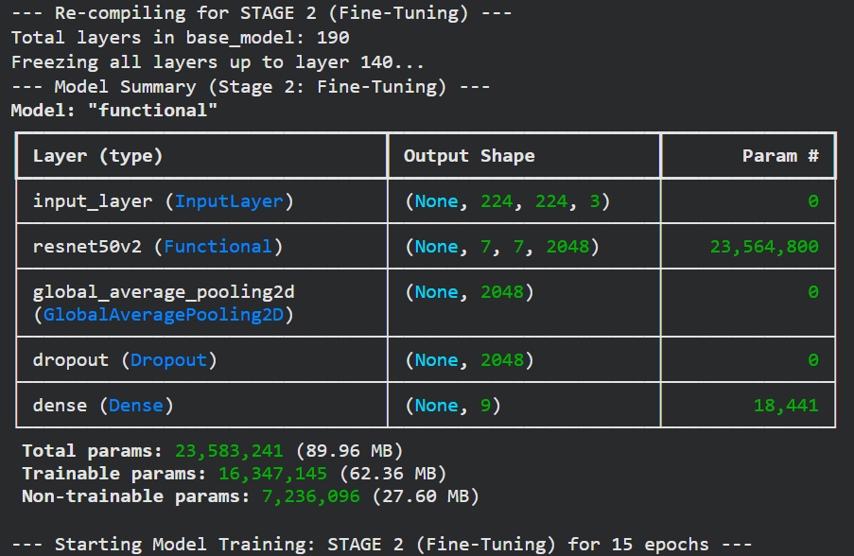
Model Structure for Stage 2

Slide 35
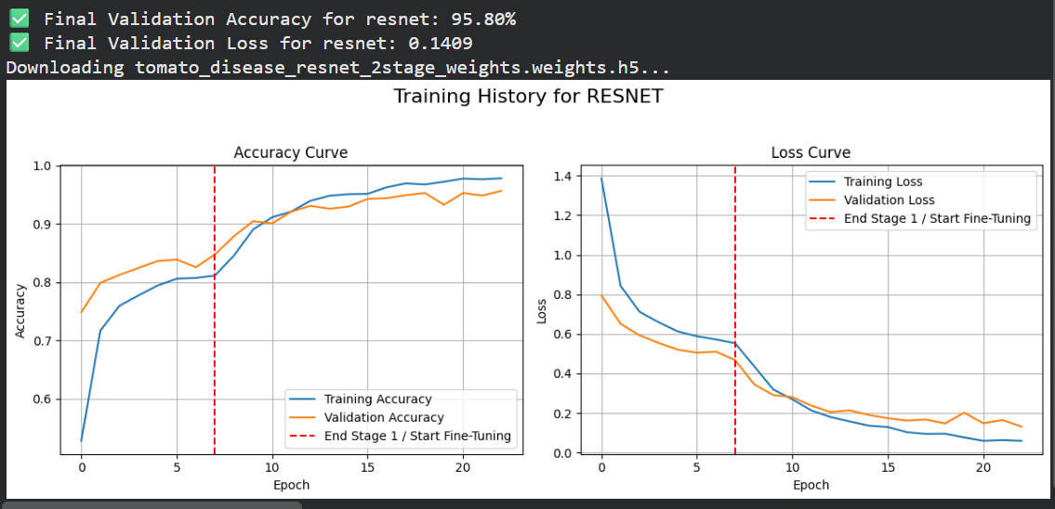

Slide 36
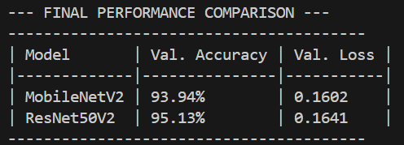
MobileNet vs. Resnet Inference
# Build model and load weights
model_resnet = build_model('resnet', num_classes)
weights_resnet = "tomato_disease_resnet_2stage_weights.h5"
if not os.path.exists(weights_resnet):
raise FileNotFoundError(f"Missing file: {weights_resnet}")
model_resnet.load_weights(weights_resnet)
print("ResNet50V2 weights loaded.")
# Build model and load weights
model_mnet = build_model('mobilenet', num_classes)
weights_mnet = "tomato_disease_mobilenet_2stage_weights.h5"
if not os.path.exists(weights_mnet):
raise FileNotFoundError(f"Missing file: {weights_mnet}")
model_mnet.load_weights(weights_mnet)
print("MobileNetV2 weights loaded.")

Slide 37
Bonus: Running the models for 15 + 30 epochs

Slide 38
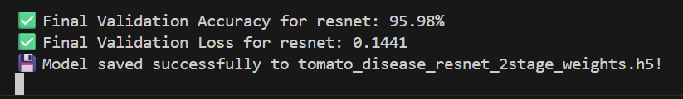
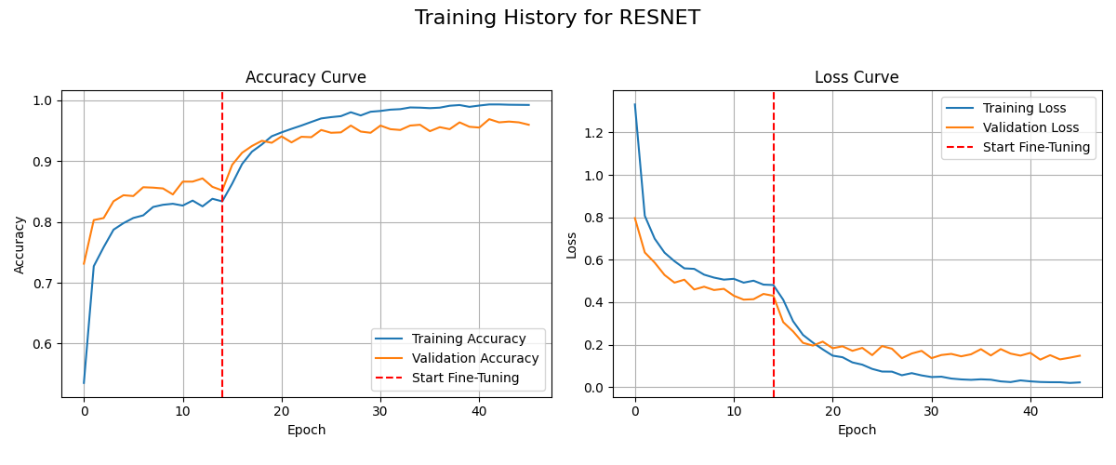

Slide 39

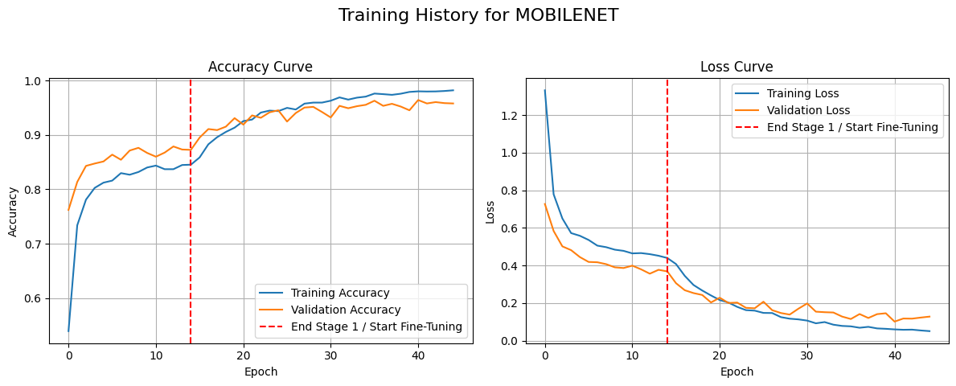

Slide 40
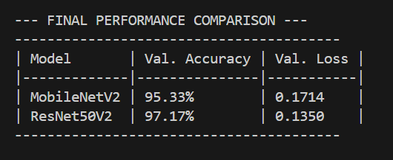

Slide 41
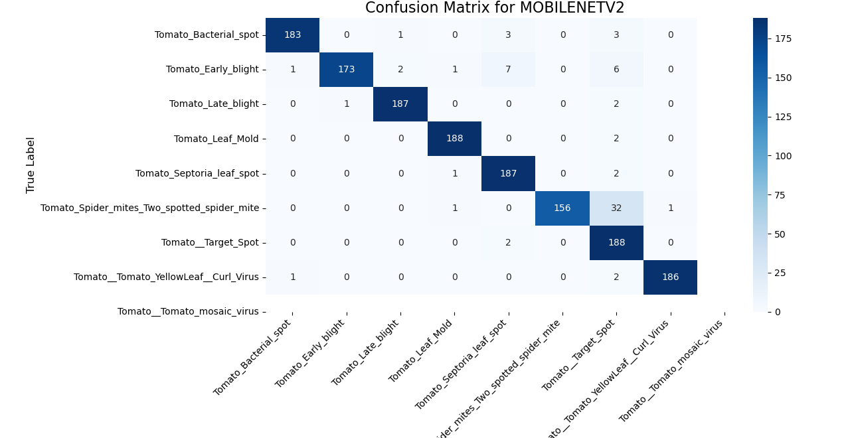

Slide 42


Slide 43
Conclusion
A interclass similarity is clearly evident between the classes tomato spider mite and tomato target spot.

