Slide 1
Separability Analysis on Plant Village Dataset

Slide 2
Embeddings taken from the penultimate layer of a trained RESNET
# Target the GlobalAveragePooling2D layer
# gap_layer_output = model.layers[-3].output # Dependent on exact stack
# Safer approach: find layer by type or name
gap_layer = next(l for l in model.layers if isinstance(l, layers.GlobalAveragePooling2D))
feature_extractor = Model(inputs=model.input, outputs=gap_layer.output)
print(f"Feature extractor built targeting layer: {gap_layer.name}")

Slide 3
Applied PCA for dimensionality reduction
# Apply PCA for dimensional reduction and covariance stability
print(f"Applying PCA (retaining {cfg['PCA_VARIANCE_RETAINED']*100}% variance)...")
pca = PCA(n_components=cfg['PCA_VARIANCE_RETAINED'])
reduced_embeddings = pca.fit_transform(raw_embeddings)

Slide 4
Results

Slide 5
Weights loaded successfully!
Feature extractor built targeting layer: global_average_pooling2d
Extracted raw feature matrix shape: (12875, 2048)
Applying PCA to retain 95% variance for covariance stability...
PCA-reduced feature matrix shape: (12875, 523)

Slide 6
--- 3.1 Intra-Class Variance ---
Top 5 Classes with LOWEST Intra-Class Variance (Tighter clustering):
Class Variance
Potato___healthy 0.687787
Tomato__Tomato_mosaic_virus 0.959765
Tomato__Target_Spot 0.987625
Tomato_healthy 1.036653
Pepper__bell___healthy 1.072502
Top 5 Classes with HIGHEST Intra-Class Variance (Looser clustering):
Class Variance
Tomato_Leaf_Mold 1.418953
Tomato_Septoria_leaf_spot 1.471926
Tomato__Tomato_YellowLeaf__Curl_Virus 1.554229
Pepper__bell___Bacterial_spot 1.613164
Tomato_Late_blight 1.898731
These classes have the least noise (least confusion)
These classes have the most noise (most confusion)

Slide 7
overcoming nervousness
--- 3.2 Inter-Class Centroid Distances ---
Top 10 Most Confusable Class Pairs (Smallest centroid distance):
Distance 16.0048 : Tomato_Spider_mites_Two_spotted_spider_mite <--> Tomato__Target_Spot
Distance 16.1957 : Tomato_Early_blight <--> Tomato_Septoria_leaf_spot
Distance 17.3442 : Tomato__Target_Spot <--> Tomato_healthy
Distance 17.7017 : Tomato_Early_blight <--> Tomato__Target_Spot
Distance 18.5400 : Tomato_Bacterial_spot <--> Tomato_Septoria_leaf_spot
Distance 18.7793 : Tomato_Early_blight <--> Tomato_Bacterial_spot
Distance 19.4194 : Potato___healthy <--> Potato___Late_blight
Distance 19.4730 : Tomato_Bacterial_spot <--> Tomato__Target_Spot
Distance 19.5305 : Tomato_Early_blight <--> Tomato_Late_blight
Distance 20.0256 : Tomato__Target_Spot <--> Tomato_Septoria_leaf_spot
==================================================
SEPARABILITY ANALYSIS (PART 1) COMPLETE
==================================================
CONFIDENCE-BUILDING STRATEGIES

Slide 8
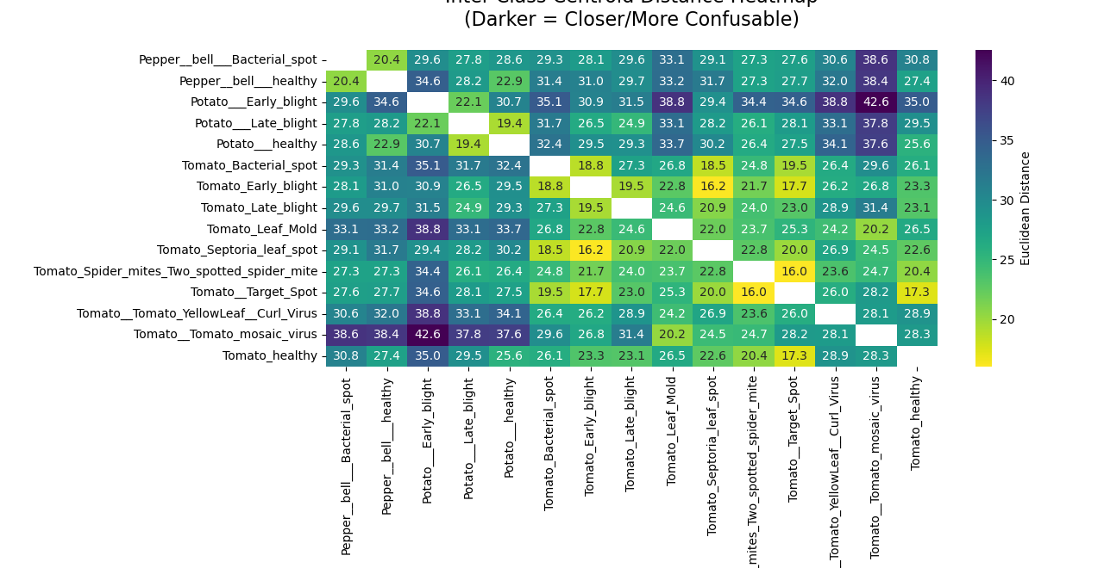
Inter-Class Centroid Distance Heatmap
Least confusing classes
Most confusing classes

Slide 9
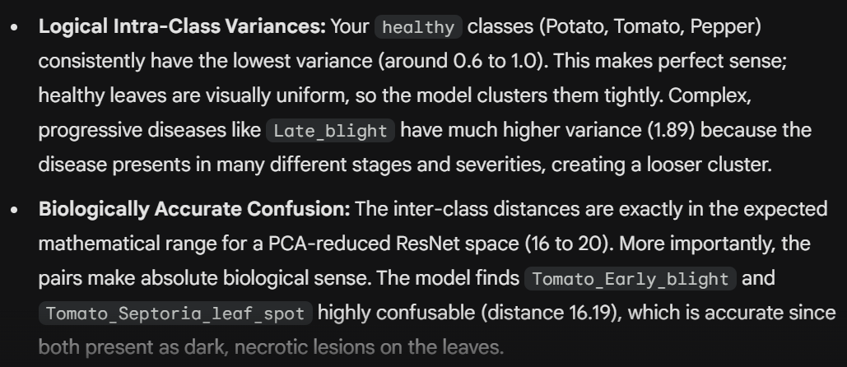
Conclusion

Slide 10
Calculating Fisher Discriminant Ratio (FDR)

Slide 11
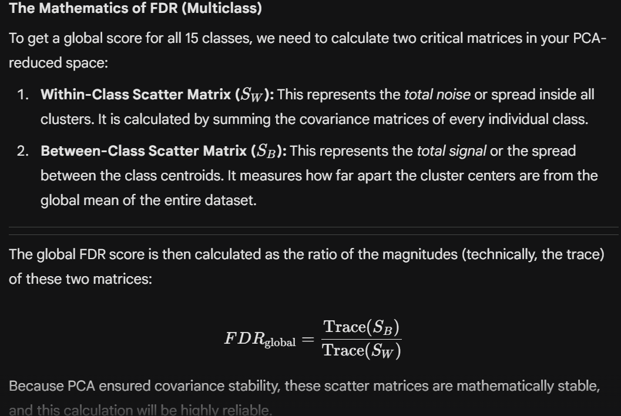

Slide 12
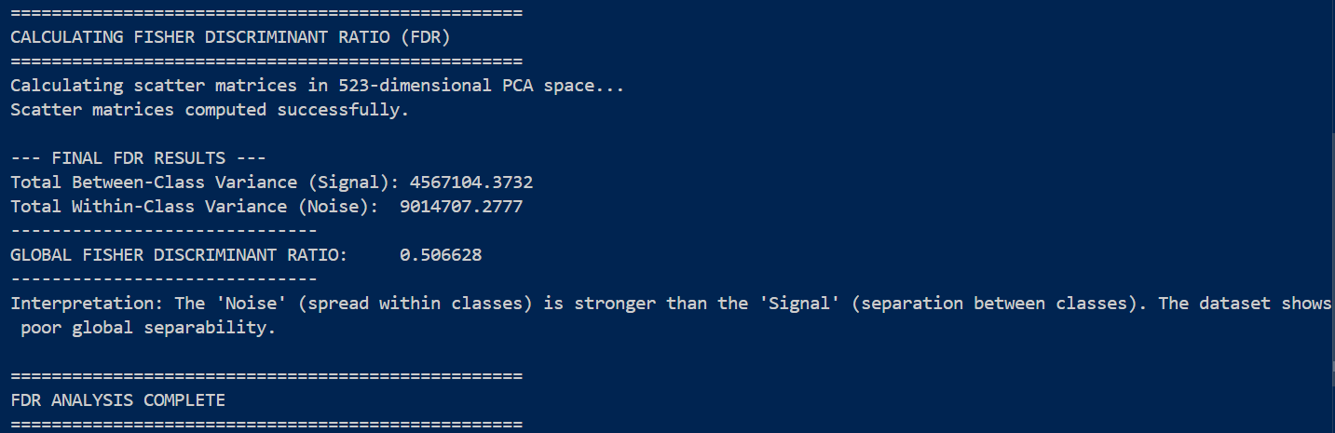

Results

Slide 13
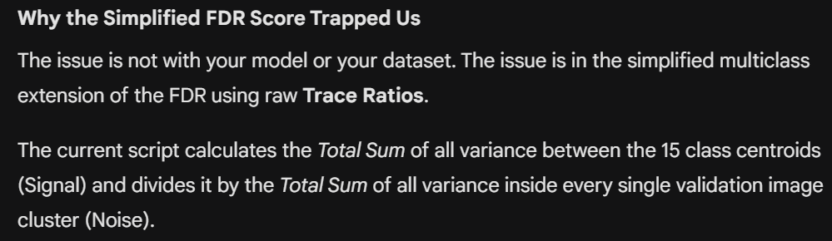
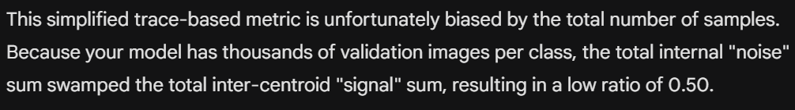
Conclusion

Slide 14
Bhattacharyya and Chernoff Distance
To solve the contradiction, we need a metric that looks at specific class pairs, rather than squashing the entire high-dimensional space into one single global number. Ex: Bhattacharyya and Chernoff Distance

Slide 15
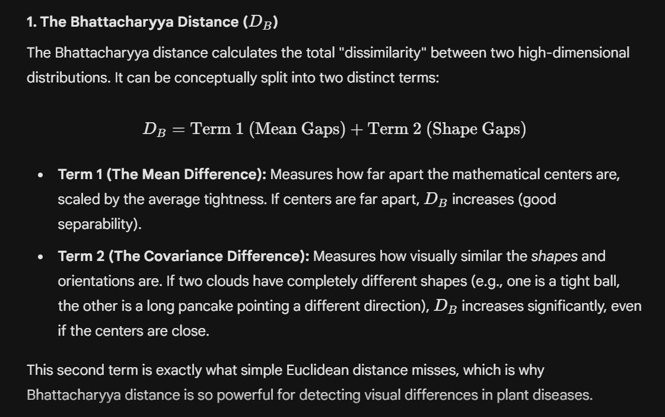

Slide 16
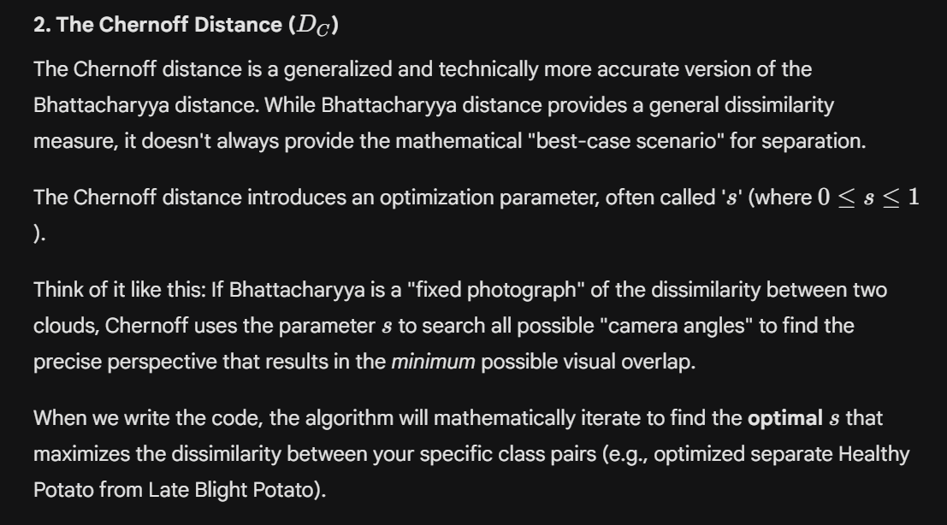

Slide 17
ERROR BOUND
Both distances directly define an upper limit on the Bayes Error—the lowest achievable error rate a linear classifier can
theoretically achieve on that feature space.

Slide 18
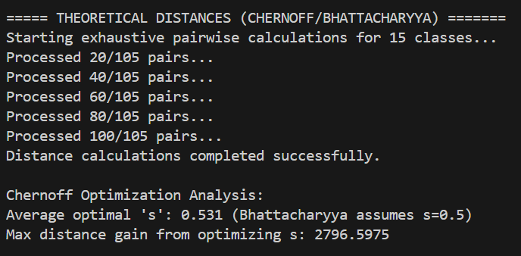
Results

Slide 19
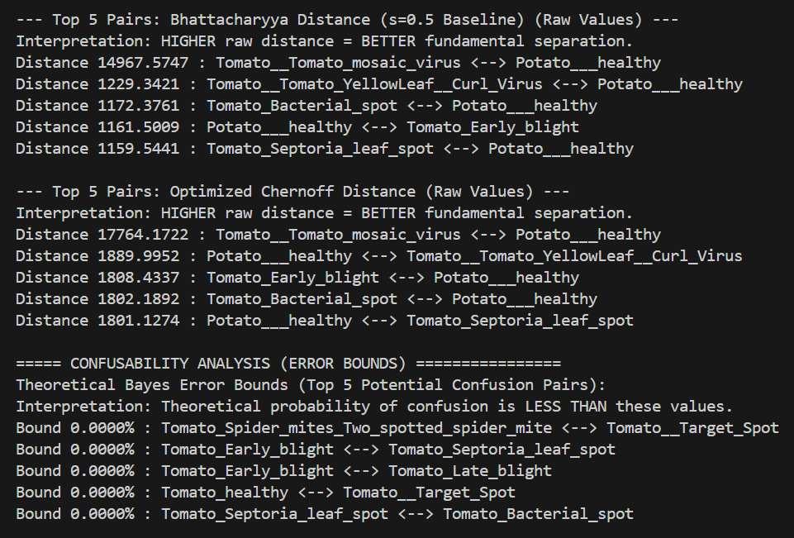

Slide 20
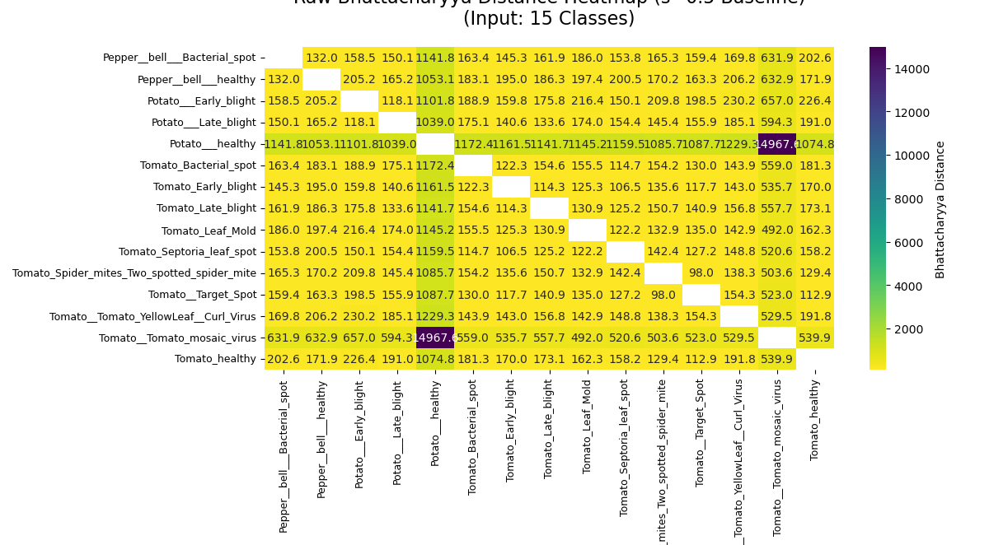
Bhattacharya Distance

Slide 21
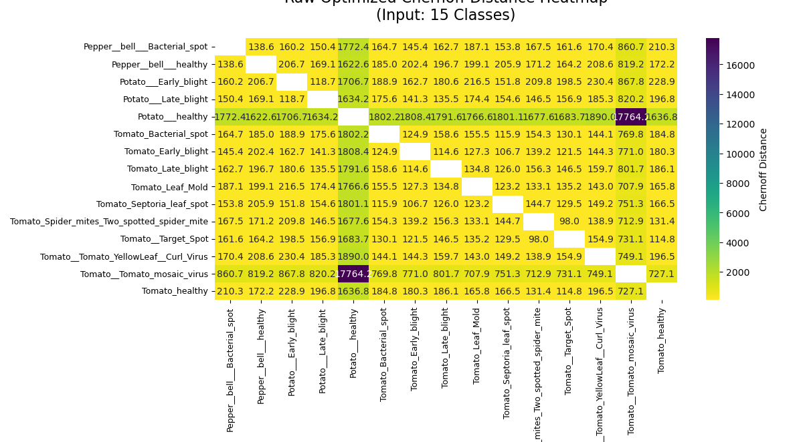
Chernoff Distance
Takeaway: Healthy potato leaves create a bit of confusion !

Slide 22
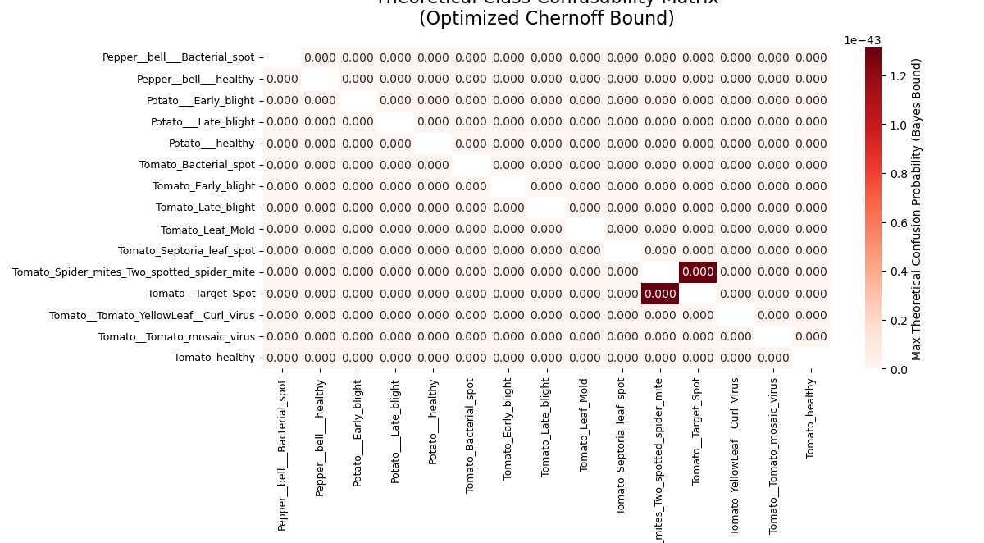
Class Confusability Matrix
Same spots of confusion as predicted by the inter-class centroid distances

Slide 23
t-SNE and UMAP visualization

Slide 24
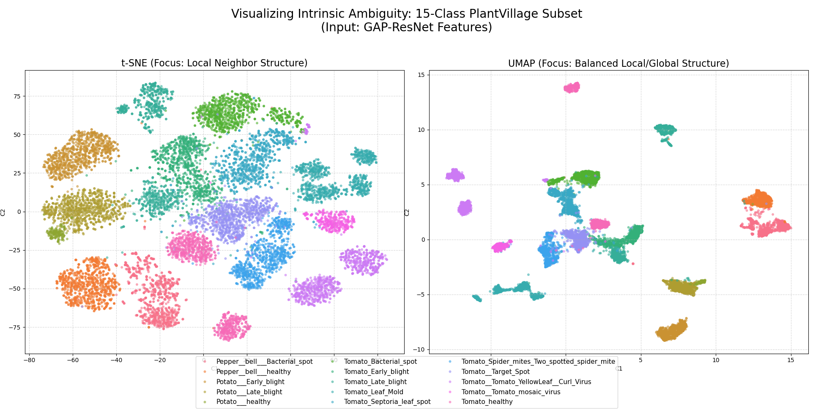

Slide 25
Overall Conclusion
Extremely low Chernoff bounds suggest a highly separable dataset
t-SNE and UMAP visualisations show that the embeddings are neatly clustered, with very few points of confusion.

