Slide 1
DSA2 project: The most fun you’ll have in your whole ISCL experience!
(tutors never lie)

Slide 2
Basic facts at a glance
Deadline: July 30, 23:59
Project grade is not part of your final grade, but you must pass the project to pass the course
Three tutor checkpoint meetings, attendance mandatory (more later)
Every member must contribute meaningfully
Team members can receive different grades for the project
Anyone who’s just free-riding off their group will fail even if the group passes

Slide 3
Project overview
You will develop an app allows users to search for key terms in some text, and shows the results in context with additional linguistic information
The text will come from either a local file or from a website
The app will be fully GUI-driven

Slide 4
Key components of the project
GUI with Java Swing – 15 points
Web scraping– 10 points
Linguistic processing with OpenNLP – 10 points
Save to file via XML – 10 points
Create executable JAR file – 5 points
NOTE: The points do not necessarily reflect the amount of work required in each component, only their relative importance to getting the whole project “working”

Slide 5
GUI (Graphical User Interface)
Your GUI should be well-designed, intuitive, and user-friendly
Think of apps you’ve used that you thought were either very intuitive, or very unintuitive, examine how their GUIs were designed
Users should get appropriate feedback in the case of any exceptions, errors, etc.
Don’t just pop a window that says “Error!”, that tells the user nothing
Don’t throw the exception as-is at the user, don’t assume end users have any programming experience

Slide 6
GUI examples from past projects

Slide 7
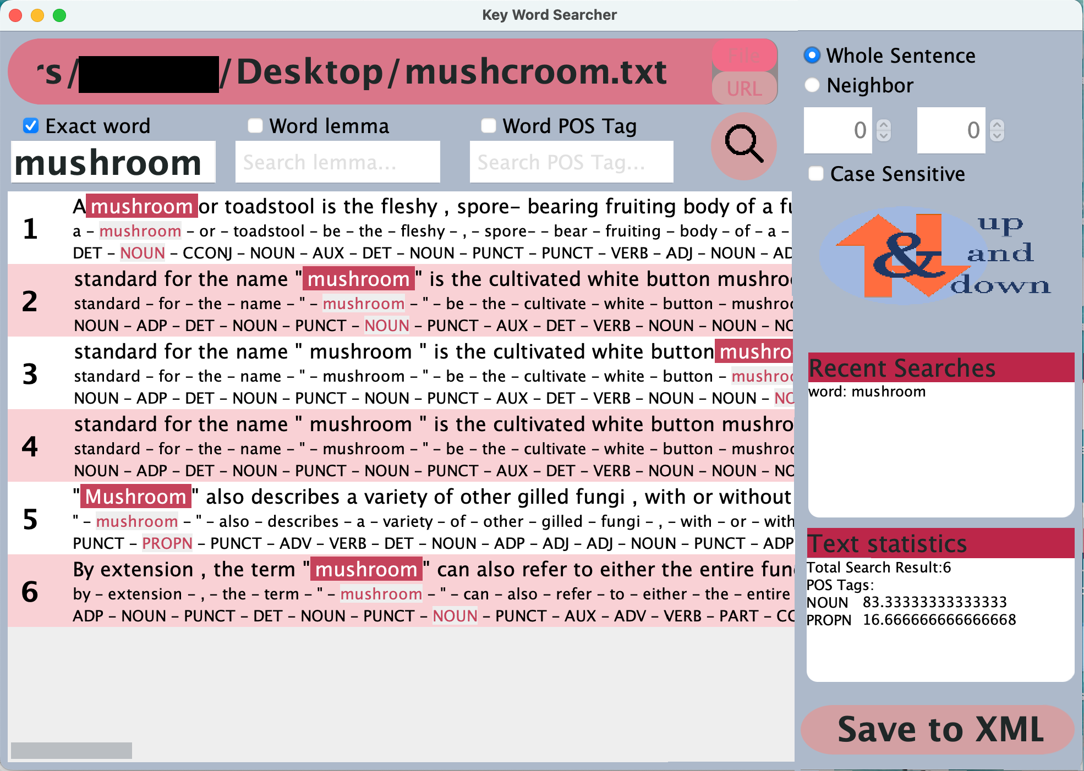
GUI examples from past projects

Slide 8
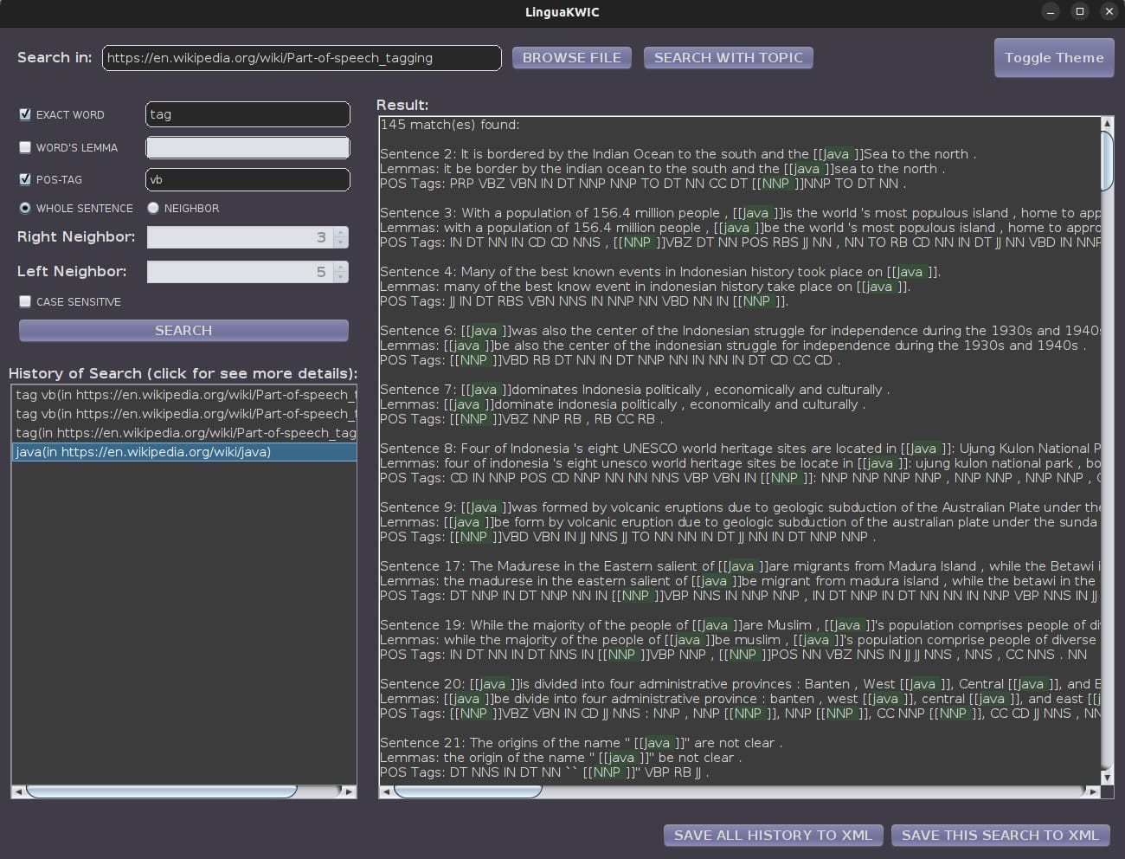
GUI examples from past projects

Slide 9
Important!
We are specifically not telling you that these are GOOD examples
We are also not telling you that these are BAD examples
These are simply examples that come from your senpais and their senpais, through the long line of our ISCL ancestry, back into the times of legend
Use your accumulated experience as savvy consumers of apps to judge what works and what doesn’t

Slide 10
Web scraping
You already know how to read in from a local file, but now you need to grab text from a webpage
For the purposes of this project, we will only consider Wikipedia pages
The user will provide a URL (through the GUI), and you need to grab the contents of that page
The text should be cleaned for the next step, so footnotes, metadata, etc, need to be removed
There are many ways to do this. Jsoup is an open-source Java library you can look into.

Slide 11
OpenNLP
AKA, the whole point of the project
Taking the cleaned text from your web scraper (or document reader), use OpenNLP to identify sentences, word tokens, lemmas, and POS tags
You need to provide a way to search by word, lemma, or POS tag
The results will be piped back to the GUI for display to the user

Slide 12
Save via XML
I’ve now made some amazing linguistic discoveries thanks to your app, but I need a way to present the data and win my Nobel Prize right?
Your app needs a way to output results to a new or existing XML file
Users should be able to specify the location and file name to save to
Results from ALL searches in the current session should be saved

Slide 13
Making a JAR
I’m a linguist, what do I know about programming? Just give me something to double click!
A JAR (Java archive) is a file format that bundles all the files of your project together into one executable package
If your project is just one long file, you and your group have made many, many wrong choices in life
A JAR allows your app to be run as an actual independent program, separate from and outside of IntelliJ
You must include a JAR with your final submission

Slide 14
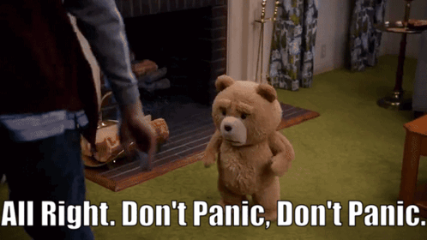
Making a JAR (continued)
But, lips quivering, tears welling in your eyes, you exclaim, “I’ve never had to do anything like this before!”
IntelliJ can help you with this. A Jar is just an artifact that IntelliJ can help you build.

Slide 15
Useful tips in case of JARring issues
Check your pom.xml (maven project file) for correct libraries, etc.
If you are using external media files in your GUI (button icons, etc.), read them as input streams:

Slide 16
How to work as a team
There is no I in the word team!
But there is camaraderie, communication, collaboration, and suffering
I didn’t know that team had so many letters!
The coding is NOT difficult (relatively speaking), the major challenge will be organizational
Every group will have different team dynamics, but figuring out how to get everyone organized and sharing a mental model of the project is key

Slide 17
How to GitHub as a team
When two people modify the same file and push, that leads to a merge conflict
Merge conflicts are annoying and a pain in the ass to resolve, so let’s try to avoid them if possible
Always pull down before you start working, so that your local codebase is up-to-date
Always push up when you have completed one logical unit of work
That could be one whole feature, one component of a larger feature, etc.

Slide 18
How Program as a team
Merge conflicts suck, so if at all possible people should not be working on the same files at the same time.
Remember, method signatures are like contracts, once we agree on your method name, the parameters it takes, and the output it gives, I can trust it to do what it does without needing to touch what’s inside
Assuming my teammate’s not a potato
It may be helpful to write up a “design document” with a list of public-facing (read: to be used by your teammates) methods and what they’re all about

Slide 19
Checkpoints
Each group will have checkpoint meetings with us
For us to give you feedback on your progress
Or to point out areas of concern
Checkpoints will take place during Friday lab, check the schedule on Moodle
All group members are expected to attend, and to be on time. Being absent without a good reason is cause for losing individual project points.

Slide 20
Checkpoints (continued)
You will need to submit a written PDF describing what each group member has done since the last checkpoint
The deadline is Thursdays 6:00PM before your group’s checkpoint session
Create a reports folder in your project and add the reports there, with the date in the name

Slide 21
For the crazy people
If you feel like this idea is boring, you can propose your own project idea, as long as the following conditions are all met:
All team members agree
The workload is similar or higher
The project is NLP-related in some way
We agree with your idea

Slide 22
Some final advice
ORGANIZE!
Don’t just start throwing code on screen, the more time you spend in the design and planning phase, the less time you will spend in the oh-my-God-our-project-is-on-fire-and-I-don’t-know-how-to-put-it-out phase
Seriously, it’s not unusual to spend more time in design/planning than in coding. Think about how you want to package data together relationally, think about data structures.

Slide 23
Some final advice
The requirements presented are just the minimum specs.
Bonus points are available. Feel free to go nuts adding extra features.
This is your time. This is your destiny. Impress us!

Slide 24
Questions?

