Slide 1
Canadian Bioinformatics Workshops
www.bioinformatics.ca
bioinformaticsdotca.github.io

Slide 2


Slide 3


Dimensionality reduction
Chaitra Sarathy, PhD
Analysis Using R
June, 28-29, 2023

Slide 4
Overview
What is dimensionality reduction?
Why reduce?
A few flavors of dimensionality reduction:
PCA
tSNE
UMAP

Slide 5
What is dimensionality reduction?
Data transformation: high-dimensional space to low-dimensional -
Retains some meaningful properties of original data
Highlights general gradients or patterns in the data
Consider the global variance of the data set
Example:
Biological data have complex phenotypes
Multiple valid clustering classifications may co-exist
Dimension reduction approaches decompose data to a few new variables (called components) - explain most of the differences in observations.
Applications
Machine learning: Reducing feature set for accurate modelling
Bioinformatics: Reduce effect of experimental and biological noise (batch effect)
Cluster analysis (Module 1) - investigates pairwise distances between objects looking for fine relationships
Wikipedia

Slide 6
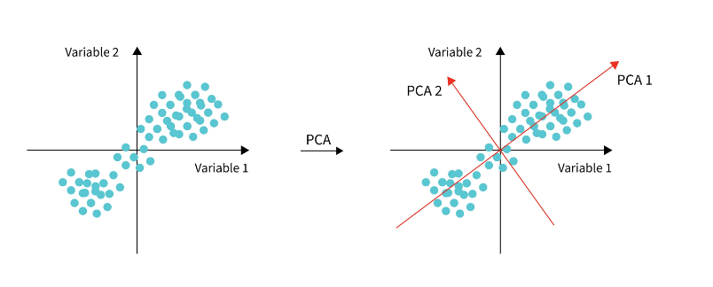
Principal Component Analysis (PCA)
Most widely used
One step in analyses pipeline
"PCA reduces data by geometrically projecting them onto lower dimensions called principal components (PCs), with the goal of finding the best summary of the data using a limited number of PCs"
Find the biggest axes of variation
First principal component - PC1 - direction that maximizes the variance of the projected data
PC2: explain’s second most variance
etc etc
Shows where the dominant structure in your data is (maybe a missing variable?)
Useful for identifying batches, unmeasured variable effect, etc
Wikipedia

Slide 7
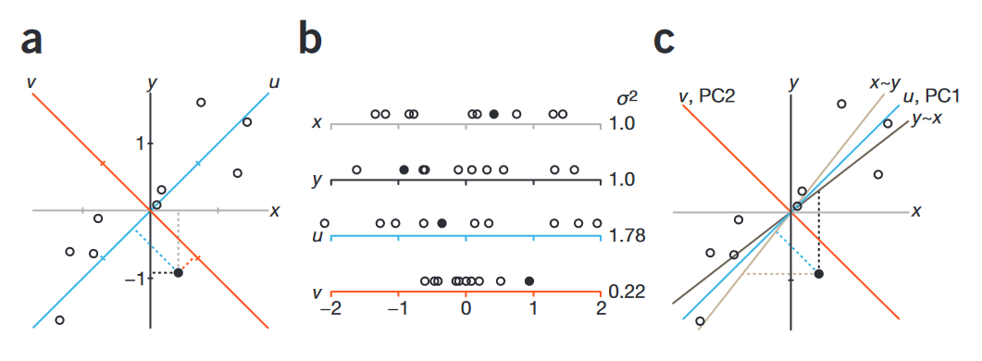
How does PCA work?
Consider data with p variables
Examine variable correlations
when p=10 there are p(p−1)/2=45 scatterplots that could be analyzed
PCA – retains interesting dimensions
interesting is measured by the amount that the observations vary along each dimension
New axes or dimensions or PCs are a linear combination of the p features
Variables in data set X₁,X₂,...,X_{p}
PC1 = ϕ₁₁X₁ + ϕ₂₁X₂ + ... + ϕ_{p1}X_{p}
PC1 is the new axis with largest variance
PC2 another axis that's uncorrelated to PC1.
PC2 = ϕ₁₂X₁ + ϕ₂₂X₂ + ...+ ϕ_{p2}X_{p}
Coefficients are stored in a ‘PCA loading matrix’
Wikipedia

Slide 8
How does PCA work?
Wikipedia

Slide 9
PCA: base r function “prcomp”
Finds new coordinate axis with each “principal component” explaining the maximum amount of remaining variance
PC1: explains most variance
PC2: explain’s second most variance
etc, etc
Shows where the dominant structure in your data is (maybe a missing variable?)
Useful for identifying batches, unmeasured variable effect, etc
A useful PCA paper: https://www.cs.cmu.edu/~elaw/papers/pca.pdf

Slide 10
PCA: base r function “prcomp”
Switch to exercise
A useful PCA paper: https://www.cs.cmu.edu/~elaw/papers/pca.pdf

Slide 11

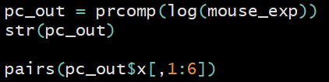
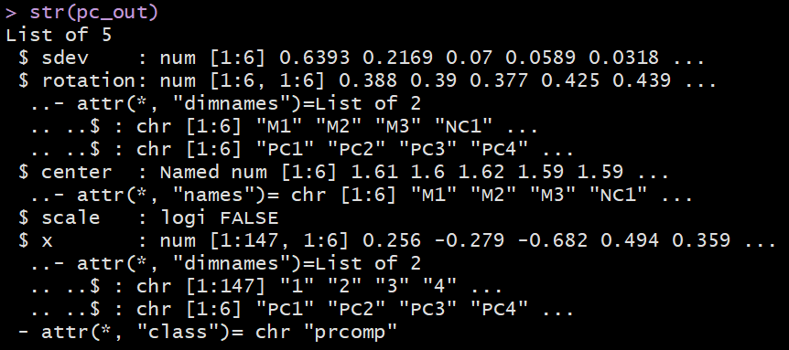
PCA: base r function “prcomp”
Perform PCA on your mouse gene expression data
Loadings for samples to generate PCs
Principal components we can extract and use

Slide 12
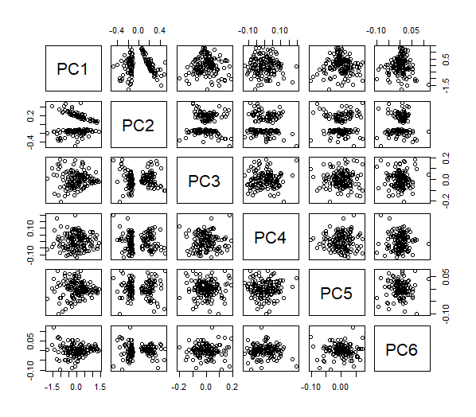
PCA: base r function “prcomp”
Plot your mouse gene expression PCA

Slide 13
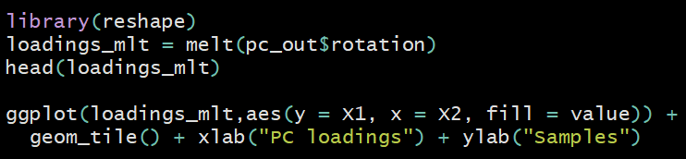
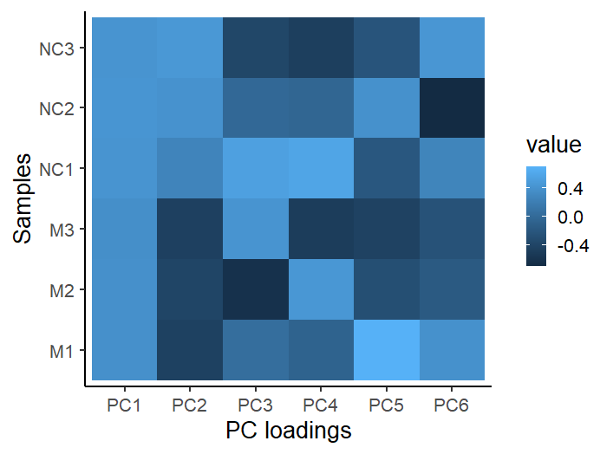
Plot loadings of your samples
May need to library in ggplot as well

Slide 14
tSNE: R package “tsne”
Stands for “t-Stochastic Neighbor Embedding”
For data that cannot be separated by any straight line
Finds low dimensional embedding (few variables that represent many variables) preserving neighborhood distances
Great for visualizations
Stochastic = random (set seed to make reproducible)
Difference from PCA
focus on local signal (neighborhood) vs global signal (explaining maximum variance)
t-SNE paper: http://www.jmlr.org/papers/volume9/vandermaaten08a/vandermaaten08a.pdf

Slide 15
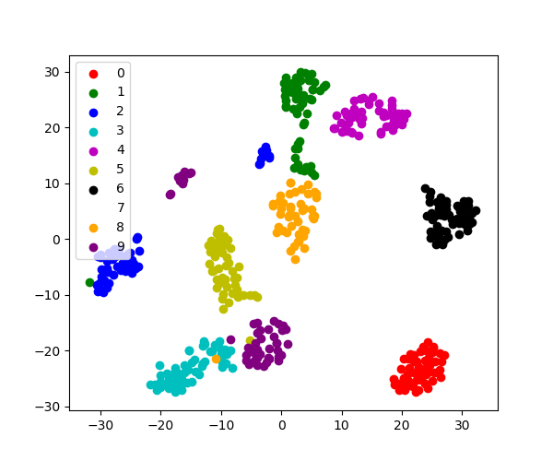
tSNE: R package “tsne”
tSNE finds axes that maintain “neighborhoods”

Slide 16
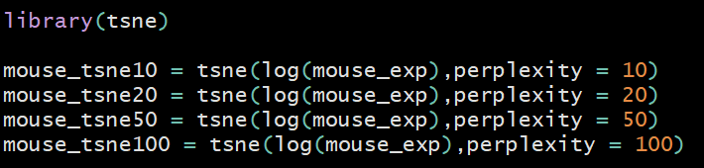
tSNE: R package “tsne”
Perplexity parameter determines how to balance attention to neighborhood vs global structure (smaller =more focus on the neighborhood)
If this is easy, try running this more efficiently
(i.e. a loop? functions?)

Slide 17
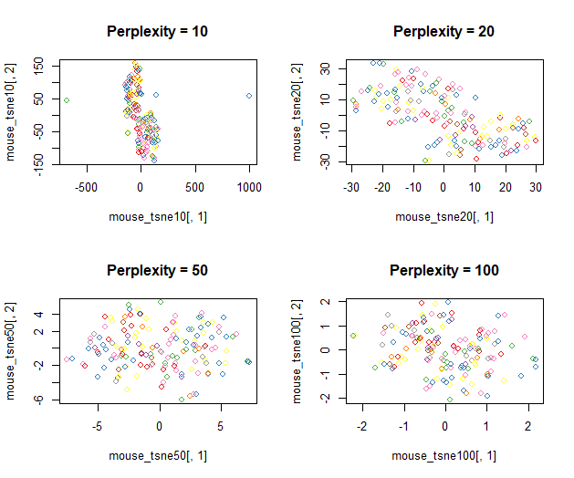
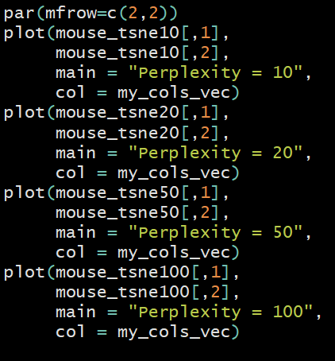
Plot your tsne’s
Create 2x2 plotting slots
Function colors vec we set before
Again, if this is easy – try a loop (or another more efficient way to code this)
Note that higher perplexity leads to higher spread in your data

Slide 18
UMAP: R package “umap”
Stands for “Uniform Manifold Approximation and Projection”
Similar neighborhood approach as t-SNE except uses Riemannian geometry (remember Riemann sums?) to approximate the manifold over which your data lies
Brass tax:
Focuses on local data relationships like t-SNE
faster than t-SNE
sometimes results in a better low dimensional representation of your data e.g. single cell
UMAP paper: https://arxiv.org/abs/1802.03426

Slide 19
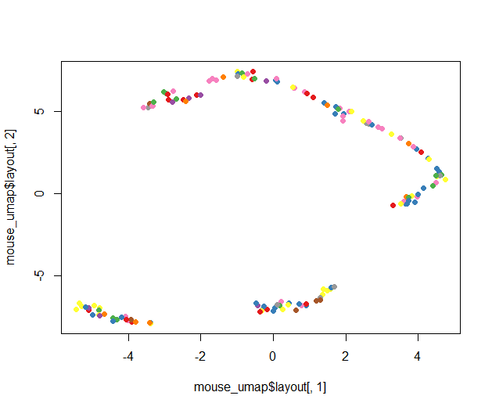
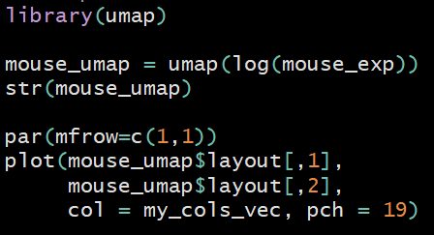
UMAP: R package “umap”
Run umap

Slide 20
PCA vs tSNE vs UMAP
PCA | tSNE | UMAP
Linear combination | Non-linear | Non-linear
Lower dimensions are called Principal components | Embeddings | TBA
Data is projected onto lower-dimensional space
Visualization, Covariates for statistical modeling | Visualization | Visualization
Concerned with preserving largest distances, to maximize variance of each PC. | Concerned with preserving nearest-neighbour distances Tuned with “perplexity” parameter | TBA

Slide 21
Exercise
Return to your crabs data
Compute the principle components (PCs) for the numeric columns
Plot these PCs and color them by species (“sp”) and sex
Now compute 2 t-SNE components for these data and color by species and sex
Finally compute 2 UMAP components for these data and color by species and sex
Do any of these dimensionality reduction methods seem to segregate sex/species groups?

Slide 22




We are on a Coffee Break & Networking Session
Workshop Sponsors:

