Slide 1
Canadian Bioinformatics Workshops
www.bioinformatics.ca
bioinformaticsdotca.github.io

Slide 2
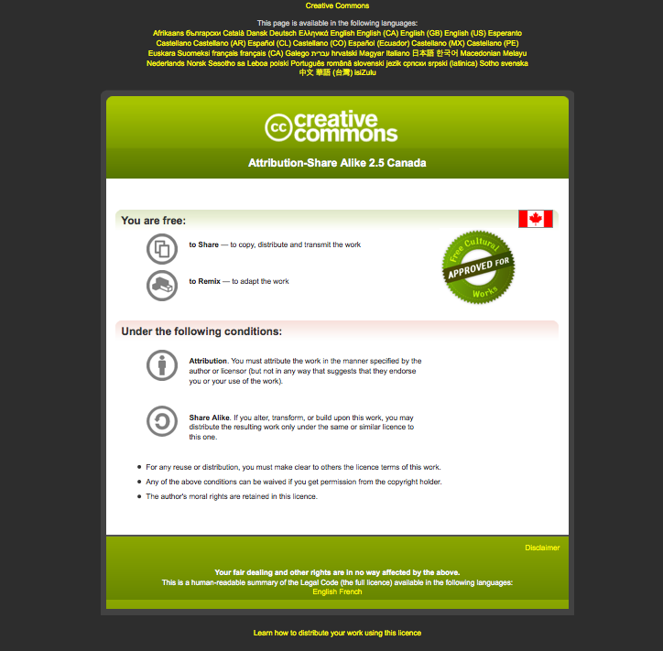

Slide 3



Generalized Linear Models
Shraddha Pai
Analysis Using R
June 14, 2024
Some material adapted from 2021 lecture by Lauren Erdman

Slide 4
Learning Objectives
By the end of this lecture, you will:
Learn to read tables into R and merge tables
Learn to create a variety of publication-quality plots using ggplot() and use them to explore data
Learn how to fit a binary response variable using glm()

Slide 5
Follow along with the worked example for Module 3 …

Slide 6




We are on a Coffee Break & Networking Session
Workshop Sponsors:

