Slide 1
Canadian Bioinformatics Workshops
www.bioinformatics.ca
bioinformaticsdotca.github.io

Slide 2


Slide 3



Basic Differential Expression Analysis
Shraddha Pai
Analysis Using R
June 14, 2024

Slide 4
Learning Objectives
By the end of this lecture, you will:
Understand the key steps in identifying differentially expressed genes in RNAseq
Learn how to use p-value histograms and QQ-plots to gauge how much signal you have after multiple hypothesis testing
Learn to create volcano plots to visualize results of differential expression analysis

Slide 5
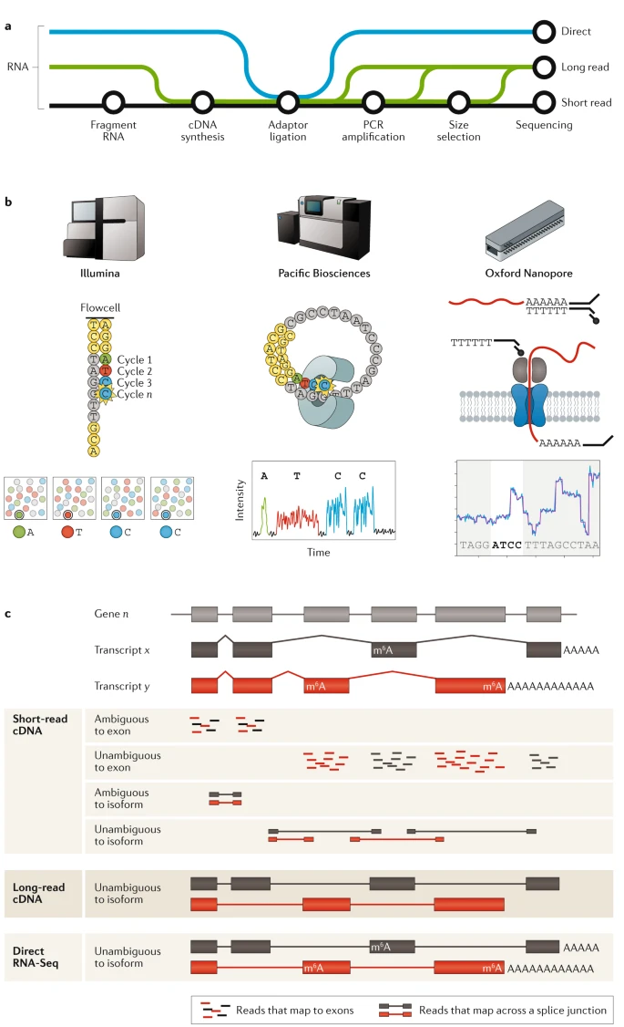
RNAseq data generation
Stark, Grzelak, Hadfield. (2019). Nat Rev Gen.

Slide 6
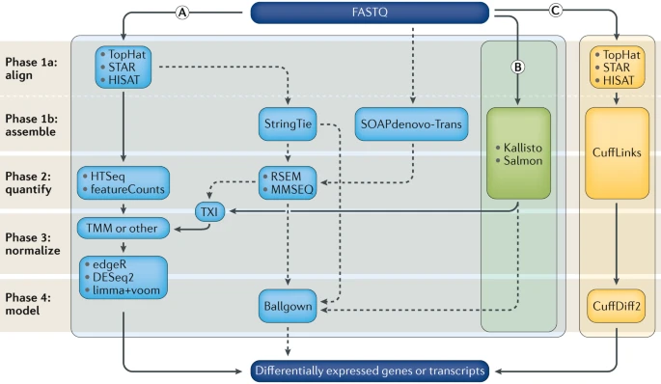
RNAseq data processing: High-level overview
Raw reads
Align reads to genome
Obtain transcript counts
Normalize
Statistical model for differential
gene expression analysis

Slide 7
RNA-seq analysis
Raw expression count matrix, output of STAR / RSEM
~ 20,000 measures
(protein-coding genes)
20,000 individual statistical tests
Multiple testing burden
Exclude genes with
low read count
20,000 p-values
Reduce multiple testing burden
Normalize for
technical variation
Variation in sequencing depth
Build statistical model
}
*
null model
Likelihood
ratio test (LRT)
Negative binomial distribution
(class of generalized linear models)
Signal in count data
Run multiple hypothesis tests*.
full model
“Differentially expressed genes” = Adjusted p-value < 0.05
Correct for multiple tests
Evaluate signal
*

Slide 8
Let’s look at a worked example for RNAseq analysis.

Slide 9
Exercise time.

Slide 10
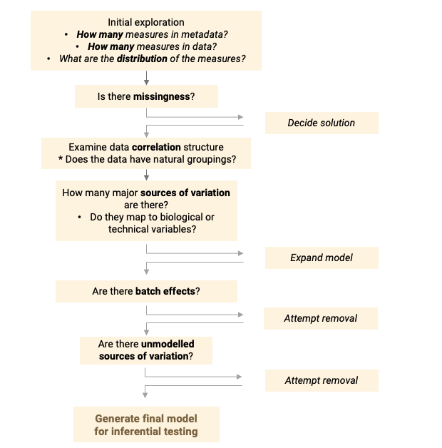
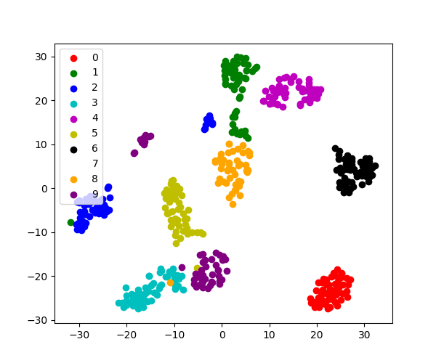
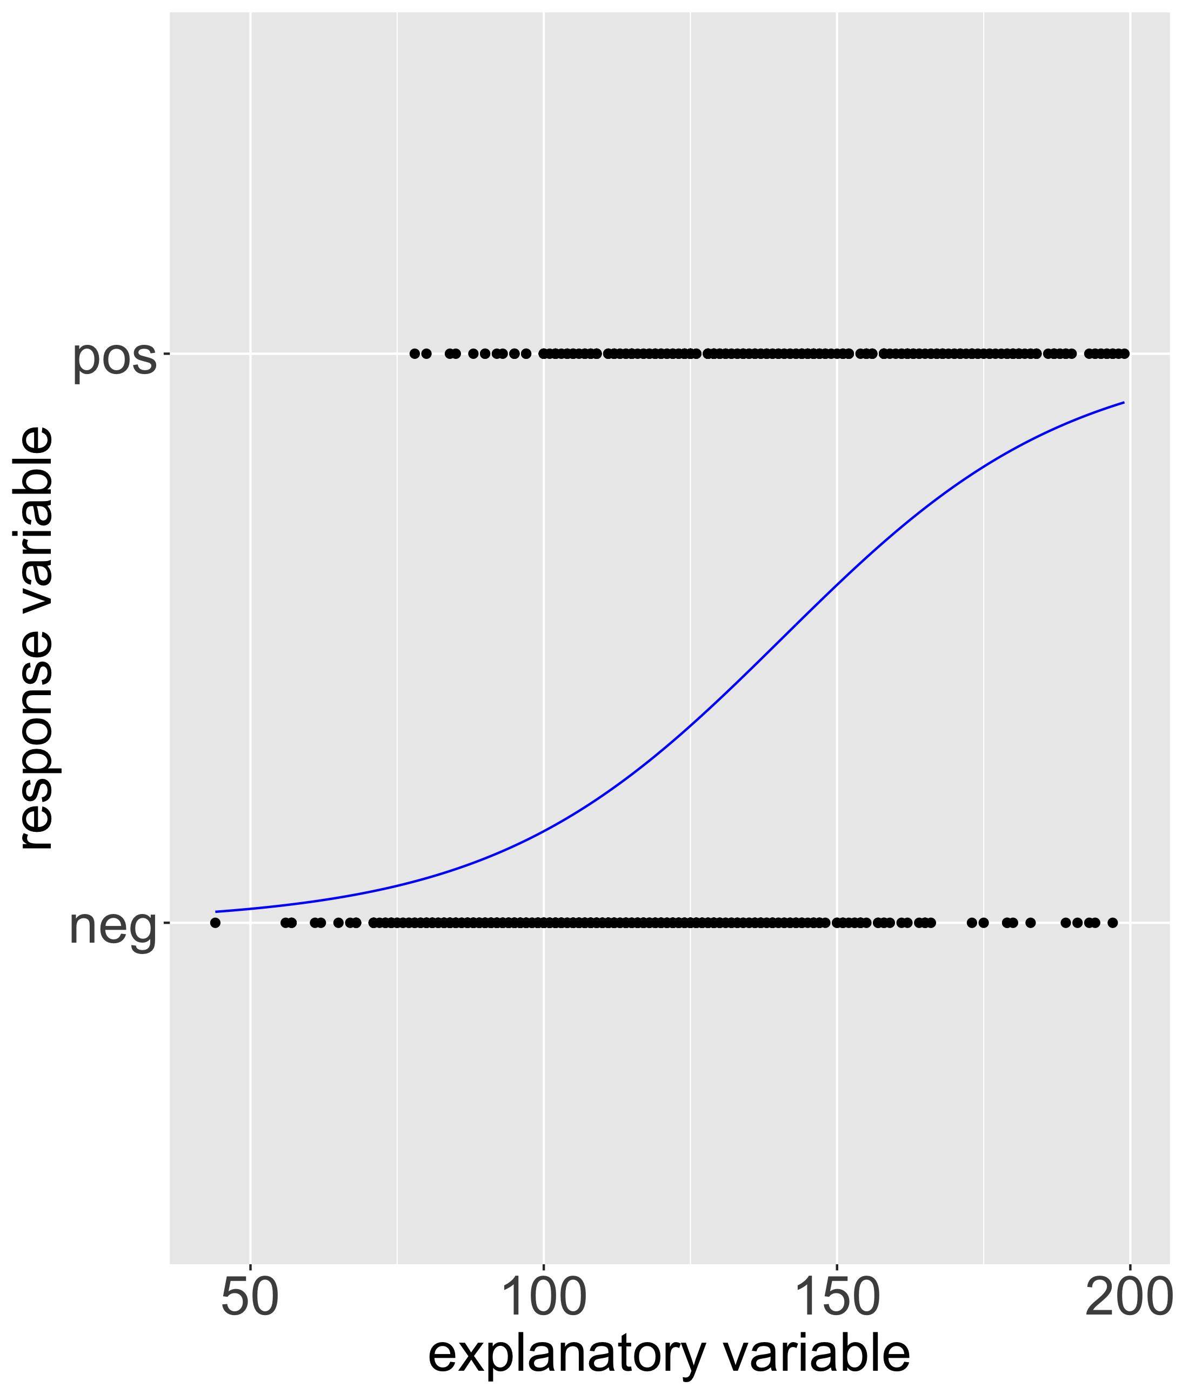
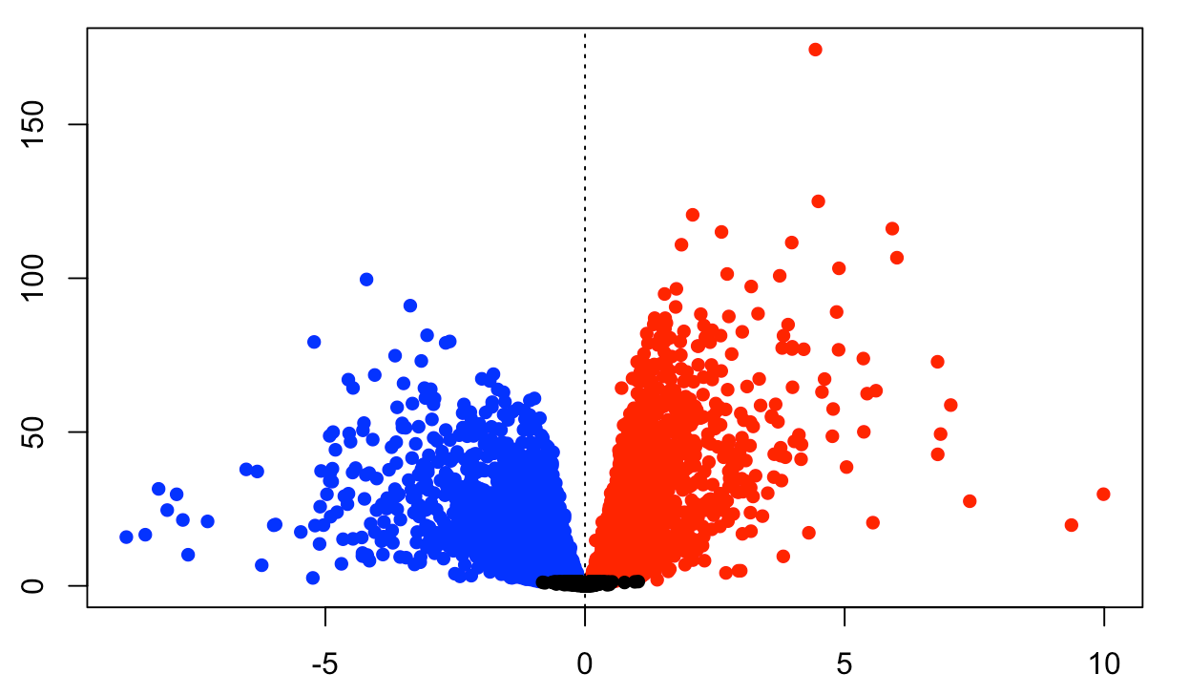
Recap course
Module 1: Systematic exploratory data analysis
Module 2: Dimensionality reduction to identify
major sources of variation in your data
Module 3: Generalized linear models to fit binary response variables (and RNAseq data!)
Module 4: Differential expression analysis, multiple hypothesis testing

Slide 11




Enjoy exploring your data!
Workshop Sponsors:

