Slide 1
Canadian Bioinformatics Workshops
www.bioinformatics.ca
bioinformaticsdotca.github.io

Slide 2


Slide 3


Dimensionality reduction
Chaitra Sarathy, PhD
Analysis Using R
June, 28-29, 2023

Slide 4
Overview
What is dimensionality reduction?
Why reduce?
A few flavors of dimensionality reduction:
PCA
tSNE
UMAP

Slide 5
Dimensionality reduction
What is dimension?
Define terms using data

Slide 6
Dimensionality reduction
Simple example data
 | Mouse 1 | Mouse 2 | Mouse 3 | Mouse 4 | Mouse 5 | Mouse 6
Gene 1 | 12 | 15 | 10 | 5 | 4 | 2
Gene 2 | 8 | 13 | 9 | 3 | 3 | 1

Slide 7
Dimensionality reduction
Simple example data
 | Mouse 1 | Mouse 2 | Mouse 3 | Mouse 4 | Mouse 5 | Mouse 6
Gene 1 | 12 | 15 | 10 | 5 | 4 | 2
Gene 2 | 8 | 13 | 9 | 3 | 3 | 1
2 genes

Slide 8
Dimensionality reduction
Simple example data
6 mice
 | Mouse 1 | Mouse 2 | Mouse 3 | Mouse 4 | Mouse 5 | Mouse 6
Gene 1 | 12 | 15 | 10 | 5 | 4 | 2
Gene 2 | 8 | 13 | 9 | 3 | 3 | 1
2 genes

Slide 9
Dimensionality reduction
Simple example data
6 mice → samples
 | Mouse 1 | Mouse 2 | Mouse 3 | Mouse 4 | Mouse 5 | Mouse 6
Gene 1 | 12 | 15 | 10 | 5 | 4 | 2
Gene 2 | 8 | 13 | 9 | 3 | 3 | 1
2 genes → variables

Slide 10
Dimensionality reduction
Simple example data
6 mice → samples
 | Mouse 1 | Mouse 2 | Mouse 3 | Mouse 4 | Mouse 5 | Mouse 6
Gene 1 | 12 | 15 | 10 | 5 | 4 | 2
Gene 2 | 8 | 13 | 9 | 3 | 3 | 1
2 genes → variables
Other biological data
 | Cell 1 | Cell 2 | Cell 3 | Cell 4 | Cell 5 | Cell 6
Protein 1 | 20 | 15 | 18 | 50 | 45 | 43
Protein 2 | 15 | 13 | 14 | 37 | 35 | 38

Slide 11
Dimensionality reduction
Simple example data
6 mice → samples
 | Mouse 1 | Mouse 2 | Mouse 3 | Mouse 4 | Mouse 5 | Mouse 6
Gene 1 | 12 | 15 | 10 | 5 | 4 | 2
Gene 2 | 8 | 13 | 9 | 3 | 3 | 1
2 genes → variables
Other biological data
Non-omic data
 | Cell 1 | Cell 2 | Cell 3 | Cell 4 | Cell 5 | Cell 6
Protein 1 | 20 | 15 | 18 | 50 | 45 | 43
Protein 2 | 15 | 13 | 14 | 37 | 35 | 38
 | Student 1 | Student 2 | Student 3 | Student 4 | Student 5 | Student 6
Math | 90 | 85 | 80 | 65 | 60 | 68
Science | 80 | 73 | 66 | 64 | 63 | 59

Slide 12
Dimensionality reduction
Simple example data
6 mice → samples
 | Mouse 1 | Mouse 2 | Mouse 3 | Mouse 4 | Mouse 5 | Mouse 6
Gene 1 | 12 | 15 | 10 | 5 | 4 | 2
Gene 2 | 8 | 13 | 9 | 3 | 3 | 1
2 genes → variables
How to visualise differences in samples?

Slide 13
Dimensionality reduction
Simple example data
mice → samples
Plot on number line
 | Mouse 1 | Mouse 2 | Mouse 3 | Mouse 4 | Mouse 5 | Mouse 6
Gene 1 | 12 | 15 | 10 | 5 | 4 | 2
Mice 4,5,6
Mice 1,2,3
genes → variables

Slide 14
Dimensionality reduction
Simple example data
Plot on two dimensional xy axis
 | Mouse 1 | Mouse 2 | Mouse 3 | Mouse 4 | Mouse 5 | Mouse 6
Gene 1 | 12 | 15 | 10 | 5 | 4 | 2
Gene 2 | 8 | 13 | 9 | 3 | 3 | 1

Slide 15
Dimensionality reduction
Simple example data
Plot on two dimensional xy axis
 | Mouse 1 | Mouse 2 | Mouse 3 | Mouse 4 | Mouse 5 | Mouse 6
Gene 1 | 12 | 15 | 10 | 5 | 4 | 2
Gene 2 | 8 | 13 | 9 | 3 | 3 | 1
Gene 2
Mice 1,2,3
Mice 4,5,6
Gene 1

Slide 16
Dimensionality reduction
Simple example data
Plot on two dimensional xy axis
 | Mouse 1 | Mouse 2 | Mouse 3 | Mouse 4 | Mouse 5 | Mouse 6
Gene 1 | 12 | 15 | 10 | 5 | 4 | 2
Gene 2 | 8 | 13 | 9 | 3 | 3 | 1
Gene 2
Y- axis: second dimension
Mice 1,2,3
Mice 4,5,6
X- axis: one dimension
Gene 1

Slide 17
Dimensionality reduction
Simple example data
Plot on three dimensional xyz axis
 | Mouse 1 | Mouse 2 | Mouse 3 | Mouse 4 | Mouse 5 | Mouse 6
Gene 1 | 12 | 15 | 10 | 5 | 4 | 2
Gene 2 | 8 | 13 | 9 | 3 | 3 | 1
Gene 3 | 5 | 5 | 6 | 15 | 18 | 22
Gene 2
Y- axis: second dimension
Mice 4,5,6
Z- axis: third dimension
Mice 1,2,3
Gene 3
X- axis: one dimension
Gene 1

Slide 18
Dimensionality reduction
Simple example data
mice → samples
 | Mouse 1 | Mouse 2 | Mouse 3 | Mouse 4 | Mouse 5 | Mouse 6
Gene 1 | 12 | 15 | 10 | 5 | 4 | 2
Gene 2 | 8 | 13 | 9 | 3 | 3 | 1
Gene 3 | 5 | 5 | 6 | 15 | 18 | 22
Gene 4 | 22 | 25 | 30 | 30 | 33 | 23
. . .
Gene 10000
Plot on four dimensions
genes → variables
Plot on 10000 dimensions
Dimensionality reduction to the rescue!

Slide 19
Dimensionality reduction
Simple example data
mice → samples
 | Mouse 1 | Mouse 2 | Mouse 3 | Mouse 4 | Mouse 5 | Mouse 6
Gene 1 | 12 | 15 | 10 | 5 | 4 | 2
Gene 2 | 8 | 13 | 9 | 3 | 3 | 1
Gene 3 | 5 | 5 | 6 | 15 | 18 | 22
Gene 4 | 22 | 25 | 30 | 30 | 33 | 23
. . .
Gene 10000
Dimensionality reduction: transform data to a few new variables which explain most of the differences in observations
genes → variables

Slide 20
Principal Component Analysis (PCA)
Most widely used method for dimension reduction
One step in analysis pipeline (Refer flowchart in Module 1)

Slide 21
Principal Component Analysis (PCA)
Variable 2
observations
Variable 1

Slide 22
Principal Component Analysis (PCA)
Variable 2
Variable 2
PC 1
observations
PCA
PC 2
Variable 1
Variable 1
Project data into newer axes or dimensions – Principal Components (PC1, PC2, etc)
PC1 - First principal component – axis with maximum variance
PC2 – Second principal component – second highest variance

Slide 23
Principal Component Analysis (PCA)
Variable 2
Variable 2
PC 1
observations
PCA
PC 2
Variable 1
Variable 1
Project data → Map data onto new axes → Projections
Amount by which data points are rotated → loading values
Loadings are the correlations between the original variables and the unit-scaled components

Slide 24
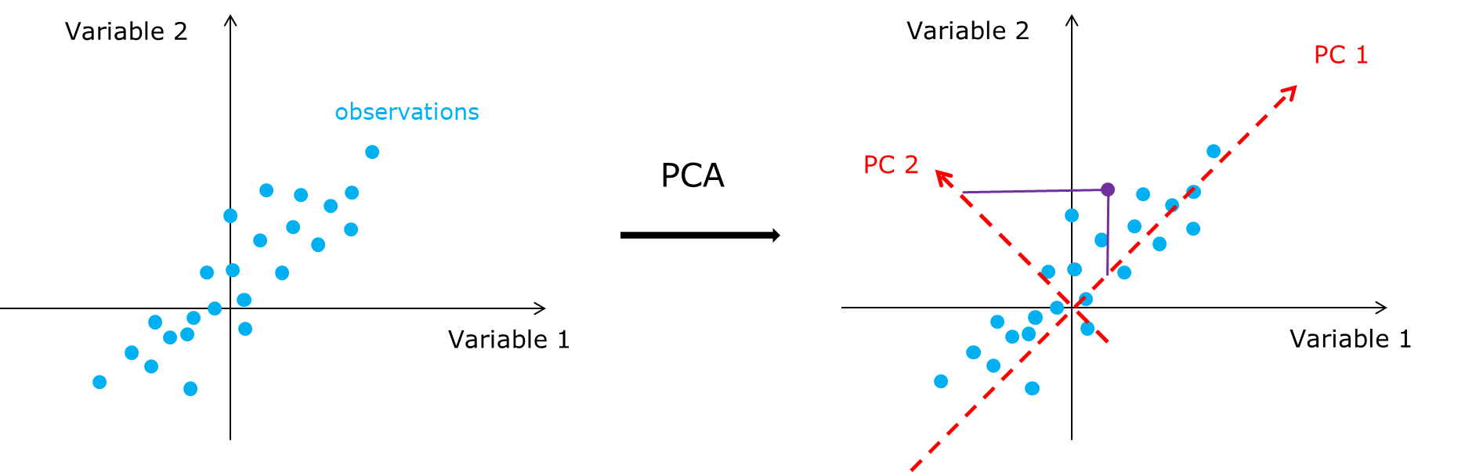
Principal Component Analysis (PCA)
Take away:
Rotate data into newer axes or dimensions – Principal Components (PC1, PC2, etc)
PC1 - First principal component – axis with maximum variance
PC2 – Second principal component – second highest variance
Project data → Map data onto new axes → Projections
The amount by which data points are rotated → loading values

Slide 25
Principal Component Analysis (PCA)
Applications
Applicable to both omic and non-omic datasets
Shows where the dominant structure in your data is
Useful for identifying batches, unmeasured variable effect, etc
Machine learning: Reducing feature set for accurate modelling
A useful PCA paper: https://www.cs.cmu.edu/~elaw/papers/pca.pdf

Slide 26
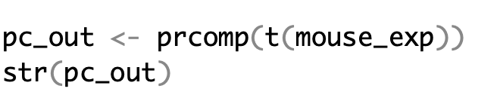
PCA: base r function “prcomp”
Perform PCA on your mouse gene expression data

Slide 27
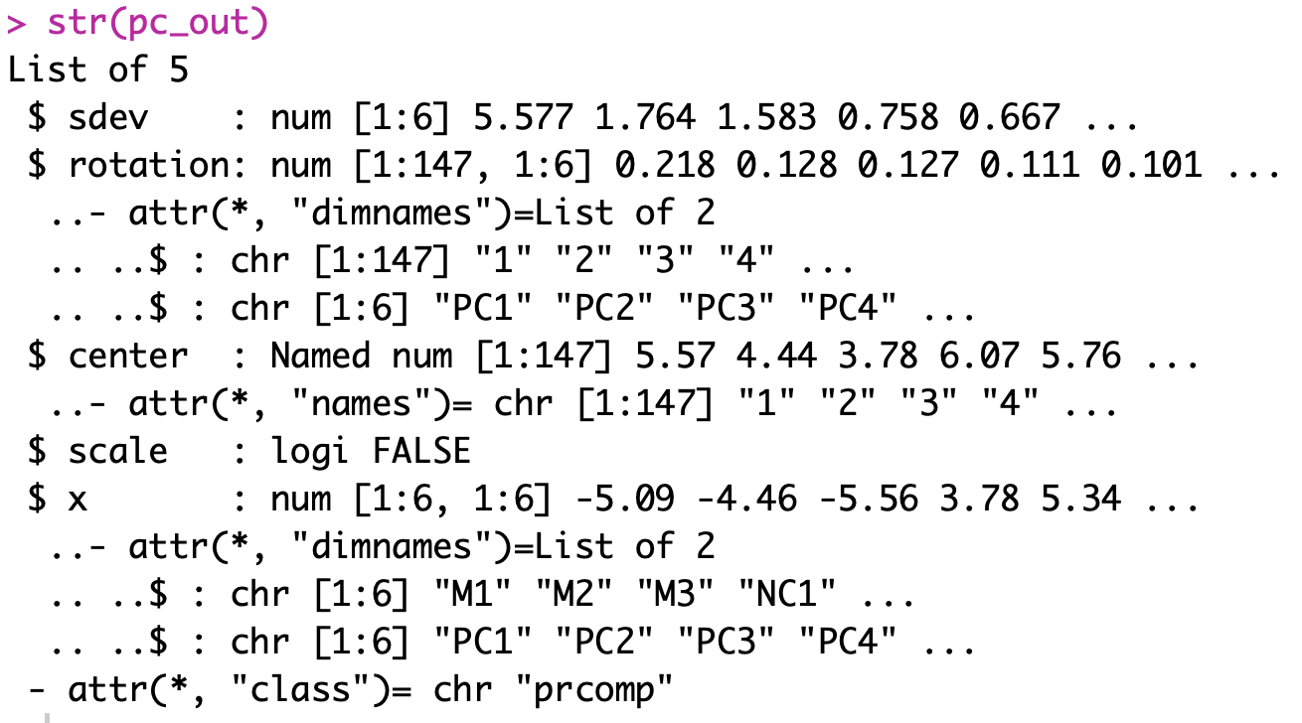
PCA: Results of “prcomp”
str(pc_out)
Standard deviation
Loading values

Slide 28
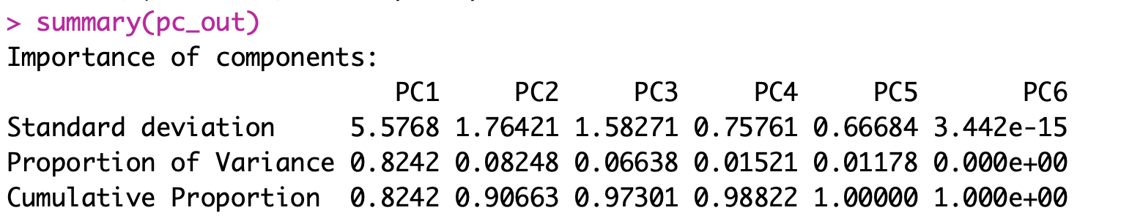
PCA: Results of “prcomp”
summary(pc_out)
Standard deviation
Variance explained
First principal component explains 89.16% of the total variance
Second principal component explains 8.9% of the variance
Amount of variance explained reduces further down with each component

Slide 29
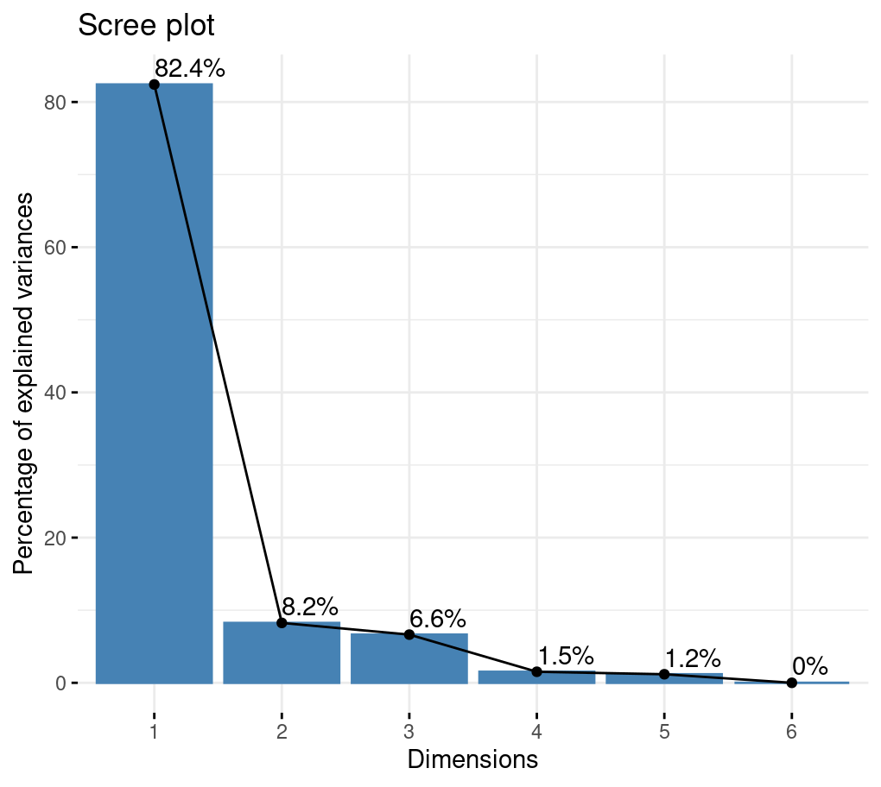
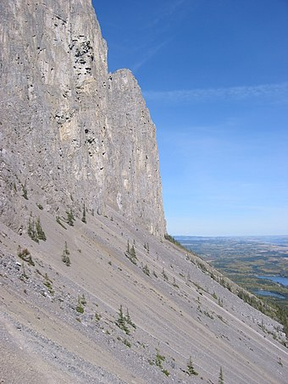
PCA: Visualising results of “prcomp”
1.Scree plot
Wikipedia: Scree is a collection of broken rock fragments at the base of a cliff or other steep rocky mass that has accumulated through periodic rockfall

Slide 30
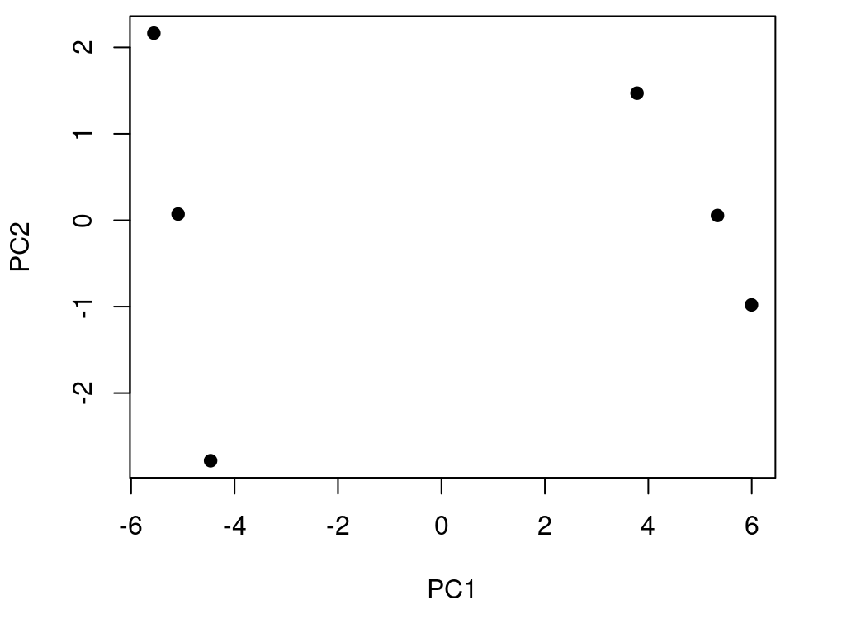
PCA: Visualising results of “prcomp”
2.Scatter plot

Slide 31
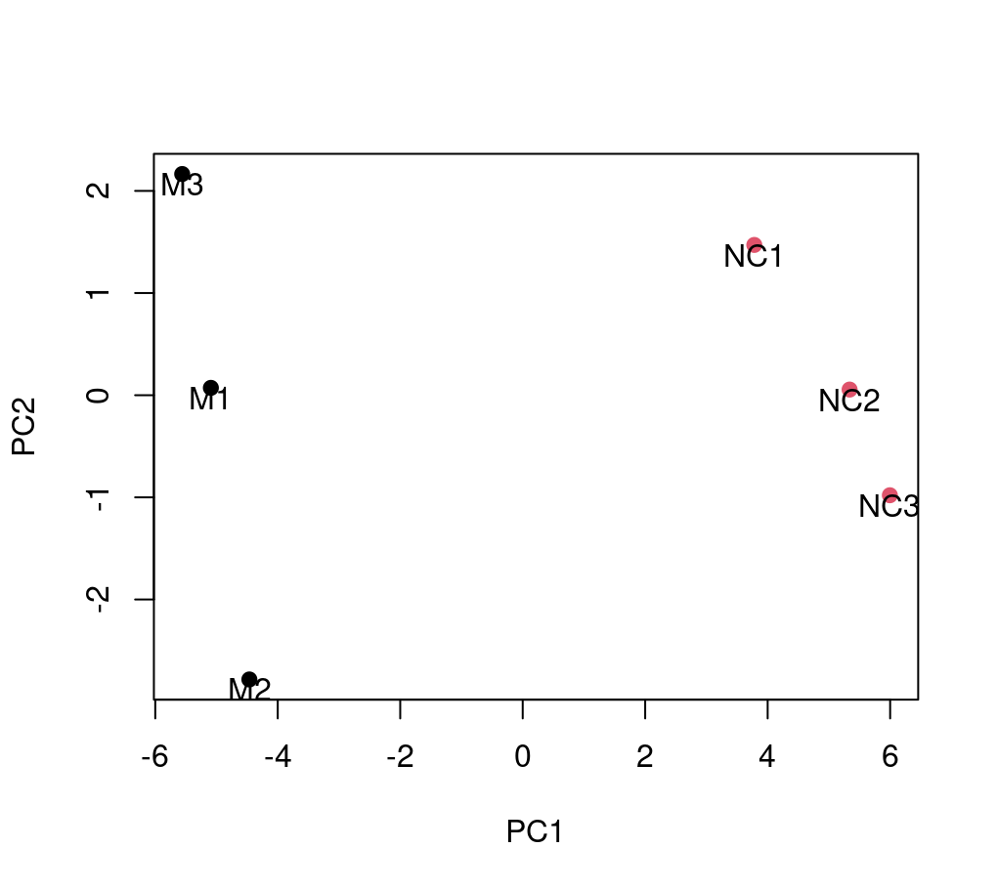
PCA: Visualising results of “prcomp”
2.Scatter plot

Slide 32
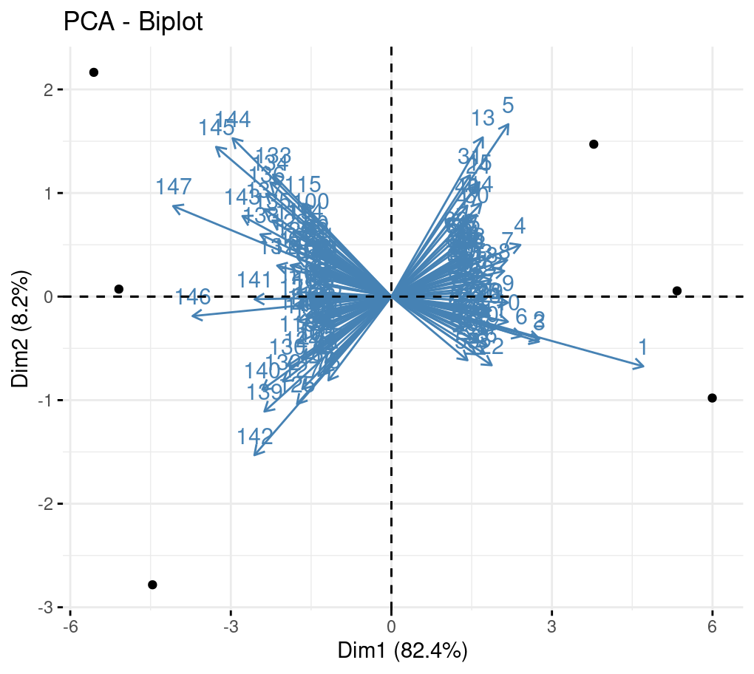
PCA: Visualising results of “prcomp”
3.Biplot
PCA biplot = PCA score plot + loading plot
When two vectors are close, forming a small angle, the two variables they represent are positively correlated.
If they meet each other at 90°, they are not likely to be correlated
When they diverge and form a large angle (close to 180°), they are negatively correlated.

Slide 33
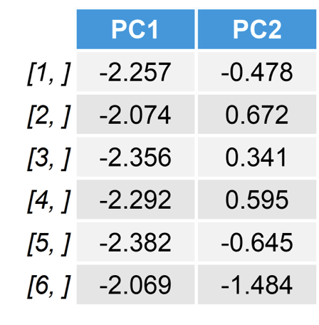
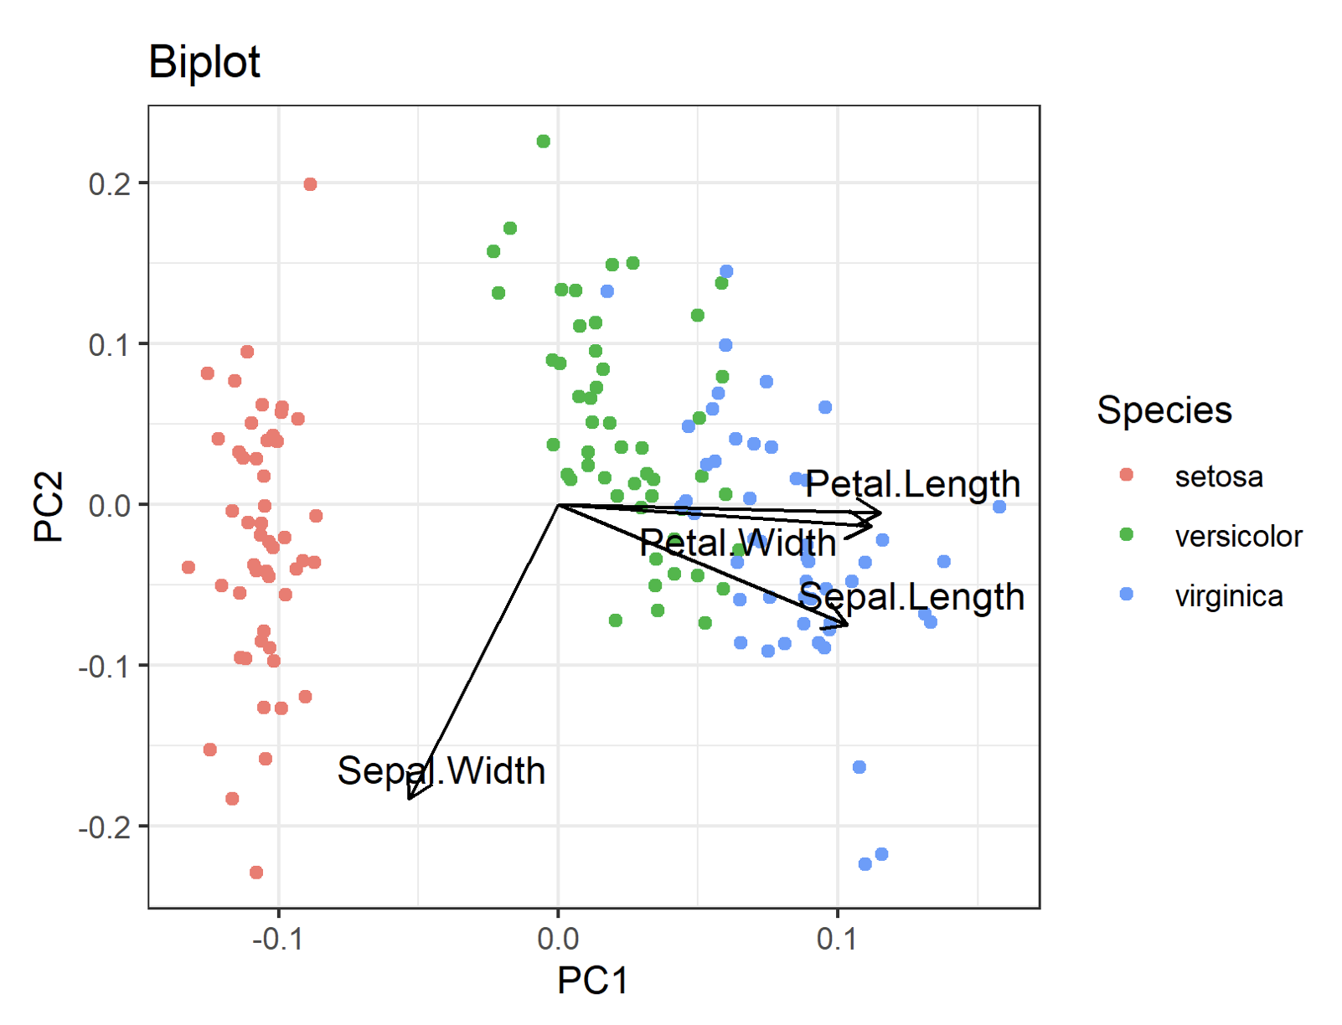
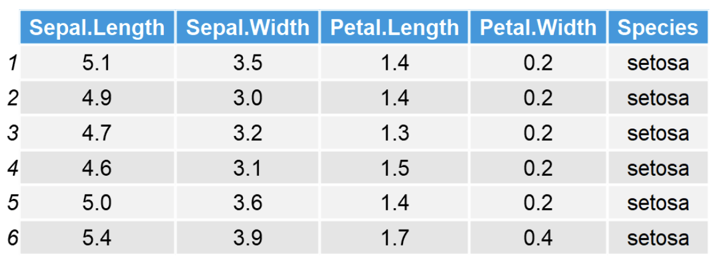
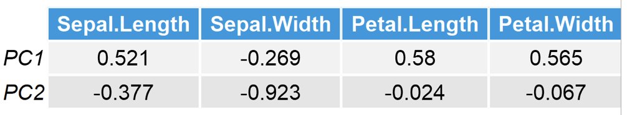
PCA: Visualization summary
Score plot: clusters of samples based on their similarity
Score matrix (x)
PCA biplot = PCA score plot + Loading plot
Score plot
Original Data
First 6 rows of the PC scores for each sample
Loading matrix (rotation)
Loading plot
Loading plot: shows how strongly each variable influences a principal component
weights that show the association between the original variables and principal components
https://statisticsglobe.com/biplot-pca-explained

Slide 34
tSNE: R package “tsne”
Stands for “t-Stochastic Neighbor Embedding”
For data that cannot be separated by any straight line
Finds few variables that represent many variables preserving neighborhood distances
Great for visualizations (scRNA-seq)
Stochastic = random (set seed to make reproducible)
Difference from PCA
focus on local signal (neighborhood) vs global signal (explaining maximum variance)
t-SNE paper: http://www.jmlr.org/papers/volume9/vandermaaten08a/vandermaaten08a.pdf

Slide 35
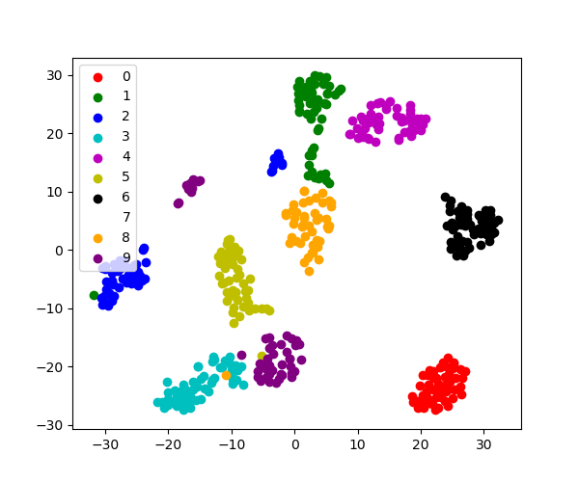
tSNE: R package “tsne”
tSNE finds axes that maintain “neighborhoods”

Slide 36
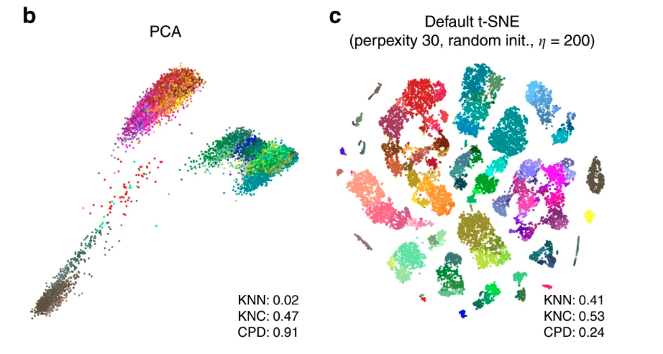
tSNE example
Tasic et al. data set. Sample size 𝑛=23,822.

Slide 37
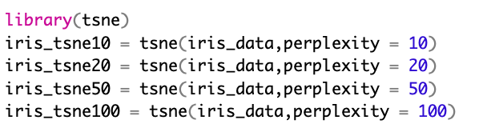
tSNE: R package “tsne”
Perplexity parameter determines how to balance attention to neighborhood vs global structure (smaller=more focus on the neighborhood)

Slide 38
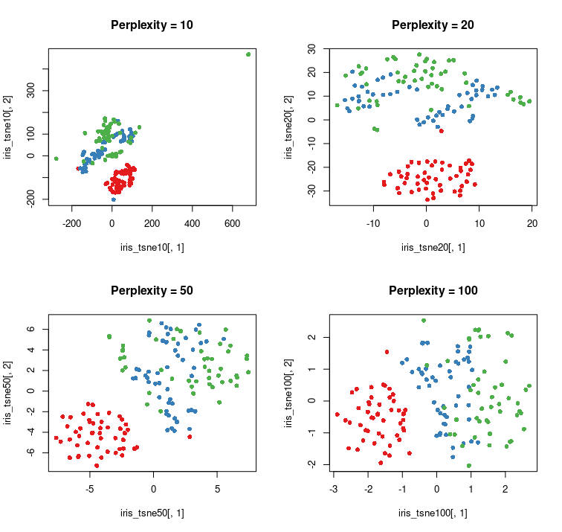
Plot your tsne’s
Note that higher perplexity leads to higher spread in your data

Slide 39
UMAP: R package “umap”
Stands for “Uniform Manifold Approximation and Projection”
Similar neighborhood approach as t-SNE
UMAP paper: https://arxiv.org/abs/1802.03426

Slide 40
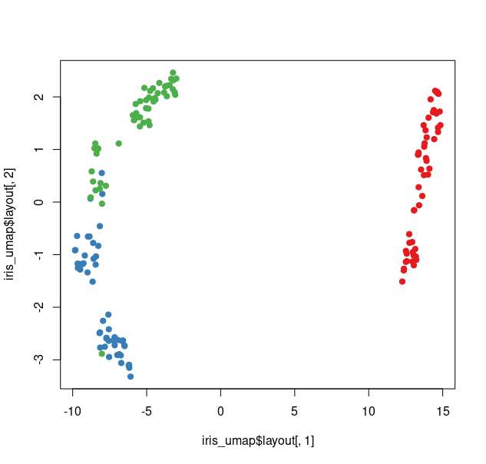

UMAP: R package “umap”
Run umap

Slide 41
PCA vs tSNE vs UMAP
PCA | tSNE | UMAP
Linear combination | Non-linear | Non-linear
Lower dimensions are called Principal components | Embeddings | Embeddings
Data is projected onto lower-dimensional space
Visualization, Covariates for statistical modeling | Visualization | Visualization
Concerned with preserving largest distances, to maximize variance of each PC. | Concerned with preserving nearest-neighbour distances Tuned with “perplexity” parameter Iterative method Stochastic method → different embedding in each run | Preserves global structures better than tSNE Non-deterministic

Slide 42
Exercise
Return to your crabs data
Compute the principle components (PCs) for the numeric columns
Plot these PCs and color them by species (“sp”) and sex
Now compute 2 t-SNE components for these data and color by species and sex
Finally compute 2 UMAP components for these data and color by species and sex
Do any of these dimensionality reduction methods seem to segregate sex/species groups?

Slide 43




We are on a Coffee Break & Networking Session
Workshop Sponsors:

