Slide 1
Canadian Bioinformatics Workshops
www.bioinformatics.ca
bioinformaticsdotca.github.io

Slide 2


Slide 3



Generalized Linear Models
Shraddha Pai
Analysis Using R
June 28-29, 2023
Some material adapted from 2021 lecture by Lauren Erdman

Slide 4
Learning Objectives
By the end of this lecture, you will:
Learn to read tables into R and merge tables
Create a variety of publication-quality plots using ggplot() and use them to explore data
Learn how to fit a binary response variable using glm()

Slide 5
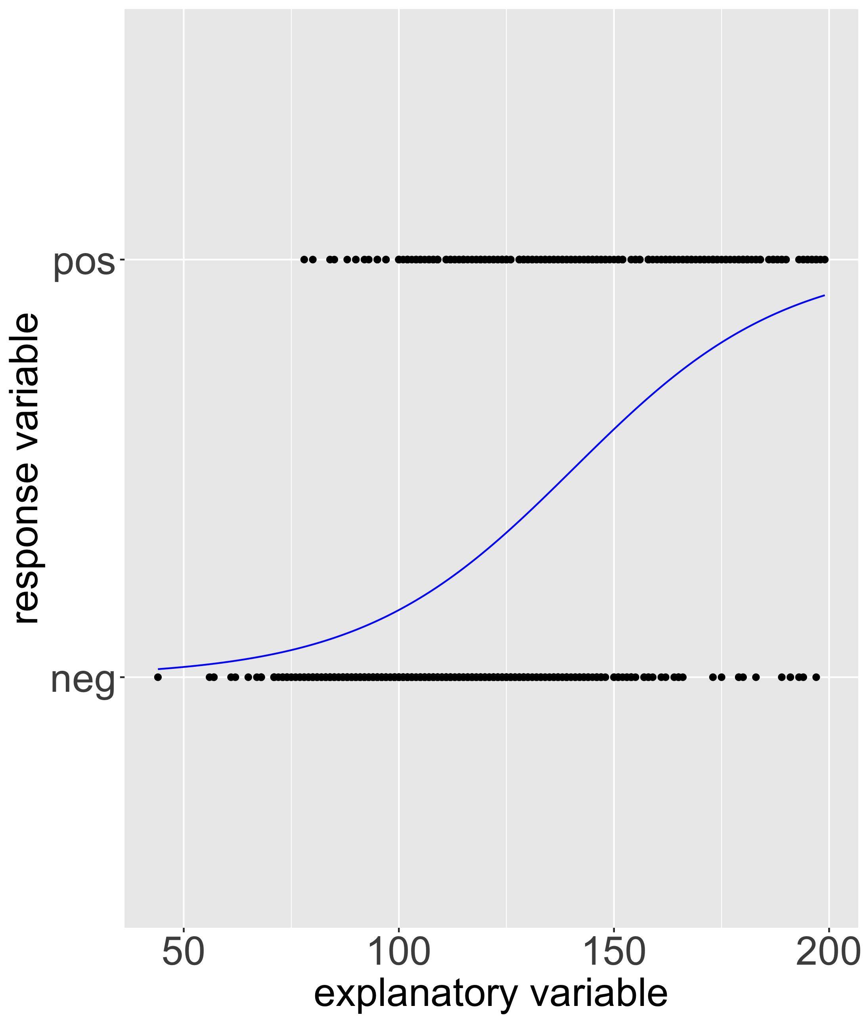
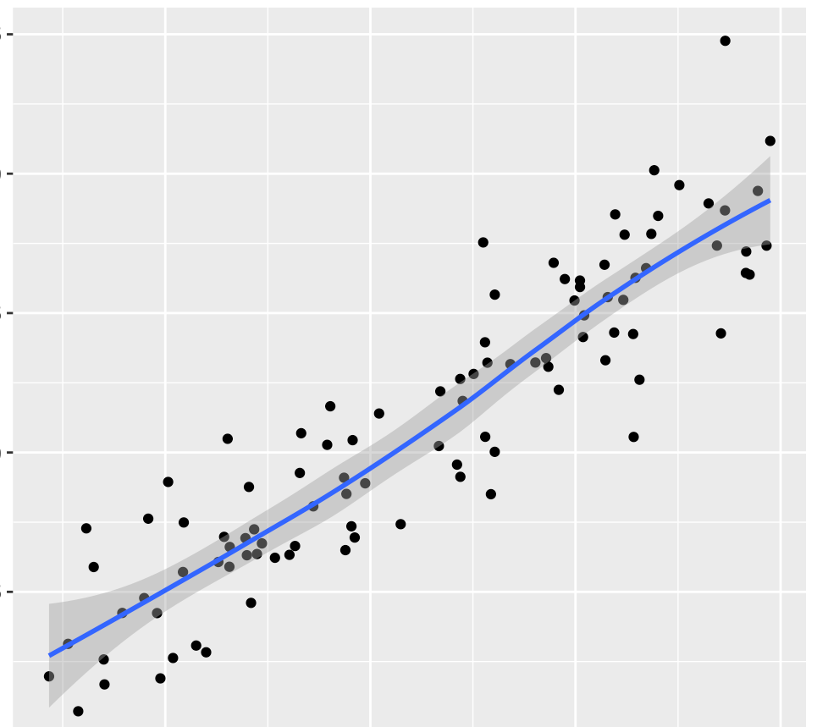
Generalized linear models (GLM) for binary response & count data
Binary y, continuous-valued x: logistic regression
Continuous-valued x & y:
linear regression
RNA-seq count data:
fit negative binomial model
Important: Model selection must be data driven
lm(y ~ x, data = df)
glm(y ~ x, data = df, family = “binomial”)

Slide 6
Model fitting notation in R
lm(Income ~ PctLiteracy,
data = dat)
glm(diabetes ~ glucose + pregnancy,
data = dat,
family = “binomial”)

Slide 7
Follow along with the worked example for Module 3 …

Slide 8




We are on a Coffee Break & Networking Session
Workshop Sponsors:

