Slide 1
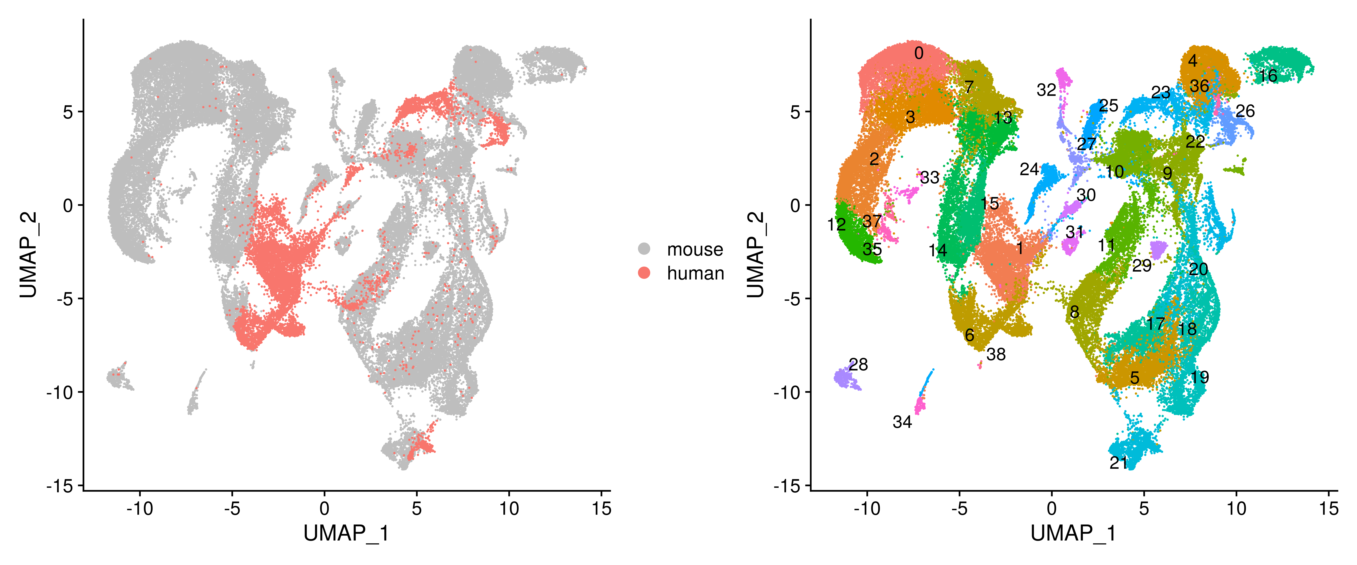
23-GCPs
6-UBCs
21-Purkinje cells

Slide 2
