Slide 1
CIHR Proposal 2022
for Shraddha Pai

Slide 2
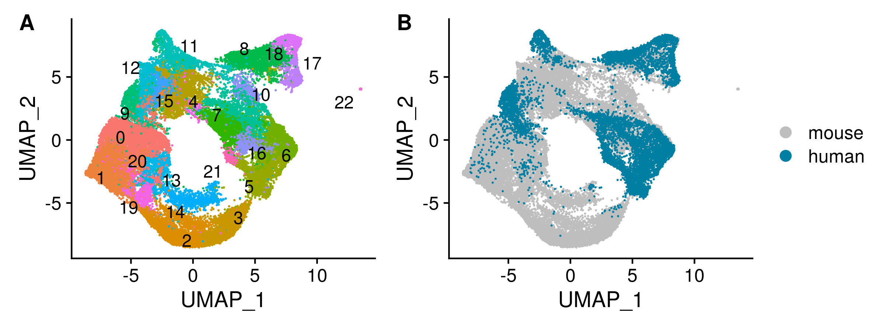
Notes:
(figure generated on 2022-08-08, see `figures` folder)
UMAP with cells highlighted by cluster (cell type) or by species

Slide 3
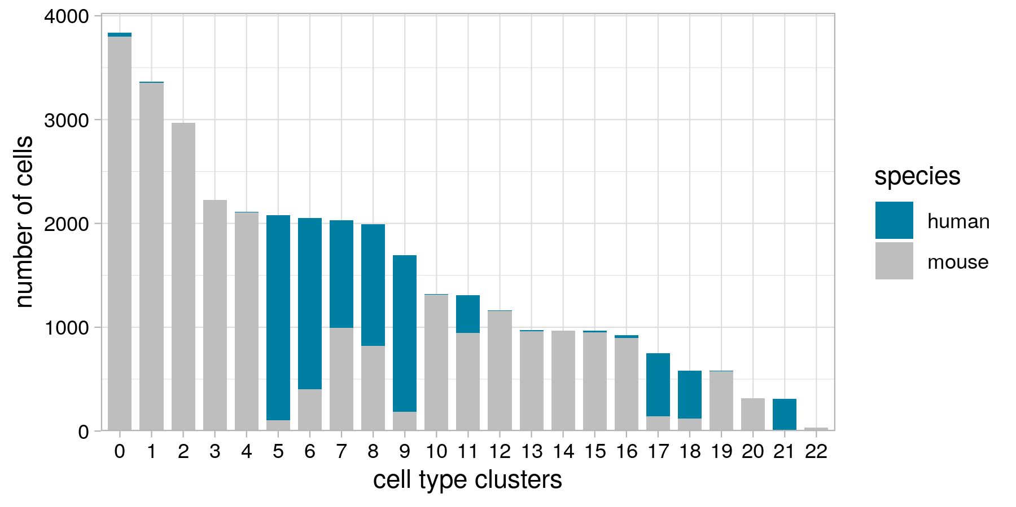
(UBC clusters are 8, 17, and 18)
Notes:
(figure generated on 2022-08-08, see `figures` folder)
Bar plot showing number of cells from each species in each of the cell type clusters.

Slide 4
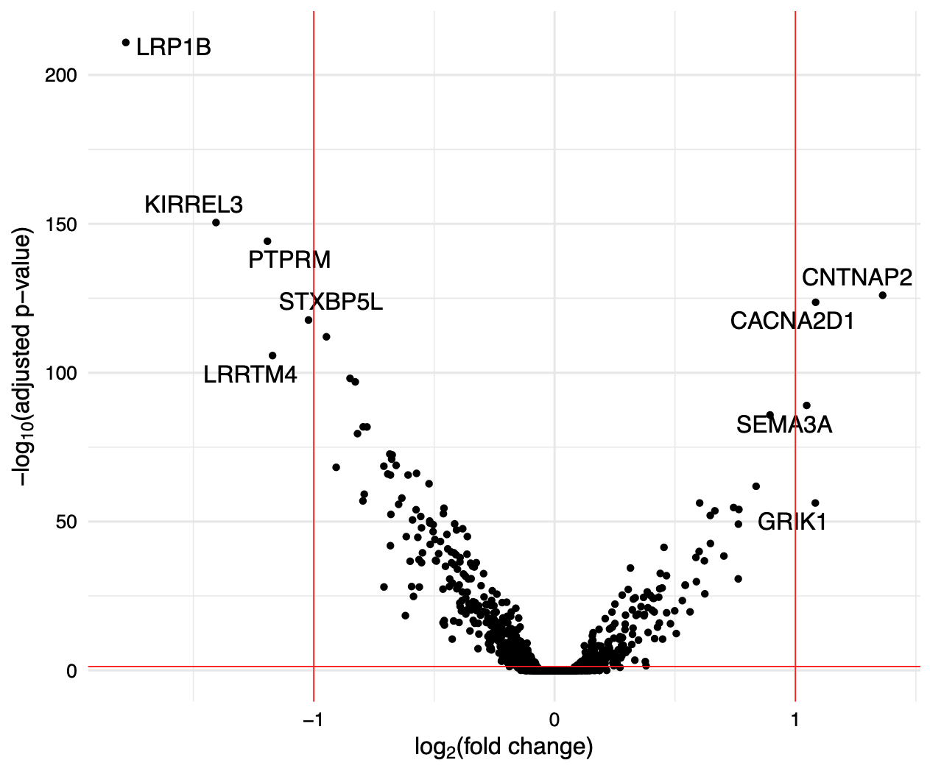
Higher expression in clusters 17 and 188 (human-specific)
Higher expression in cluster 8 (conserved between human and mice)
Notes:
(figure from results on 2022-07-15)
Volcano plot showing the top differentially expressed genes. The vertical red lines indicate a log fold change > -1 or < 1. The horizontal red line indicates an adjusted p-value of 0.05. The p-values shown here have been adjusted using the Bonferroni correction.

