Slide 1
SESSION-3
SAKSHI SINHA
16BCE1123

Slide 2
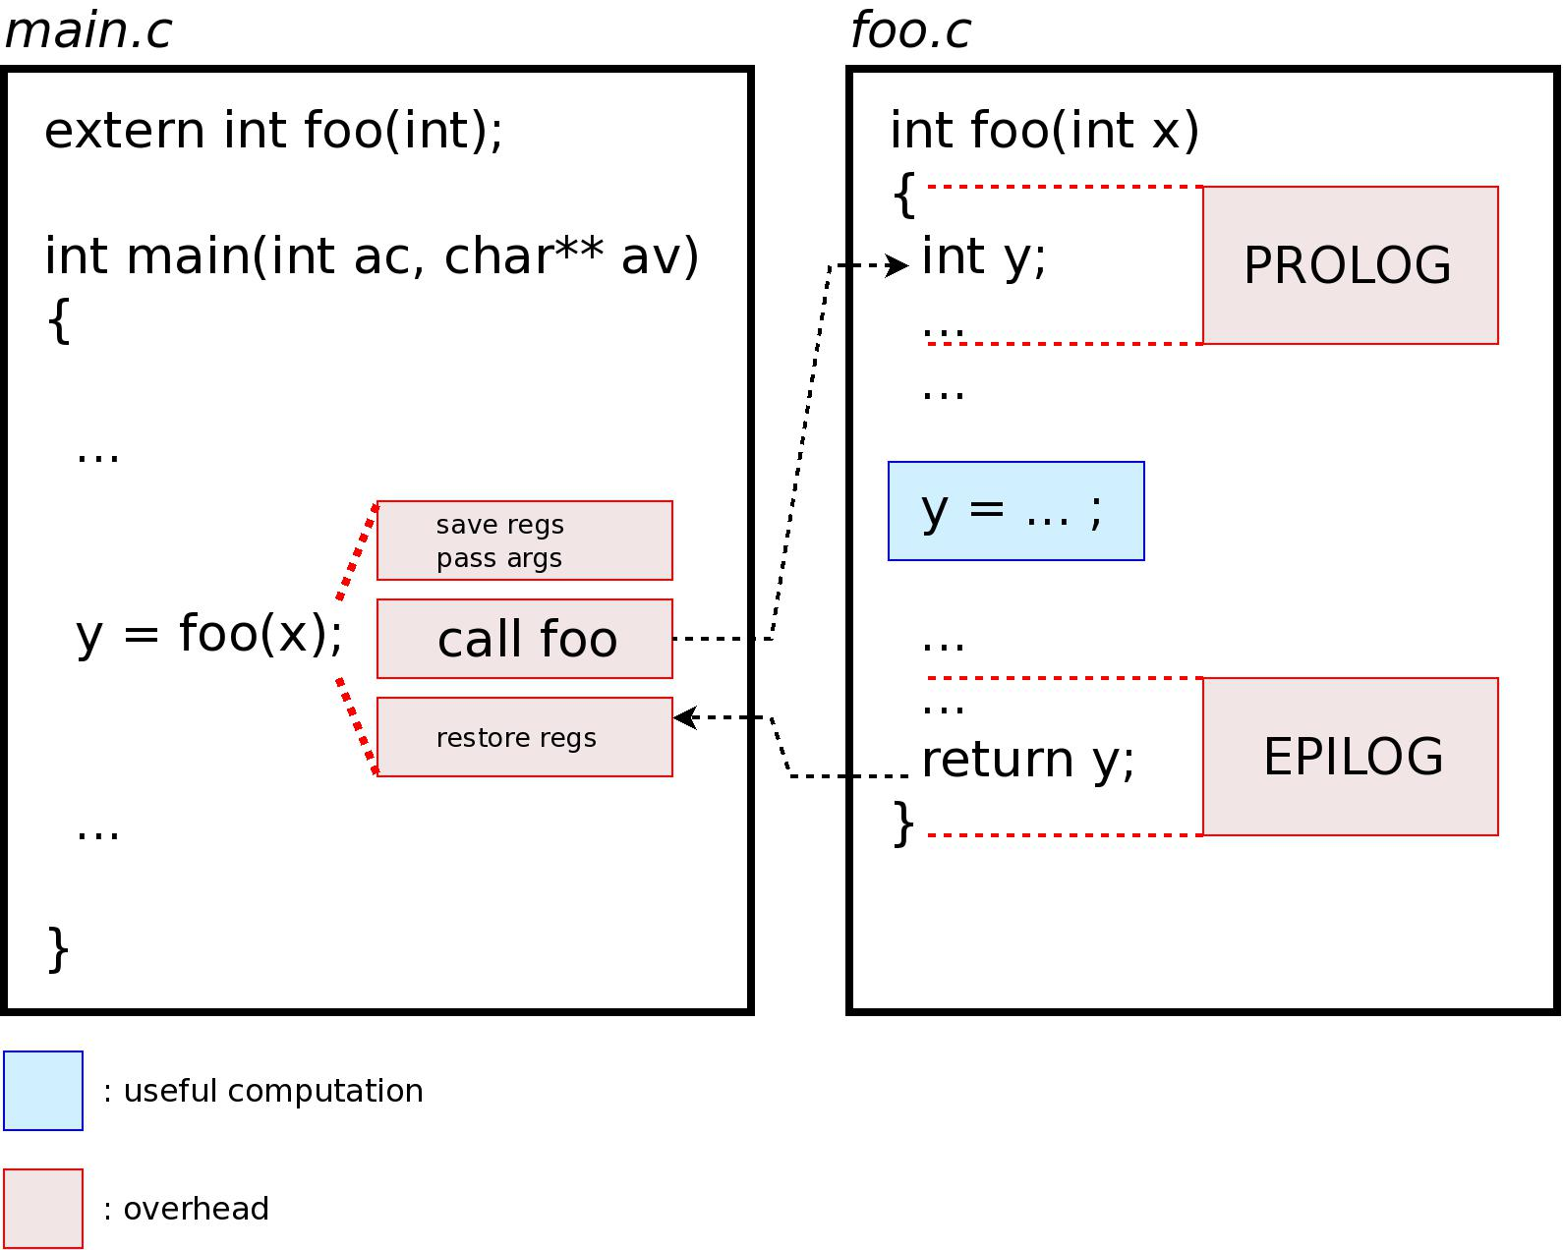
WHAT HAPPENS WHEN we make a function call?
CPU stores the memory address of the instruction following the function call
CPU copies the arguments of the function on the stack
CPU then executes the function code
CPU stores the function return value in a predefined memory location/register
returns control to the calling function

Slide 3

BUT WHAT ABOUT FUNCTIONS WITH LOW EXECUTION TIME?
This can become an overhead!
For functions that are large and/or perform complex tasks, the overhead of the function call is usually insignificant.
For small functions, the time needed to make the function call is a lot more than time needed to execute the function’s code.

Slide 4
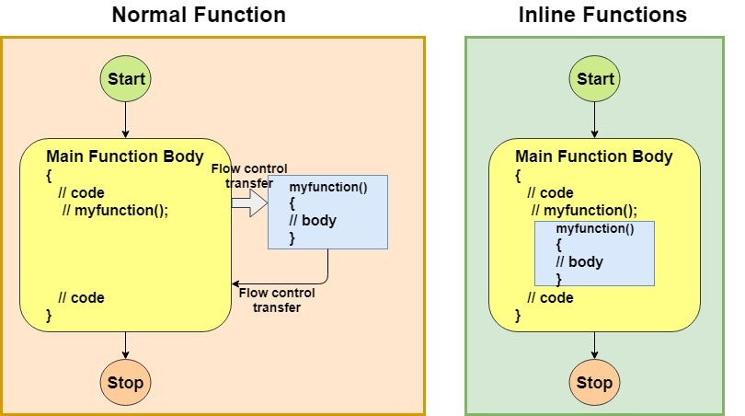
THUS THE INLINE FUNCTIONS!
Reduce the function call overhead
Expanded in line when it is called
Whole code of the inline function gets inserted or substituted at the point of inline function call
Substitution is performed by the C++ compiler at compile time
May increase efficiency if it is small.

Slide 5

INLINE FUNCTIONS AREN’T THAT POWERFUL IT SEEMS :(
Inlining is only a request to the compiler, not a command
Compiler may not perform inlining in such circumstances like:
If a function contains a loop. (for, while, do-while)
If a function contains static variables.
If a function is recursive.
If a function return type is other than void, and the return statement doesn’t exist in function body.
If a function contains switch or goto statement.

Slide 6
Functions with a twist?
#include<iostream>
using namespace std;
// A function with default arguments, it can be called with
// 2 arguments or 3 arguments or 4 arguments.
int sum(int x, int y, int z=0, int w=0)
{
return (x + y + z + w);
}
/* Driver program to test above function*/
int main()
{
cout << sum(10, 15) << endl;
cout << sum(10, 15, 25) << endl;
cout << sum(10, 15, 25, 30) << endl;
return 0;
}
DEFAULT PARAMETERS
Automatically assigned by the compiler if the caller of the function doesn’t provide a value for the argument with a default value.

Slide 7
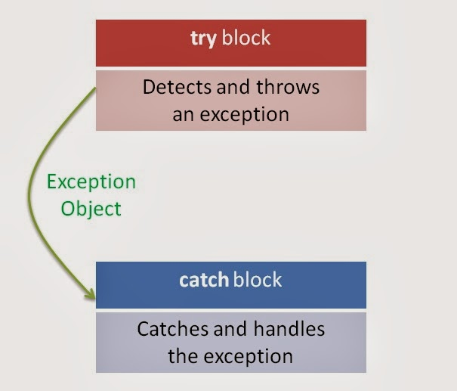
EXCEPTIONS...
try: represents a block of code that can throw an exception.
catch: represents a block of code that is executed when a particular exception is thrown.
throw: Used to throw an exception.

Slide 8
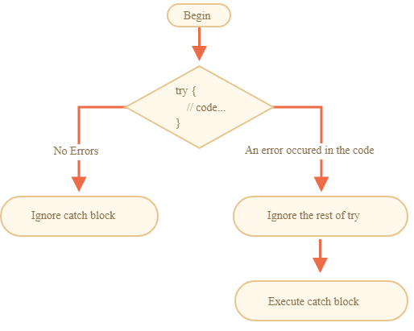
PROGRAM FLOW EXECUTION DURING TRY-CATCH
You cannot have multiple try and multiple/one catch
You can have multiple catch for any exception that occurs in the try block
The code in the try block after once something is thrown/error occurs is never executed

Slide 9
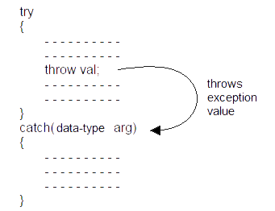
A GENERAL TRY CATCH SCENARIO
A special catch block that can catch all sorts of errors:
catch (...) {
cout << "Default Exception\n";
}

Slide 10

RECURSION-AN EXAMPLE!
You are sitting on the last bench in your class
You want to know the rows ahead of you but you are lazy!
You ask the person ahead of you to count it for you
He does the same XD
The train reaches the person on the first bench.
He says it’s 1
The train continues back now with each person adding 1 to the value they receive.
Notes:
I want you all to type recursion on the Google search bar and tell me !

Slide 11

THE THREE LAWS OF RECURSION
A recursive algorithm must have a base case.(To avoid cycles)
A recursive algorithm must change its state and move toward the base case.
A recursive algorithm must call itself, recursively

Slide 12
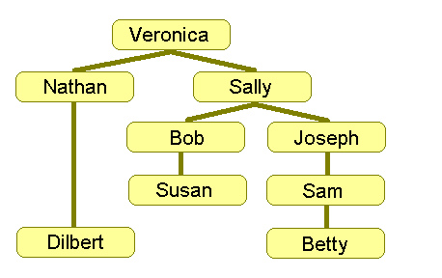
countEmployees(employeeName)
{
counter = 0
for each person in Database
{
if(person.manager == employeeName)
{
counter = counter + 1
counter = counter +
countEmployees(person.name)
//Call to itself
}
}
return counter
}

Slide 13





JUST KEEP CODING :) SUGGESTED RESOURCES:

