Slide 1
SESSION-2
SAKSHI SINHA
16BCE1123

Slide 2
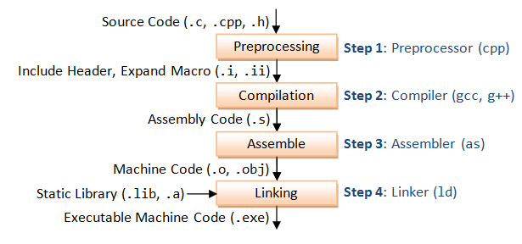
What are runtime and compile time?
Programming terms that refer to different stages of software program development
Compile-time is the instance where the code you entered is converted to executable
Run-time is the instance where the executable is running

Slide 3
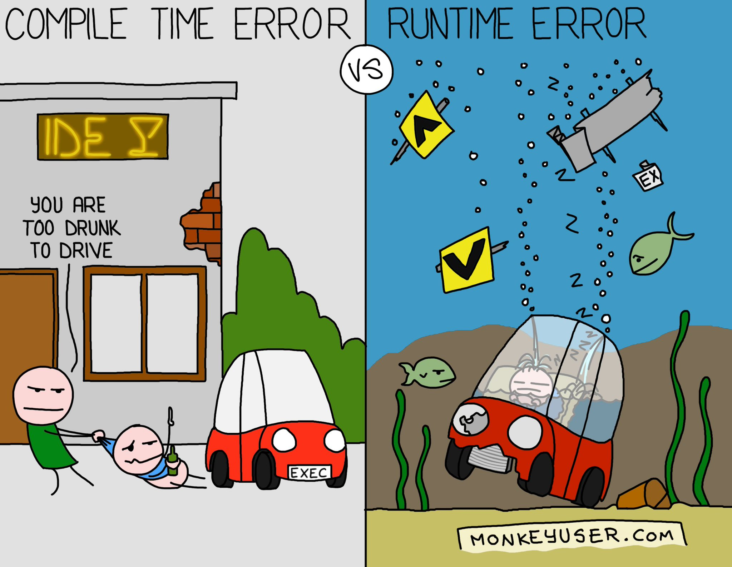
THUS THE TERMS RUNTIME AND COMPILE TIME ERRORS
Compile time errors can be:
Syntax errors
Type-checking errors
Compiler crashes (Rarely)
Runtime errors (Exceptions)
Make program to behave unexpectedly
May even kill your program. Ex-Division by zero.

Slide 4
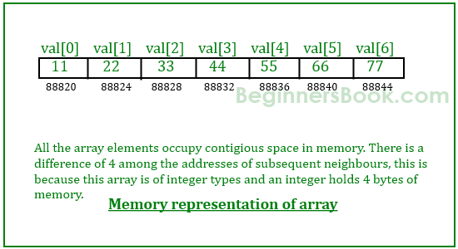
WHAT HAPPENS WHEN WE CREATE ARRAYS?
It can be seen that the length (size) of the array above made is 7 but what if there is a requirement to change this length (size)?
What if there are only 4 elements that need to be entered in the array?We are then just wasting the remaining 3 spaces.

Slide 5
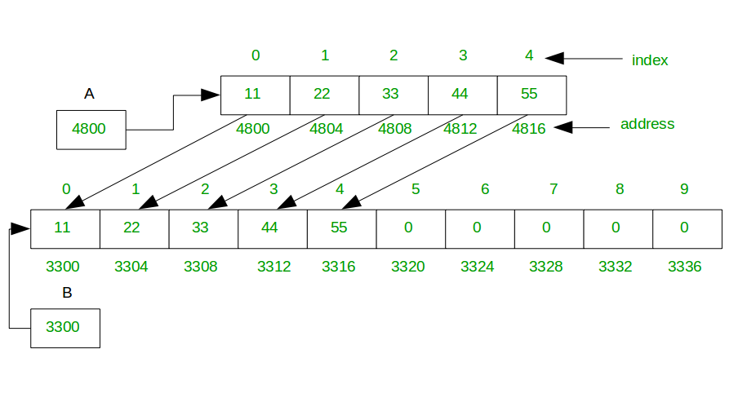
DYNAMIC MEMORY ALLOCATORS
Allocate memory during runtime of programme
Can thus change the size of the array.
C++ uses free() and delete() in addition to malloc() and calloc()

Slide 6
NEW AND DELETE
NEW
new operator initializes the memory and returns the address of the newly allocated and initialized memory to the pointer variable
int *p=new int(25);
For Blocks of Memory:int *p=new int[10];
If enough memory is not available new indicates failure by throwing an exception of type std::bad_alloc
DELETE
Releases memory pointed by pointer-variable
To free dynamically allocated
Notes:
https://stackoverflow.com/questions/13797926/what-does-new-int100-do

Slide 7
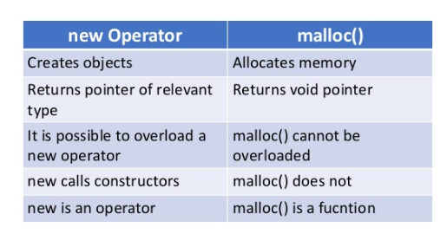
MALLOC VS NEW/DELETE VS FREE

Slide 8
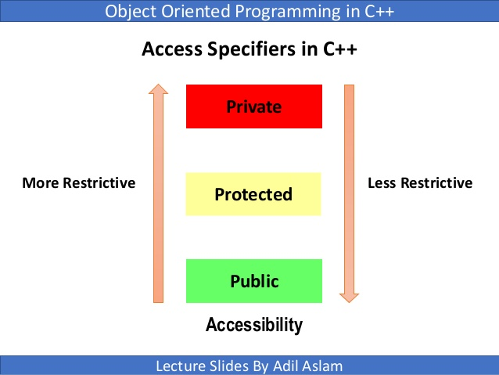
ACCESS SPECIFIERS
Three access specifiers
Public
Private
Protected

Slide 9
LET’S UNDERSTAND ACCESS SPECIFIERS
#include <iostream>
using namespace std;
class base
{
public:
int pubdat;
void pub_print()
{cout<<"A public print:"<<pubdat<<"\n";
pro_print();
pri_print();
}
protected:
int prodat;
void pro_print()
{cout<<"A protected print:"<<prodat<<"\n";}
private:
int pridat;
void pri_print()
{
cout<<"A private print:"<<pridat<<"\n";
}
};
int main()
{
base b;
cout<<b.pubdat<<endl;
b.pub_print();
//cout<<b.prodat<<endl;
///b.pro_print();
//cout<<b.pridat<<endl;
//b.pri_print();
}
Notes:
Tell them to uncomment various parts of the code and check

Slide 10
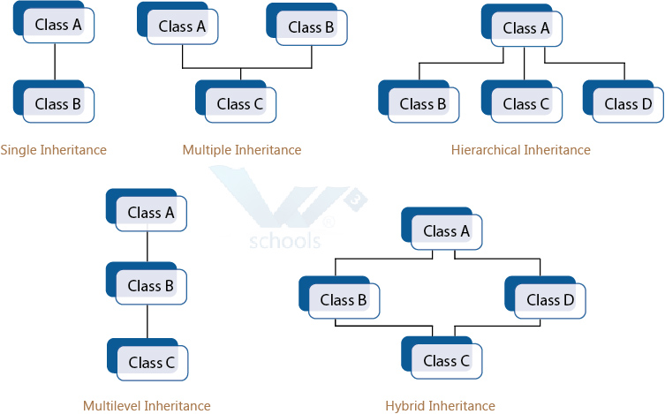
INHERITANCE
Capability of a class to derive features and characteristics of another class
Subclass:Inherits properties
Superclass:Class whose properties are inherited.

Slide 11
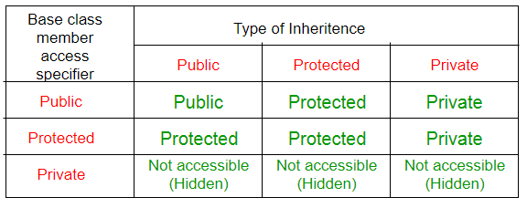
INHERITANCE AND ACCESS SPECIFIERS
Depending on the access specifier of the variable/function in the class and the type of inheritance there is variability in access of components of the class

Slide 12
#include <iostream>
using namespace std;
class base
{
public:
int pubdat;
void pub_print()
{cout<<"A public print:"<<pubdat<<"\n";
pro_print();
pri_print();
}
protected:
int prodat;
void pro_print()
{cout<<"A protected print:"<<prodat<<"\n";
}
private:
int pridat;
void pri_print()
{cout<<"A private print:"<<pridat<<"\n";
}
};
class dertwo:protected base
{
public:
void access()
{
cout<<"Protected derivations"<<endl;
pub_print();
pro_print();
//pri_print();
}
};
class derthree:private base
{
public:
void access()
{
cout<<"Private derivations"<<endl;
pub_print();
pro_print();
//pri_print();
}
};
int main()
{
base b;
cout<<b.pubdat<<endl;
b.pub_print();
//cout<<b.prodat<<endl;
//b.pro_print();
//cout<<b.pridat<<endl;
//b.pri_print();
derone d;
d.access();
dertwo t;
t.access();
derthree th;
th.access();
}
Notes:
Uncomment various parts of the code and check for yourself

Slide 13
FRIENDSHIP IN C++(Where friends have access to your private members)
FRIEND CLASS
Used to access private and protected members of other class
Does not inherit the class it is friend to
Considered an alternative to friend function
FRIEND FUNCTION
A non member function that can gain access of private and protected data members of a class
Friend functions are not inherited by child class
They cannot be declared as static
Notes:
A class

Slide 14
DIFFERENCE BETWEEN A NORMAL FUNCTION AND A FRIEND
#include<iostream>
using namespace std;
class Base
{
private:
int num;
public:
friend void input(Base obj);
void base_input(Base obj);
};
void input(Base obj)
{
cin>>obj.num;
cout<<"Friend function called"<<endl;
cout<<obj.num;
}
void Base::base_input(Base obj)
{
cin>>obj.num;
cout<<"Normal function called"<<endl;
cout<<obj.num;
}
int main()
{
Base ob1;
input(ob1);//Friend fn. call
Base ob2;
ob2.base_input(ob2);
//Normal function call
return 0;
}
Notes:
Extern and const:In a non-const global variable declaration, extern specifies that the variable or function is defined in another translation unit. The extern must be applied in all files except the one where the variable is defined.In a const variable declaration, it specifies that the variable has external linkage. The extern must be applied to all declarations in all files. (Global const variables have internal linkage by default.)

Slide 15
FRIEND CLASS
#include<iostream>
using namespace std;
class Base
{
private:
int a;
public:
A(){cin>>a;}
friend class Inherit;
};
class Inherit
{
private:
int b;
public:
void show(Base &x)
{
cout<<"Base variable a:"<<x.a;
}
};
int main()
{
Base a;
Inherit b;
b.show(a);
return 0;
}

Slide 16
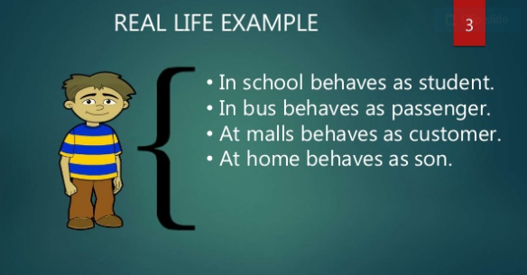
POLYMORPHISM
Polymorphism means having many forms
Ability of a message to be displayed in more than one form

Slide 17
Run time and compile TIME POLYMORPHISM
Compile time Polymorphism:
(Static Polymorphism)
Response to a function determined at compile time
The binding of functional call and choosing the correct function declaration is done by compiler at the compile time.
Achieved by Function Overloading and Operator Overloading
Runtime Polymorphism:
(Dynamic Polymorphism)
More flexible than runtime polymorphism
Achieved by function overriding
Slower execution than compile time polymorphism as not known at compile time

Slide 18
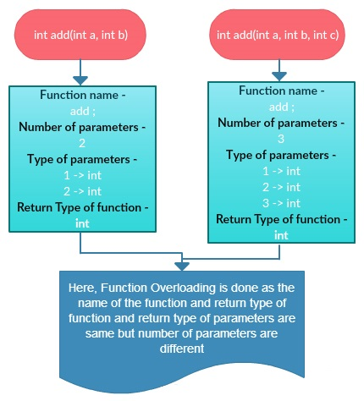
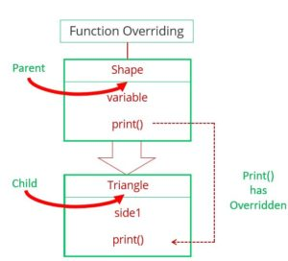
FUNCTION OVERLOADING AND OVERRIDING
Notes:
Functions that cannot be overloaded in C++:https://www.geeksforgeeks.org/function-overloading-in-c/

Slide 19
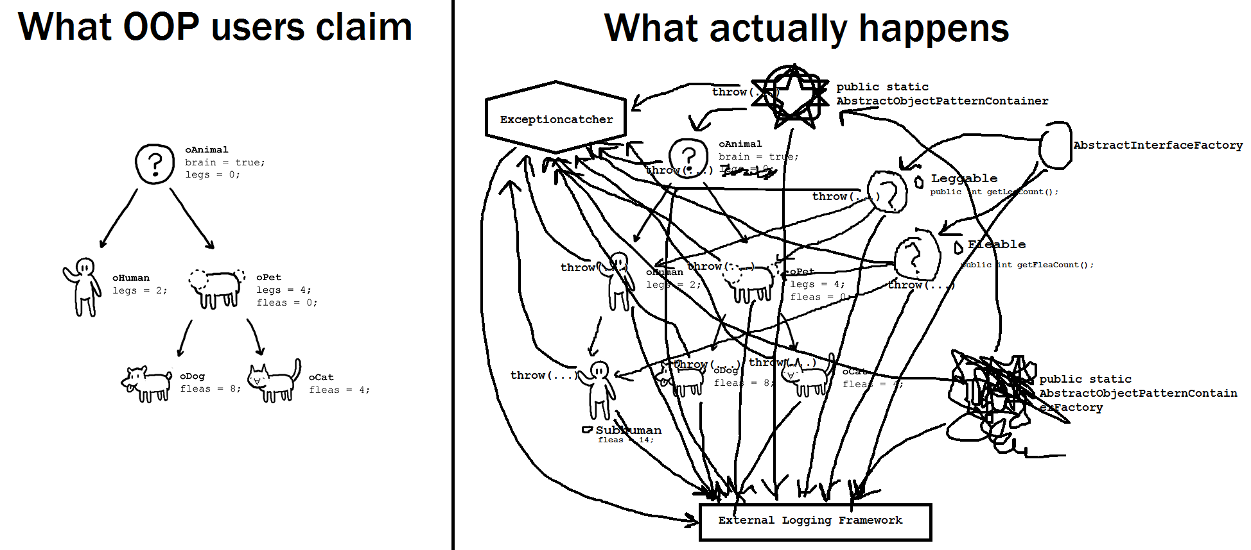
MORE ABOUT IT IN NEXT SESSION…
Notes:
A pure virtual function (or abstract function) in C++ is a virtual function for which we don’t have implementation, we only declare it. A pure virtual function is declared by assigning 0 in declaration. See the following example.

