Slide 1
Gyani
Smart & Simple

Slide 2
What is Gyani?
Gyani is your loan-sanctioning assistant which eases the tedious process of approving loans and primarily focuses on reducing the number of Non-Performing Assets and alleviating the pain of banks by means of Decision and Data Science.

Slide 3
Our Focus:
To make the whole process of loan approval hassle-free and easy- to both the consumer and the banker.
We aim to change the modus operandi of loan sanctioning, from the current method that takes hours of human interpretation to a much simpler technique which takes only few seconds of computational work.

Slide 4
Story Time
What Automation Can Do? (Our Vision)

Slide 5

The Consumer
Ramu kaka’s nephew says his fields need an upgrade if he wants to earn more. So kaka decides to apply for loan.
He thus fills up the form online to apply for loan.

Slide 6
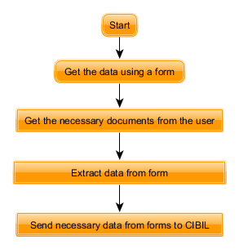
What Gyani does here?
The Customer-Gyani dynamics
Module-1
Focus:Getting the data from consumer.
1.The form that consumer fills would send the data to CIBIL which can help generate credit worthiness and give needed data.
2.The necessary list of documents are uploaded by user.It is ensured that the documents are duly uploaded.
Notes:
Future Improvisation: The available loan schemes can be suggested to the customer.

Slide 7
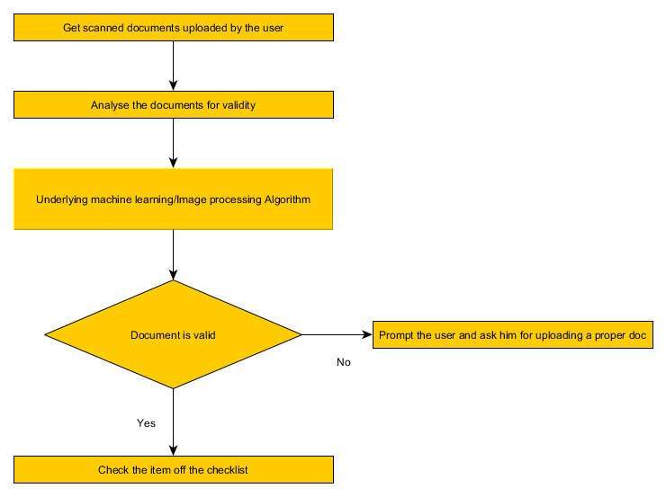
Gyani Magic
Module-2
Focus:Analysing the uploaded documents to check their validity
1.The documents uploaded by the user can be converted into an appropriate format and analysed for their validity and other discrepancies.
Notes:
Current focus: As of now, our focus would only be on scanned pdf documents which would be converted to text and analysed with Machine Learning Algorithms.

Slide 8
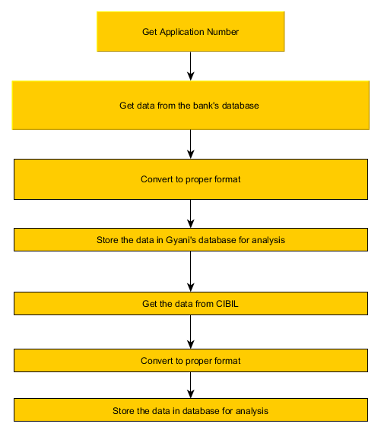
Gyani Magic
Module-3
Focus:Getting the data to Gyani’s reserves
1.The applicant number is fetched from bank’s database.
2.The other applicant data is fetched from the bank’s database.
3.The data is fetched from CIBIL.
4.Converting the data to needed format.
5.Storing the data for analysis.

Slide 9
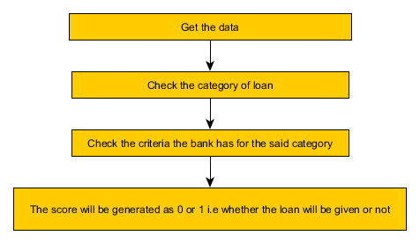
Gyani Magic
Module-4
Focus:Use of Decision Science to help the banks reduce NPA
1.Use the conditions the bank currently has for deciding whether the loan shall be given to the consumer or not.
Notes:
Module 4 is the one that needs the maximum amount of work, as each and every sector involves various calculations and provisions for loan sanctioning

Slide 10
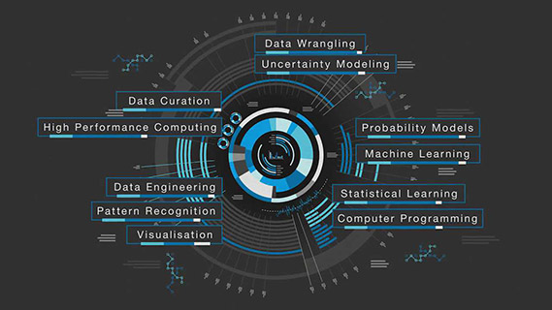
Gyani Magic
Module-5
Focus:Use of Data Science to help reduce NPA
1.Take the decision science result as data to train the data science module.
2. Identify more parameters.
3.Use various machine learning algorithms to help make the predictions more accurate.

Slide 11
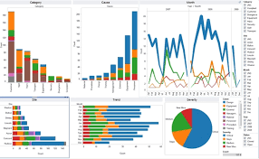
Gyani Magic
Module 6-Visualization
Various visualizations would be added to the dashboard to aid and make the whole process more convenient.

Slide 12
Future Plans
Extending the model to cater to loans for SMEs (Small Medium Enterprises) and other large-scale loans because they are the ones that require more work and hence, more automation.

Slide 13

Thank you!

