Slide 1
Data Analysis Final Assignment
Andreas Heindl
I Love Data Analysis

Slide 2
The Data
Solar Power Plant
Dataset from Kaggle
15-min time series over 2 months
~70k datapoints

Slide 3
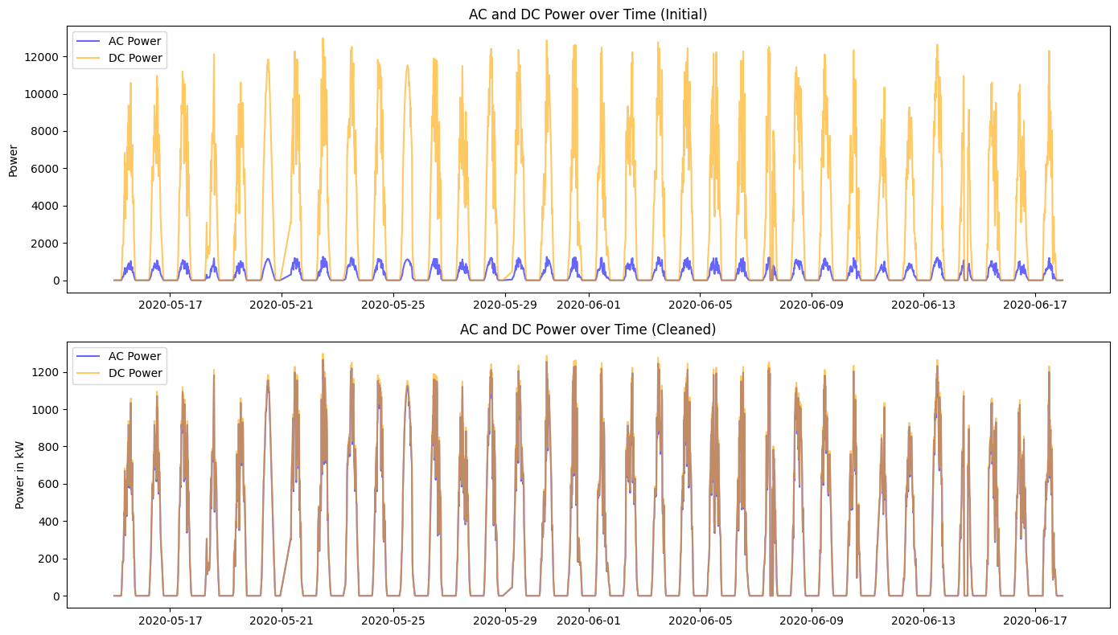
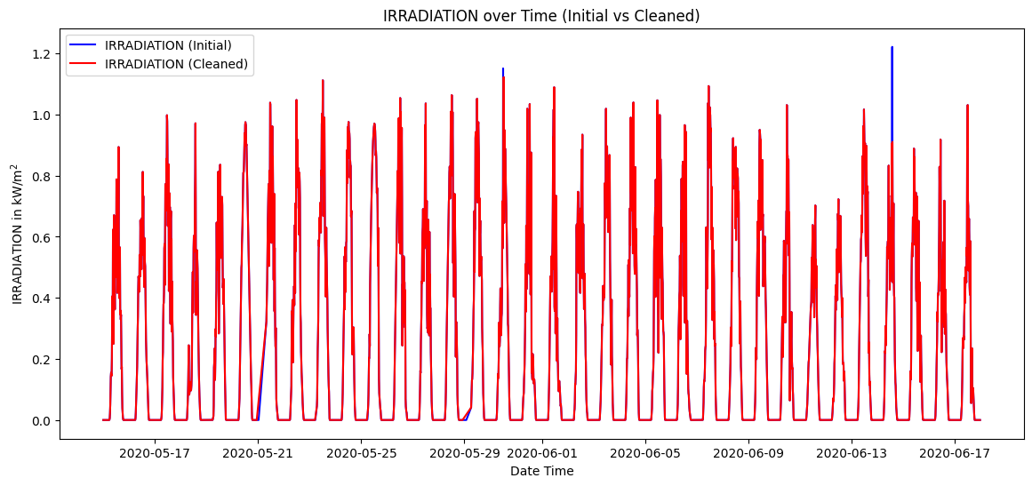
Data cleaning& Preprocessing
DC Power fix
Handling missing and outliers
2 different files merged:
Weather and Generation

Slide 4
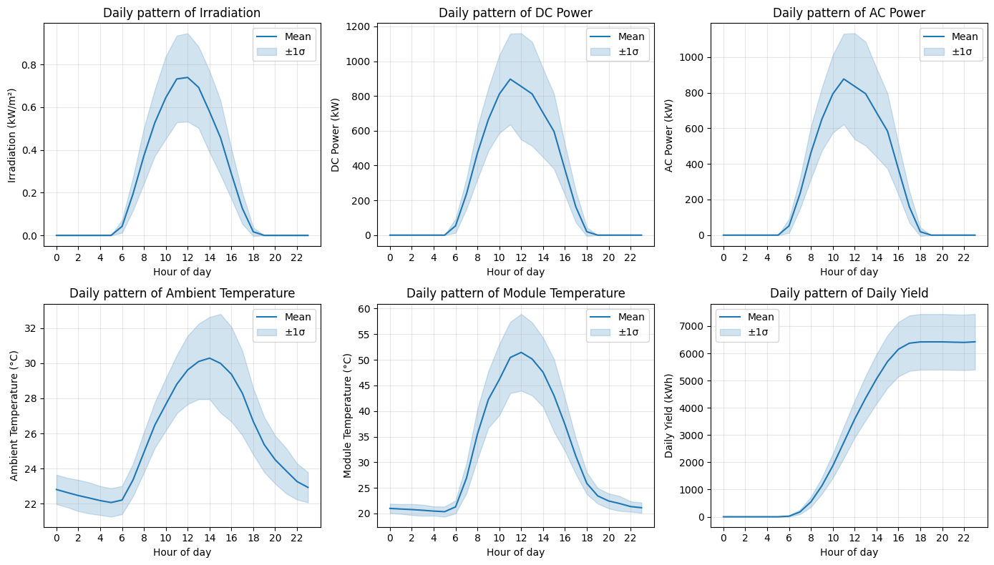
Day and Night cycle

Slide 5
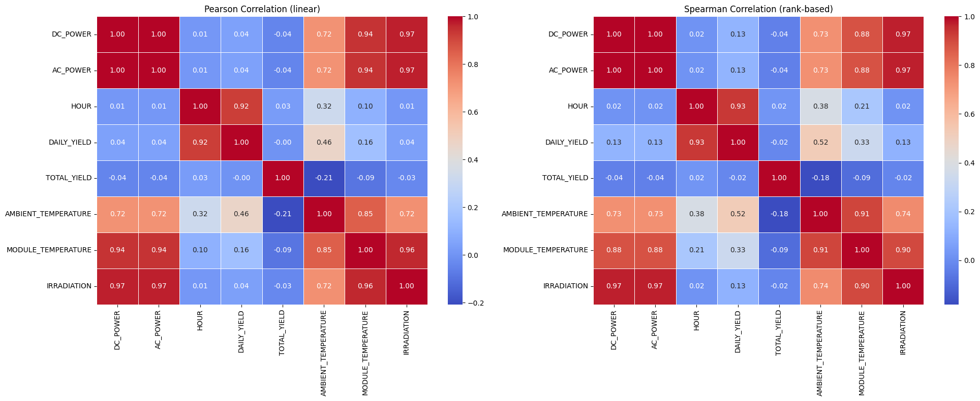
Correlation Analysis

Slide 6
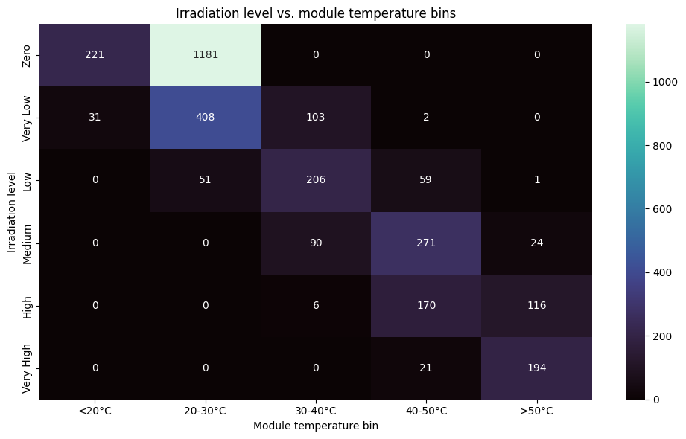
Cross Tab

Slide 7
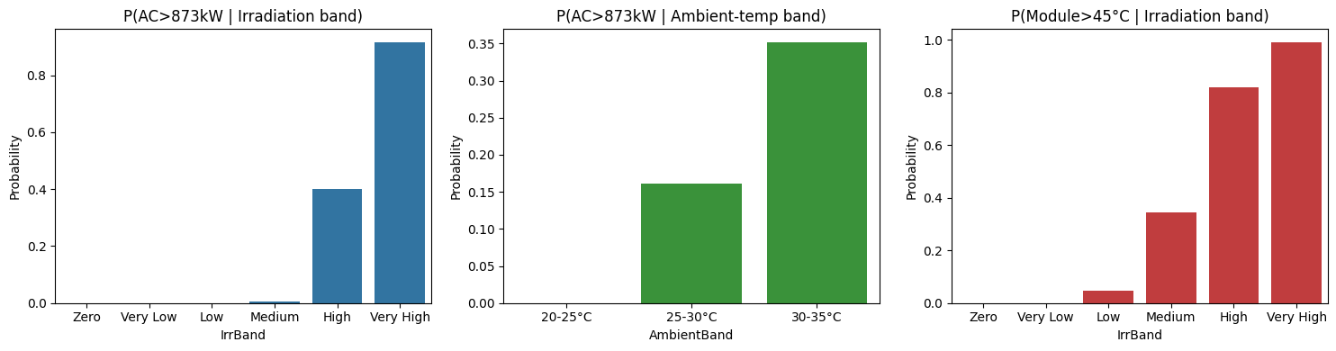
Conditional Probability

Slide 8
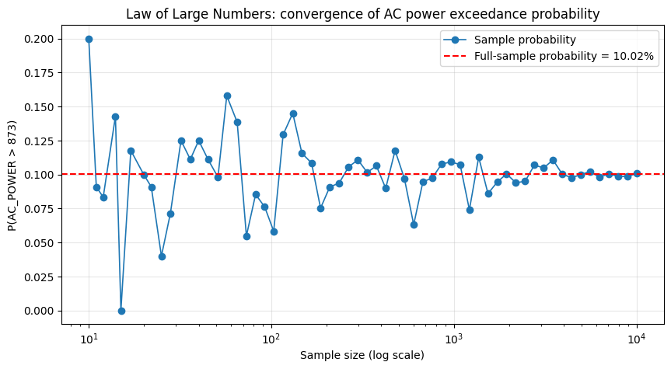
Law of Large Numbers

Slide 9
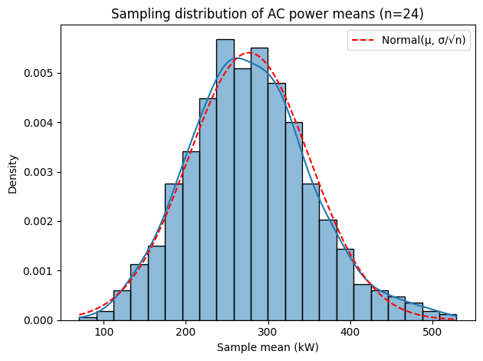
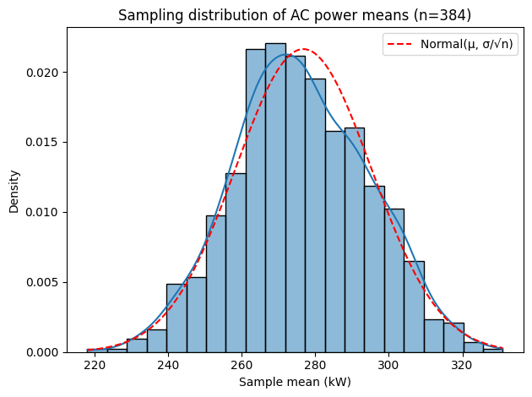
Central Limit Theorem

Slide 10
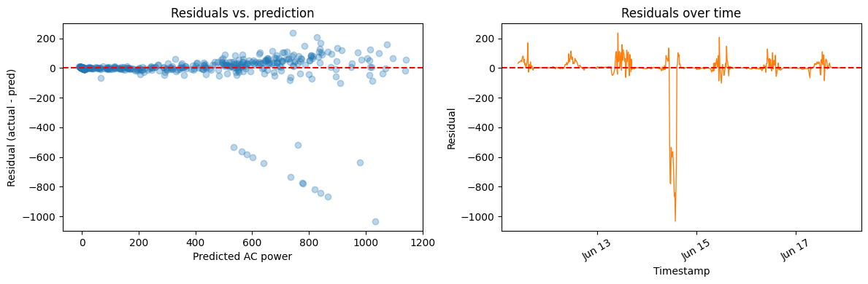
Regression and Predictive Modeling

Slide 11
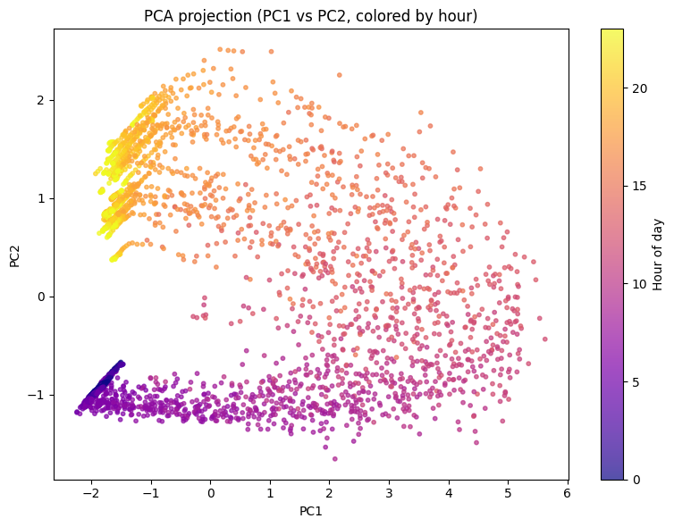
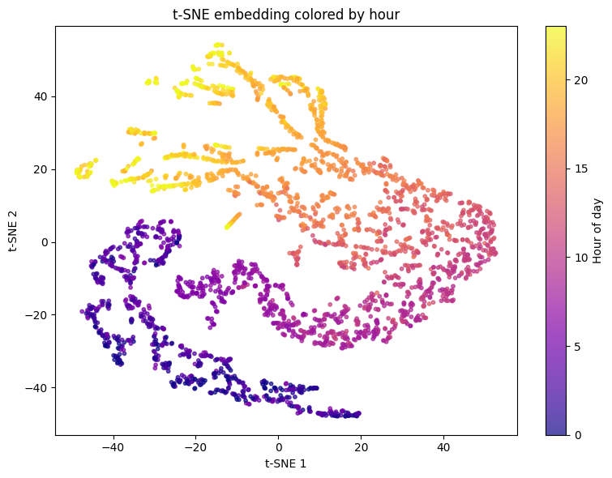
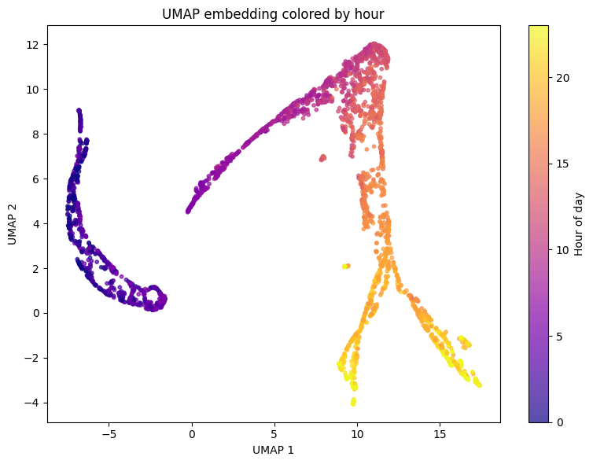
PCA, t-SNE, UMAP

