Slide 1
Multi Asset Factor Modeling & Alpha Attribution
Advisors: Dr Tao Pang, Mr Patrick Roberts
Group Leader: Chinna Gurram
Group Members: Ryan Landey, Melanie Sanchez, Shiqin Song, Derek Wu
April 10, 2026
Notes:
Melanie

Slide 2





The Team
Chinna Gurram
crgurram@ncsu.edu
Ryan Landey
rjlandey@ncsu.edu
Melanie Sanchez
mnsanche@ncsu.edu
Shiqin Song
ssong29@ncsu.edu
Derek Wu
dwu22@ncsu.edu
Notes:
Melanie

Slide 3
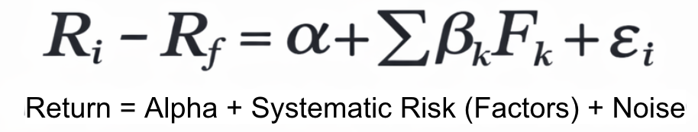
Big Picture
EQUITY FACTORS
BOND FACTORS
COMMODITY FACTORS
MULTI-ASSET FACTOR MODEL
PERFORMANCE ATTRIBUTION

Slide 4
Data Universe
Dimension | Specification
Data Frequency | Monthly
Sample Period | 2007–Present
Asset Classes | Equity, Fixed Income, Commodities
LHS Assets | AAPL, AGG, XOM
Number of Factors | 10 systematic factors
Factor Types | Equity, Rates, Credit, Volatility, Macro
Risk-Free Proxy | SHV (1–3M Treasury ETF)
Returns Used | Excess returns
Data Source | Yahoo Finance (Adjusted Close)
Notes:
Melanie
Monthly data reduces noise and aligns with macro regimes
ETF proxies ensure investability and transparency
Excess returns enable clean factor attribution
AAPL
High beta, growth-oriented, factor-sensitive
Broad investment-grade bond exposure
Equity proxy for commodity and oil exposure

Slide 5
Factor Overview
Factor | Proxy | Rationale
🟦 MKT_EQ | SPY | Captures broad equity market risk and systematic beta
🟦 SMB_EQ | IWM | Proxies size premium and cyclicality in equity markets
🟦 HML_EQ | VTV | Differentiates value versus growth exposure
🟦 MOM_EQ | PDP | Captures momentum effects and trend persistence
🟦 MKT_VOL | VIX | Controls for volatility and risk aversion regimes
Notes:
Chinna
Factor selection was driven by economic intuition across equity, fixed income, and macro regimes, and validated using correlation structure, stationarity, and multicollinearity diagnostics to avoid redundant or unstable exposures

Slide 6
Factor Overview
Factor | Proxy | Rationale
🟥 TERM_BND | TLT | Measures duration risk and term-structure sensitivity
🟥 CREDIT_BND | LQD | Captures corporate credit spread risk
🟥 LRF_BND | BND | Proxies bond market liquidity and broad rate exposure
🟩 COMM_BASKET | DBC | Represents inflation pressure and real-asset cycles
🟩 OIL_MACRO | USO | Captures oil price shocks and energy-driven macro risk
Notes:
Chinna

Slide 7
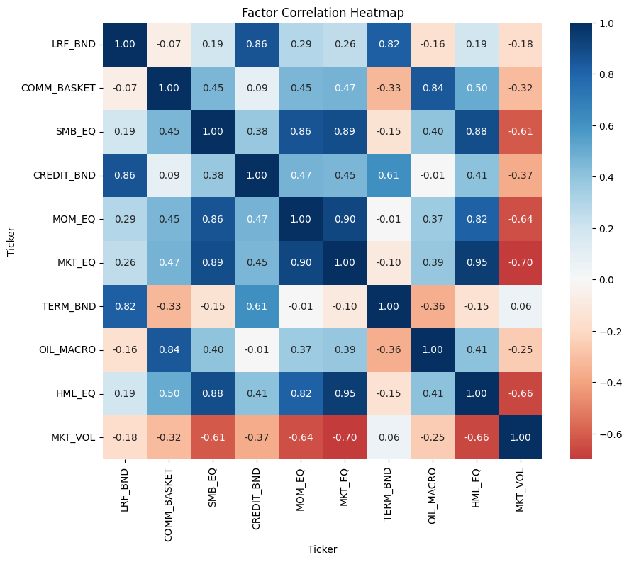
EDA
Equity factors are highly correlated.
Bond factors share exposure.
Volatility moves opposite equities.
Multicollinearity risk.
Notes:
Chinna

Slide 8
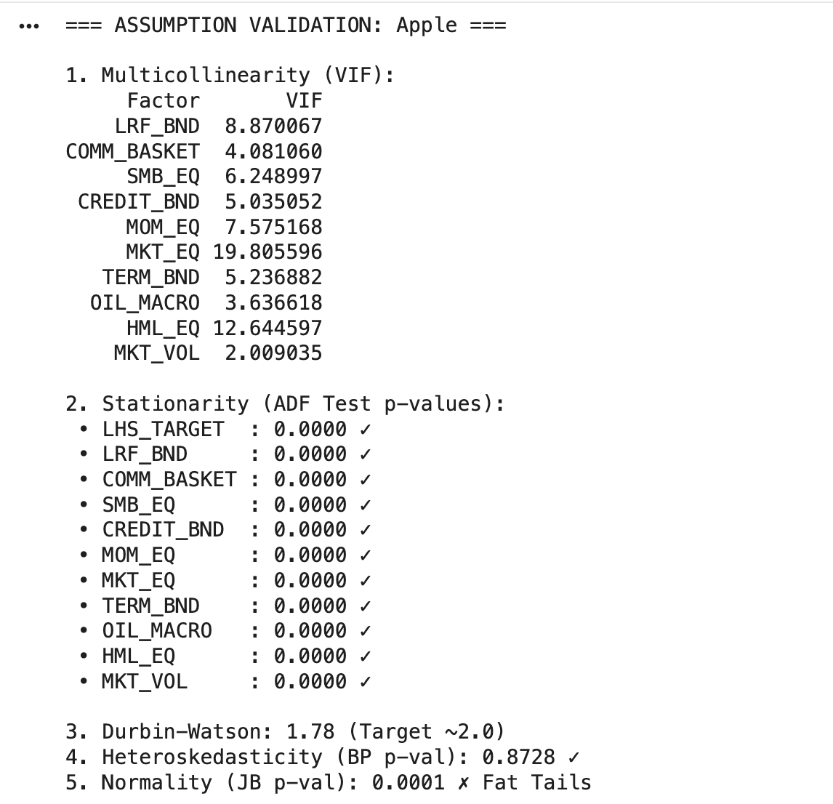
Assumption Validation
Variance Inflation Factor
ADF Test: all factors are stationary
Durbin–Watson: independent residuals
Breusch–Pagan: constant variance
Jarque–Bera
Notes:
Derek from Chinna
So we then did assumption validation to test the our hypothesis
Main takeaways from this is how our Market Equitys factor, and Value proxy HML have high multicolinearity, meaning theyre highly correlated with other factors in the model.
All your factors and the target variable (LHS_TARGET) are stationary
Residuals are reasonably independent, with constant variance
But they dont follow a normal distribution with fat tails

Slide 9
Model Overviews
Linear Regression
Ridge Regression
ElasticNet
Random Forest
XGBoost
Notes:
Derek
so we used a couple different models to determine best fit.
Linear regression was our baseline
Ridge shirks the coefficients to prevent overfitting and reduce complexity
ElasticNet combines the L1 L2 penaltys even further.
Then Random forest and XGboost. Building trees independantly reducing var vs sequentially for bias and var

Slide 10
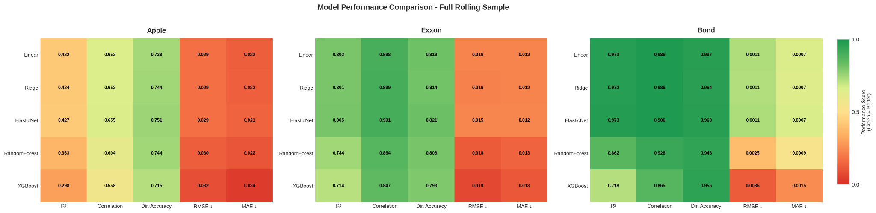
Model Fit
Notes:
Derek
So we were measuring Variance, Correlation, Hit rate, Magnitude of prediction errors
Equitys moderate fit and errors, good direction prediction
Commodities strong fit, low errors, very good direction
Bond Excellent fit, tiny errors, nearly perfect accuracy
Next Shiqin will explain our model backtesting

Slide 11
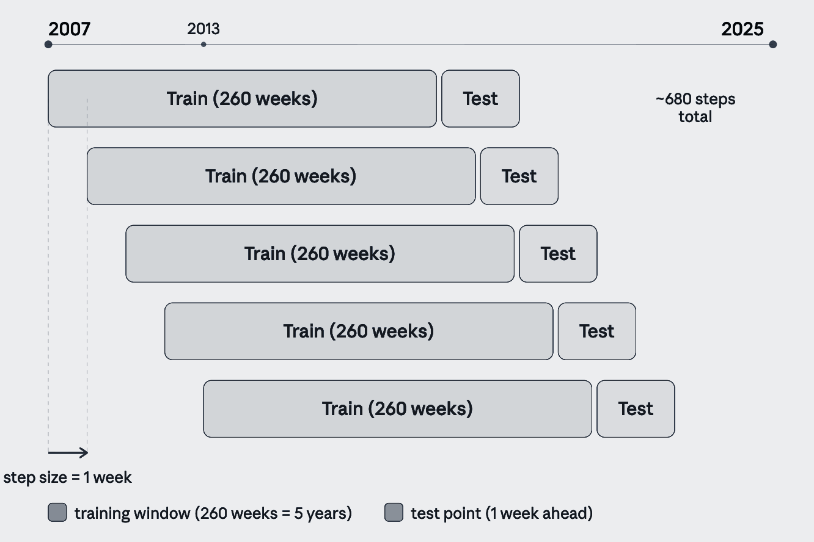
Model Backtesting
260-week training window
Predict 1 week ahead at each step, then slide forward
3 assets: Apple (AAPL), Bonds (AGG), Exxon (XOM)
No look ahead bias — winsorization, scaling, and CV all use training data only

Slide 12
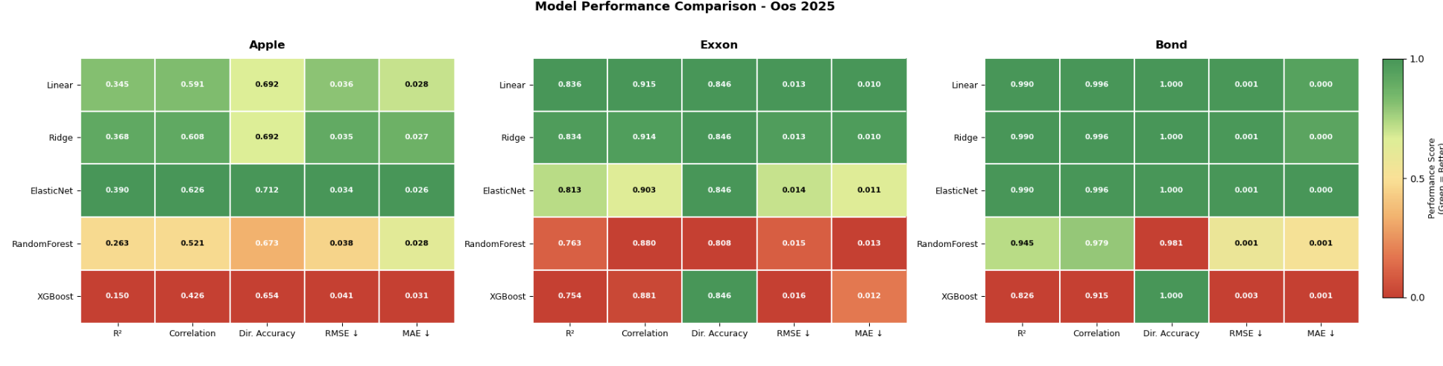
Backtesting Results

Slide 13
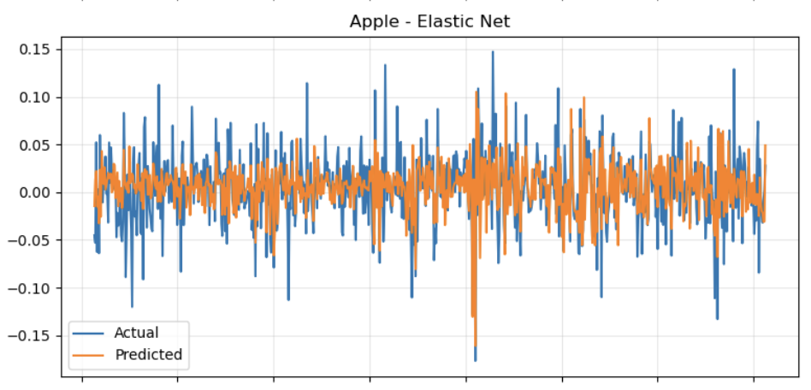
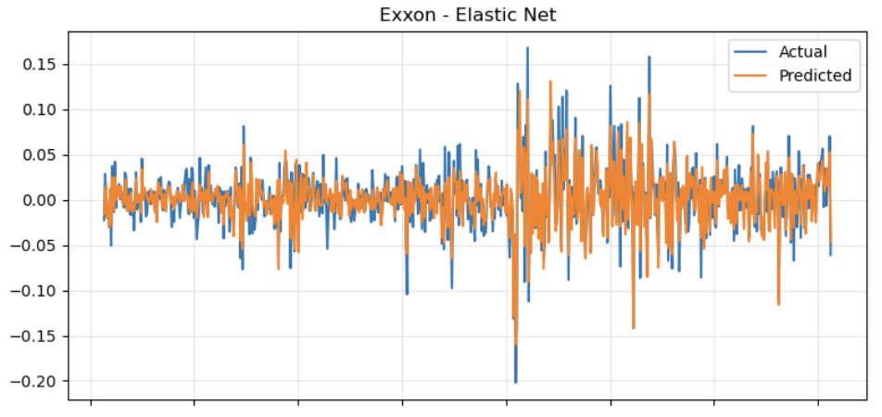
Rolling Backtest
Generates one-step-ahead predictions over time
Blue = Actual return | Orange = Predicted return
Predictions track direction but remain noisy
Indicates limited but present predictive signal

Slide 14
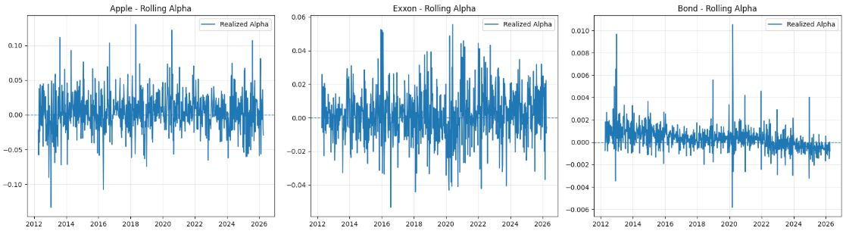
Alpha Attribution
Apple: Persistent positive alpha
Exxon: Regime dependent alpha
Bond: Declining, negative alpha post 2022
Notes:
Apple: Persistent positive alpha → model misses key growth and tech specific drivers .
Exxon: Regime dependent alpha → model partially captures energy dynamics but fails in stress and upcycles .
Bond: Declining, negative alpha post 2022 → model breaks under the rate tightening regime.

Slide 15
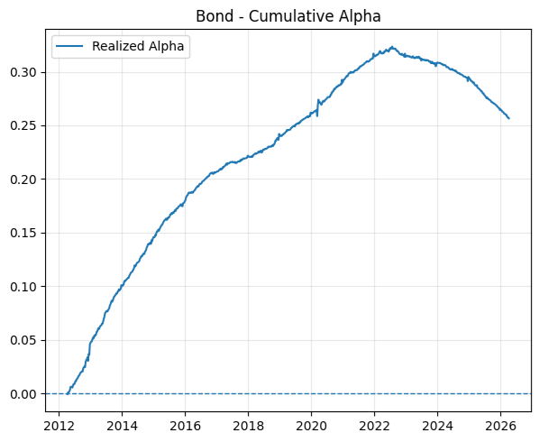
Alpha Attribution
Cumulative Alpha
Performance deteriorates post-2022 regime
Returns erode after initial accumulation
Indicates regime sensitivity and instability

Slide 16
Next Steps
Expand factor set: Add missing cross-asset drivers (rates, term structure, volatility, commodities, growth/tech proxies)
Regime detection (TDA): Use topological features to identify market regimes and condition the model dynamically
Time-varying betas: Replace static coefficients with rolling/Kalman estimation to capture changing exposures

Slide 17
Thank you!
Chinna Gurram
crgurram@ncsu.edu
Ryan Landey
rjlandey@ncsu.edu
Melanie Sanchez
mnsanche@ncsu.edu
Shiqin Song
ssong29@ncsu.edu
Derek Wu
dwu22@ncsu.edu
Notes:
Melanie

