Slide 1

CMP-5036A - Search Experiments
Ace Shyjan - 100390438

Slide 2

CODE OVERVIEW

Slide 3
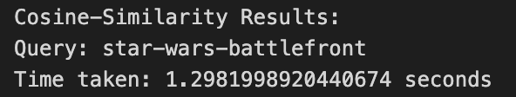
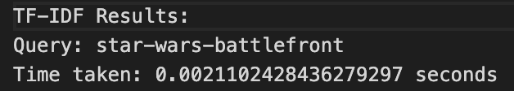
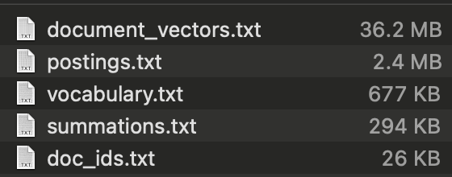
basline metrics
These are the metrics for the end search engine

Slide 4
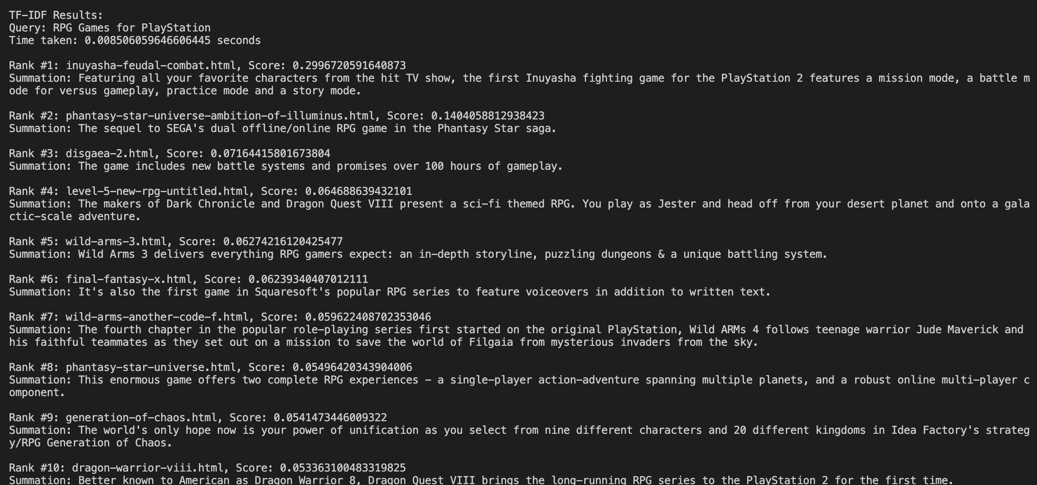
‘Action-adventure games’
What console output looks like, includes summations

Slide 5
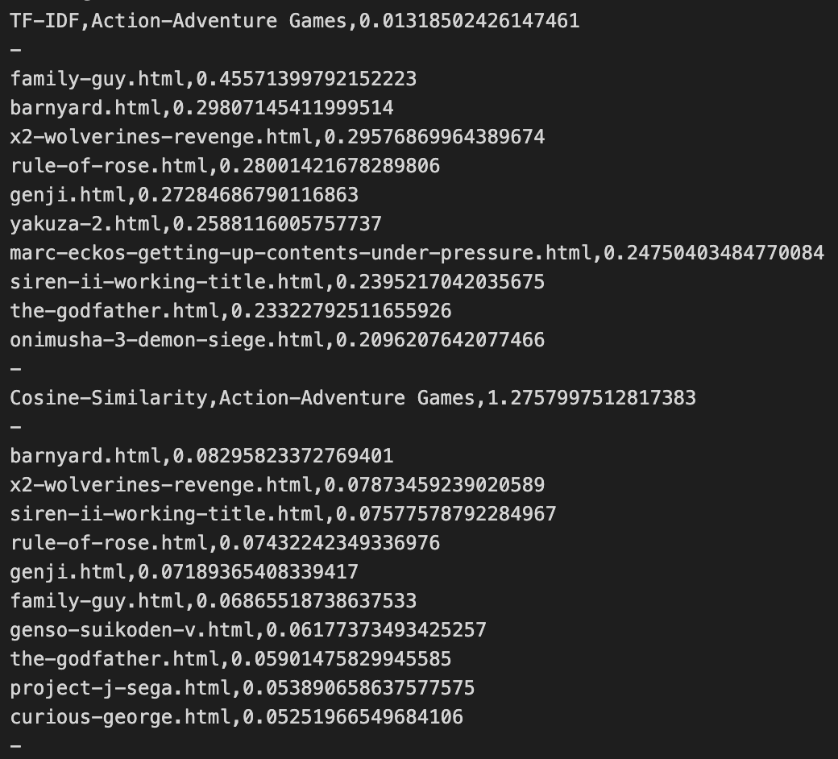
query results – ‘RPG Games for playstation’
What file output looks like, doesn’t include summations.

Slide 6
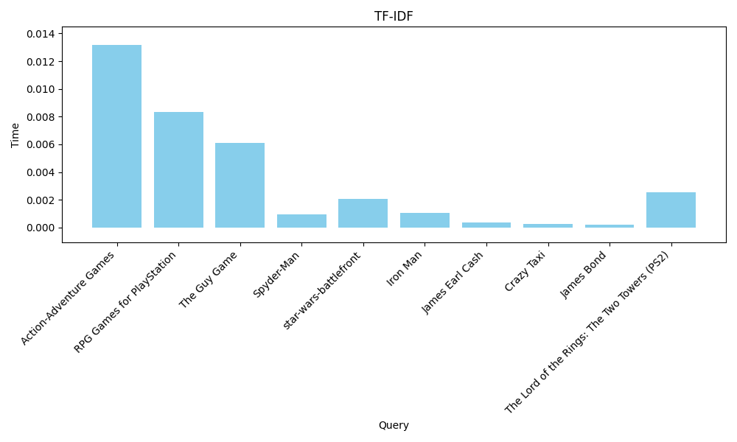
INPUT TESTING – TF-IDF

Slide 7
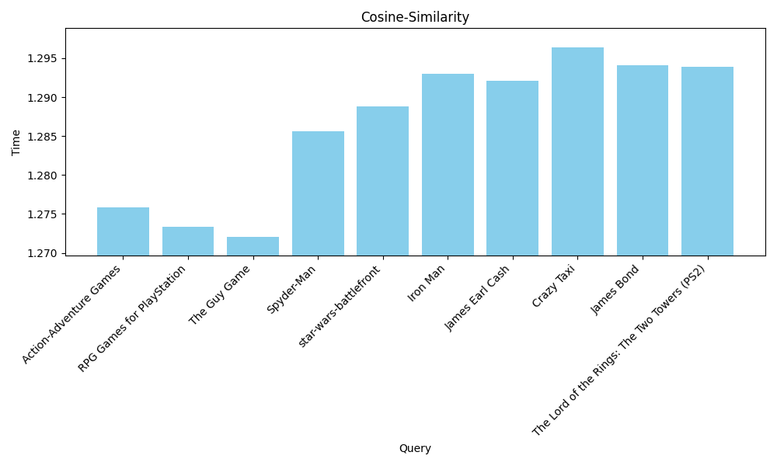
INPUT TESTING – Cosine similarity

Slide 8
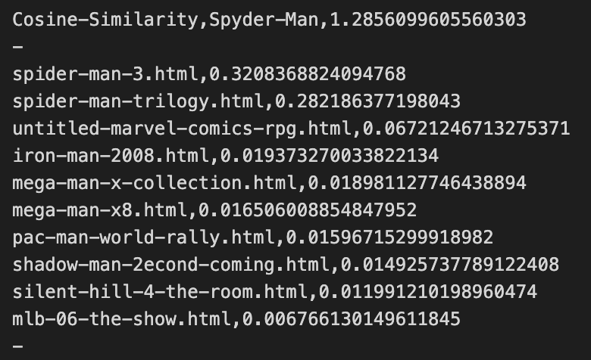
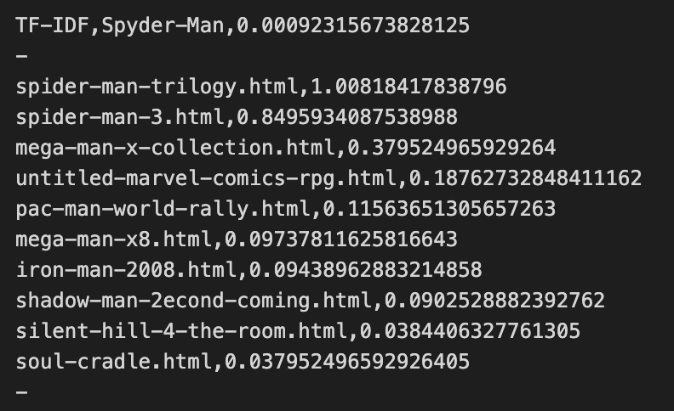
TF-IDF VS COSine similarity evaluation
TF-IDF is roughly 100x faster than Cosine Similarity
Cosine Similarity on average produces more accurate results, as shown with its 3rd and 4th ranks being more closely related than 3rd and 4th from TF-IDF

Slide 9
CORE EXPERIMENTS

Slide 10
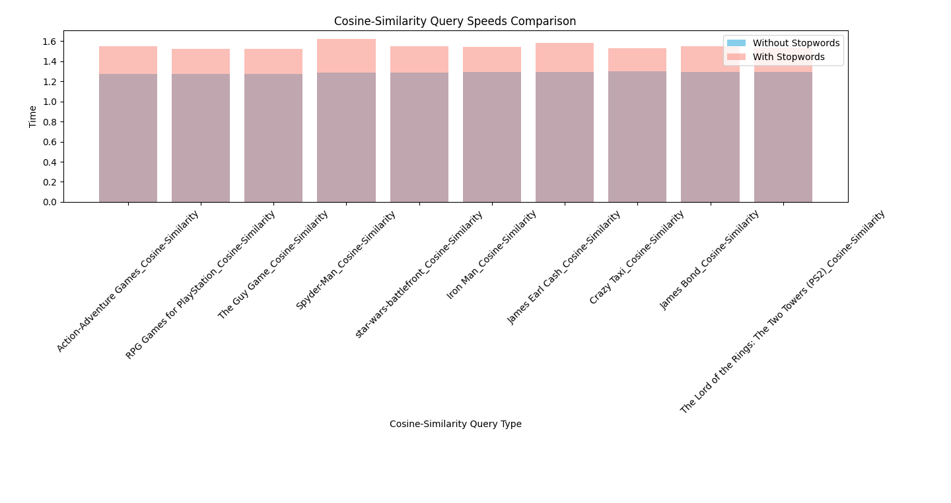
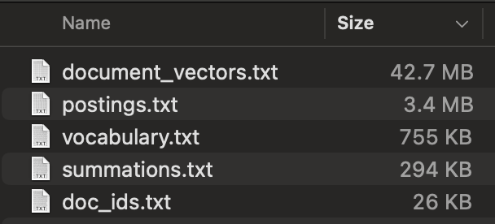
STOP WORDS
Keeping stopwords increases retrieval times
doc vectors ⇧ 17.9%
POSTINGS ⇧ 41.%
VOCAB ⇧ 11.5%
CS: ⇧ 15.7%

Slide 11
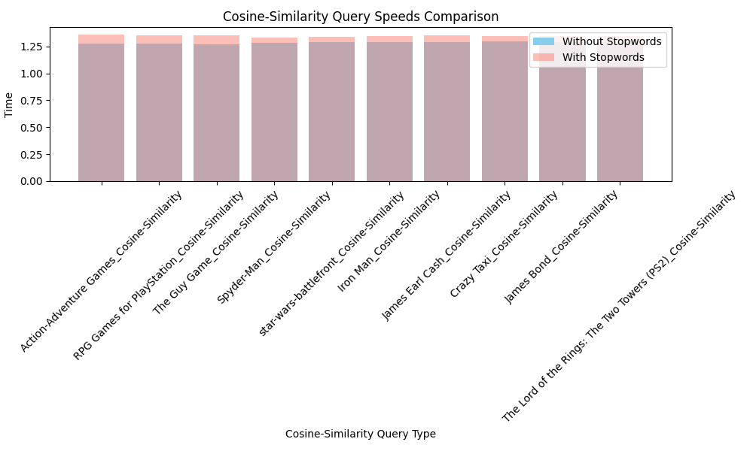
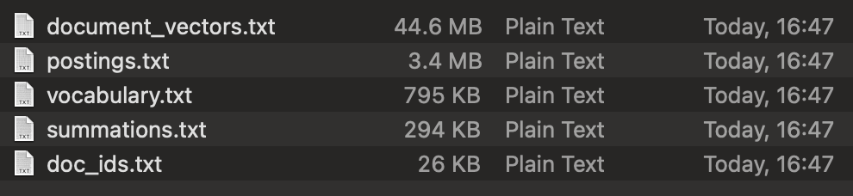
LEMMATISING
KEEPING LEMMAS INCREASING RETRIEVAL TIMES
doc vectors ⇧ 23%
POSTINGS ⇧ 41.%
VOCAB ⇧ 17.4%
CS: ⇧ 26.86%

Slide 12
Additional EXPERIMENTS

Slide 13
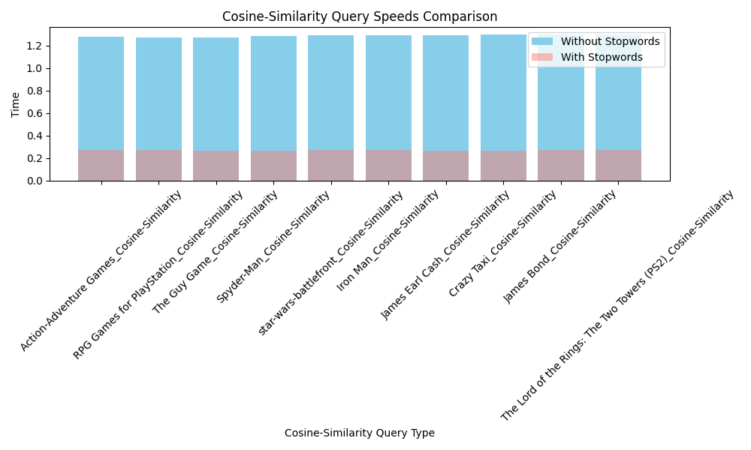
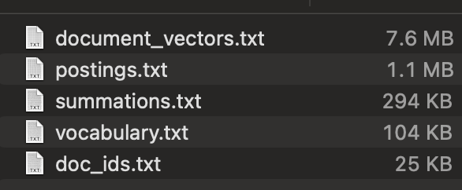
BIGRAMS (I)
doc vectors ⇩ 79%
POSTINGS ⇩ 54%
VOCAB ⇩ 84.6%
CS: ⇩ 78.67%

Slide 14
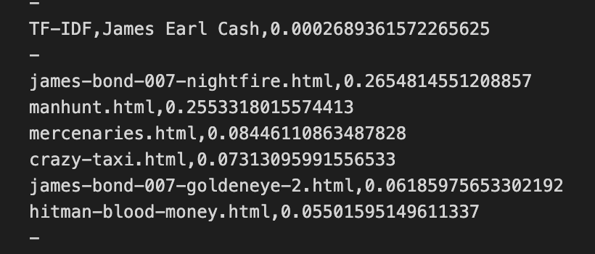
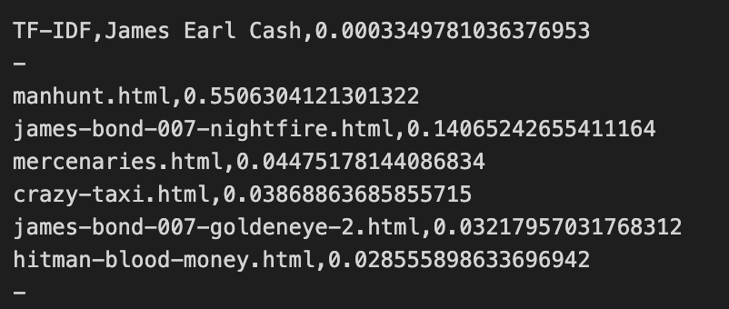
BIGRAMS (II)
Removing BIGRAMS OFFERS QUICKEST RETRIEVAL TIMES AND BEST STORAGE SIZES at the cost of more inaccurate retrieval.
In the case of the query ‘james earl cash’
The use of bigrams allows manhunt.html to be ranked #1 (it is the only one related to the entire query)

Slide 15
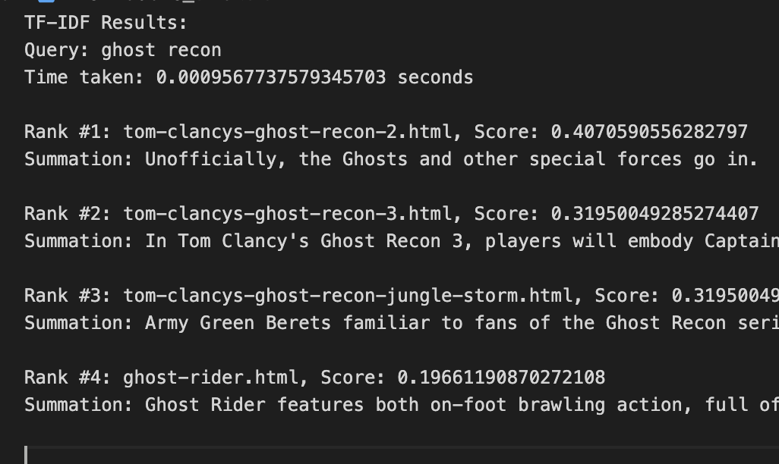
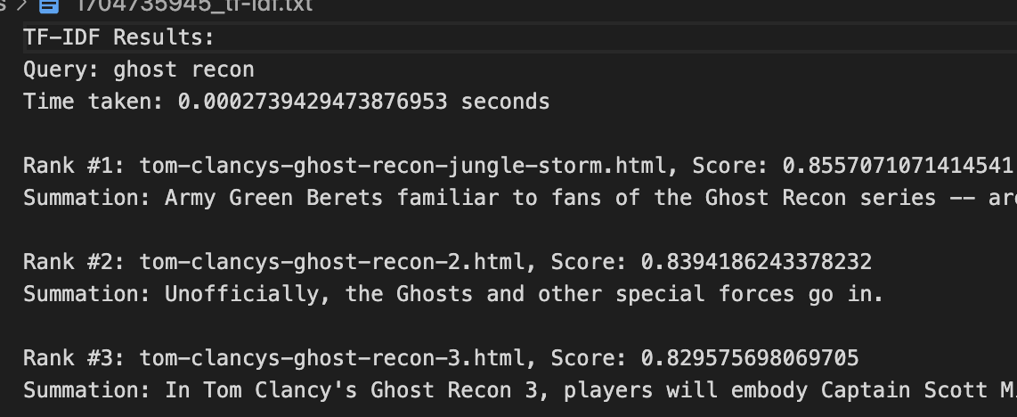
Bigrams have proven to massively increase the storage and retrieval times
However, bigrams have also shown to improve retrieval, providing more accurate results, as without bigrams “Ghost rider” is also retrieve

Slide 16
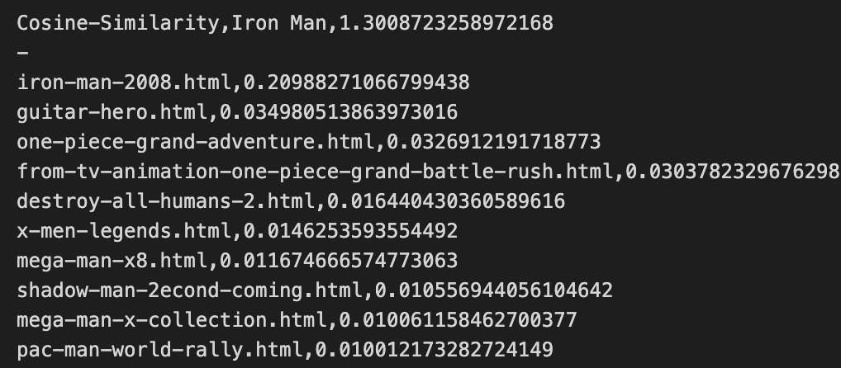
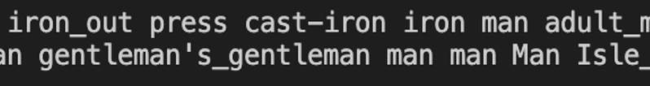
THESAURUS BASED QUERY EXPANSION
Regular query expansion generate irrelevant words such
Query: Iron Man
Expanded Query: Cast-Iron, Isle_Of_Man, … etc.
By filtering with words in vocabulary, generally the expanded list returns as empty

Slide 17
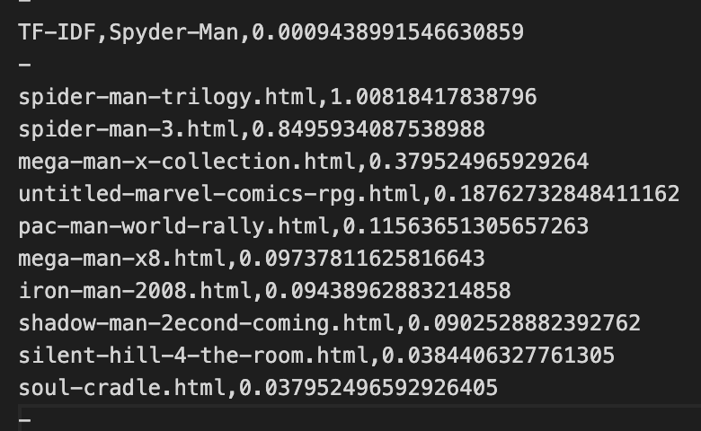
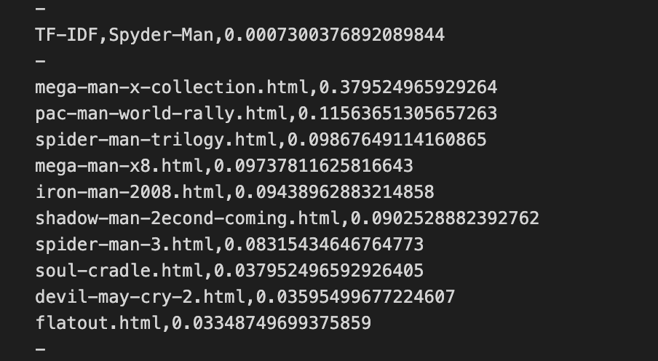
SPELL CHECKER
Spell checking is clearly beneficial as when the words are misspelt, the incorrect words are ignored, thus causing a different query to be ranked

