Slide 1
Welcome to Networking

Slide 2
Agenda
OSI Review
Data Transmission
Common Networking Equipment
Common Network Topologies
LAN Vs WAN
MAC Addresses
IP Addresses
  Binary Math!
Network Masks / CIDR Notation

Slide 3
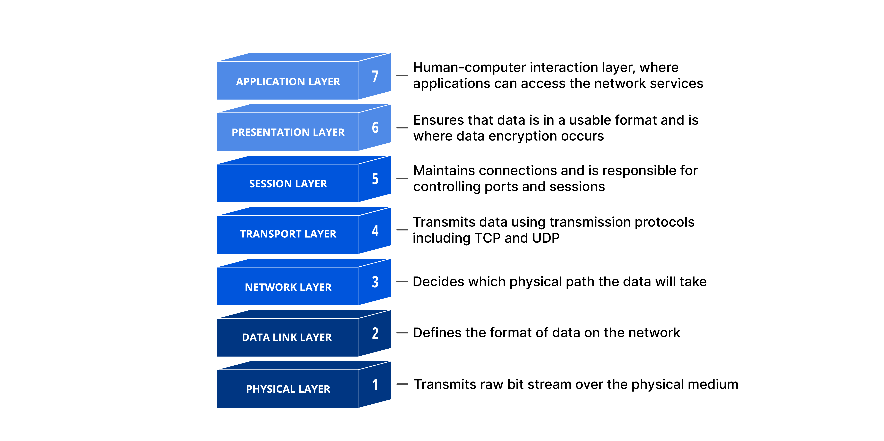
https://www.cloudflare.com/learning/ddos/glossary/open-systems-interconnection-model-osi/

Slide 4
Data Transmission
Frame - A frame is the unit of transmission in a link layer protocol, and consists of a link-layer header followed by a packet.
Packet - A packet is the unit of data passed across the interface between the network layer and the link layer. It includes an IP header and data. A packet may be a complete IP datagram or a fragment of an IP datagram.

Slide 5
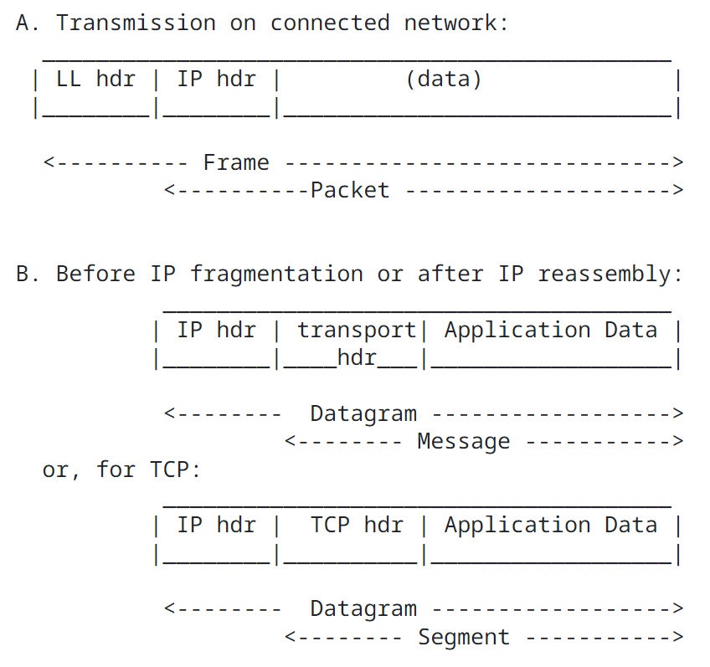
Data Transmission
IP datagram – The unit of end-to-end transmission in the IP protocol. An IP datagram consists of an IP header followed by transport layer data, i.e., of an IP header followed by a message.
https://datatracker.ietf.org/doc/html/rfc1122#section-3

Slide 6
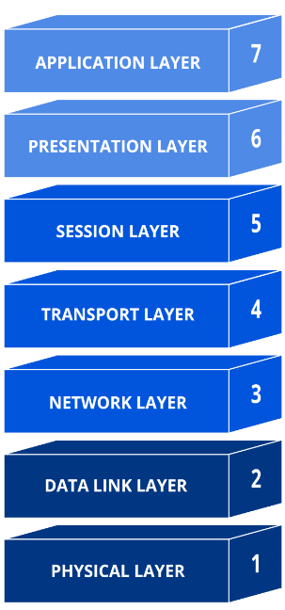
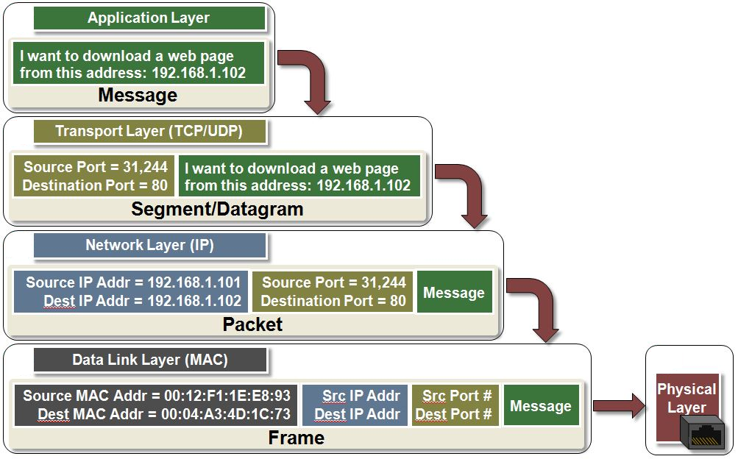
Data Transmission

Slide 7
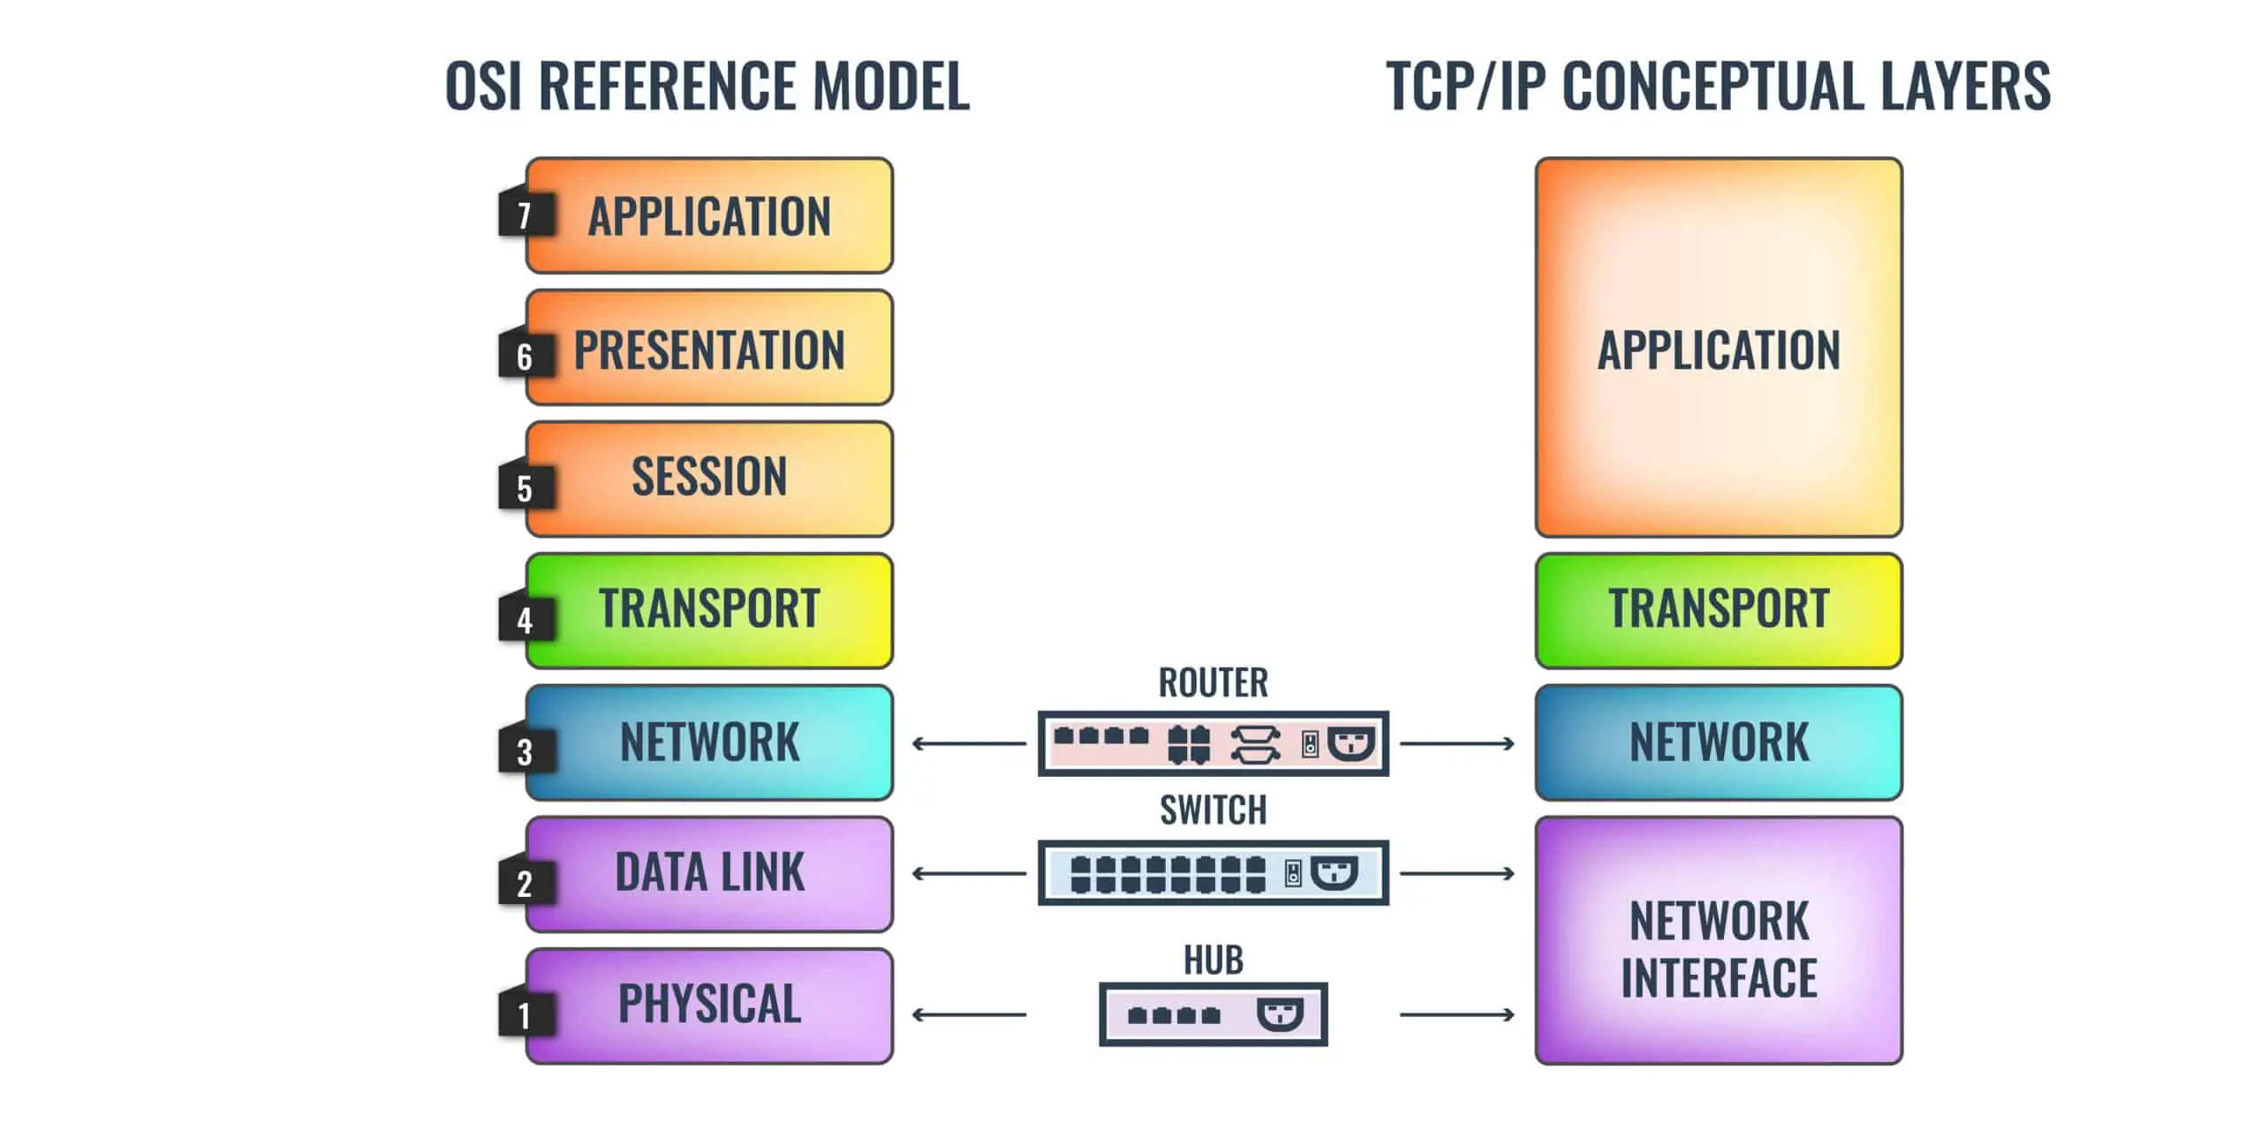
Common Networking Equipment
https://www.comparitech.com/net-admin/hub-vs-switch-vs-router/

Slide 8
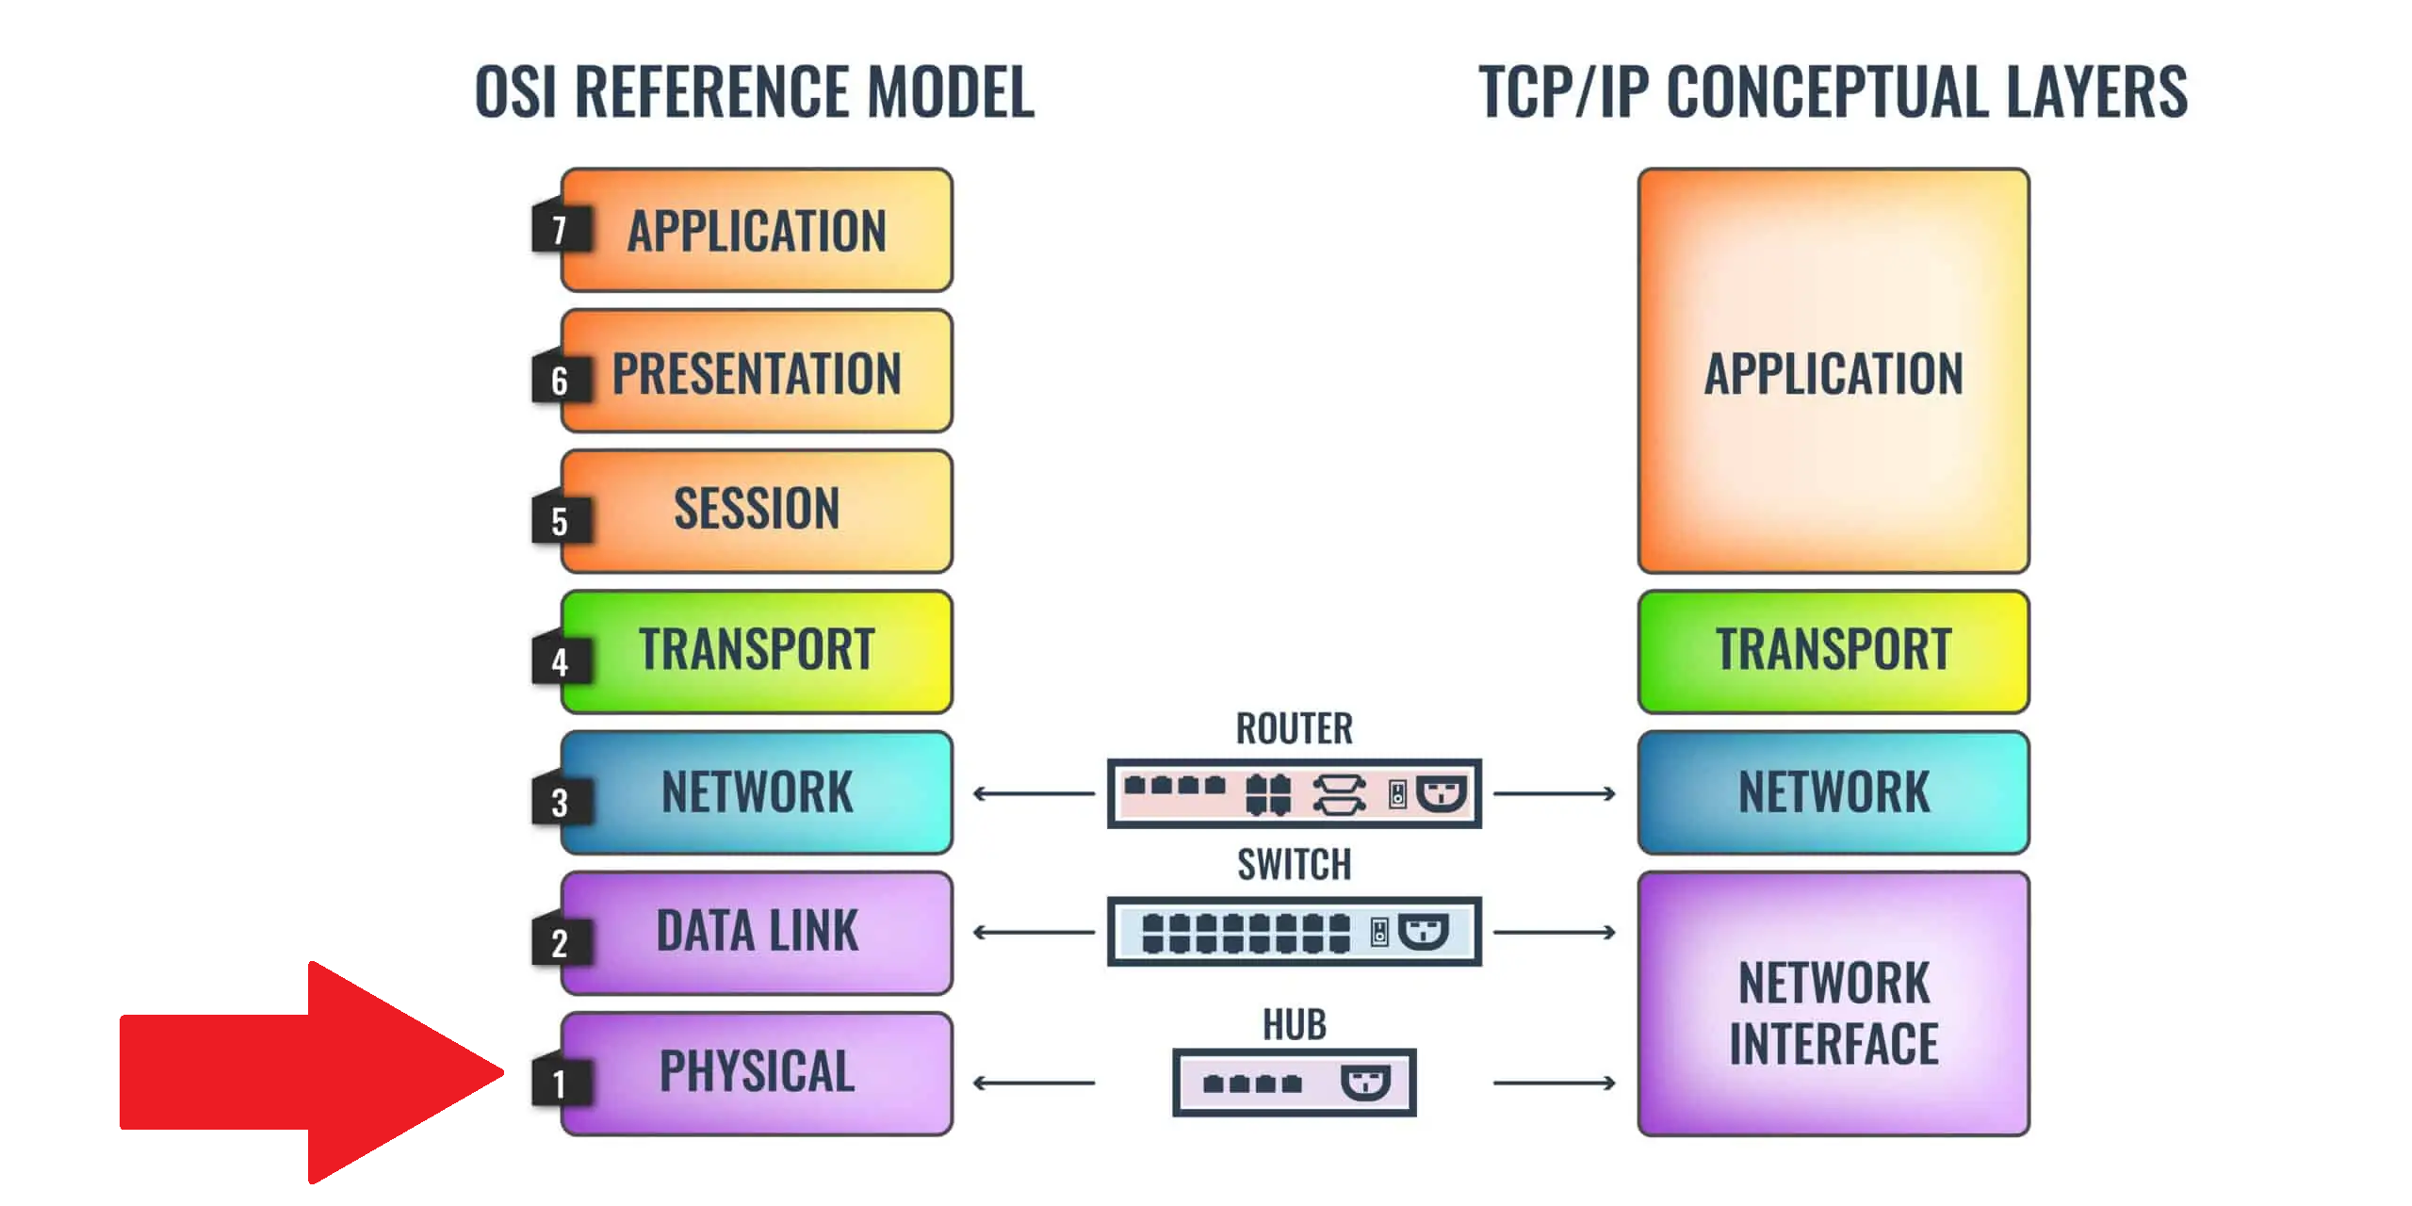
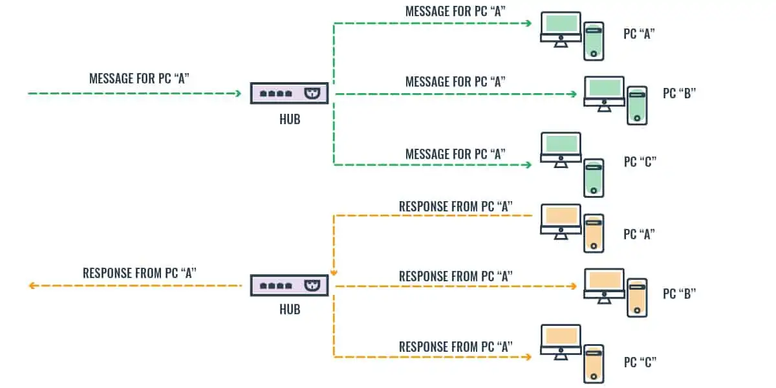
Common Networking Equipment
Hub – Physically connects parts of a network(s). This is a VERY low level hardware solution that creates a lot of network traffic! These are less common today, but they are cheap!
https://www.comparitech.com/net-admin/hub-vs-switch-vs-router/

Slide 9
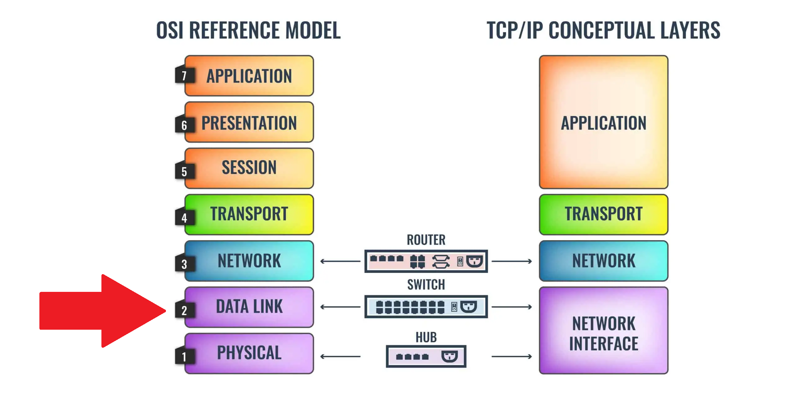
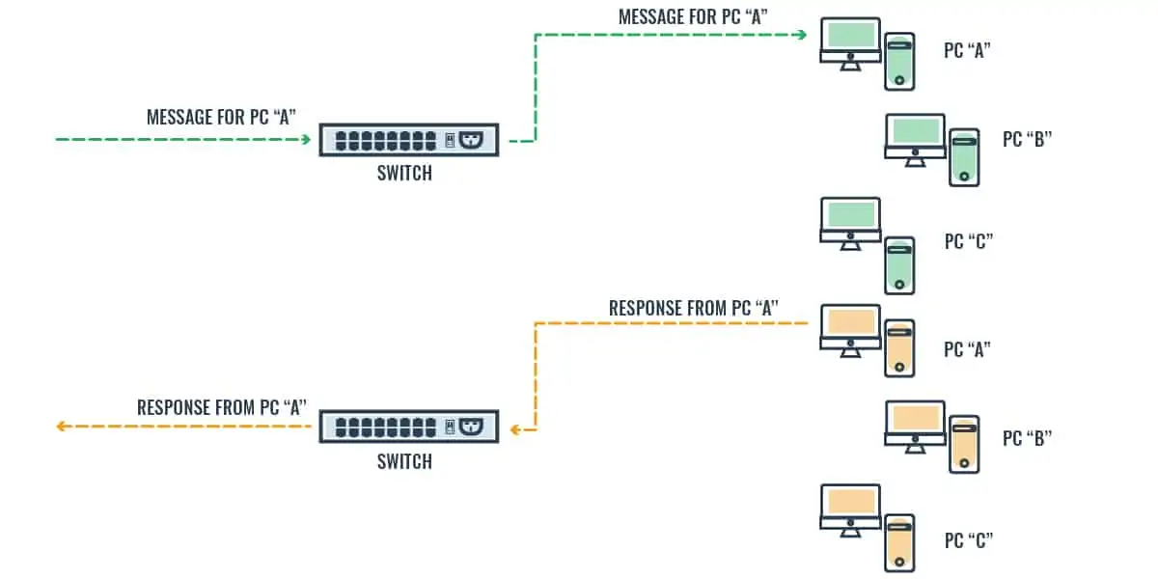
Common Networking Equipment
Switch – Copies Data Frames on private networks at the Data Link layer. Uses “Hardware” MAC addresses.
  Managed – Most common type of switch. Capable of some administrative tasks such as load balancing and reporting.
  Unmanaged – “Workhorses”, generally no extra bells or whistles. Cheaper.

Slide 10
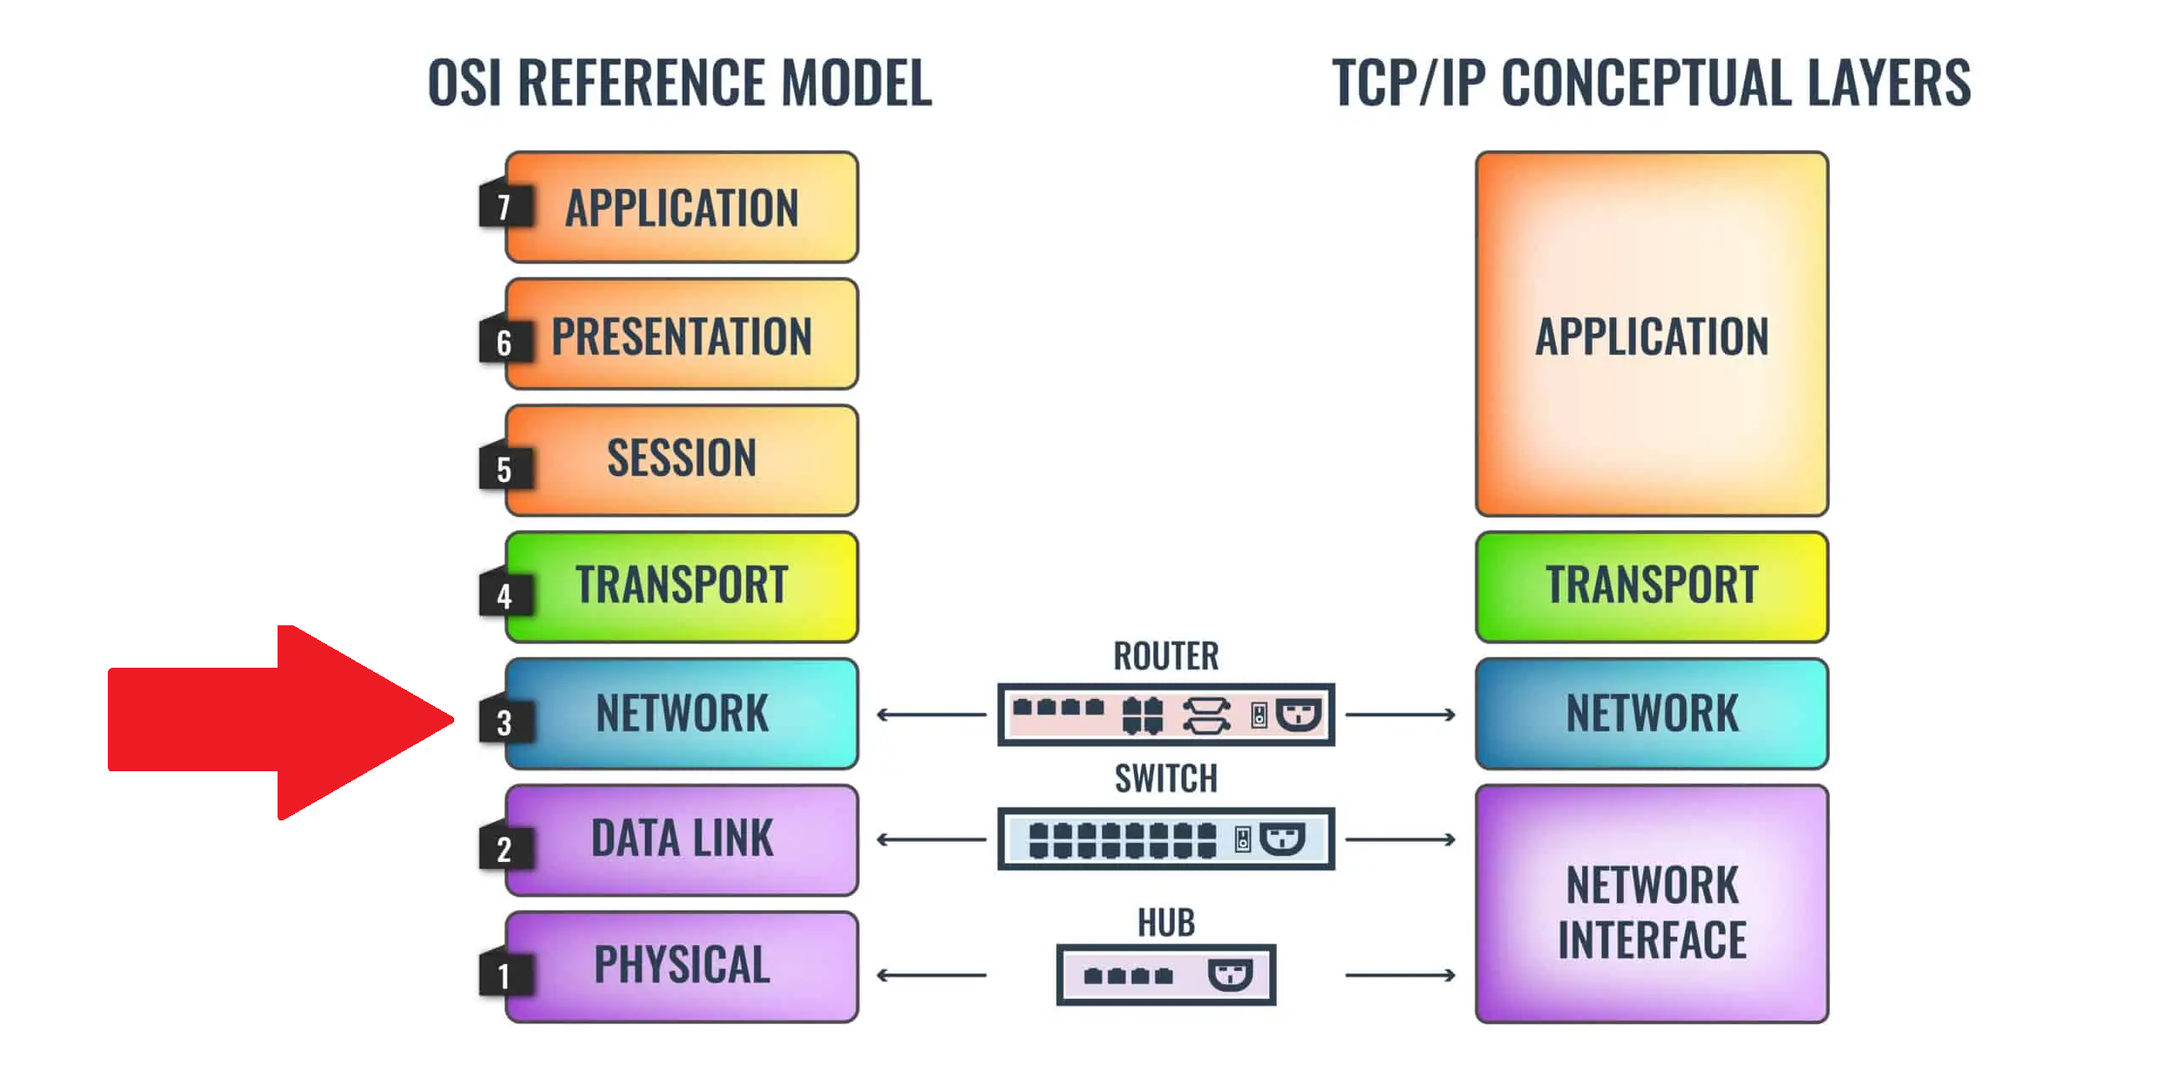
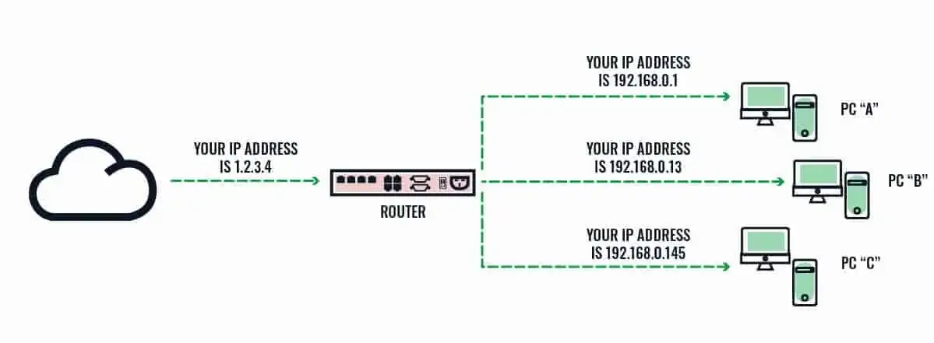
Common Networking Equipment
Router – A device used for routing traffic on and between multiple networks. Commonly the internet.

Slide 11
Common Networking Equipment
Firewall - A network security device that monitors incoming and outgoing network traffic and decides whether to allow or block specific traffic based on a defined set of security rules.
https://www.cisco.com/c/en/us/products/security/firewalls/what-is-a-firewall.html

Slide 12
Common Networking Equipment
Intrusion Detection System (IDS) - A network security tool that monitors network traffic and devices for known malicious activity, suspicious activity or security policy violations.
Intrusion Prevention System (IPS) - monitors network traffic for potential threats and automatically takes action to block them by alerting the security team, terminating dangerous connections, removing malicious content, or triggering other security devices.
https://www.ibm.com/topics/intrusion-detection-system
https://www.ibm.com/topics/intrusion-prevention-system

Slide 13
Common Networking Equipment
Access Point - An access point connects to a wired router, switch, or hub via an Ethernet cable, and projects a WiFi signal to a designated area.
https://www.linksys.com/what-is-a-wifi-access-point.html

Slide 14
Common Networking Equipment
Consumer Grade Equipment – Often you may have a device provided by your ISP that is referred to as the “router” or “modem” . This piece of equipment is generally multiple network appliances combined in a single housing.

Slide 15
Common Network Topologies
Physical – The actual connections (wires, cables, etc.) of how the network is arranged. Setup, maintenance, and provisioning tasks require insight into the physical network.
Logical – higher-level idea of how the network is set up, including which nodes connect to each other and in which ways, as well as how data is transmitted through the network.
https://www.dnsstuff.com/what-is-network-topology

Slide 16
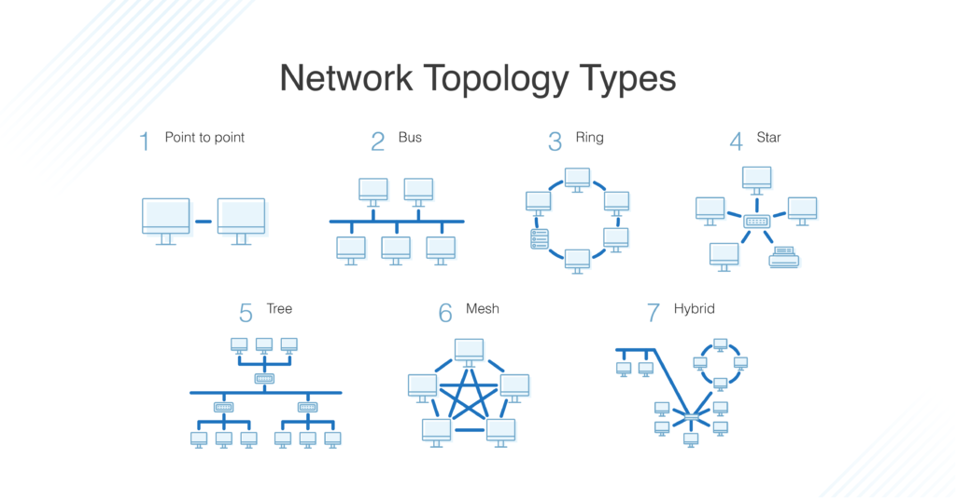
Common Network Topologies
https://www.dnsstuff.com/what-is-network-topology

Slide 17
Tiers of ISP
Tier 1 ISP - Networks that are the backbone of the Internet. These ISPs build infrastructure such as the Atlantic Internet sea cables. They provide traffic to all other ISPs, not end users.
Tier 2 ISP - Utilizes a combination of paid transit via Tier 1 ISPs and peering with other Tier 2 ISPs to deliver Internet traffic to end customers through Tier 3 ISPs. Tier 2 ISPs are typically regional or national providers.
Tier 3 ISP - strictly purchases Internet transit. A Tier 3 provider is by definition primarily engaged in delivering Internet access to end customers. Tier 3 ISPs focus on local business and consumer market conditions.
https://www.thousandeyes.com/learning/techtorials/isp-tiers

Slide 18
LAN VS WAN
Local Area Network (LAN) - collection of wired and
Wi-Fi connected devices in your home or office. This is your personal network. Your computer, phone, tablet, router, etc. make up your LAN.
Wide Area Network (WAN) - exists over a large-scale geographical area. Your modem sends and receives information to and from the internet through its WAN port.
https://support.google.com/googlenest/answer/6274166

Slide 19
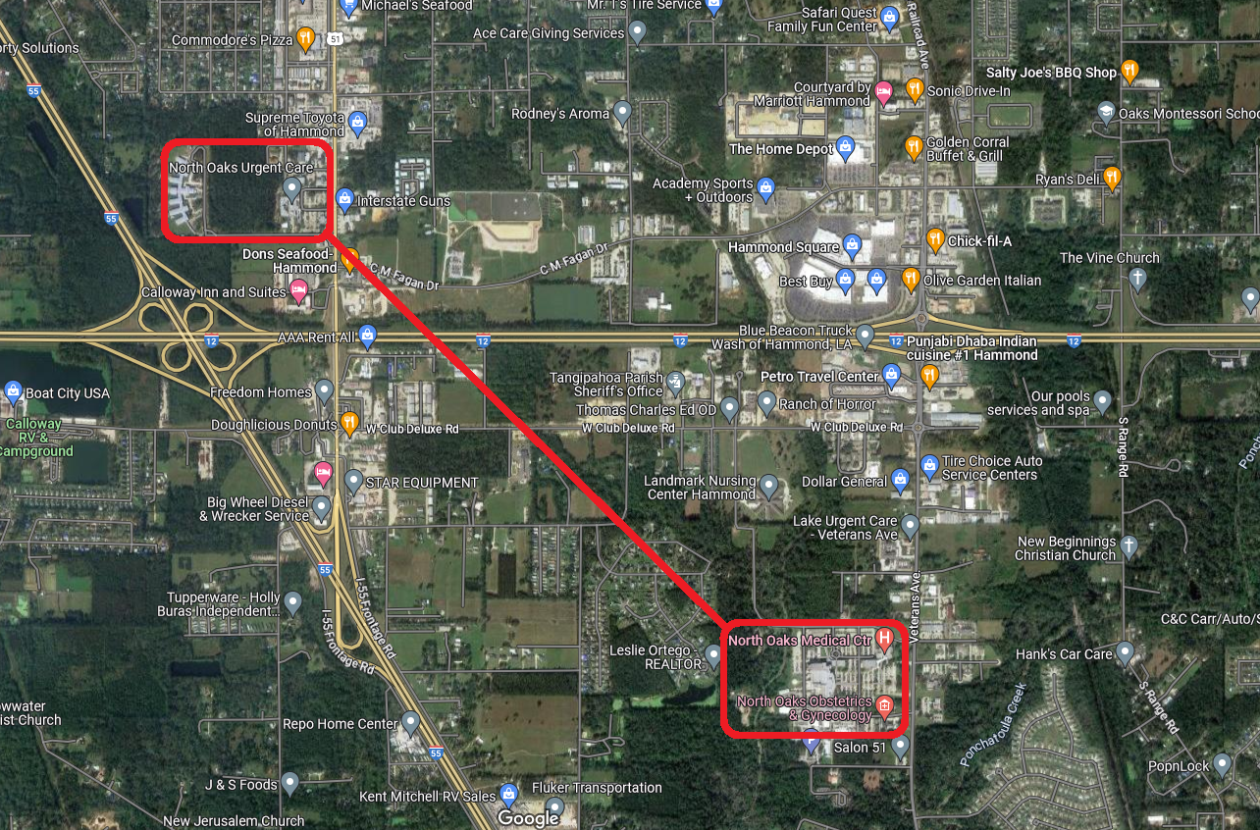
LAN VS WAN

Slide 20

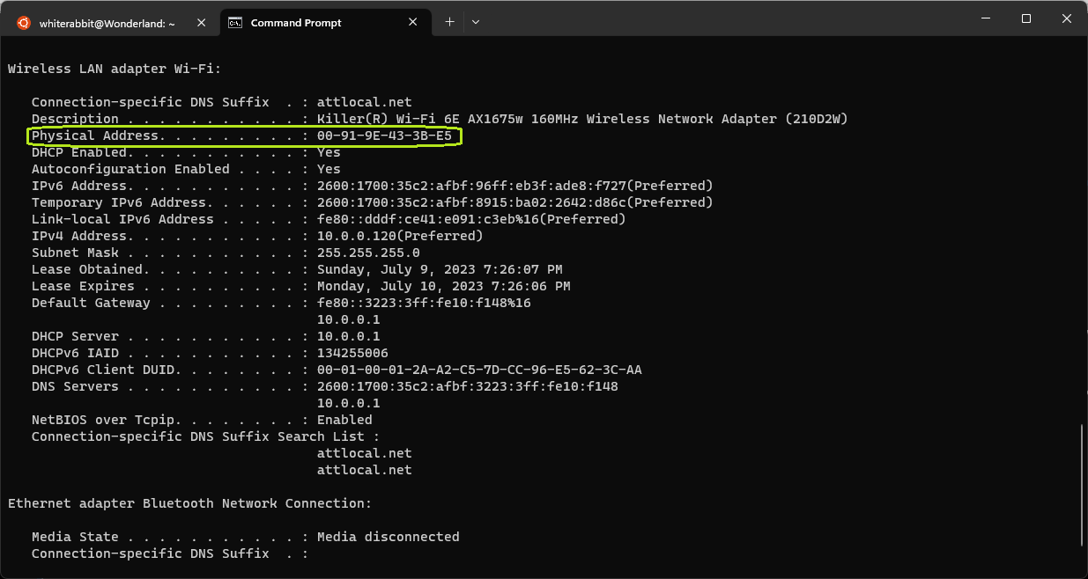
MAC Addresses
“Hardware” Address of your networking devices. This address is “burned” onto a ROM chip that is soldered onto your network card.

Slide 21
MAC Addresses
Physical Address: 00-91-9E-43-3B-E5
OUI – Organizationally Unique Identifier.
First 3 bytes of MAC. Identifies the vendor. Set by Institute of Electrical and Electronics Engineers (IEEE) standard.
  00-91-9E
Unique Identifier- last 3 bytes of MAC. Uniquely identify physical device.
  43-3B-E5
https://standards-oui.ieee.org/
https://www.wireshark.org/tools/oui-lookup.html

Slide 22

IP Address
Assigned by a Dynamic Host Configuration Protocol (DHCP) Server.
IPv4 – Older Standard that is still commonly used today and fairly easy for humans to memorize. Consists of 4 octets. Not enough IPs for all devices! 4,294,967,296
  Octet – 8 bits (0-255 in decimal notation)
https://www.ciscopress.com/articles/article.asp?p=348253

Slide 23
IP Addresses
Private Range - Address exists within specific private IP address ranges reserved by the Internet Assigned Numbers Authority (IANA) and should never appear on the internet.
Class A: 10.0.0.0 — 10.255.255.255
Class B: 172.16.0.0 — 172.31.255.255
Class C: 192.168.0.0 — 192.168.255.255
Public Range – Basically everything else.
https://www.avast.com/c-ip-address-public-vs-private

Slide 24
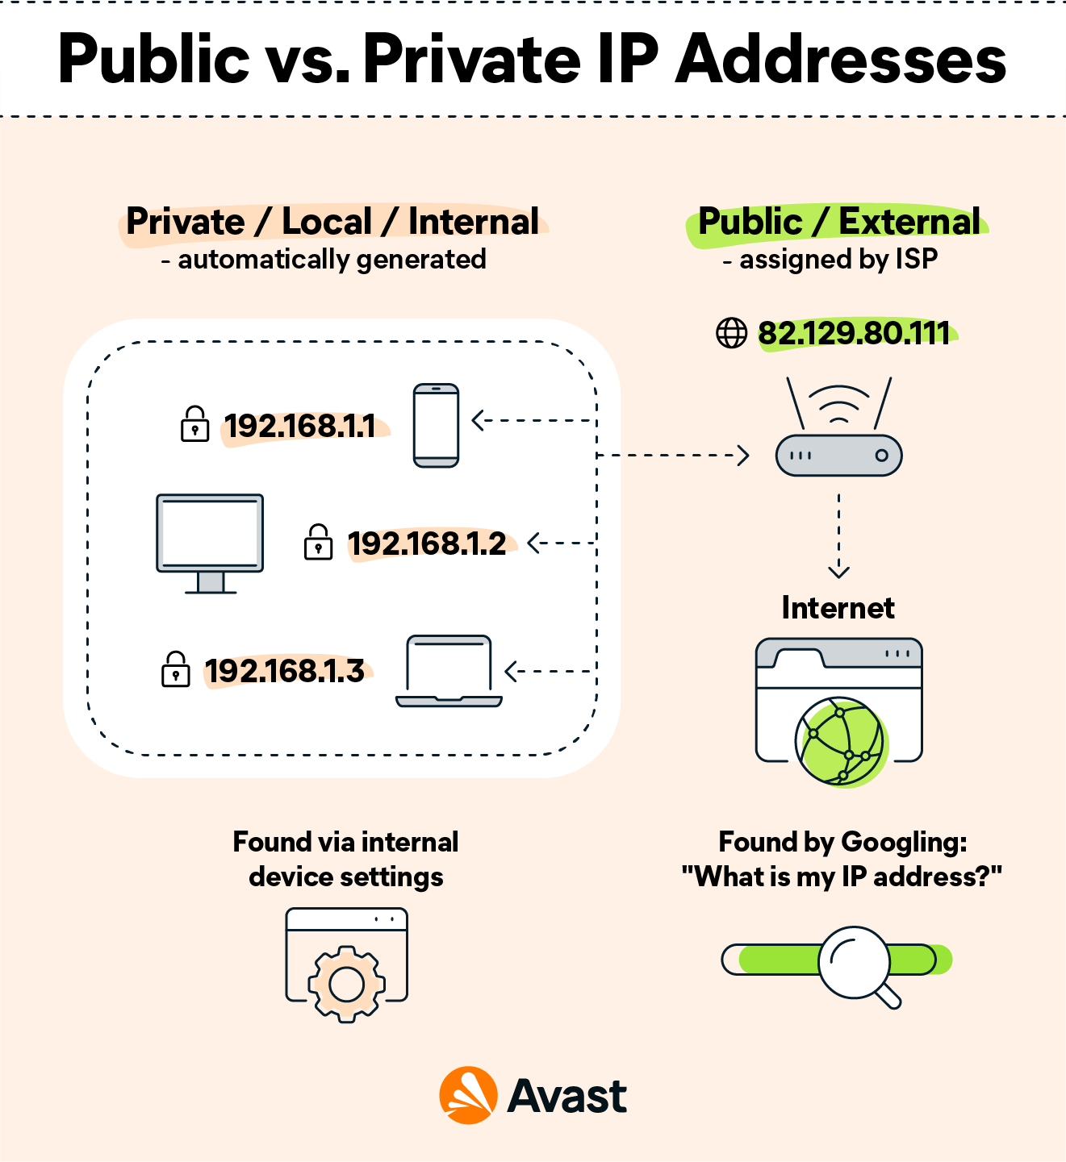
IP Addresses
https://www.avast.com/c-ip-address-public-vs-private

Slide 25
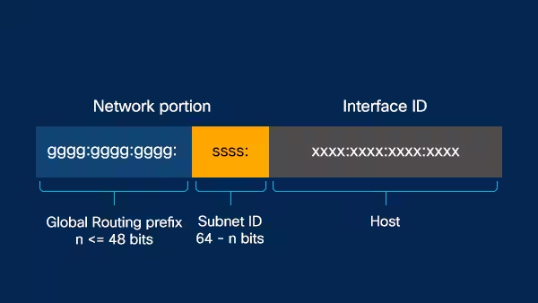
IP Addresses
IPv6 – The better solution! Less human readable. 340 undecillion unique addresses.
Uses hexadecimal (base 16)
https://www.cisco.com/c/en/us/solutions/ipv6/overview.html

Slide 26
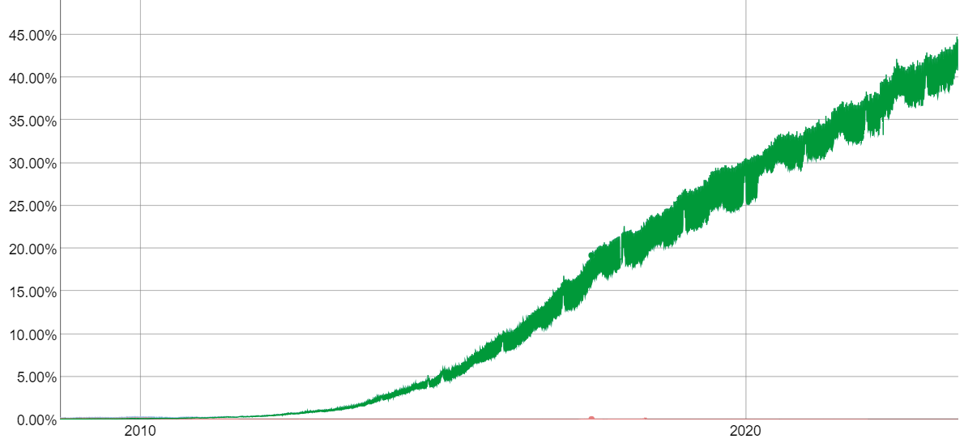
IPv6 Adoption
https://www.google.com/intl/en/ipv6/statistics.html

Slide 27
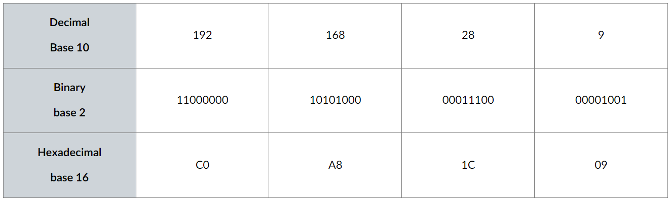
IP Addresses - Math

Slide 28
IP Addresses – Masks/CIDR Notation
Class A, B, and C networks have natural masks, or default subnet masks:
Class A: 255.0.0.0
Class B: 255.255.0.0
Class C: 255.255.255.0
CIDR Notation uses a “/” to represent which bits should not change. EX. 192.168.1.0/24
https://avinetworks.com/glossary/subnet-mask/

