Slide 1
Introduction to GRC and NIST
Identify

Slide 2
Governance, Risk, and Compliance (GRC)
Governance oversees policies, procedures, and standards for operations.
Risk Management is the practice of identifying, analyzing, and mitigating our risks
  What is the difference in threats, vulnerabilities, and risks?
  risk = (threat x vulnerability x probability of occurrence x impact)/controls
Compliance is the practice of adhering to laws, regulations, and industry standards
https://stateofsecurity.com/formula-for-calculating-cyber-risk/

Slide 3

National Institute of Standards and Technology
Non-regulatory federal agency housed under the
U.S. Department of Commerce
Mission: To promote U.S. innovation and industrial competitiveness by advancing measurement science, standards, and technology in ways that enhance economic security and improve our quality of life.
NIST develops and publishes standards and guidelines for many industries including cybersecurity, manufacturing, and scientific research
https://www.nist.gov/about-nist

Slide 4
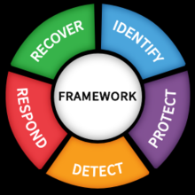
NIST: Cybersecurity Framework
Framework Version 1.1 Current Version
Framework Version 2.0 published for public comment through
November 4, 2023
Guidelines and standards designed to improve organizations’ cybersecurity posture
v1.1
https://www.nist.gov/cyberframework

Slide 5
Identify
NIST Definition: Develop the organizational understanding to manage cybersecurity risk to systems, assets, data, and capabilities.
Managing risk by understanding what assets, systems, and data we own as a company and as a cybersecurity team that need protection
Inventory of assets, reviews of data stored, compiling our policies and procedures
Helps organizations gain visibility into their vulnerabilities, threats, and risks
https://nvlpubs.nist.gov/nistpubs/CSWP/NIST.CSWP.04162018.pdf

Slide 6
Protect
NIST Definition: Develop and implement the appropriate safeguards to ensure delivery of critical infrastructure services.
Safeguarding an organization’s assets against threats
Implementation of security measures designed to mitigate unauthorized access, disclosure, alteration, distribution, and destruction of data.
Ensuring Confidentiality, Integrity, and availability (CIA-Triad)
What are some tools and actions we may implement to protect our assets?
https://nvlpubs.nist.gov/nistpubs/CSWP/NIST.CSWP.04162018.pdf

Slide 7
Detect
NIST Definition: Develop and implement the appropriate activities to identify the occurrence of a cybersecurity event.
We need to know when a security event, incident, or anomaly has occurred.
What are some systems and actions we may implement to help with detection?
https://nvlpubs.nist.gov/nistpubs/CSWP/NIST.CSWP.04162018.pdf

Slide 8
Respond
NIST Definition: Develop and implement the appropriate activities to take action regarding a detected cybersecurity event.
Creating incident response plans and playbooks to quickly respond to a cybersecurity event.
Defining roles and duty assignments during a cybersecurity event
This is go time! Triage, Containment, Eradication, and Mitigation of lost/exfiltrated/encrypted/stolen data.
https://nvlpubs.nist.gov/nistpubs/CSWP/NIST.CSWP.04162018.pdf

Slide 9
Recover
NIST Definition: Develop and implement the appropriate activities to maintain plans for resilience and to restore any capabilities or services that were impaired due to a cybersecurity event.
Get the machine turning again! Mitigate downtime and restore service.
Recovering from backups, system restorations, Incident analysis, and postmortems/lessons learned

Slide 10
Threat Models
Understanding our attack surface and potential threats to our organization.
Identify potential attack vectors, vulnerabilities, and understanding the impact of exploitation.
Prioritize issues and implement appropriate security controls, countermeasures, and mitigations
The goal is to reduce the risk and minimize the impact of a successful cyber attack

Slide 11

Building Threat Models
1. Identify assets
  List critical assets, systems, and data that needs protection
2. Identify our threats and vulnerabilities
  Consider who or what may be a threat to our operations.
  Who are these threats?
    Script kiddies? Disgruntled employees? Competitors? Hacktivist Groups?Advanced Persistent Threats / Nation-States?
3. Assess the risks
  What is the likelihood of a threat actually impacting our operations?
  What is that impact if they do?

Slide 12
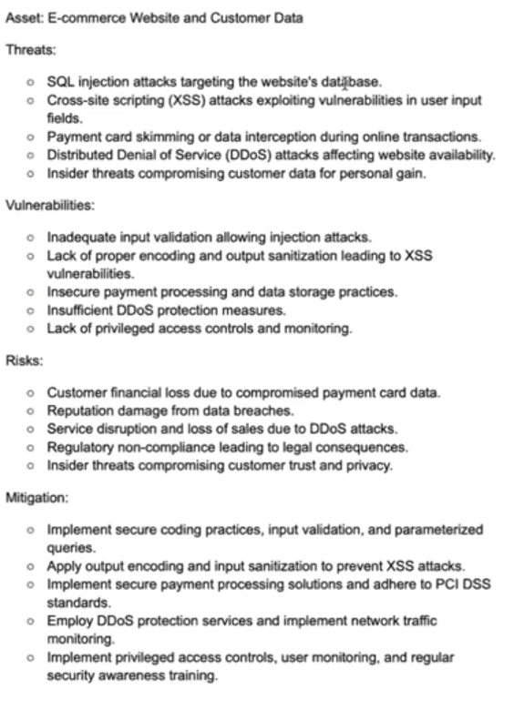

Slide 13
STRIDE
Developed by Microsoft and is one of the most widely used and oldest threat modeling frameworks
Spoofing: Involves illegally accessing and then using another user's authentication information, such as username and password
Tampering: Involves the malicious modification of data. Examples include unauthorized changes made to persistent data, such as that held in a database, and the alteration of data as it flows between two computers over an open network, such as the Internet
Repudiation: Associated with users who deny performing an action without other parties having any way to prove otherwise—for example, a user performs an illegal operation in a system that lacks the ability to trace the prohibited operations. Non-Repudiation refers to the ability of a system to counter repudiation threats. For example, a user who purchases an item might have to sign for the item upon receipt. The vendor can then use the signed receipt as evidence that the user did receive the package
Information Disclosure: Involves the exposure of information to individuals who are not supposed to have access to it—for example, the ability of users to read a file that they were not granted access to, or the ability of an intruder to read data in transit between two computers
Denial of service (DoS): attacks deny service to valid users—for example, by making a Web server temporarily unavailable or unusable. You must protect against certain types of DoS threats simply to improve system availability and reliability
Elevation of Privilege: An unprivileged user gains privileged access and thereby has sufficient access to compromise or destroy the entire system. Elevation of privilege threats include those situations in which an attacker has effectively penetrated all system defenses and become part of the trusted system itself, a dangerous situation indeed
https://learn.microsoft.com/en-us/azure/security/develop/threat-modeling-tool-threats

