Slide 1
NIST - Protect

Slide 2
Protect
NIST Definition: Develop and implement the appropriate safeguards to ensure delivery of critical infrastructure services.
Safeguarding an organization’s assets against threats
Implementation of security measures designed to mitigate unauthorized access, disclosure, alteration, distribution, and destruction of data.
Ensuring Confidentiality, Integrity, and availability (CIA-Triad)
https://nvlpubs.nist.gov/nistpubs/CSWP/NIST.CSWP.04162018.pdf

Slide 3

CIA Triad
https://www.energy.gov/femp/operational-technology-cybersecurity-energy-systems

Slide 4
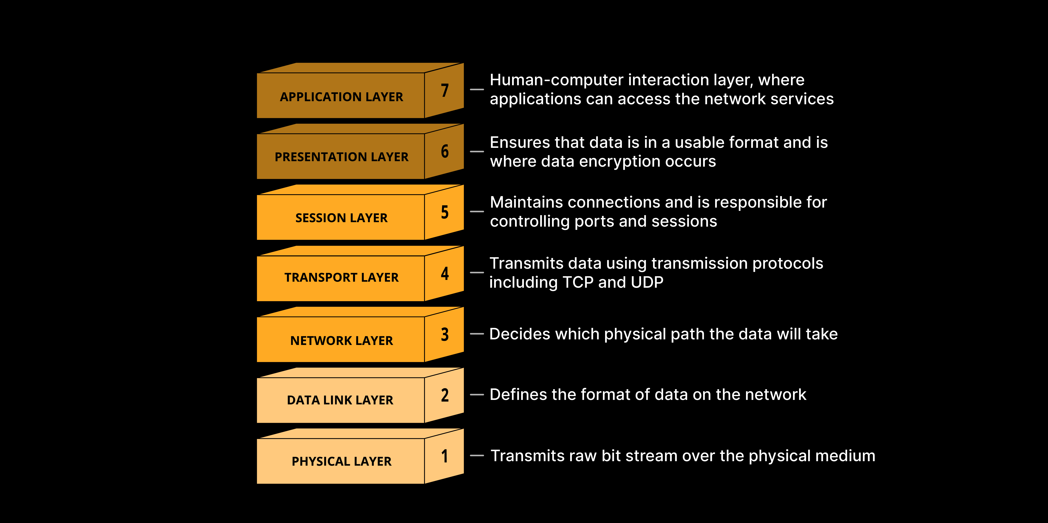
OSI Model
https://www.cloudflare.com/learning/ddos/glossary/open-systems-interconnection-model-osi/

Slide 5

Security Controls
Technical – Probably the first type of control we tend to think of working in IT. These are controls we enforce through the use of technology; our hardware and software systems we have implemented on our network.

Slide 6
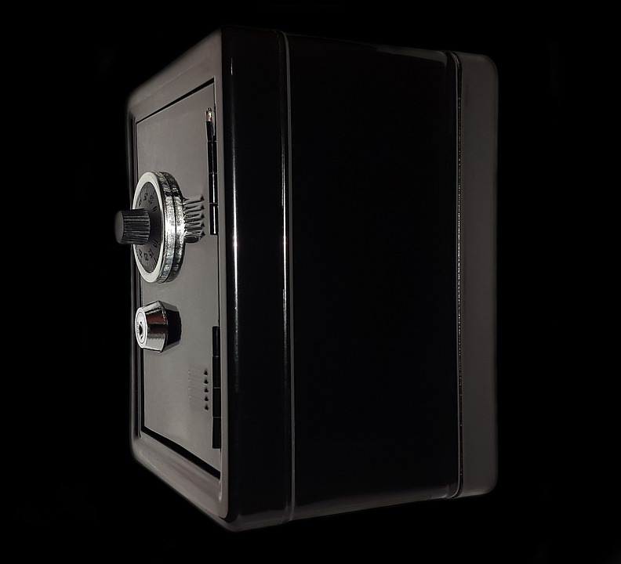
Security Controls
Physical – These are controls that are implemented to keep people in real space from being able to access, modify, or destroy our assets.

Slide 7

Security Controls
Administrative – These are controls that are put in place and enforced via policies and procedures… No you can’t take that $20,000 server home to work on it… That violates company policy 42 section IV subsection B

Slide 8
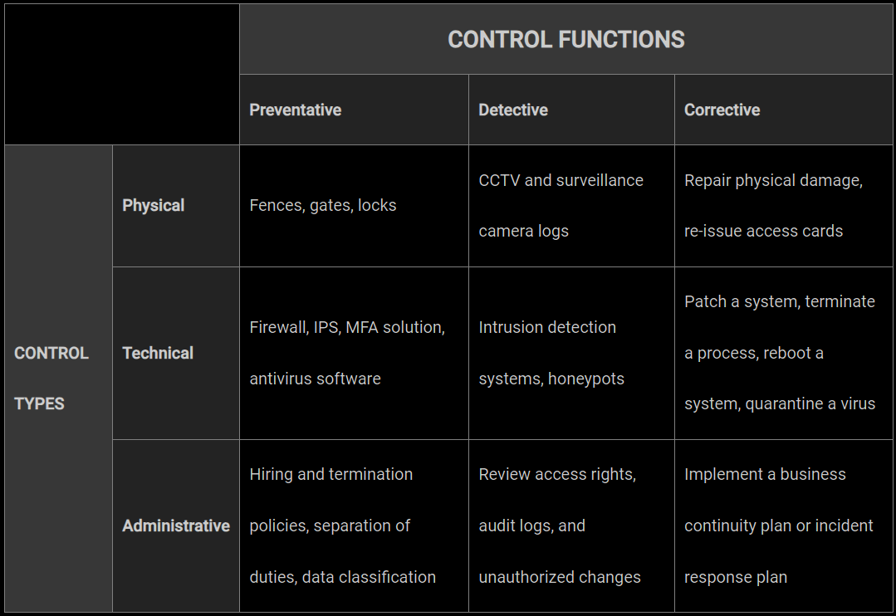
Security Controls
https://www.f5.com/labs/learning-center/what-are-security-controls

Slide 9
Protecting Data at Rest and in Flight
Questions to consider:
  Where is data stored both physically and logically?
  How is data transmitted?
  How is our data being handled internally and by 3rd parties?
  Who should have access to what data?
    Principle of least privilege – only access necessary to complete a job
  Are access logs in place and working ?
What is a use case for encryption and hashing?

Slide 10
What to do in Protection
Cybersecurity awareness training
Penetration testing/threat hunting
Resilience (Incident Response plans, playbooks, workshops)
Patching and Upgrading systems
Improving workflows
Reviewing rule-sets on systems like email
And much much more!

Slide 11
Patches and Updates
Patch Tuesday!
  This is an unofficial day, usually the second Tuesday of the month, when companies release patches and updates for their software
Any idea what the following Wednesday is called?
In a Windows environment what tool on the domain controller may I use to control how updates are handled?

Slide 12
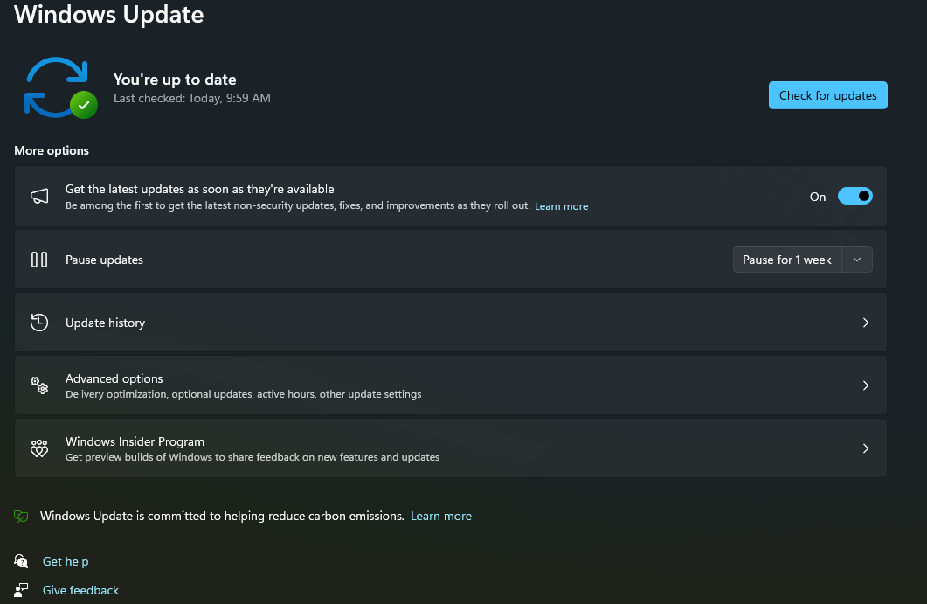
Patches and Updates
DEMO

Slide 13
Detect
NIST Definition: Develop and implement the appropriate activities to identify the occurrence of a cybersecurity event.
We need to know when a security event, incident, or anomaly has occurred.
https://nvlpubs.nist.gov/nistpubs/CSWP/NIST.CSWP.04162018.pdf

Slide 14
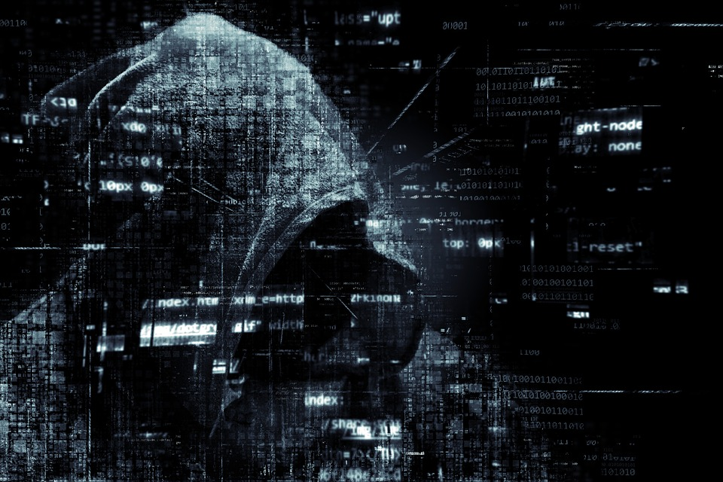
Detection Methods
What are some indicators of compromise?
What activities or events may tip us off that we have been compromised?
What sources can we lean on to learn about a breach?

Slide 15
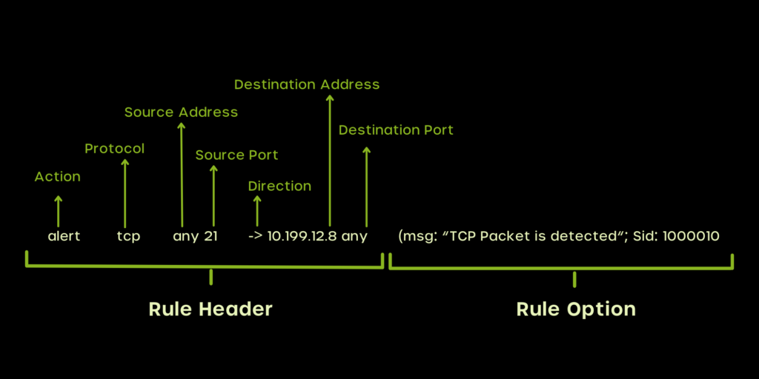

SNORT
Widely used, open-source Intrusion Detection/Prevention System
https://cyvatar.ai/write-configure-snort-rules/
https://www.snort.org/

Slide 16
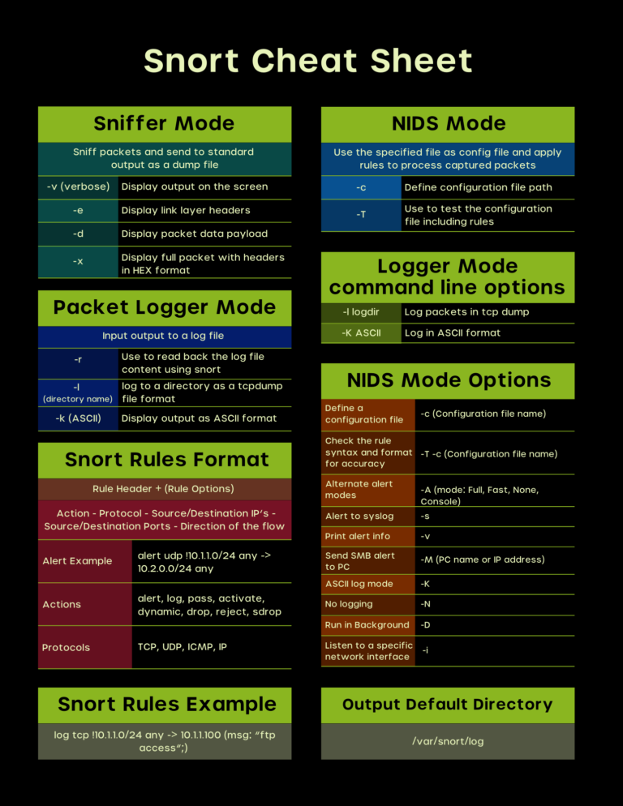
https://cyvatar.ai/write-configure-snort-rules/

Slide 17
SNORT
https://resources.infosecinstitute.com/topics/penetration-testing/snort-rules-workshop-part-one/
rules stored:
/etc/snort/rules/
config add ruleset (section 7):
nano /etc/snort/snort.conf
Rule to create in sera.rules:
alert icmp any any -> 8.8.8.8 any (msg:"GOOGLE PING DETECTED!"; SID: 500000001337;)
validate config:
sudo snort -T -i eth0 -c /etc/snort/snort.conf
Run Snort:
sudo snort -A console -q -c /etc/snort/snort.conf -i eth0

