Slide 1
Single-Cycle ARM Processor Design 2nd Term Project
Additional Materials
TA: Eunjin Lee
Email: eunjin_lee@korea.ac.kr

Slide 2
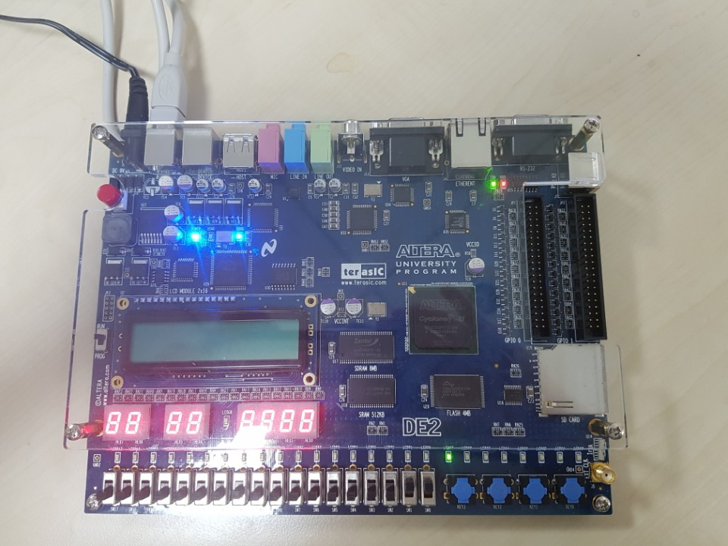
Q & A
Single-cycle ARM-reduced processor for reference
Demo video: https://youtu.be/PSpGsqWJZ6U
Features:
7-digit clock
A or P (AM or PM)
HH (hours)
MM (minutes)
SS (seconds)
SS is incremented continuously
MM increments when SS reaches 60 (value 60 never shows in SS)
HH increments when MM reaches 60 (value 60 never shows in MM)
A/P becomes P when HH reaches 12
A/P becomes A when HH reaches 24 (value 24 never shows in HH)
A/P
H
H
M
M
S
S

Slide 3
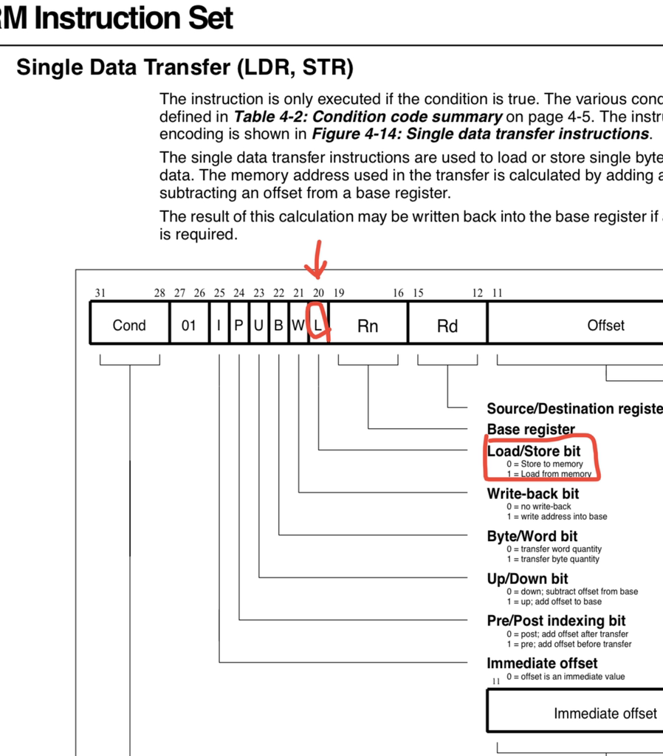
Q & A
Svalue is the bit which is used for distinguishing LDR and STR instruction.

Slide 4
Q&A
If you have any question, mail to TA
(eunjin_lee@korea.ac.kr)

