Slide 1
Single-Cycle ARM Processor Design 2nd Term Project
Announcement
TA: Eunjin Lee
Email: eunjin_lee@korea.ac.kr

Slide 2
Team & Freeday
Team
Teams for the 2nd project will be fixed on November 7th (Monday).
If you didn’t write your team information on the google sheet until November 4th, I will make the rest teams randomly on this weekend based on the google sheet.
Free-day
You can use free-day for 1st and 2nd assignment and freeday for your team depends on how many days your team members used it for the 1st assignment.
I will share google sheet link so that you can auto-check whether you will lose point due to the late submission when you fill the certain submission date on next Monday.
p.s., You don’t need to notice to use free-day.

Slide 3
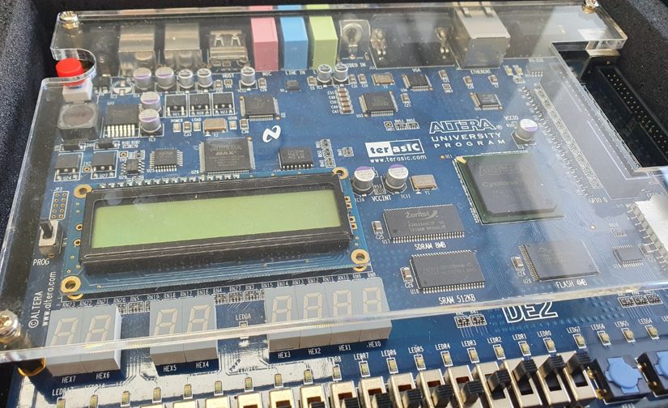
TA Session
Schedule
TA Session will be on November 9th Wednesday.
Please attend to get DE2/FPGA board and details of the 2nd assignment.
In TA Session,
DE2/FPGA board will be distributed.
DE2 board which has Cyclone II → Use ‘CA2_TermProject_for_DE2.zip’
FPGA board which has Cyclone IV → Use ‘CA2_TermProject_for_FPGA.zip’

Slide 4
TA Session
Schedule
TA Session will be on November 9th Wednesday.
Please attend to get DE2/FPGA board and description of the 2nd assignment.
In TA Session,
I will explain about the 2nd assignment.
How the single-cycle processor works with material ‘CA2_TermProject_SingleCycleProcessor.pptx’
How to modify the given project

Slide 5
2nd Term Project
What to submit (Total 25 points)
Module
RegisterFile.v (2 points)
ControlUnit.v (3 points)
Extend.v (2 points)
ALU.v (3 points)
ARMProcessor.v (5 points) - 5 points will be given depending on whether the top module operates or not.
Report (10 points)
Module description
How to submit
Upload project file and report file to BlackBloard
Due date: December 16 (Friday) 23:59
You can write module description both in Korean and English
Please fill in the fille name as ‘CA2_TeamID_StudentID_Name’
Ex) CA2_1_2022012345_HongGilDong.zip
Ex) CA2_1_2022012345_HongGilDong.docx
Please keep submission format!!!

Slide 6
Q&A
If you have any question, mail to TA
(eunjin_lee@korea.ac.kr)

