Slide 1
Single-Cycle ARM Processor Design 2nd Term Project
Quartus
TA: Eunjin Lee
Email: eunjin_lee@korea.ac.kr

Slide 2
Tutorial 1
Install Quartus

Slide 3

Installation
Install Quartus2 9.1sp2 Web Edition
For Window OS, try this.
https://bit.ly/358dqmc (91sp2_quartus_free.exe)
cf. Don’t mind the message – ‘Virus test cannot be done because this file is too large. Do you want to download it though?’
For Mac OS, try this.
Try this with material named ‘Quartus_on_m1.pdf’

Slide 4
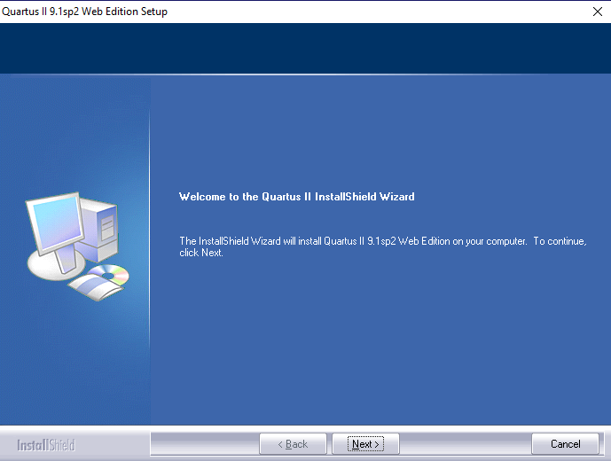
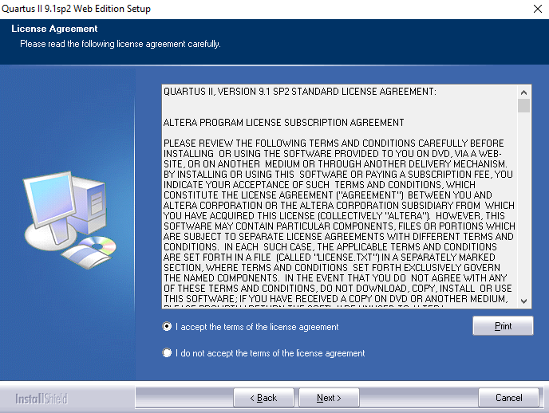
Installation
How to install Quartus?
1
2
Step 1: Click ‘Next’
Step 2: Select ‘I accept~’ button and click ‘Next’

Slide 5
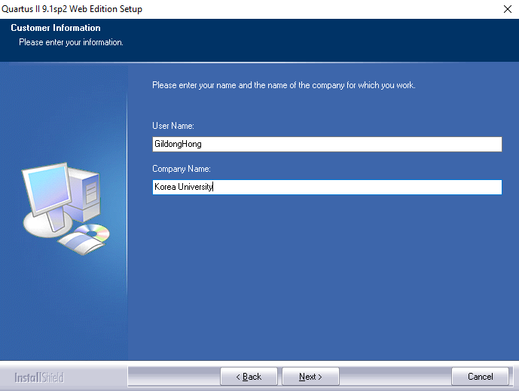
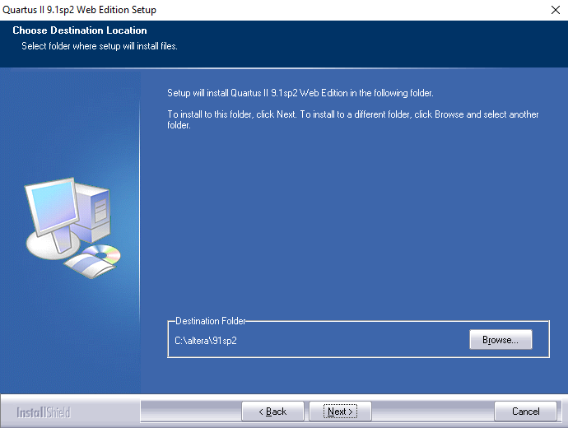
Installation
How to install Quartus?
Step 3: Put on your username(ex.GildongHong) and company name(ex.Korea University) then click ‘Next’
Step 4: Select the destination folder where the program will be installed then click ‘Next’

Slide 6
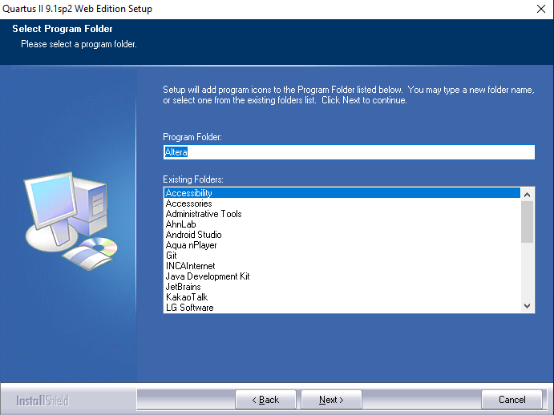
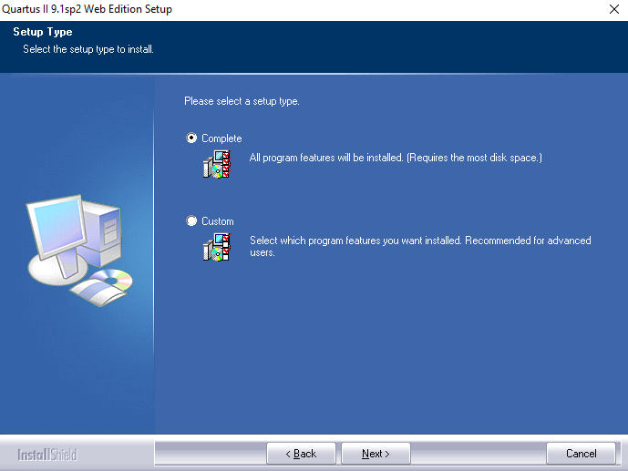
Installation
How to install Quartus?
Step 5: Select a program folder (cf. Just follow the default setting) then click ‘Next’
Step 6: Select ‘Complete’ button and click ‘Next’

Slide 7
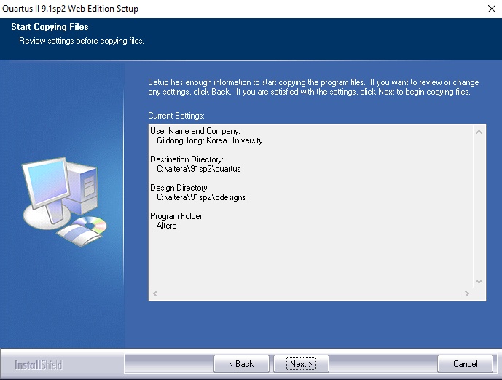

Installation
How to install Quartus?
Step 7: Review your setting

Slide 8
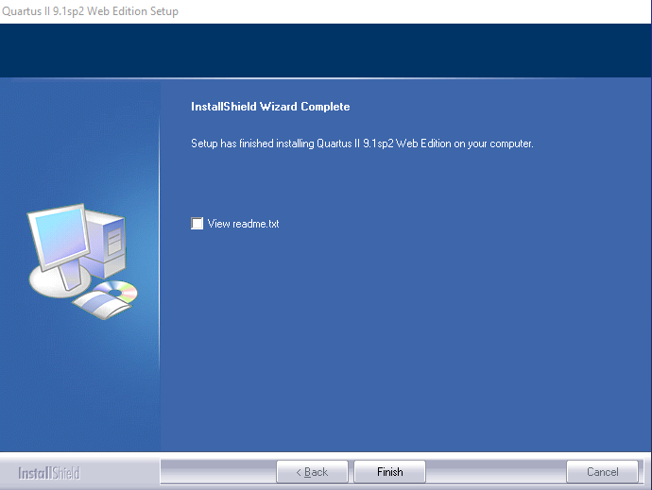
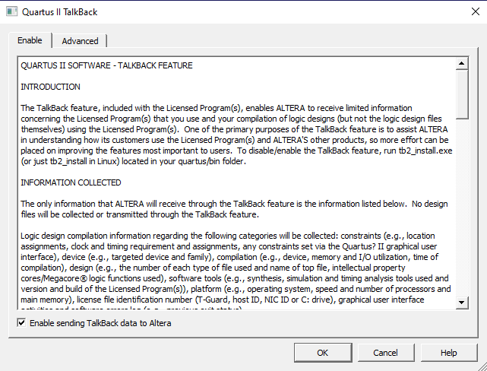
Installation
How to install Quartus?

Slide 9
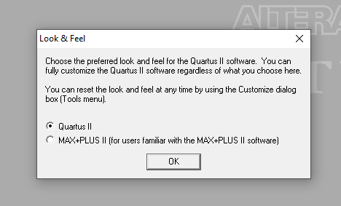
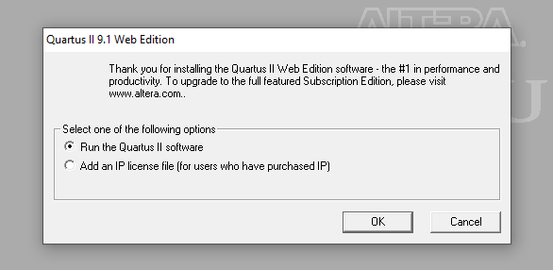
Installation
How to install Quartus?

Slide 10
Tutorial 2
Timing Simulation

Slide 11
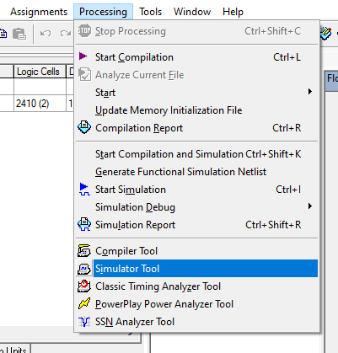
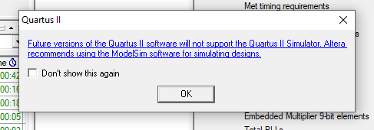
Timing Simulation
LEDG7 is not turned on
when SW1 and SW0 are turned off
LEDG7 is turned on
when both SW1 and SW0 are turned on

Slide 12
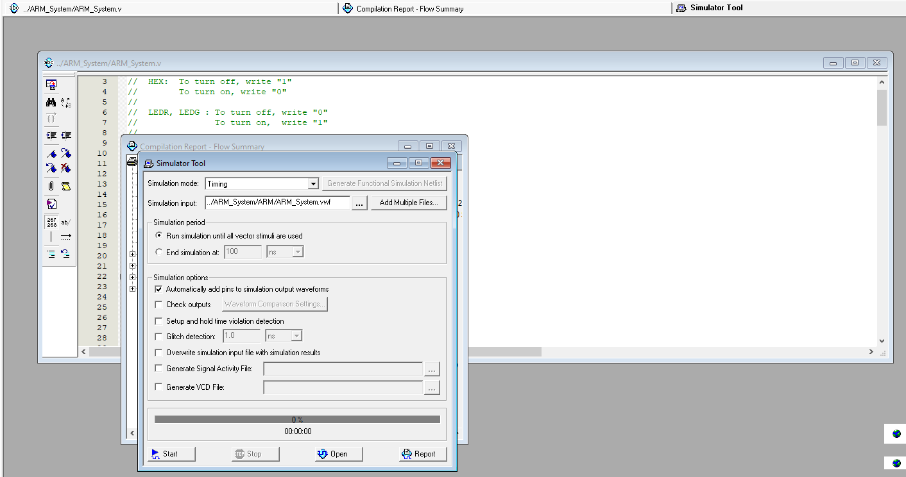
Timing Simulation
LEDG7 is not turned on
when SW1 and SW0 are turned off
LEDG7 is turned on
when both SW1 and SW0 are turned on

Slide 13
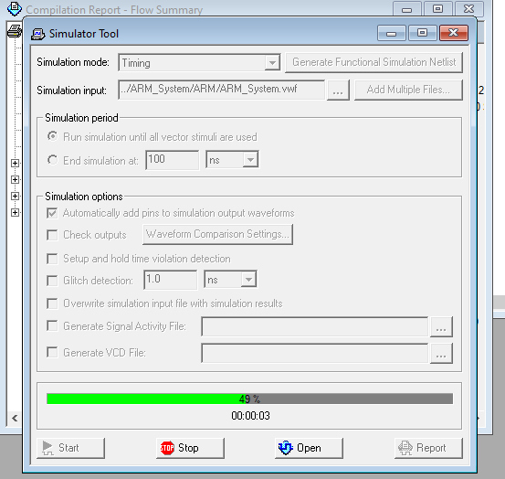
Timing Simulation
LEDG7 is not turned on
when SW1 and SW0 are turned off
LEDG7 is turned on
when both SW1 and SW0 are turned on

Slide 14
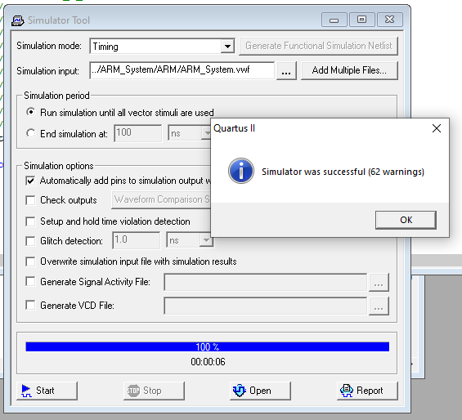
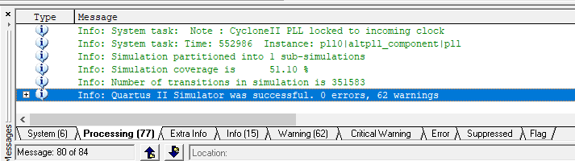
Timing Simulation
LEDG7 is not turned on
when SW1 and SW0 are turned off
LEDG7 is turned on
when both SW1 and SW0 are turned on

Slide 15
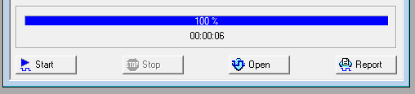
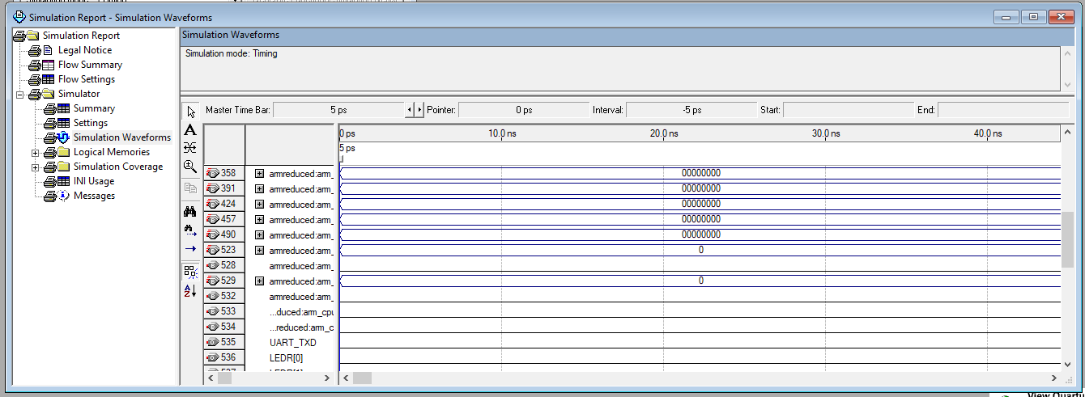
Timing Simulation
LEDG7 is not turned on
when SW1 and SW0 are turned off
LEDG7 is turned on
when both SW1 and SW0 are turned on

Slide 16
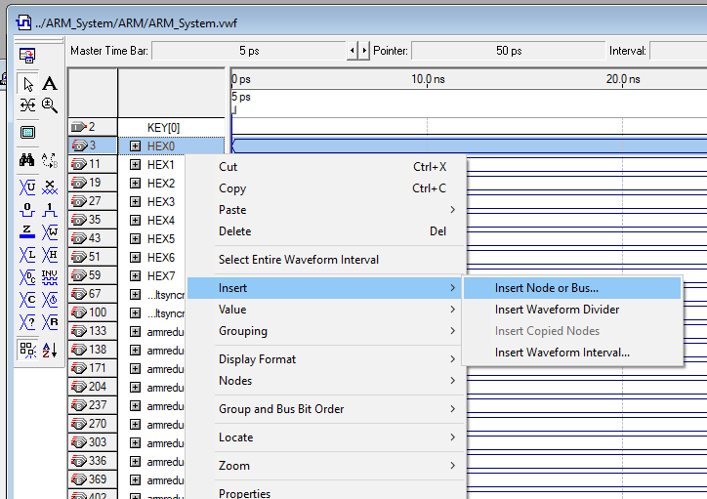
Timing Simulation
LEDG7 is not turned on
when SW1 and SW0 are turned off
LEDG7 is turned on
when both SW1 and SW0 are turned on

Slide 17
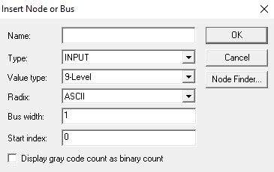
Timing Simulation
LEDG7 is not turned on
when SW1 and SW0 are turned off
LEDG7 is turned on
when both SW1 and SW0 are turned on

Slide 18
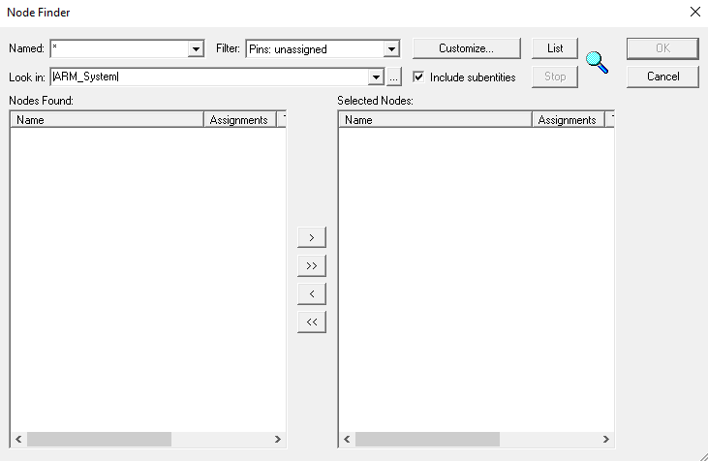
Time Simulation
LEDG7 is not turned on
when SW1 and SW0 are turned off
LEDG7 is turned on
when both SW1 and SW0 are turned on

Slide 19
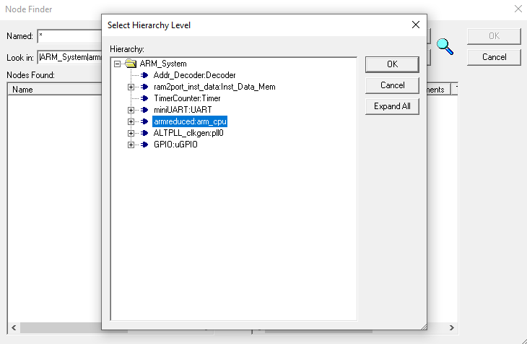
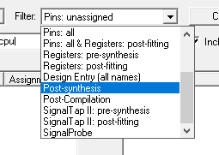
Time Simulation
LEDG7 is not turned on
when SW1 and SW0 are turned off
LEDG7 is turned on
when both SW1 and SW0 are turned on

Slide 20
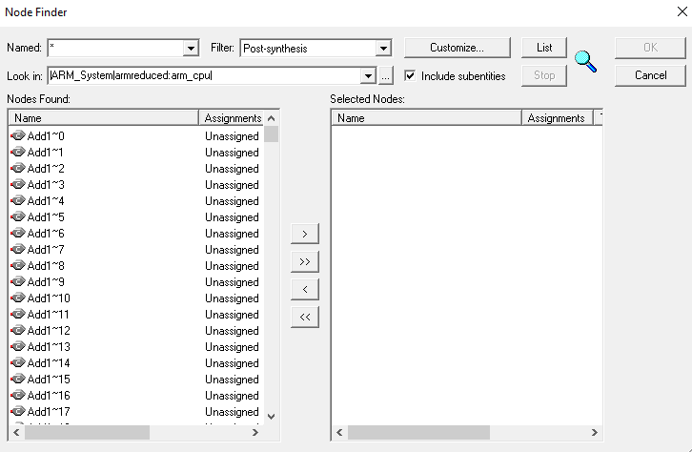
Time Simulation
LEDG7 is not turned on
when SW1 and SW0 are turned off
LEDG7 is turned on
when both SW1 and SW0 are turned on

Slide 21
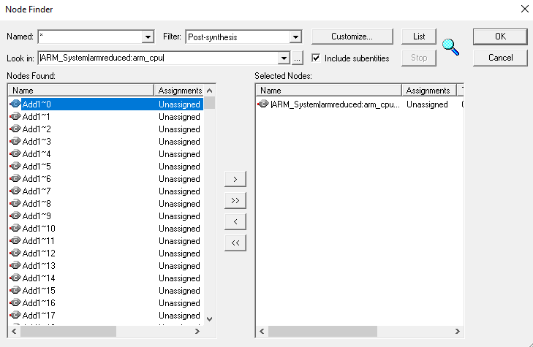
Time Simulation
LEDG7 is not turned on
when SW1 and SW0 are turned off
LEDG7 is turned on
when both SW1 and SW0 are turned on

Slide 22
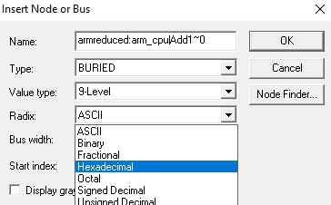
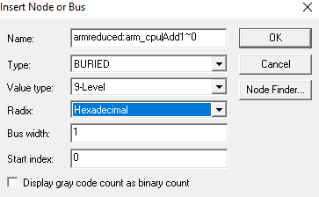
Time Simulation
LEDG7 is not turned on
when SW1 and SW0 are turned off
LEDG7 is turned on
when both SW1 and SW0 are turned on

Slide 23
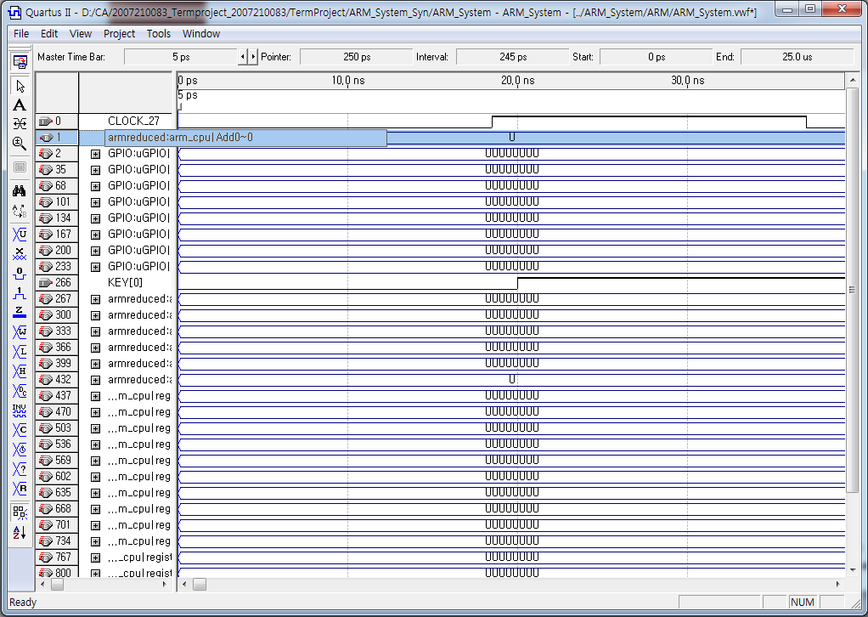
Time Simulation
Success
LEDG7 is not turned on
when SW1 and SW0 are turned off
LEDG7 is turned on
when both SW1 and SW0 are turned on

Slide 24
Q&A
If you have any question, mail to TA
(eunjin_lee@korea.ac.kr)

