Slide 1
Single-Cycle ARM Processor Design 2nd Term Project
Single-cycle Processor
TA: Eunjin Lee
Email: eunjin_lee@korea.ac.kr

Slide 2
Overview
Instruction Analysis
Control Signal Analysis
Module Implementation
1st Term Project
2nd Term Project

Slide 3
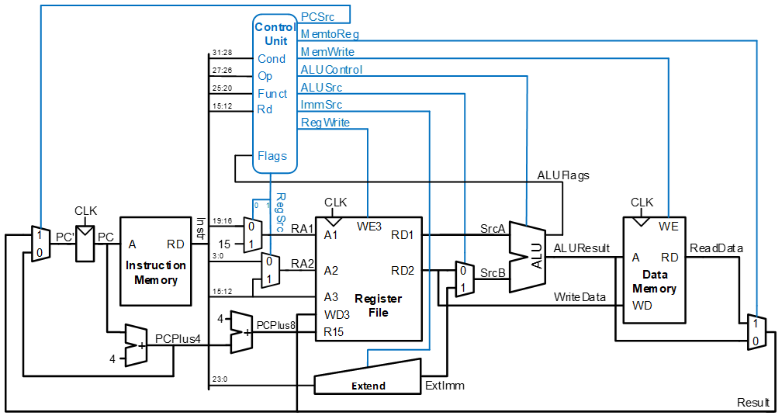
Overview
ARMProcessor.v
ControlUnit.v
ALU.v
RegisterFile.v
Extend.v

Slide 4
Overview

Slide 5
Overview
Given processor can run following instructions
Branch : B, BL
Arithmetic : ADD, SUB, CMP, MOV
Load/Store : LDR, STR
Given processor can run following suffixes
Logical : EQ, NE (‘Z’ in ‘NZCV’)
Addressing Modes
Addressing Mode 1 : 1 (immediate), 2 (register)
Addressing Mode 2 : 1 (immediate offset), 2 (register offset)

Slide 6
Overview
Clock
2)
4)
1)
3)
5)
6)
1 Clock Cycle
Clock 0: blue, Clock 90: red
(Clock 0 is memory-related, Clock 90 is register file-related)
1) Instruction fetch (Clock 0’s posedge)
2) Check condition code & Initialize control signal
3) Register read (Clock 90’s posedge)
4) ALU
After ALU operation: Update NZCV
5) Memory read / write (Clock 0’s negedge)
6) Register write (Clock 90’s negedge)

Slide 7
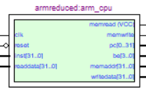
Module
ARMProcessor module
Input
clk : Clock 90
reset : 1 if press “KEY0” button
inst[31:0] : current instruction
readdata : data from memory
Output
pc : instruction address (starting at 0)
be[3:0] : 1111(2) (default) – don’t change!
memaddr[31:0] : data address
memread : 1(2) (default) – don’t change!
memwrite : specify whether memory is to be written
writedata[31:0] : write data to memory

Slide 8
Module
RegisterFile Module
Register 14 ($14) – Link Register (LR)
This register holds the address of the next instruction after a Branch and Link instruction
$14 = PC + 4
Register 15 ($15)
It can be used in most instructions as a pointer to the instruction which is two instructions after the instruction being executed
$15 = PC + 8
PC (It is different with Register 15($15))
PC (next instruction) = PC (current instruction) + 4

Slide 9
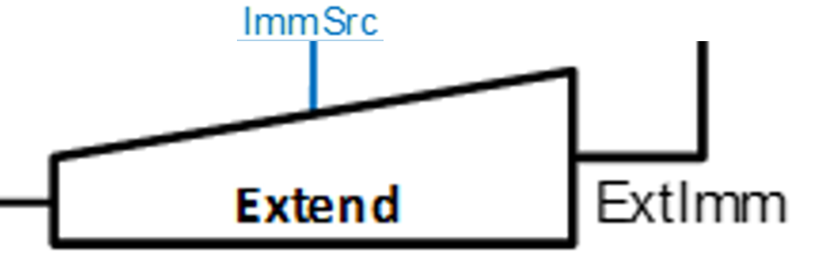
Module
Extend Module
Data Processing Type: zero extended-imm8
0000/1010(2) -> 0000/0000/0000/0000/0000/0000/0000/1010(2)
Load/Store Type: zero extended-imm12
0000/1010/0000(2) -> 0000/0000/0000/0000/0000/0000/1010/0000(2)
Branch Type: sign-extended-imm24, shifting left two bits
1000/0000/0000/0000/1010/0000(2) -> 1111/1110/0000/0000/0000/0010/1000/0000(2)
0000/0000/0000/0000/1010/0000(2) -> 0000/0000/0000/0000/0000/0010/1000/0000(2)

Slide 10
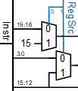
Control signal
RegSrc
RegSrc[0] = “0” : ADD, SUB, CMP, MOV, LDR, STR
Using Register[inst(19:16)]
RegSrc[0] = “1” : B, BL
Using Register[15] for calculating branch target address

Slide 11
Reference
Single-cycle processor in ARM
https://cs631.cs.usfca.edu/guides/single-cycle-processor
https://pages.hmc.edu/harris/class/e85/old/fall19/lect19.pdf
https://redirect.cs.umbc.edu/~jtang/archives/cs411.f21/lectures/L12SingleCycleControl.pdf
Verilog https://www.chipverify.com/verilog/verilog-tutorial

