Slide 1

Computer Architecture
Assignment #1: ARM Instruction Analysis
Q & A
Eun Jin Lee (eunjin_lee@korea.ac.kr)
Intelligent Computer Architecture & Systems Lab.

Slide 2
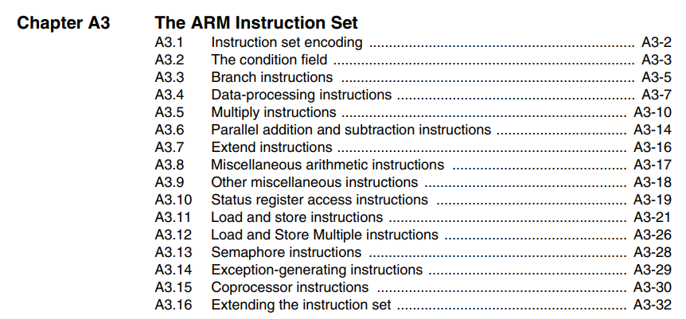
Q & A: 1
Q: How to analyze instruction by referring to manual?
A: If the explanation in Chapter A4 is not enough, please refer to Chapter A3 instead.
Data-processing instruction: Move(MOV), Compare(CMP)
Branch instruction: Branch(B)
Load and store instruction: Load(LDR), Store(STR)

Slide 3
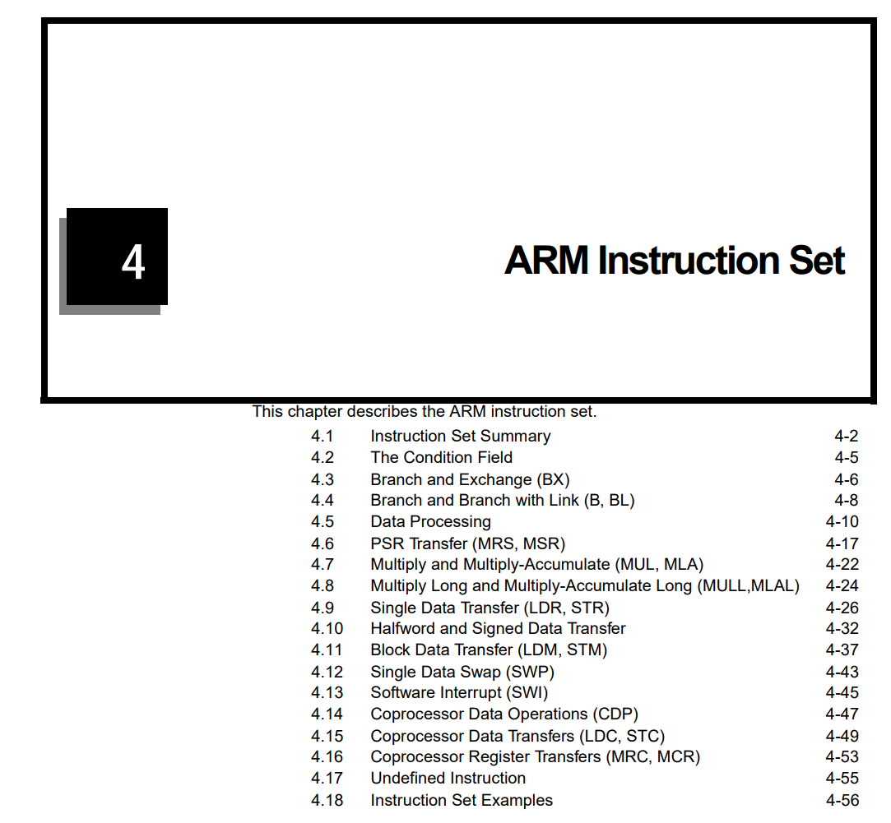
Q & A: 1
Q: How to analyze instruction by referring to manual?
A: Or you can refer to this material(arm_inst_set_manual2.pdf) instead.

Slide 4
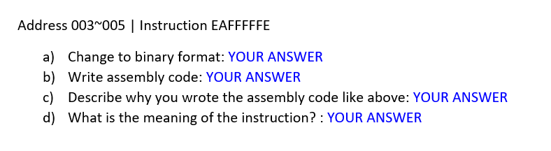
Q & A: 2
Q: How should I write the answer of instruction which is located at address [003:005]?
A: Regard it as one instruction (It means you can write the answer just for one time)

Slide 5
Q & A: 3
Q: How should I write target address or value in assembly code? Decimal? Or Hexadecimal?
A: I hope you write it in decimal. However, there is no minus point if you write the answer in hexadecimal.

Slide 6
Q & A: 4
Q: How should I write target address or value in assembly code? Decimal? Or Hexadecimal?
A: I hope you write it in decimal. However, there is no minus point if you write the answer in hexadecimal.

Slide 7
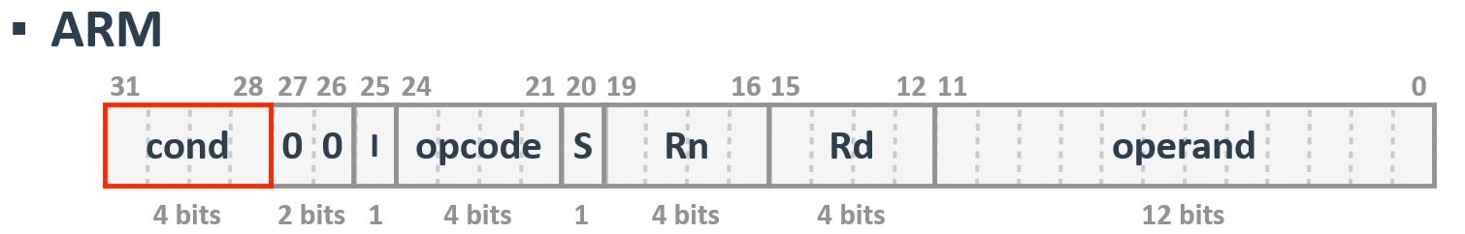
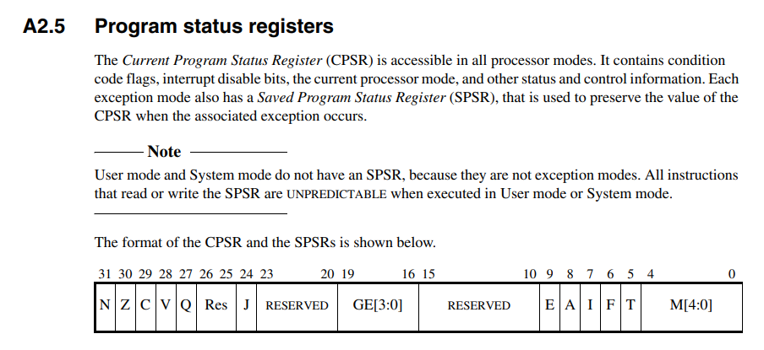


Q & A: 5
Q: I have trouble understanding the difference between condition field and condition flag.
A: The condition field is the part of instruction field, and the condition flag is the part of register(=program status register) field.

Slide 8
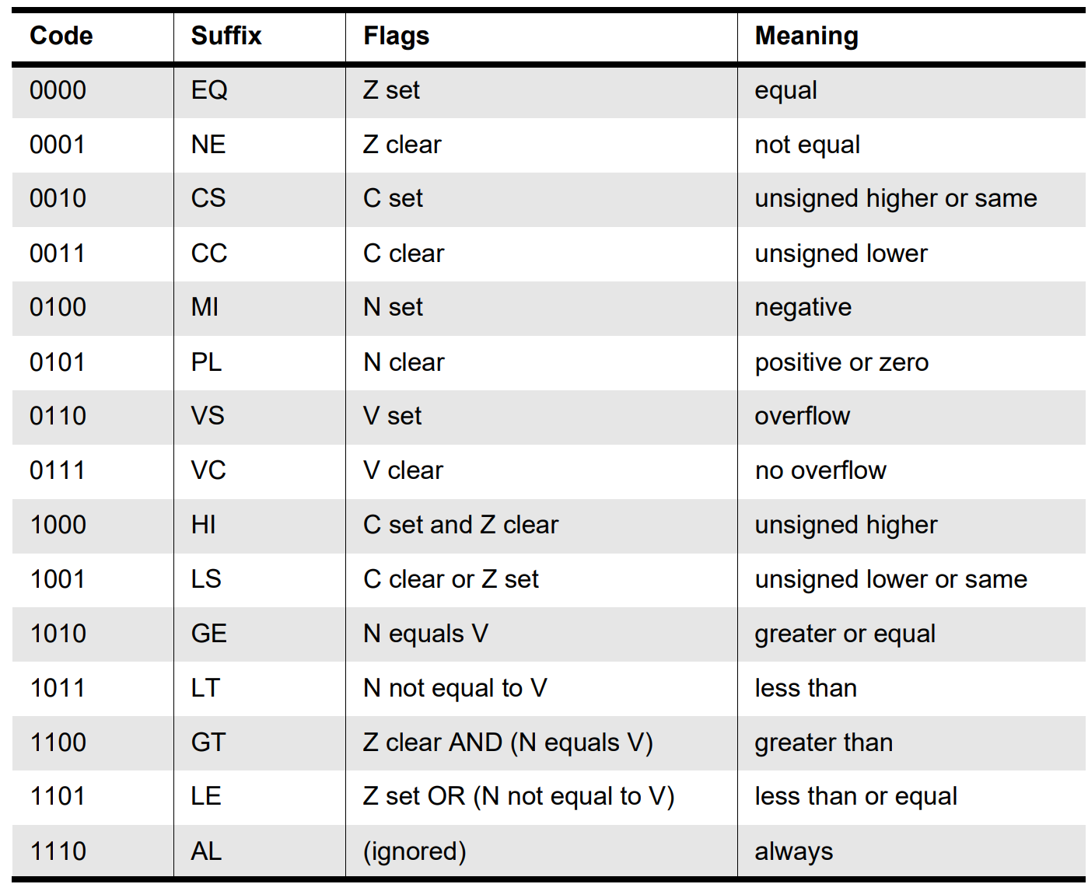
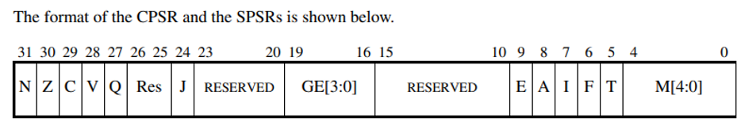


Q & A: 5
Q: I have trouble understanding the difference between condition field and condition flag.
A: So, if the condition field is AL(Always) N, V, C flag will be not set.
This not means N, Z, C flags will be 1, and V flag will be 0!

Slide 9
Q & A: 5
Q: I have trouble understanding the difference between condition field and condition flag.
A: If the condition to execute the instruction is meet, the instruction will be executed successfully. The condition here means ‘is the flag state is equal to flags of the condition field?’.

Slide 10
Q & A: 5
Q: I have trouble understanding the difference between condition field and condition flag.
A: For example, when the condition field is 0000(Suffix: EQ), this means ‘check whether the z flag in the program status register is set’ and doesn’t mean ‘set z flag to be set’.

Slide 11
Q & A: 6
Q: I don’t know how to write assembly code with suffix.
A: Let the given instruction is branch, target address is 100, and the condition field is 0000 (Suffix: EQ). Because the suffix is EQ, you should write assembly code like BEQ #100; (Wrong: B #100;)
However, you can omit this(suffix) when the suffix is AL(always). (e.g., BAL #100; (o) B #100; (o))

Slide 12
Q & A: 7
Q: When I write the execution flow of the given instructions, should I write all the instructions? I mean, if the instruction which is located at 000 address branches to 005 address(just for example), is it okay to omit the instructions located at 001~004 addresses?
A: Yes, if you write the execution flow you can write just 000 -> 005 -> so on address. However, don’t forget that you should analyze (e.g., write assembly code) all given instructions.

Slide 13
Q&A
If you have any questions about Assignment #1, mail me. (eunjin_lee@korea.ac.kr)

