Slide 1
Lab 1: Simulator

Slide 2
Objective
To get familiar with a logic simulator
To develop understanding of how logic gates work

Slide 3
Getting Started
Download this file (Lab1.pptx) from Blackboard
Open a web browser and go to www.circuitverse.org
Click “Launch Simulator”

Slide 4
Lab 1-1
Put an OrGate
Change its BitWidth to 8
Put two Inputs
Change their BitWidth to 8
Connect them to the input ports of the OrGate
Put an Output
Change its BitWidth to 8
Connect it to the output port of the OrGate
Change the Inputs and observe how the Output changes

Slide 5
Lab 1-2
Put a Multiplexer
Change it BitWidth to 4
Change its Control Signal Size to 2
Put 4 ConstantVals
Change their BitWidth to 4
Change their value to whatever you want
Connect them to input ports of the Multiplexer
Place an Input
Change its BitWidth to 2
Connect it to the Control Signal port of the Multiplexer
Place a HexDisplay
Connect it to the output port of the Multiplexer
Change the Input and observe what is displayed at the Multiplexer

Slide 6
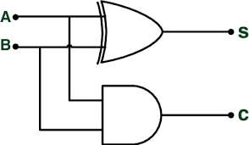
Lab 1-3
Implement a half adder
Circuit → New Circuit + → “HalfAdder”
A | B | C | S
0 | 0 | 0 | 0
0 | 1 | 0 | 1
1 | 0 | 0 | 1
1 | 1 | 1 | 0

Slide 7
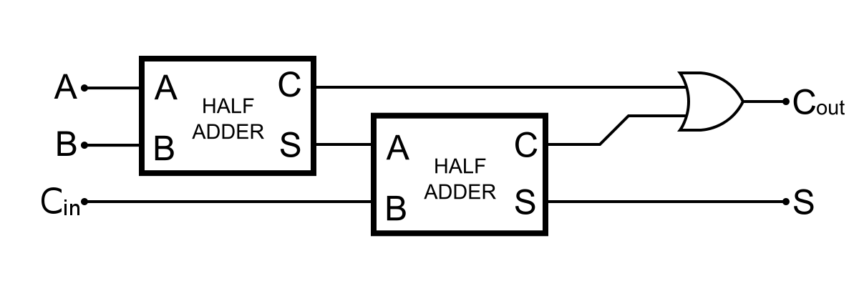
Lab 1-4
Implement a full adder
Circuit → New Circuit + → “FullAdder”
Insert SubCircuit → Select “HalfAdder”

Slide 8

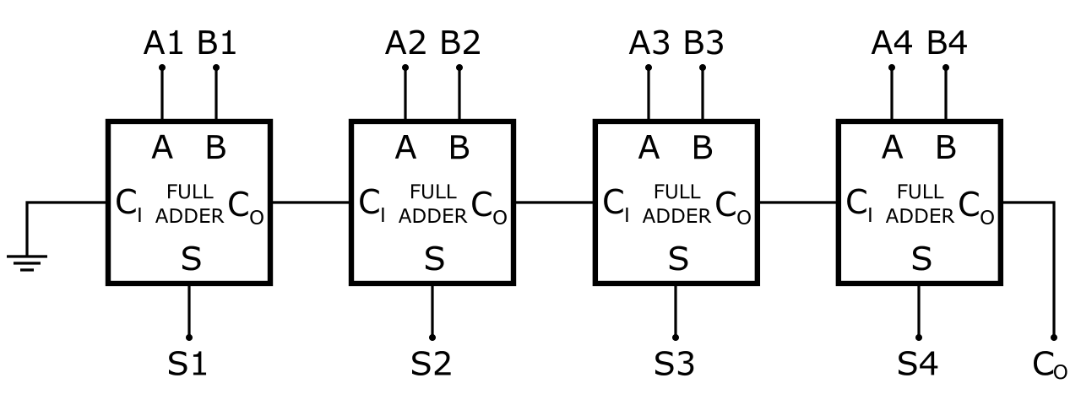
Lab Assignment
Build a 4-bit full adder
Save your design (login is required) and submit the HTML code.
Project → Save Online → </>Embed → Submit to Blackboard

