Slide 1
Lab 2: Logic Optimization

Slide 2
Objective
To develop understanding of how to optimize combinational logic

Slide 3
Getting Started
Download this file (Lab2.pptx) from Blackboard
Open a web browser and go to www.circuitverse.org
Click “Launch Simulator”

Slide 4
Lab 2-1
Implement the following truth table using two-level logic (ANDs followed by Ors)
A | B | C | Y
0 | 0 | 0 | 0
0 | 0 | 1 | 1
0 | 1 | 0 | X
0 | 1 | 1 | X
1 | 0 | 0 | X
1 | 0 | 1 | 1
1 | 1 | 0 | 0
1 | 1 | 1 | 1

Slide 5
Lab 2-2
Implement the following truth table using a multiplexer
A | B | C | Y
0 | 0 | 0 | 0
0 | 0 | 1 | 1
0 | 1 | 0 | X
0 | 1 | 1 | X
1 | 0 | 0 | X
1 | 0 | 1 | 1
1 | 1 | 0 | 0
1 | 1 | 1 | 1

Slide 6
Lab 2-3
Implement the following truth table using a decoder
A | B | C | Y
0 | 0 | 0 | 0
0 | 0 | 1 | 1
0 | 1 | 0 | X
0 | 1 | 1 | X
1 | 0 | 0 | X
1 | 0 | 1 | 1
1 | 1 | 0 | 0
1 | 1 | 1 | 1

Slide 7
Lab 2-4
Implement the following truth table using AND, OR and NOT gates after optimizing it by K-map
A | B | C | Y
0 | 0 | 0 | 0
0 | 0 | 1 | 1
0 | 1 | 0 | X
0 | 1 | 1 | X
1 | 0 | 0 | X
1 | 0 | 1 | 1
1 | 1 | 0 | 0
1 | 1 | 1 | 1

Slide 8
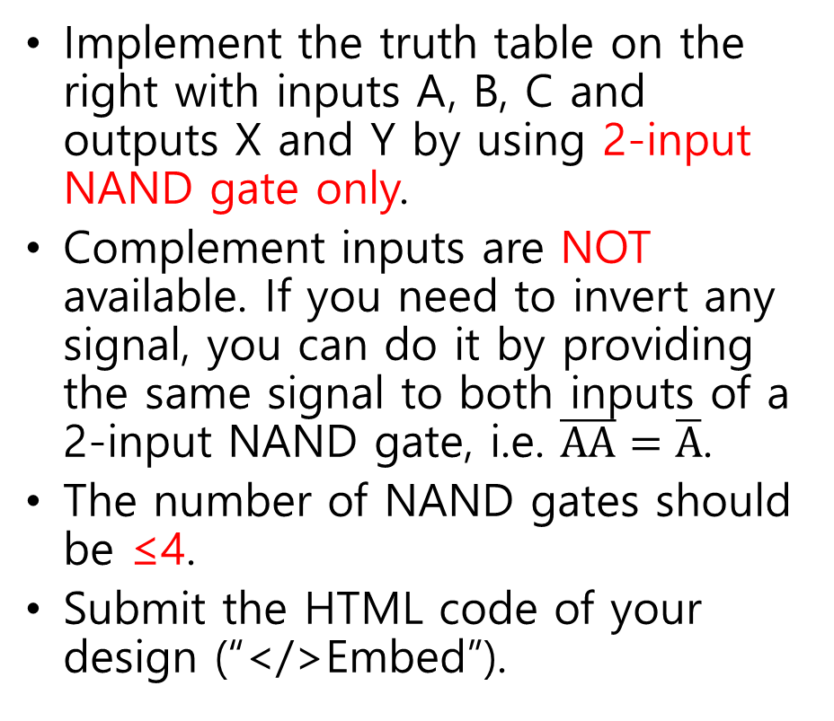
Lab Assignment
Implement the truth table on the right with inputs A, B, C and outputs X and Y by using 2-input NAND gate only.
Complement inputs are NOT available. If you need to invert any signal, you can do it by providing the same signal to both inputs of a 2-input NAND gate, i.e. $\overline{AA}=\overline{A}$.
The number of NAND gates should be ≤4.
Submit the HTML code of your design (“</>Embed”).
A | B | C | X | Y
0 | 0 | 0 | 0 | 1
0 | 0 | 1 | 1 | 0
0 | 1 | 0 | 0 | 1
0 | 1 | 1 | 1 | 0
1 | 0 | 0 | 0 | 1
1 | 0 | 1 | 1 | 0
1 | 1 | 0 | 1 | 1
1 | 1 | 1 | 1 | 1

