Slide 1

MarketMind AI: Autonomous Business Research Agent
A University Research Presentation — Formal Academic Defence

Slide 2

The Business Problem: Manual Market Research
⏱ 28–40 Hours
Analyst time consumed per single market brief
🔍 Bottleneck
Manual source discovery, synthesis, and verification
💸 Cost Impact
High-value analyst time spent on routine research tasks
⚠ Quality Risk
Inconsistent source evaluation and citation practices

Slide 3



Why Chatbots Fall Short
Hallucination
Black Box
No provenance tracking — claims lack source attribution entirely
Users cannot verify reasoning chain or underlying evidence
No Tool Integration
Unfit for Research
Cannot autonomously search, validate, or cite sources
Designed for conversation — not evidence-based synthesis

Slide 4




MarketMind AI: The Solution
Autonomous Agent
Evidence-First
Conducts research end-to-end with human oversight at every stage
Every claim backed by cited sources with full provenance metadata
Transparent Reasoning
Specialised Tools
Workflow fully visible; humans approve outputs before delivery
Web search, document parsing, data extraction, and synthesis

Slide 5
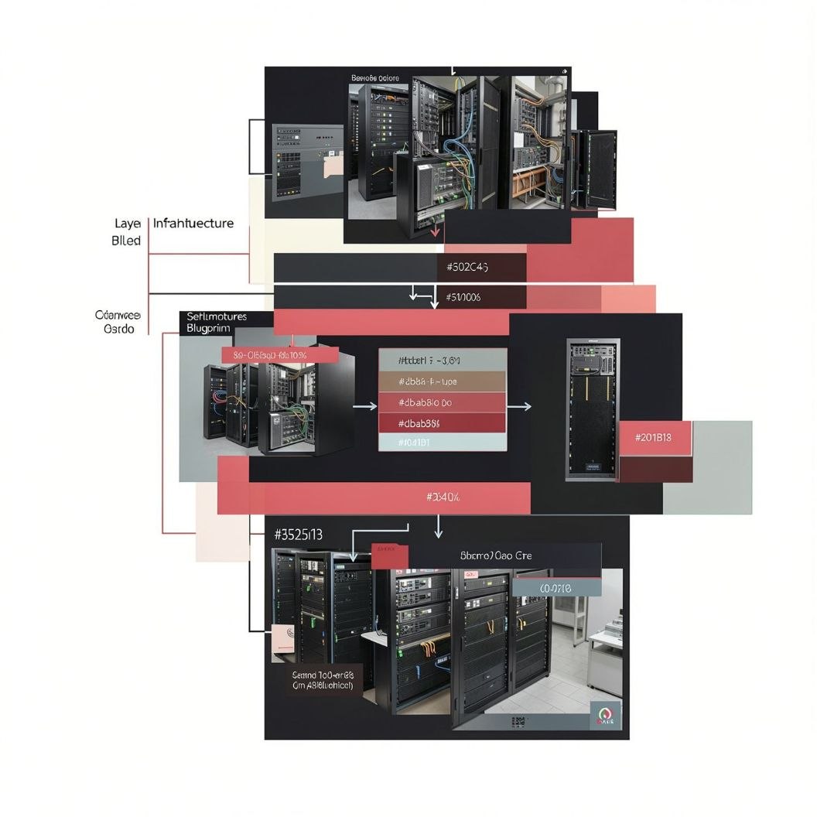
System Architecture
Core Architectural Layers
1
Agent Orchestrator
Manages research workflow and tool sequencing
2
Tool System
Search, retrieval, parsing, validation, and synthesis
3
Evidence Store
Tracks all sources, quotes, and provenance metadata
4
Human-in-the-Loop
Review and approval gates before output delivery

Slide 6





Agent Components & Responsibilities
Research Planner
Source Discoverer
Evidence Extractor
Decomposes brief into structured research questions
Finds relevant documents and authoritative web sources
Pulls quotes, data, and key findings with citations
Synthesizer
Uncertainty Handler
Integrates findings into a coherent, structured narrative
Flags gaps, conflicts, and evidence confidence levels

Slide 7
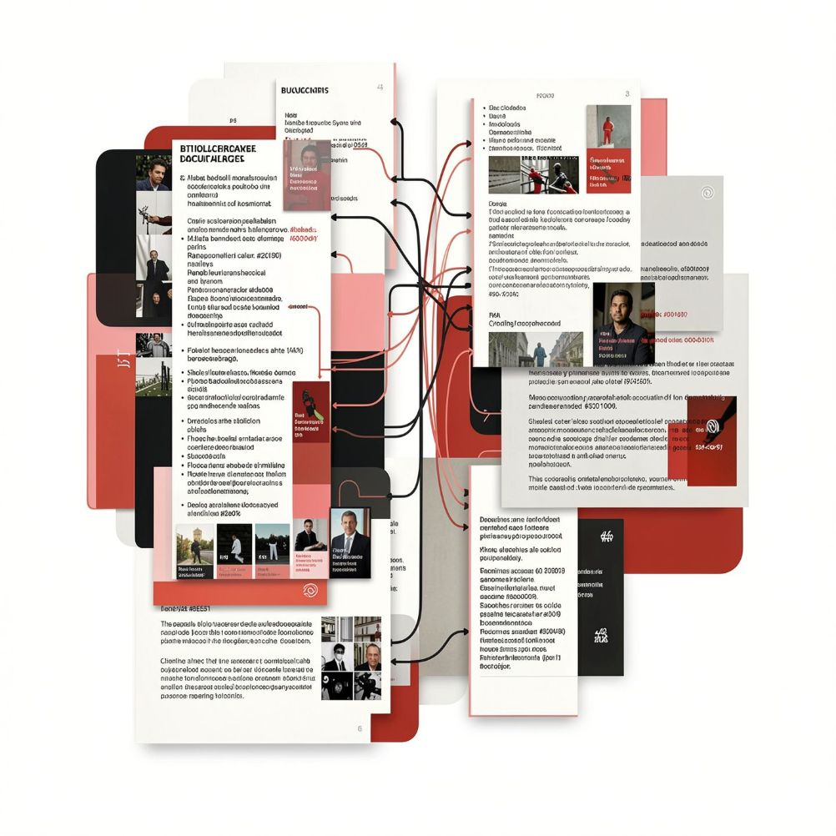

Tool System & Provenance
Every tool in the pipeline is designed around a single principle: no claim without a source.
Web Search
Document Retrieval
Data Extraction
Citation Engine
Ranked results with source URLs and content snippets
Extracts text from PDFs, reports, and regulatory filings
Parses tables, metrics, and structured data accurately
Maintains full quote-to-source mapping for every claim
Confidence Scoring
Rates evidence quality and overall source reliability

Slide 8
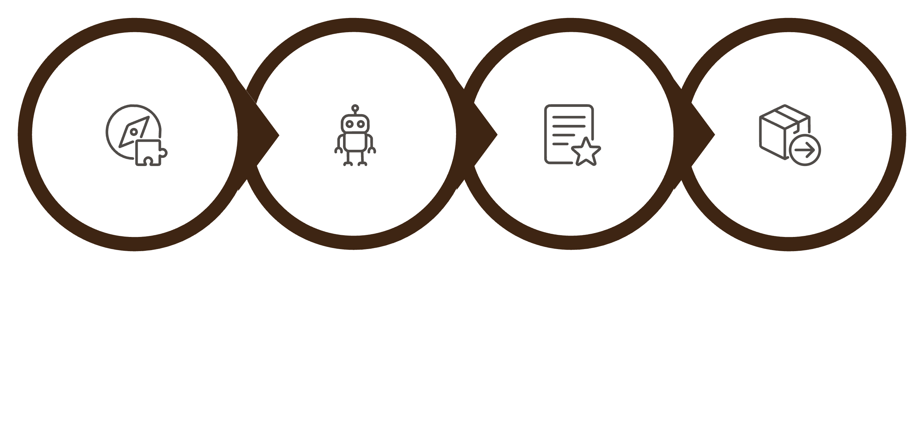

Research Workflow & Human Approval
Autonomous Execution
Human Review
Approval & Delivery
Agent Plans
Every brief includes a full provenance record and audit trail — suitable for compliance and academic scrutiny.

Slide 9
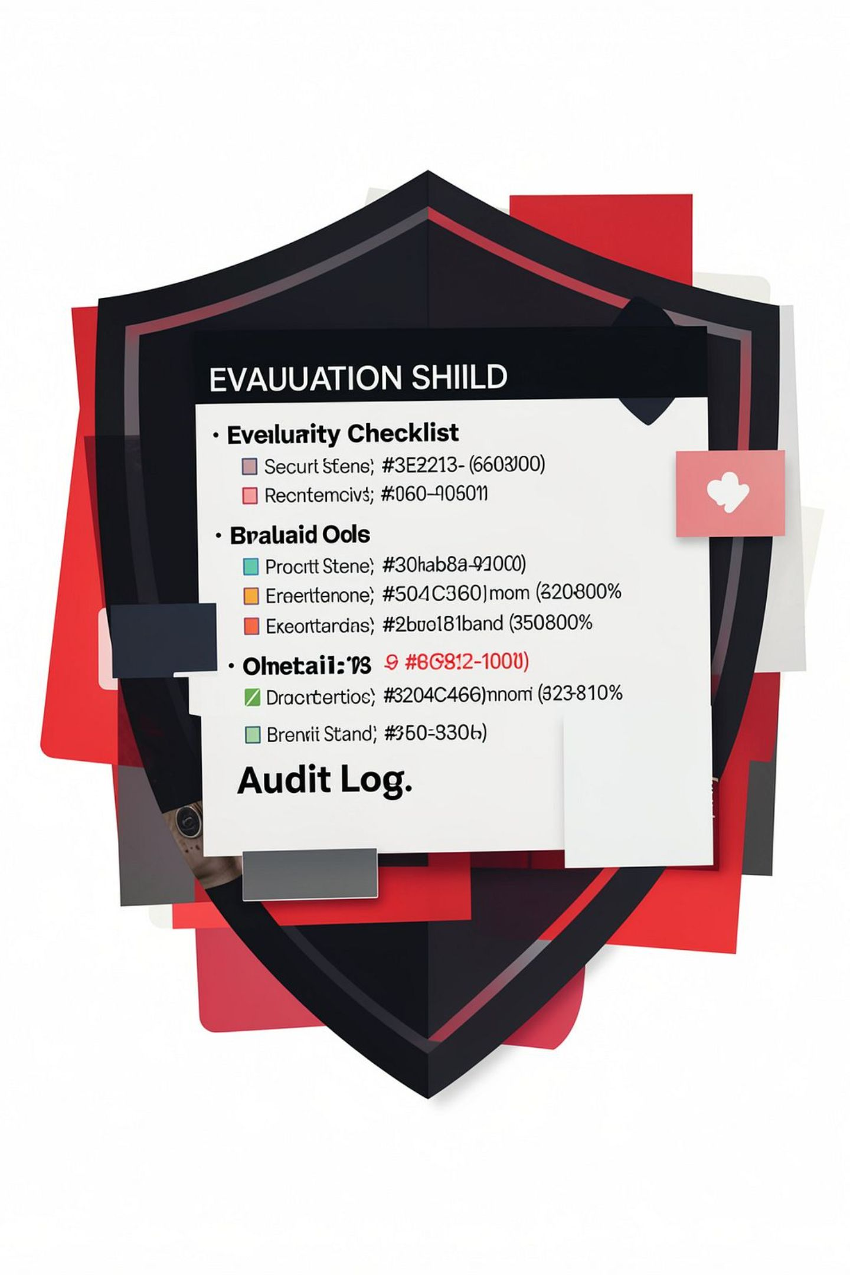




Security, Safety & Evaluation
Source Validation
Filters for credible, authoritative sources only
Bias Detection
Flags conflicting evidence and alternative viewpoints
100-Point Evaluation
Scores accuracy, completeness, citation quality, and clarity
Audit Trail
Every decision logged for compliance and peer review

Slide 10
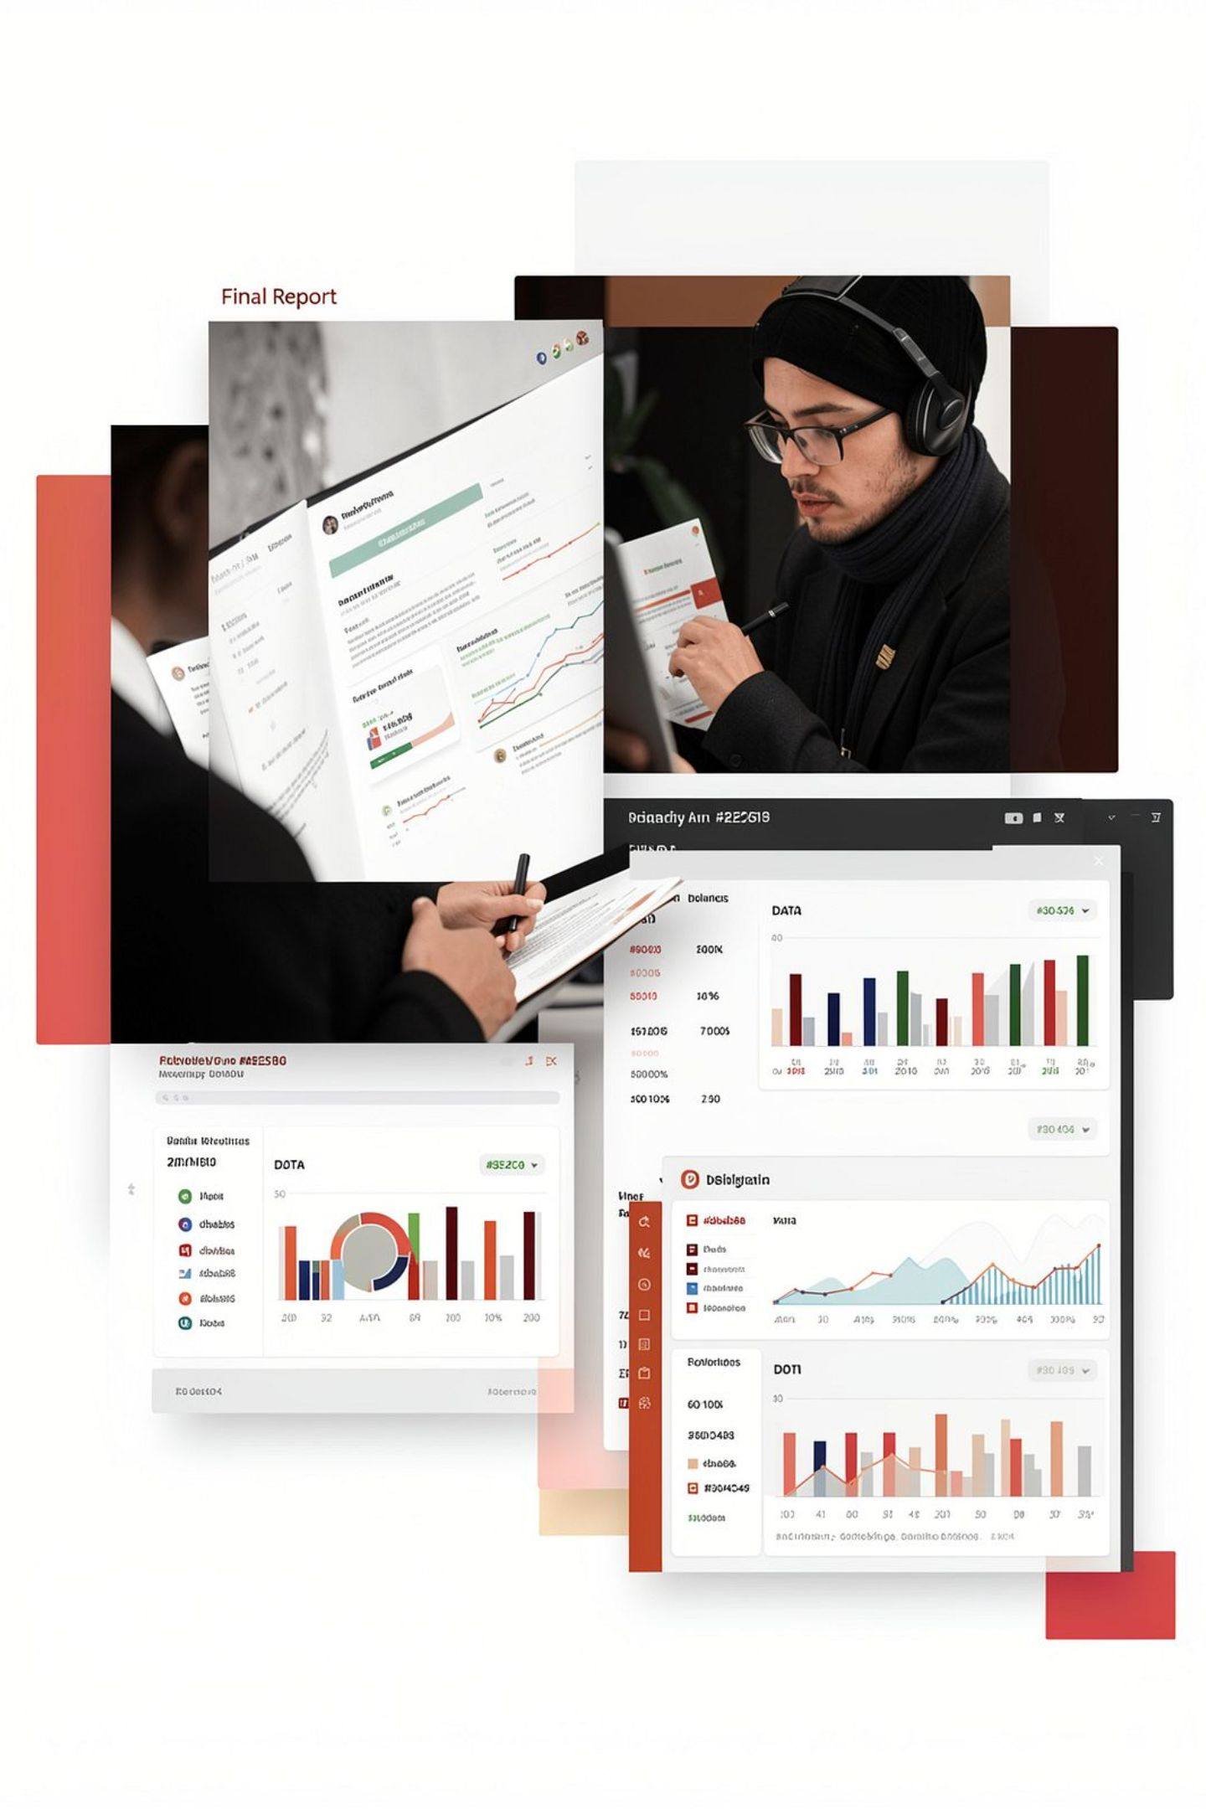
Expected Impact & Conclusion
4–6h
Brief Turnaround
Down from 28–40 hours per market brief
10x
Analyst Capacity
Handle 5–10× more briefs annually
Quality
Trust
Consistent, evidence-backed research with full provenance
Transparent reasoning and human oversight build stakeholder confidence
Questions?

