Slide 1

Customer Churn Prediction using Machine Learning
Python Machine Learning Internship Project
B.TECH COMPUTER SCIENCE
INTERNSHIP PROJECT

Slide 2

Introduction
What is Customer Churn?
Customer churn occurs when customers stop doing business with a company — canceling subscriptions, closing accounts, or switching to competitors. It is a critical metric for subscription-based industries like telecom.
Why Predict Churn?
Acquiring a new customer costs significantly more than retaining an existing one. Early churn prediction allows businesses to take proactive steps — personalized offers, improved support, or targeted outreach — before customers leave.
Role of Machine Learning
ML algorithms can identify patterns in customer behavior that signal churn risk. By learning from historical data, these models predict which customers are most likely to leave, enabling data-driven retention strategies.

Slide 3
Project Objectives
This project aims to build and evaluate machine learning models that predict customer churn using a real-world dataset.
1
2
Predict Customer Churn
Compare Three Algorithms
Build ML models capable of classifying customers as churners or non-churners based on historical data.
Train and evaluate Logistic Regression, KNN, and Naive Bayes on the same dataset for a fair comparison.
3
4
Evaluate Model Accuracy
Identify the Best Model
Measure each model's performance using prediction accuracy as the primary evaluation metric.
Determine which algorithm delivers the highest accuracy and is most suitable for churn prediction tasks.

Slide 4

DATASET
Telco Customer Churn Dataset
Source: Kaggle
This widely-used benchmark dataset contains records for over 7,000 customers of a telecommunications company. It is structured, clean, and well-suited for binary classification tasks.
Demographics
Subscriptions
Billing Info
Churn Label
Age, gender, tenure, and senior citizen status
Phone, internet, streaming, and contract type
Monthly charges, total charges, and payment method
Binary target variable — Yes or No

Slide 5
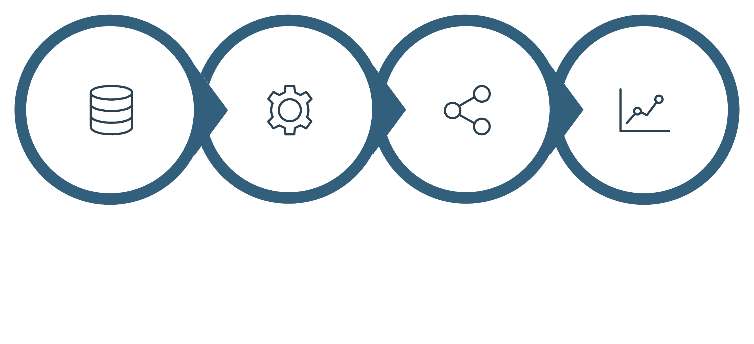
Methodology
The project follows a structured machine learning pipeline — from raw data collection to final model evaluation — ensuring reproducibility and rigor at each stage.
Data Prep
Model Train
Prediction
Evaluation
Each phase builds on the previous one. Data preprocessing ensures quality input, model training learns patterns, prediction generates outputs, and evaluation identifies the best-performing algorithm.

Slide 6

Algorithms Used
Logistic Regression
A probabilistic linear model that estimates the probability of a binary outcome. Simple, interpretable, and effective as a baseline classifier for churn prediction.
K-Nearest Neighbors (KNN)
A non-parametric algorithm that classifies a customer based on the majority class among their k closest neighbors in feature space. Intuitive and easy to implement.
Naive Bayes
A probabilistic classifier based on Bayes' theorem with an assumption of feature independence. Computationally efficient and robust even with limited training data.

Slide 7

Advantages of This Approach
Simple Implementation
All three algorithms are straightforward to implement using Python libraries like scikit-learn, making the project accessible and reproducible.
Fast Prediction
Once trained, these models generate predictions almost instantly — suitable for real-time or batch churn scoring in production systems.
Actionable for Retention
Churn predictions directly inform business decisions — enabling targeted retention campaigns before customers leave.
Easy Algorithm Comparison
Using a common dataset and evaluation metric allows a fair, transparent comparison to identify the best-performing model.

Slide 8
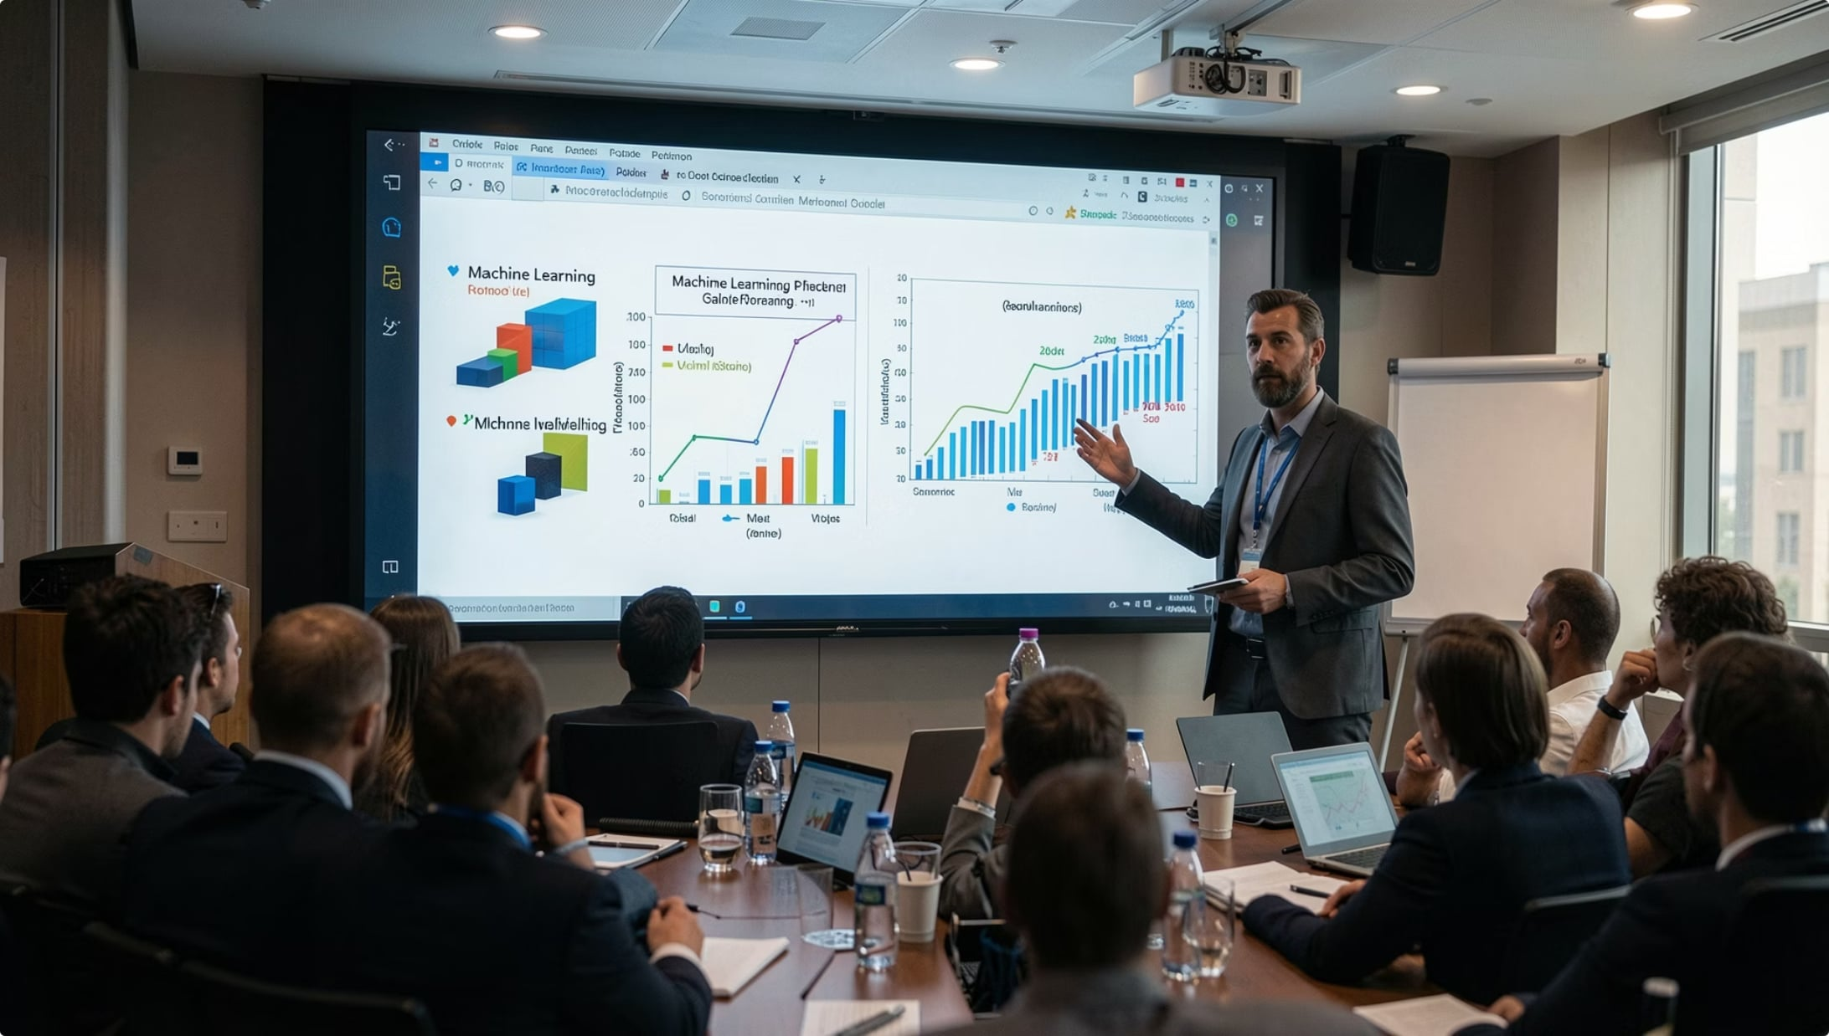
Conclusion
ML Successfully Predicts Churn
Machine learning models can effectively learn from customer data to predict churn behavior, demonstrating the practical value of supervised classification.
Algorithm Comparison is Essential
No single algorithm is universally best. Comparing Logistic Regression, KNN, and Naive Bayes on the same data reveals which model is most suitable for this specific problem.
Real-World Applicability
This project demonstrates how Python and ML can be applied to solve a genuine business problem — bridging academic concepts with industry use cases.

Slide 9


Thank You
This project was developed as part of a B.Tech Computer Science internship, applying Python and machine learning to a real-world customer analytics problem.
Python
Machine Learning
Customer Analytics
Questions?
Feel free to ask about the dataset, methodology, algorithms, or results.

