Slide 1
Multi-Period Optimization for Power Distribution Systems with Battery Storage
Aryan Ritwajeet Jha
Notes:
Remember to hit the reset button to make sure all the page elements react properly.
There are 20 different layouts that you can choose from.

Slide 2
Receding-Horizon Optimization of Unbalanced Distribution Systems with Time-Scale Separation for Discrete and Continuous Control Devices
Power System Computation Conference (2018)
Nawaf Nazir and Mads Almassalkhi
Currently at PNNL Then: PhD at University of Vermont (UVM)
Currently Assoc. Prof. at UVM

Slide 3
Receding-Horizon Optimization of Unbalanced Distribution Systems with Time-Scale Separation for Discrete and Continuous Control Devices
Distribution System
Unbalanced
Mechanical Assets?
Significant Solar Penetration
Two Different Optimization Time-Scales
A slow time-scale for dispatching discrete mechanical assets using Mixed-Integer Program (MIP)
A fast time-scale for continuously monitoring DERs using SOCP.

Slide 4
Receding-Horizon Optimization of Unbalanced Distribution Systems with Time-Scale Separation for Discrete and Continuous Control Devices
Two Different Optimization Time-Scales
Different Types of discrete and continuous operated devices.
E.g. Capacitor/Reactor Banks, Line Regulators (On/Off), Load-Tap-Changing (LTC) Transformers
Discrete states of these devices render the problem NP-hard. (So, they were NOT NP-hard anyway?)
McCormick relaxation and linearization techniques have been used to incorporate these devices into the OPF problem for a BALANCED network. [16b]
This necessitates the use of separate optimization loops to coordinate them.
Mechanical assets also have operational constraints on tap changes per hour to limit wear and tear, which necessitates separation.

Slide 5
Receding-Horizon Optimization of Unbalanced Distribution Systems with Time-Scale Separation for Discrete and Continuous Control Devices
Novel hierarchical OPF scheme for separation of the slow-mechanical (discrete control scheme) and fast power-electronic (continuous control scheme) on two different time-scales.
Service Transformer Layers (STL) elements dispatched optimally using Multi-Period three-phase SOCP convex relaxation techniques applied to radial distribution networks for fast corrective control.
Simultaneous charging and discharging of batteries in a convex model of 3-phase system is also analyzed and conditions are provided under which this can be avoided.

Slide 6
Receding-Horizon Optimization of Unbalanced Distribution Systems with Time-Scale Separation for Discrete and Continuous Control Devices
Outer Loop Formulation
Want to minimize number of changes in mechanical discrete control components to reduce wear and tear.

Slide 7
Optimal Multi-Period Dispatch of Distributed Energy Resources in Unbalanced Distribution Feeders
IEEE TRANSACTIONS IN POWER SYSTEMS (2020)
Nawaf Nazir, Pavan Racherla and Mads Almassalkhi
Currently at PNNL PhD at University of Vermont (UVM)
Currently Asst. Prof. at UVM
Currently Assoc. Prof. at UVM

Slide 8
Optimal Multi-Period Dispatch of Distributed Energy Resources in Unbalanced Distribution Feeders
Distribution System
Unbalanced
Inverter-Interfaced
Significant Solar Penetration
Three-Phase Unbalanced
Non-Convex Loss-minimization problem
Formulated as a Convex Second Order Conic Program (SOCP) for arriving at an initial solution for Non-Linear Program (NLP)
NLP run to ensure physically realizable solution

Slide 9
Optimal Multi-Period Dispatch of Distributed Energy Resources in Unbalanced Distribution Feeders
Conditions derived to ensure that batteries do NOT simultaneously charge and discharge. (Is that a big problem?)
Tested with GridLab-D for IEEE 13 and IEEE 123.
AC feasibility of the solutions ensured
Near-optimal performance
Solution time < 1 min.

Slide 10
Optimal Multi-Period Dispatch of Distributed Energy Resources in Unbalanced Distribution Feeders
ConEd* of NY moving towards Distributed System Platforms (DSPs)
These DSPs allow for DERs to be factored into Optimization schemes for Power Generation
DERs can be Optimized to function as Virtual Batteries (VBs)
provide energy services at different spatio-temporal scales.
* Consolidated Edison, electric utility in NY and NOT ComEd, Commonwealth Edison, electric utility in IL

Slide 11
Optimal Multi-Period Dispatch of Distributed Energy Resources in Unbalanced Distribution Feeders
Traditionally, DistFlow algorithms based on the Branch Flow Model (BFM), which are an exact non-linear formulation of the distribution power flow equations, only work on balanced single-phase equivalent networks.
But Distribution Networks are inherently unbalanced.

Slide 12
Optimal Multi-Period Dispatch of Distributed Energy Resources in Unbalanced Distribution Feeders
In [22] by the same authors, they have developed a three-phase convex SOCP relaxation of the multi-period OPF problem, and provided sufficient conditions which ensure the avoidance of simultaneous charging and discharging.
In this paper, they extend the work by developing a Multi-Period SOCP-NLP algorithm that provides a near optimal and guaranteed feasible solution.

Slide 13
Optimal Multi-Period Dispatch of Distributed Energy Resources in Unbalanced Distribution Feeders
The optimized solutions from the relaxed SOCP model, are used to initialize a Non-Linear Program (NLP) of the actual AC Power Flow, to obtain a physically realizable solution.
Real-Power Solutions that form the energy trajectory and are obtained from the SOCP, are fixed in the NLP, leading to a decoupling of the different time-steps. (What? How?)
As a result, the NLP solves for each time-step separately (possibly in-parallel), leading to a scalable framework. (What?)
Validation is performed using GridLab-D.

Slide 14
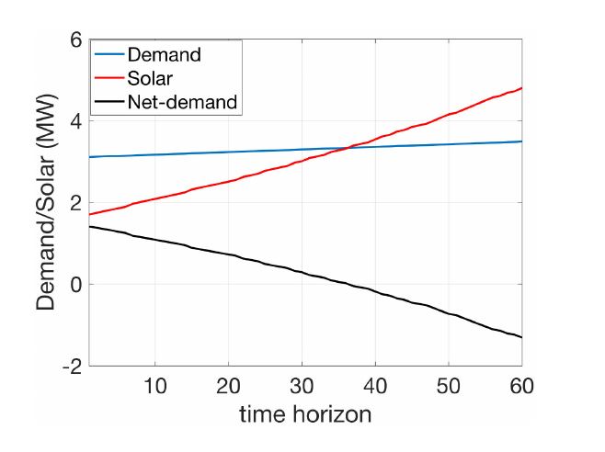


Optimal Multi-Period Dispatch of Distributed Energy Resources in Unbalanced Distribution Feeders
Case Study Description
IEEE $123$, Unbalanced, $kV_{B}=2.4, MVA_{B}=1$
Algorithm implemented in Receding-Horizon fashion.
Receding-Horizon means a rolling window where predictions for the next $T$ time-steps from time $t+1$to $t+T$are made at time $t,$and since predictions are updated at every time step, for the next time step $t+1$ , predictions for the next $T$ time steps from $t+2$to $t+T+1$ are once again made.
The cycle goes on.
Fig. Aggregate solar, demand and net-demand profile over a prediction horizon of $60 minutes.$

Slide 15
Optimal Multi-Period Dispatch of Distributed Energy Resources in Unbalanced Distribution Feeders
The SOCP solution outputs an optimal battery and inverter control schedule
The schedule is used by the NLP to calculate a physically realizable schedule
The physically realizable schedule is implemented by GridLab-D to determine the resulting AC Power Flows.
The forecast of demand and renewable generations are updated.
The Process

Slide 16
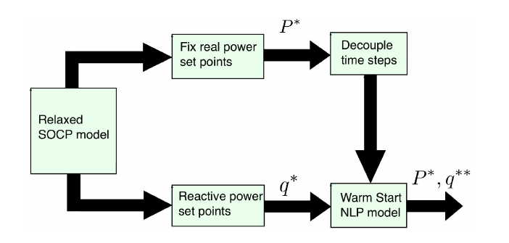
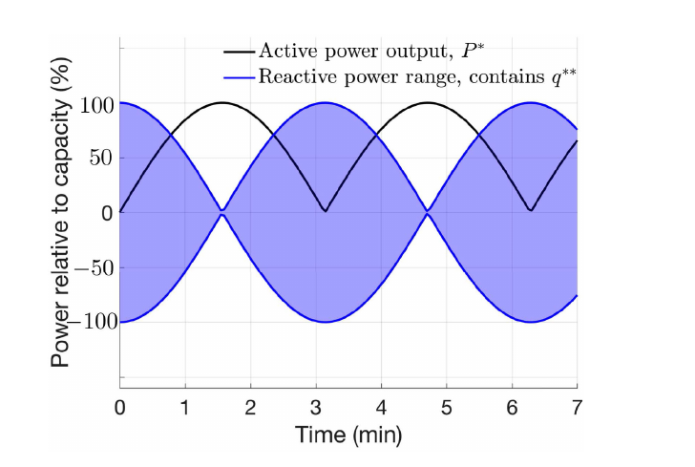
Optimal Multi-Period Dispatch of Distributed Energy Resources in Unbalanced Distribution Feeders
The Process
Fig. Coupling of SOCP with NLP by fixing real power solutions from SOCP and hence decoupling the NLP to obtain a feasible solution. (What? How?)
Fig. Available reactive power variation range for NLP across multiple time-steps based on the active power trajectory provided by the SOCP.

Slide 17

Optimal Multi-Period Dispatch of Distributed Energy Resources in Unbalanced Distribution Feeders
Case Study Description
Distributed Storage and Solar PV Units randomly added to $16$ nodes
They can supply active and reactive power through four quadrant operation.
Each storage unit has capacity $=40kWh$ and apparent power rating $=50kVA$
Each solar PV unit has a rating $=100kVA$
Solar and Load Profile prediction horizon $30 steps=30 min.$
Each step $=1 min.$

Slide 18

Optimal Multi-Period Dispatch of Distributed Energy Resources in Unbalanced Distribution Feeders
Case Study Description
Three-phase OPF is run in a receding horizon fashion with prediction horizon of $30$ time-steps, for the dispatch of controllable assets of the network to minimize network losses.
Set-points provided by the solutions of the SOCP are used to initialize an NLP to provide a feasible solution.
SOCP modeled in JuMP, with Julia and solved using GUROBI.
Multi-period SOCP has
$108$k variables (k as in thousand)
$48$k linear constraints
$81$k SOC constraints

Slide 19
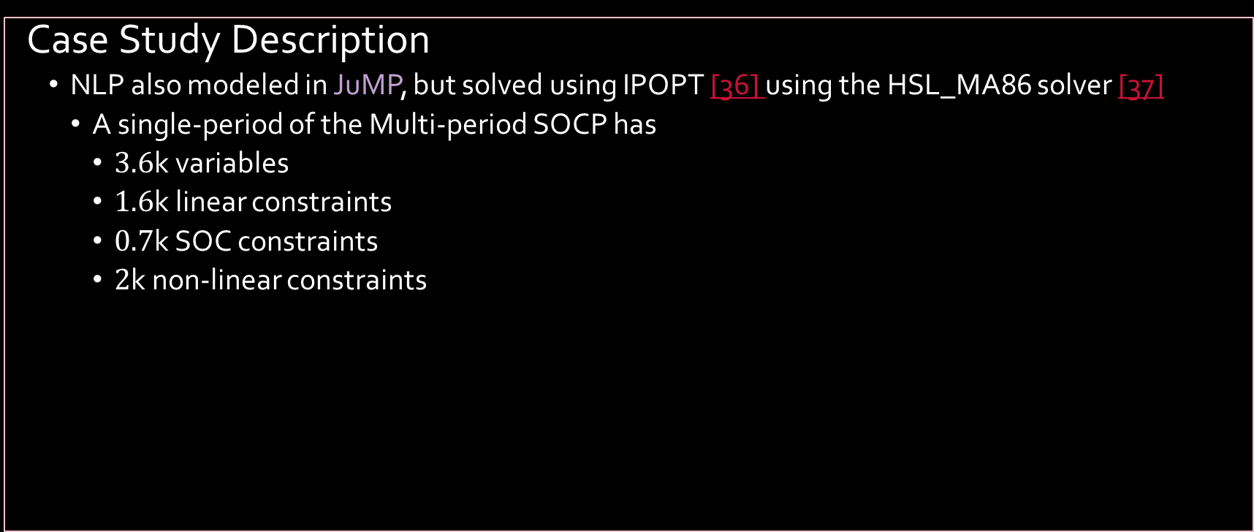
Optimal Multi-Period Dispatch of Distributed Energy Resources in Unbalanced Distribution Feeders
Case Study Description
NLP also modeled in JuMP, but solved using IPOPT [36] using the HSL_MA86 solver [37]
A single-period of the Multi-period SOCP has
$3.6$k variables
$1.6$k linear constraints
$0.7$k SOC constraints
$2$k non-linear constraints

Slide 20
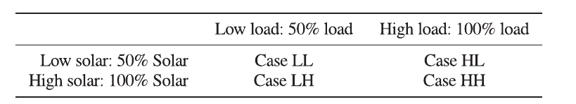

Optimal Multi-Period Dispatch of Distributed Energy Resources in Unbalanced Distribution Feeders
Results
$2$ levels for both loads (low and high) and solar PV generation (low and high)
‘High’ implies Base Values for both Loads as well as solar PV
‘Low’ implies $50\%$ of the base values in both cases.
Thus $4$ scenarios are modeled:
LL (Low Solar, Low Loads)
LH (Low Solar, High Loads)
HL (High Solar, Low Loads)
HH (High Solar, High Loads)
Different Solar and Load Cases

Slide 21
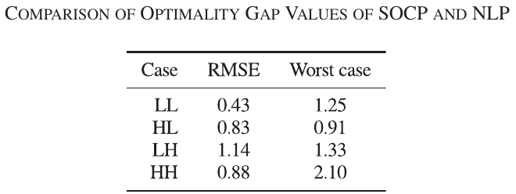
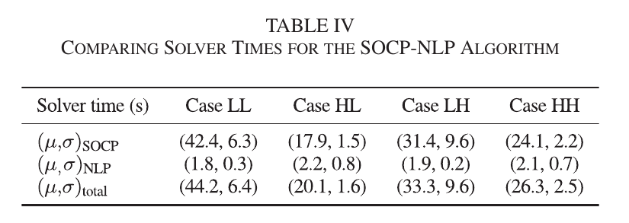

Optimal Multi-Period Dispatch of Distributed Energy Resources in Unbalanced Distribution Feeders
Results
Optimality gap always below 3% for different solar penetration levels.
Feasible solutions always ($<1e−5pu$ difference).
Solution times $<45s$
NLP total time assuming parallelized operation over every single time step.
Table: Comparison of the Optimality Gap Values of SOCP and NLP.

Slide 22
References
[22] Nazir, N., & Almassalkhi, M. (2018). Receding-Horizon Optimization of Unbalanced Distribution Systems with Time-Scale Separation for Discrete and Continuous Control Devices. 2018 Power Systems Computation Conference (PSCC). IEEE. doi: 10.23919/PSCC.2018.8442555
[36] Wächter, A., & Biegler, L. T. (2006). On the implementation of an interior-point filter line-search algorithm for large-scale nonlinear programming. Math. Program., 106(1), 25–57. doi: 10.1007/s10107-004-0559-y
[37] HSL - Home Page. (2023, May 24). Retrieved from https://www.hsl.rl.ac.uk
[16b] Briglia, E., Alaggia, S., & Paganini, F. (2017). Distribution network management based on optimal power flow: Integration of discrete decision variables. 2017 51st Annual Conference on Information Sciences and Systems (CISS). IEEE. doi: 10.1109/CISS.2017.7926079

Slide 23
References

