Slide 1







Cover
Prob
$$P_{Loss}$$
$$P_{Subs}$$
$$Q_{DER}$$
Large Distribution Model Simulations
$$P_{12}$$
$$Q_{12}$$
Aryan Ritwajeet Jha
$$V_{1}$$
Observation of the effect of change in parameter values on Distributed OPF Simulations for the synthetic 1k and 10k Power Distribution networks.
$$ΔV$$

Slide 2
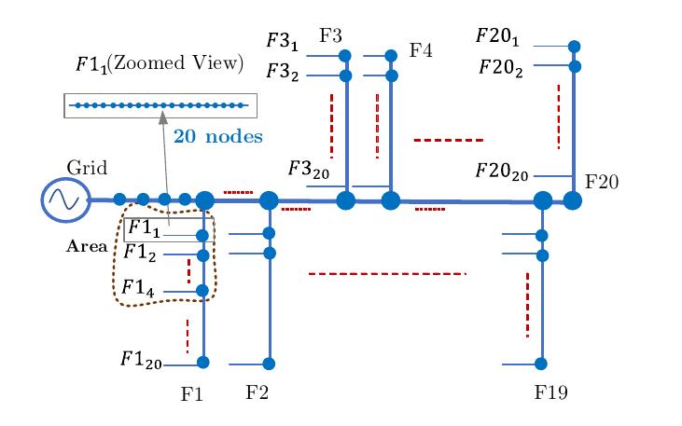
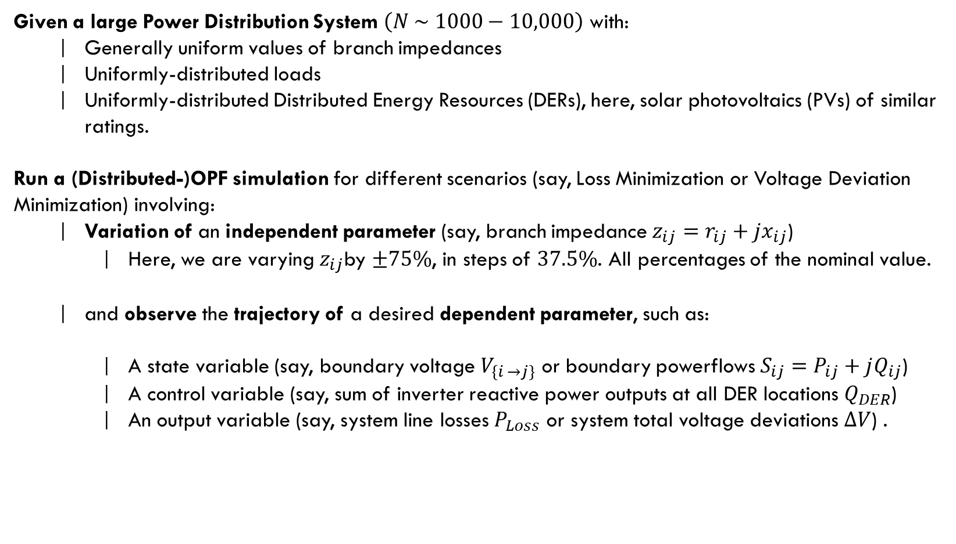
Cover
Prob
C
Problem Statement
Prob
B
$$P_{Loss}$$
A
$$P_{Subs}$$
Given a large Power Distribution System $\left(N \sim 1000−10,000\right)$ with:
Generally uniform values of branch impedances
Uniformly-distributed loads
Uniformly-distributed Distributed Energy Resources (DERs), here, solar photovoltaics (PVs) of similar ratings.
Run a (Distributed-)OPF simulation for different scenarios (say, Loss Minimization or Voltage Deviation Minimization) involving:
Variation of an independent parameter (say, branch impedance $z_{ij}=r_{ij}+{jx}_{ij}$)
Here, we are varying $z_{ij}$by $±75\%$, in steps of $37.5\%$. All percentages of the nominal value.
and observe the trajectory of a desired dependent parameter, such as:
A state variable (say, boundary voltage $V_{\left\{i →j\right\}}$ or boundary powerflows $S_{ij}=P_{ij}+jQ_{ij}$)
A control variable (say, sum of inverter reactive power outputs at all DER locations $Q_{DER}$)
An output variable (say, system line losses $P_{Loss}$ or system total voltage deviations $ΔV$) .
Synthetic 10k Distribution Network
$$Q_{DER}$$
$$P_{12}$$
$$Q_{12}$$
$$V_{1}$$
$$ΔV$$

Slide 3
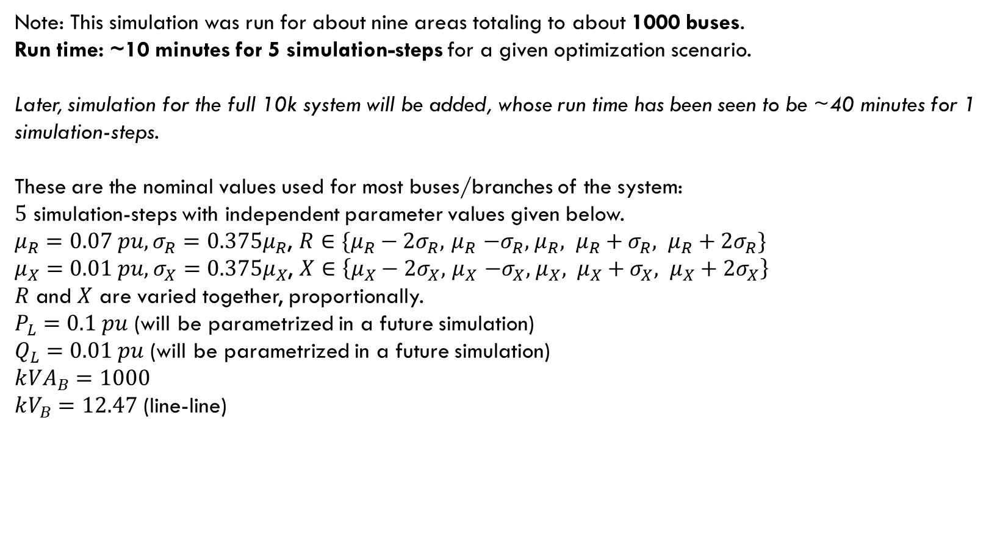
Cover
Prob
C
Problem Statement
Prob
B
$$P_{Loss}$$
A
$$P_{Subs}$$
Synthetic 10k Distribution Network
$$Q_{DER}$$
Note: This simulation was run for about nine areas totaling to about 1000 buses.
Run time: ~10 minutes for 5 simulation-steps for a given optimization scenario.
Later, simulation for the full 10k system will be added, whose run time has been seen to be ~40 minutes for 1 simulation-steps.
These are the nominal values used for most buses/branches of the system:
$5$ simulation-steps with independent parameter values given below.
$μ_{R}=0.07 pu, σ_{R}=0.375μ_{R}$, $R∈\{μ_{R}−2σ_{R}, { μ}_{R} −σ_{R}, { μ}_{R}, μ_{R}+σ_{R}, μ_{R}+2σ_{R}\}$
$μ_{X}=0.01 pu, σ_{X}=0.375μ_{X}$, $X∈\left\{μ_{X}−2σ_{X}, { μ}_{X} −σ_{X}, { μ}_{X}, μ_{X}+σ_{X}, μ_{X}+2σ_{X}\right\}$
$R$ and $X$ are varied together, proportionally. $P_{L}=0.1 pu$ (will be parametrized in a future simulation) $Q_{L}=0.01 pu$ (will be parametrized in a future simulation) $$k{VA}_{B}=1000$$ $kV_{B}=12.47$ (line-line)
$$P_{12}$$
$$Q_{12}$$
$$V_{1}$$
$$ΔV$$

Slide 4
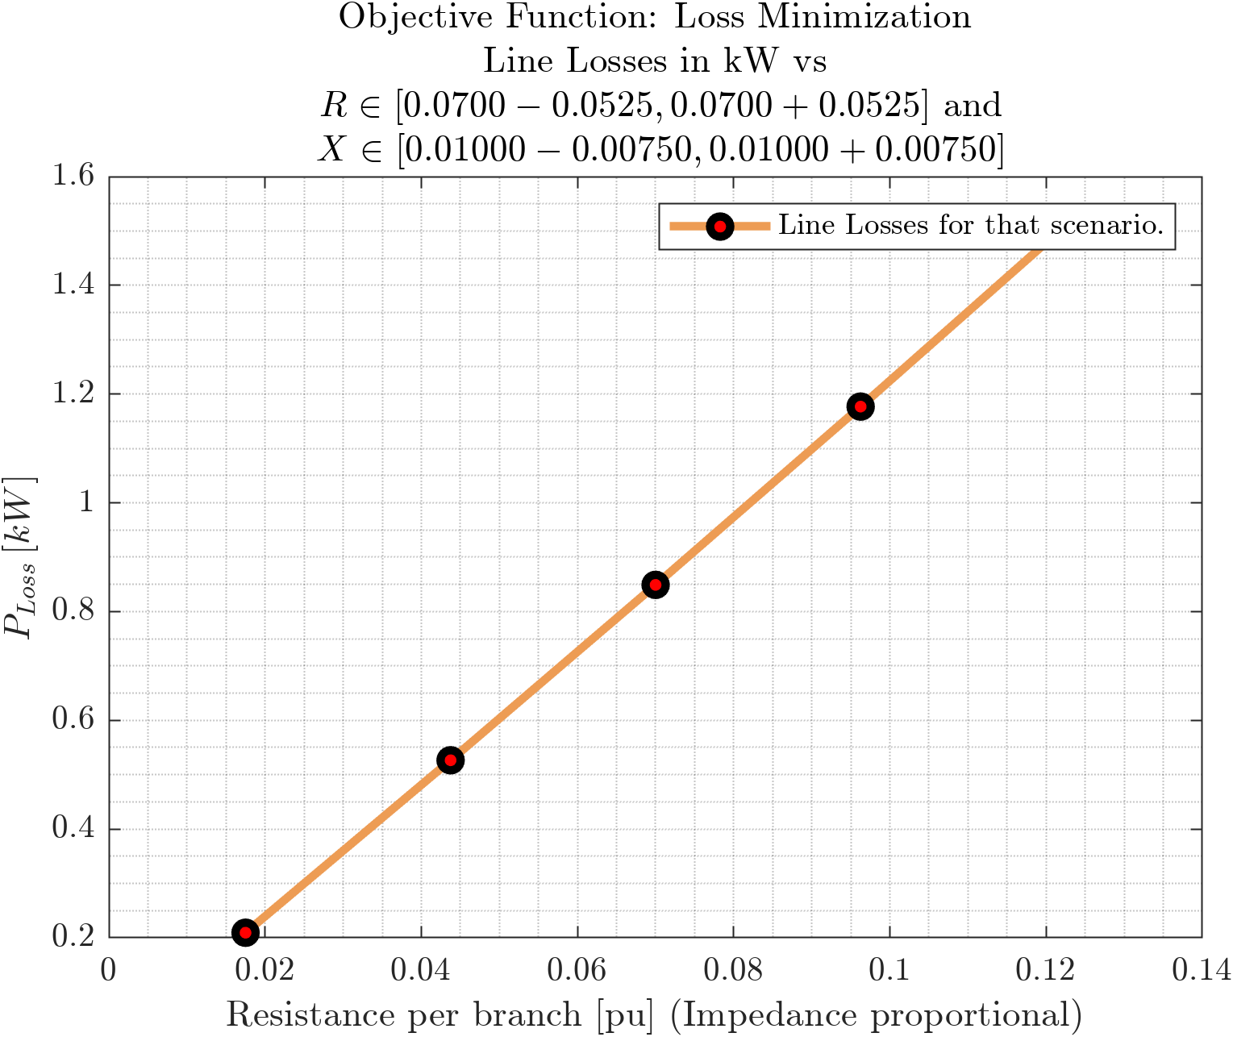
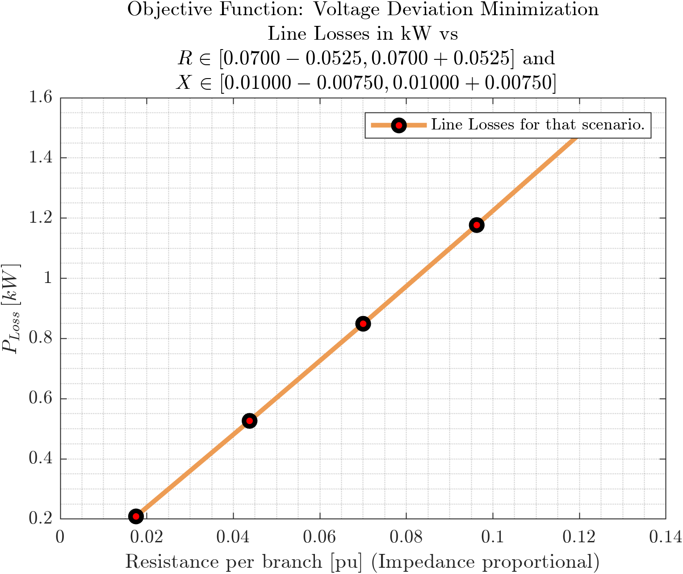
D
Cover
Line Losses vs Branch Impedance
C
Prob
Objective Functions: Loss Minimization, Voltage Deviation Minimization
B
$$P_{Loss}$$
A
$$P_{Subs}$$
$$Q_{DER}$$
$$P_{12}$$
$$Q_{12}$$
$$V_{1}$$
$$ΔV$$
Linear change in branch impedance $z$ caused a Linear change in line losses $P_{Loss}$

Slide 5
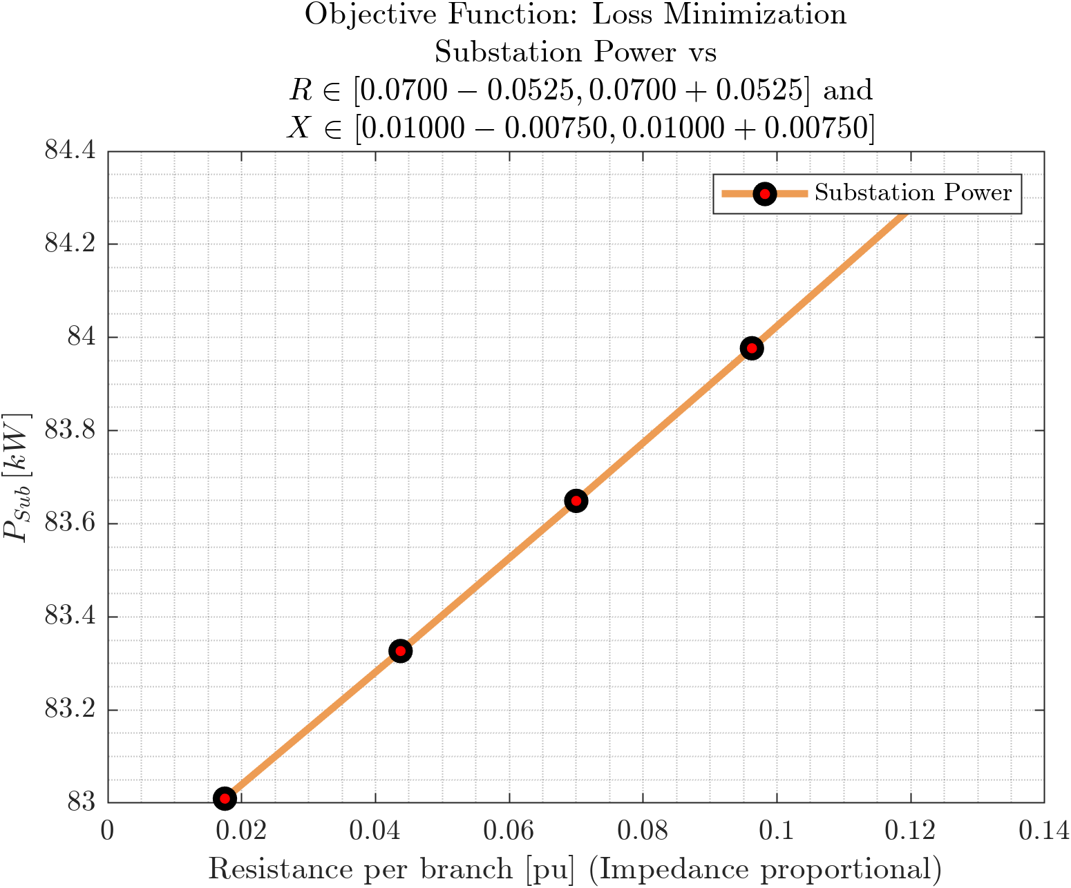
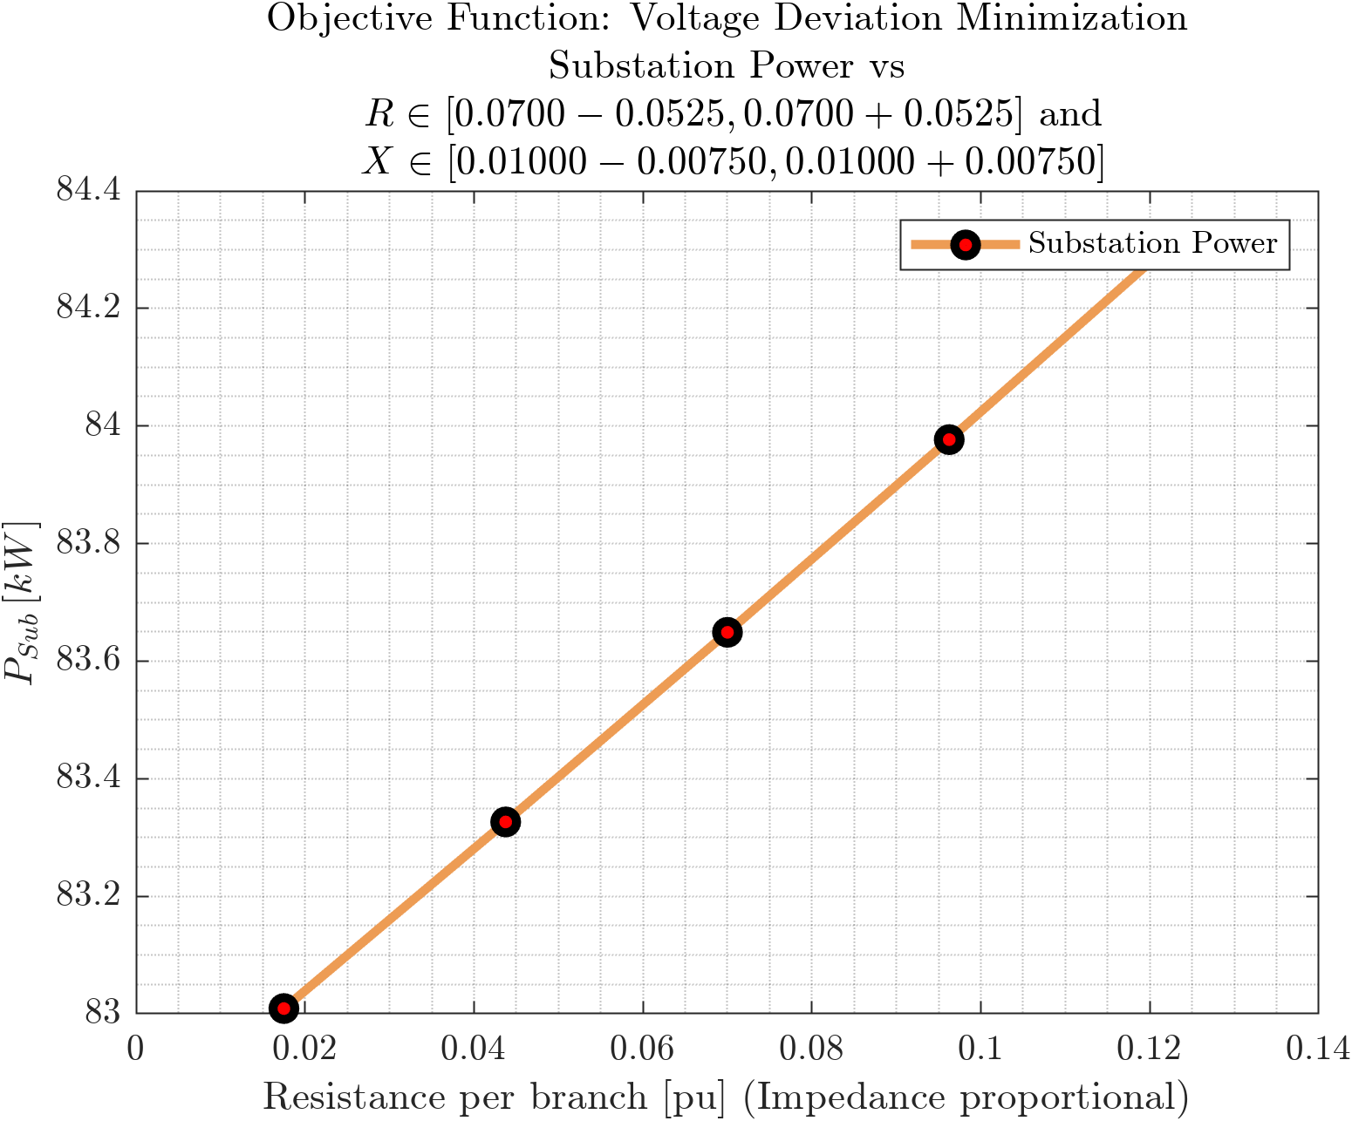
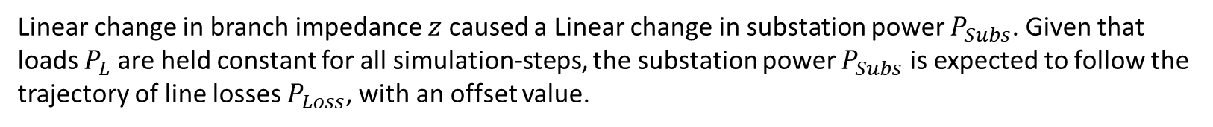
D
Cover
Substation Power vs Branch Impedance
C
Prob
Objective Functions: Loss Minimization, Voltage Deviation Minimization
B
$$P_{Loss}$$
A
$$P_{Subs}$$
$$Q_{DER}$$
$$P_{12}$$
$$Q_{12}$$
$$V_{1}$$
$$ΔV$$
Linear change in branch impedance $z$ caused a Linear change in substation power $P_{Subs}$. Given that loads $P_{L}$ are held constant for all simulation-steps, the substation power $P_{Subs}$ is expected to follow the trajectory of line losses $P_{Loss}$, with an offset value.

Slide 6
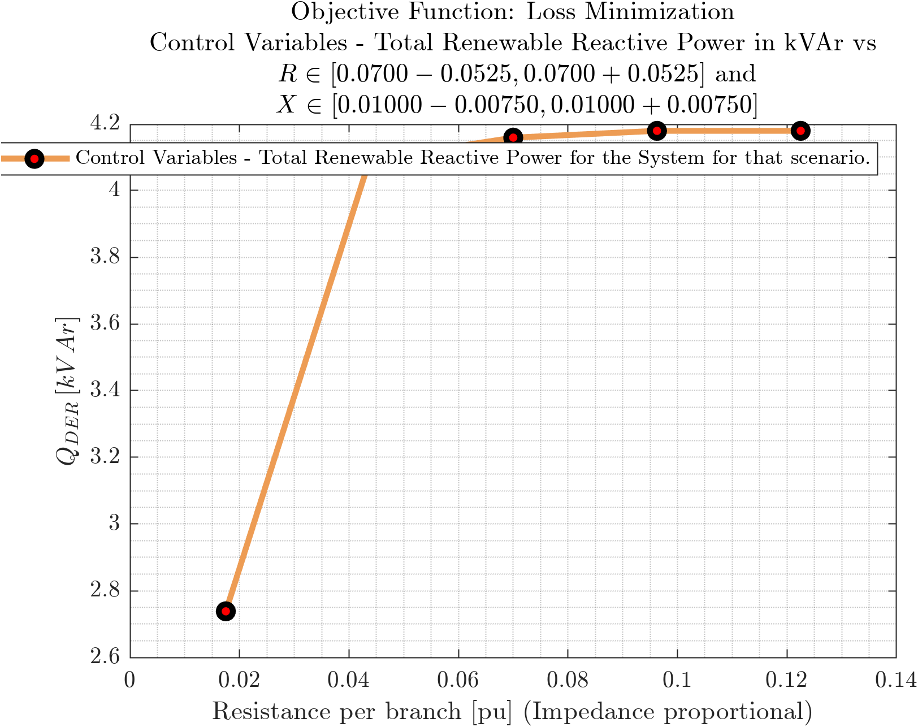
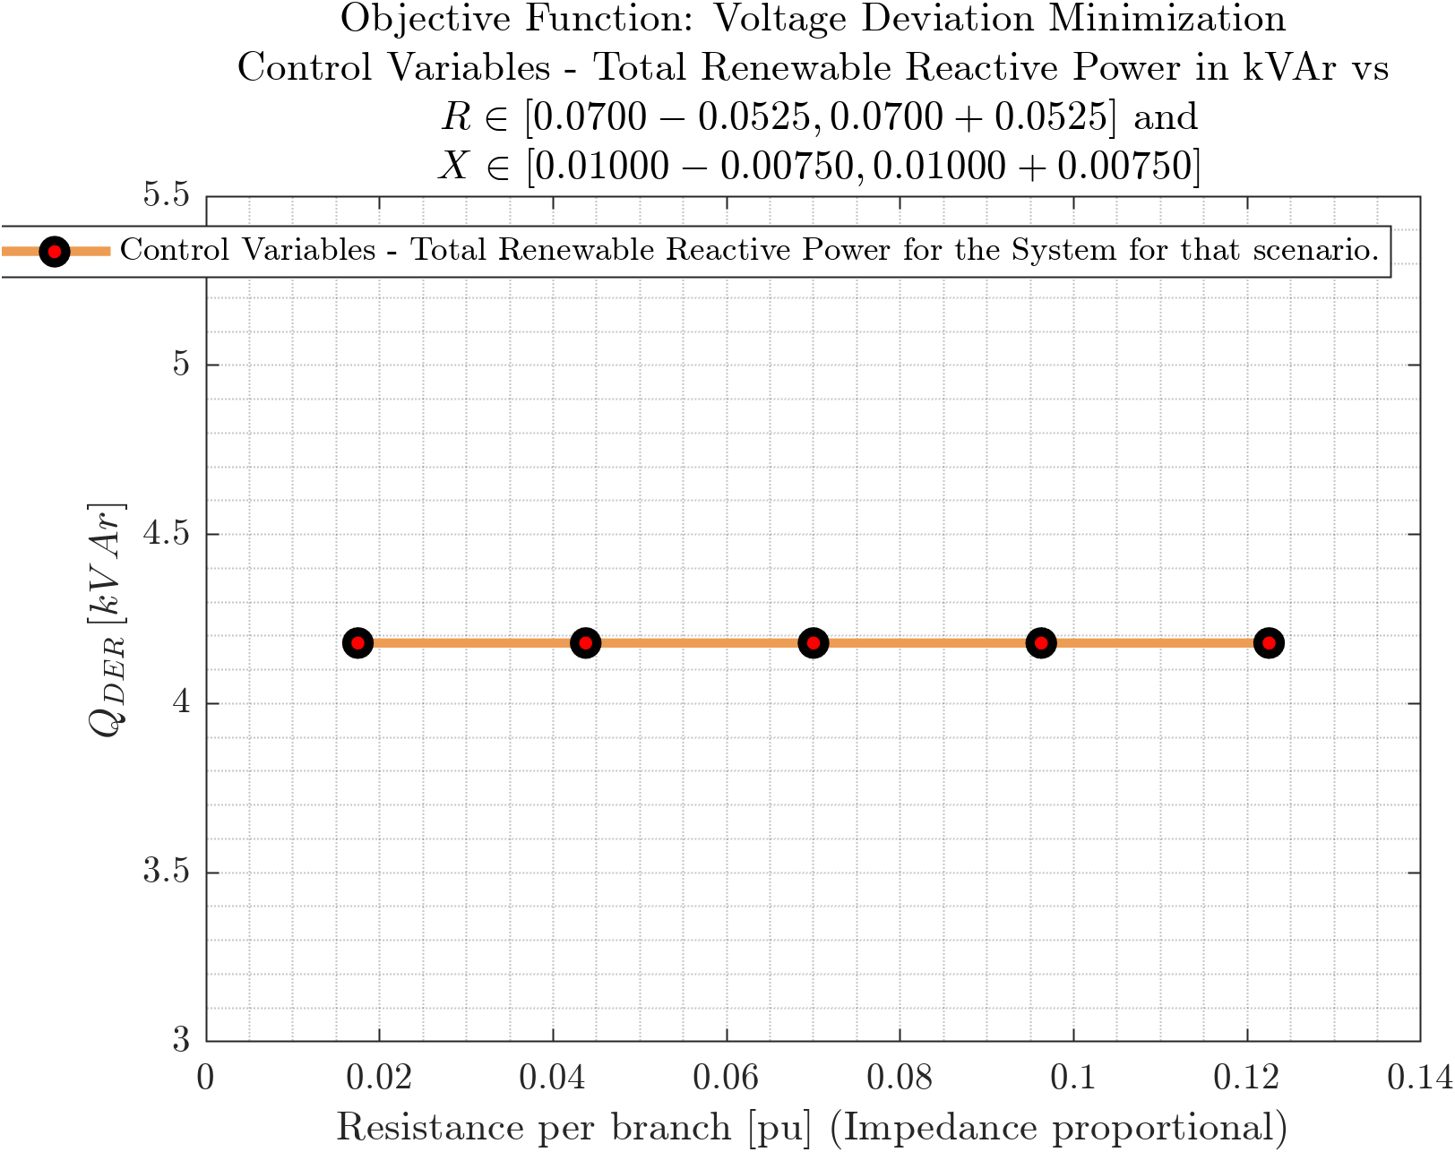
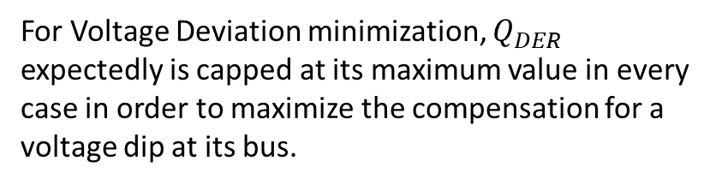
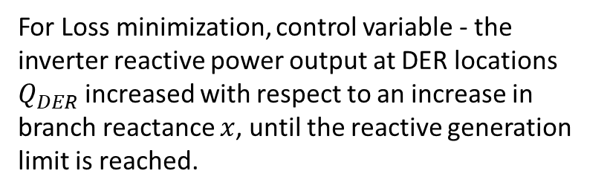
D
Cover
DER Reactive Power vs Branch Impedance
C
Prob
Objective Functions: Loss Minimization, Voltage Deviation Minimization
B
$$P_{Loss}$$
A
$$P_{Subs}$$
$$Q_{DER}$$
$$P_{12}$$
$$Q_{12}$$
$$V_{1}$$
$$ΔV$$
For Loss minimization, control variable - the inverter reactive power output at DER locations $Q_{DER}$ increased with respect to an increase in branch reactance $x$, until the reactive generation limit is reached.
For Voltage Deviation minimization, $Q_{DER}$ expectedly is capped at its maximum value in every case in order to maximize the compensation for a voltage dip at its bus.

Slide 7
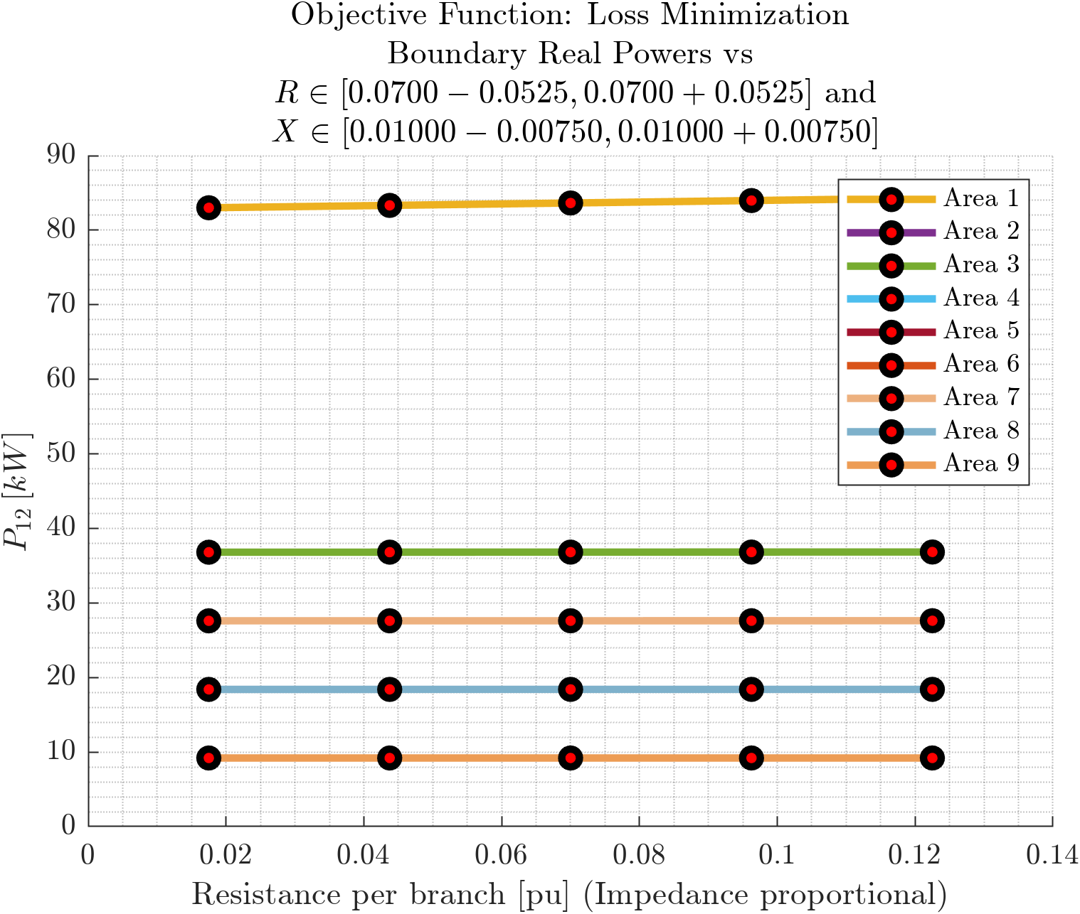
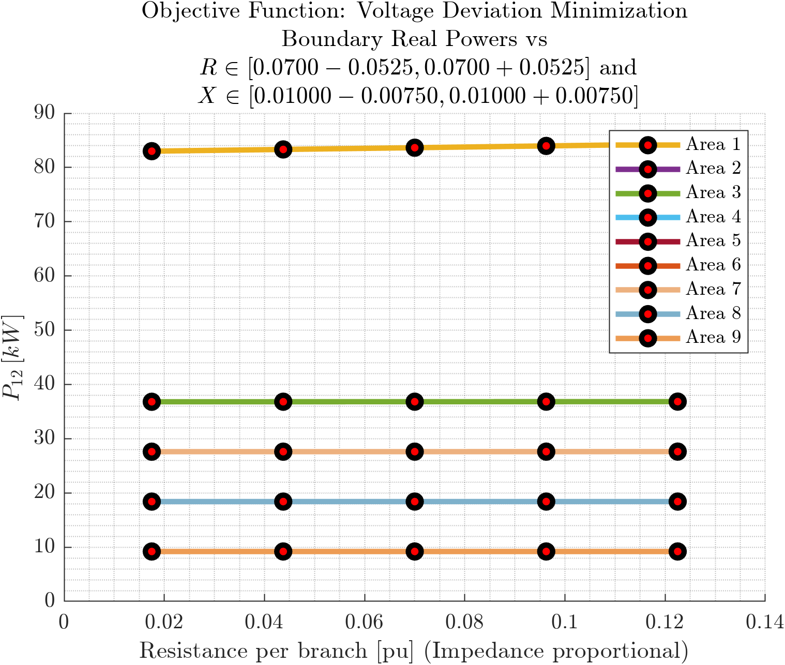
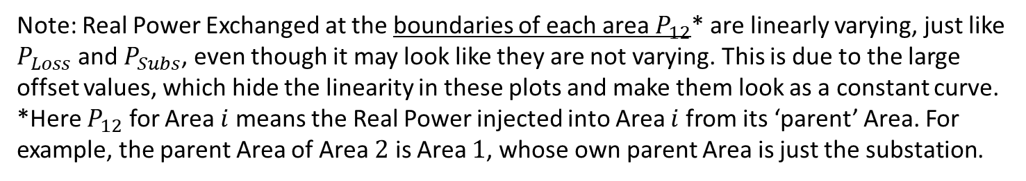
Cover
Real Power at Area Boundaries vs Branch Impedance
Prob
C
Prob
Objective Functions: Loss Minimization, Voltage Deviation Minimization
B
$$P_{Loss}$$
A
$$P_{Subs}$$
$$Q_{DER}$$
$$P_{12}$$
$$Q_{12}$$
$$V_{1}$$
$$ΔV$$
Note: Real Power Exchanged at the boundaries of each area $P_{12}$* are linearly varying, just like $P_{Loss}$ and $P_{Subs}$, even though it may look like they are not varying. This is due to the large offset values, which hide the linearity in these plots and make them look as a constant curve. *Here $P_{12}$ for Area $i$ means the Real Power injected into Area $i$ from its ‘parent’ Area. For example, the parent Area of Area $2$ is Area $1$, whose own parent Area is just the substation.

Slide 8
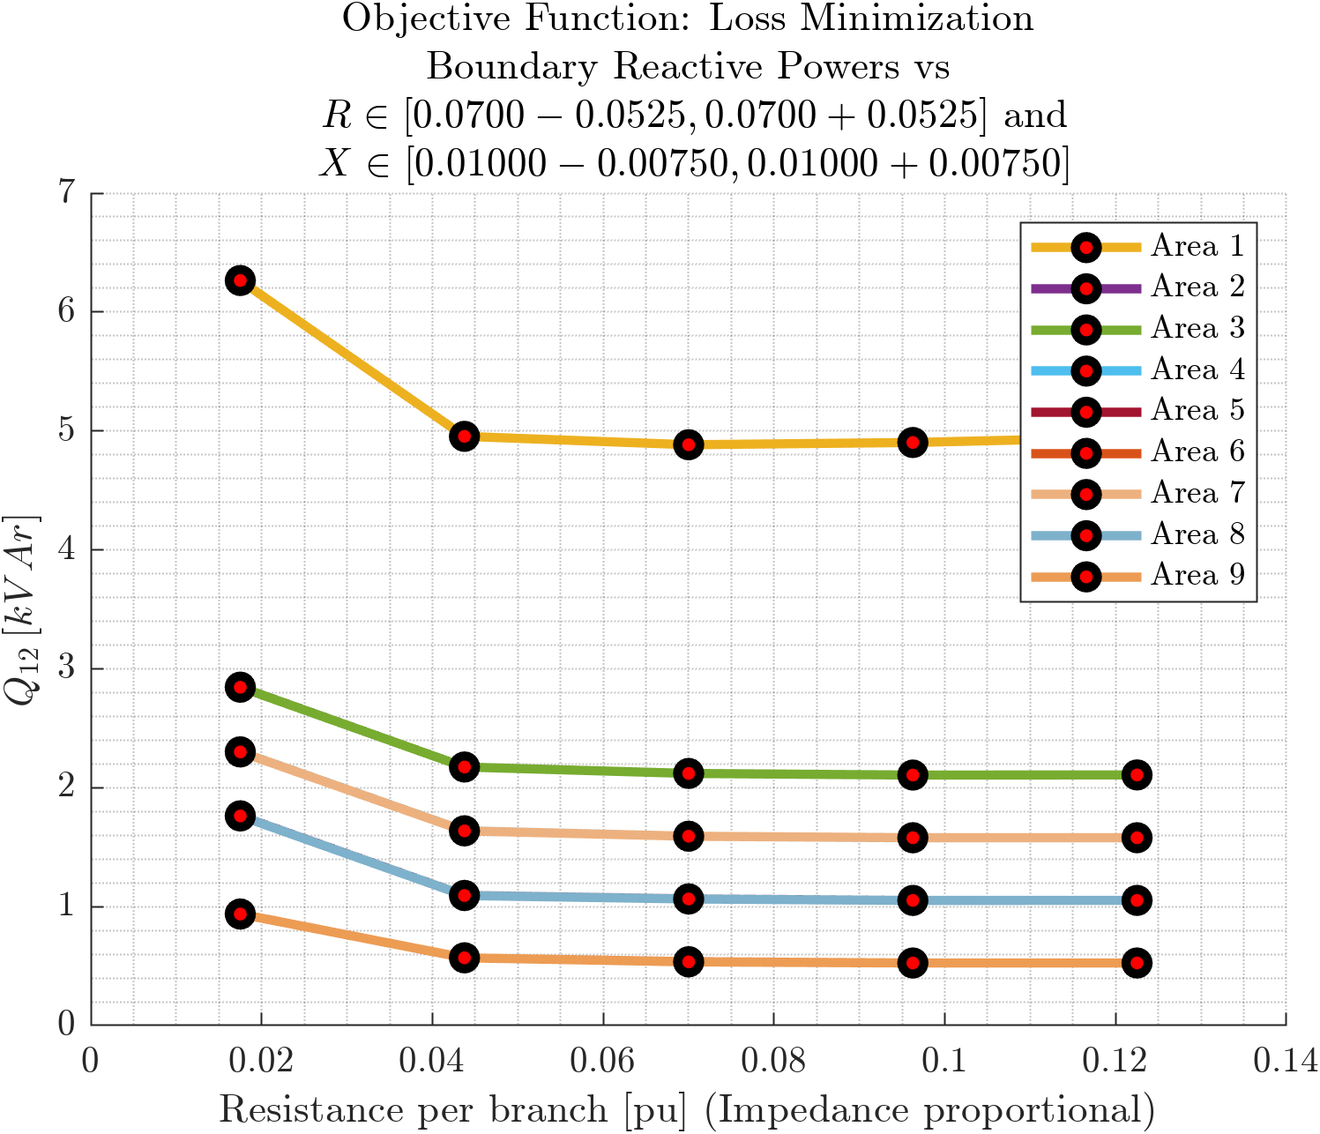
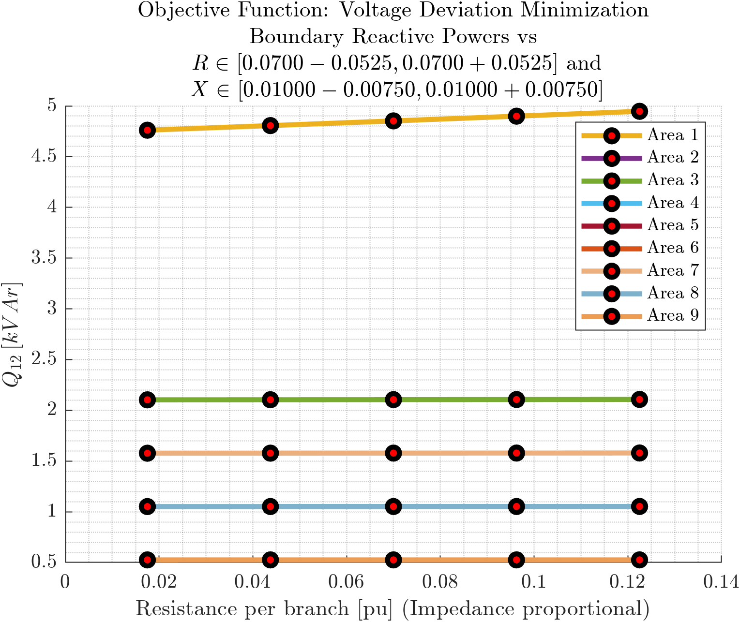
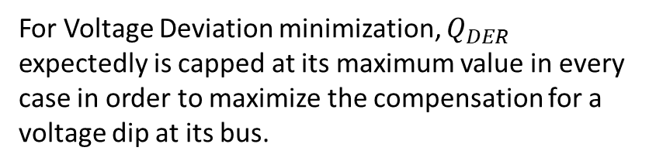
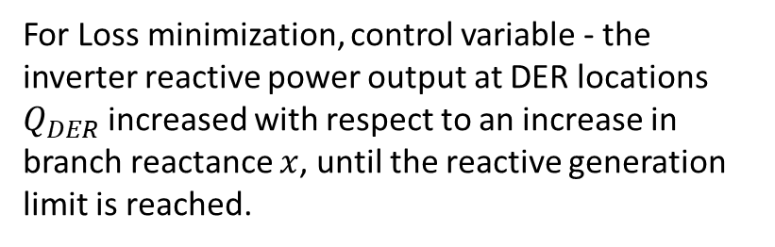
D
Cover
Reactive Power at Area Boundaries vs Branch Impedance
C
Prob
Objective Functions: Loss Minimization, Voltage Deviation Minimization
B
$$P_{Loss}$$
A
$$P_{Subs}$$
$$Q_{DER}$$
$$P_{12}$$
$$Q_{12}$$
$$V_{1}$$
$$ΔV$$
For Loss minimization, control variable - the inverter reactive power output at DER locations $Q_{DER}$ increased with respect to an increase in branch reactance $x$, until the reactive generation limit is reached.
For Voltage Deviation minimization, $Q_{DER}$ expectedly is capped at its maximum value in every case in order to maximize the compensation for a voltage dip at its bus.

Slide 9
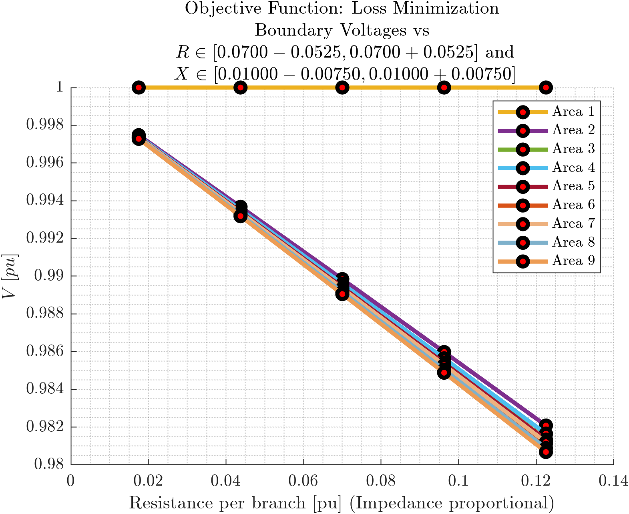
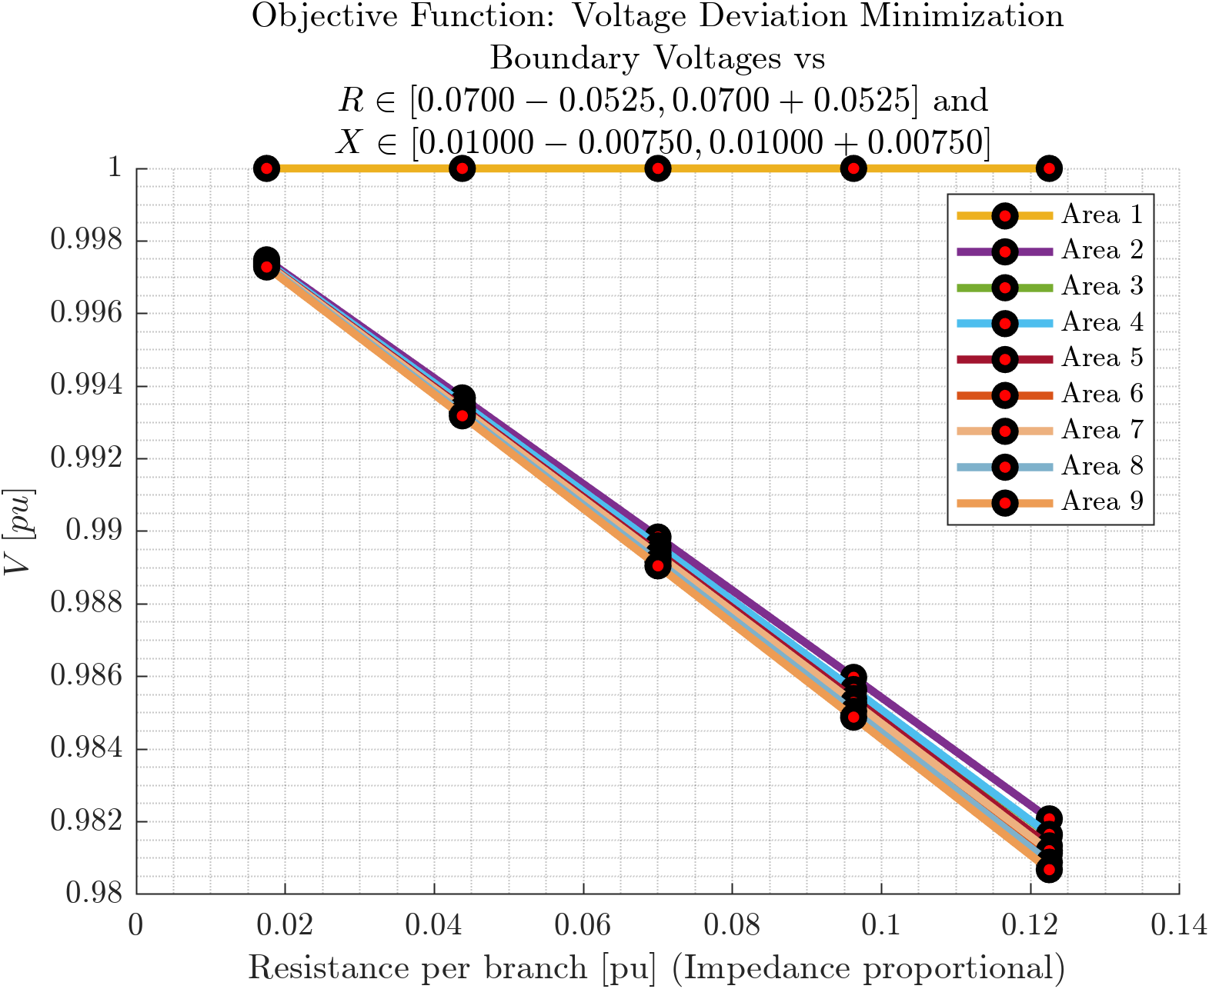
D
Cover
Voltages at Area Boundaries vs Branch Impedance
C
Prob
Objective Functions: Loss Minimization, Voltage Deviation Minimization
B
$$P_{Loss}$$
A
$$P_{Subs}$$
$$Q_{DER}$$
$$P_{12}$$
$$Q_{12}$$
$$V_{1}$$
$$ΔV$$

Slide 10
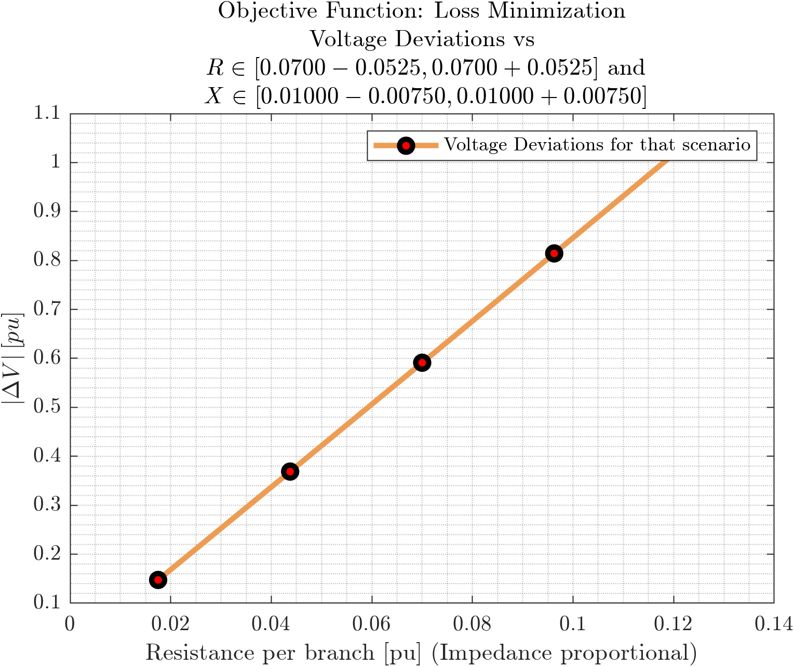
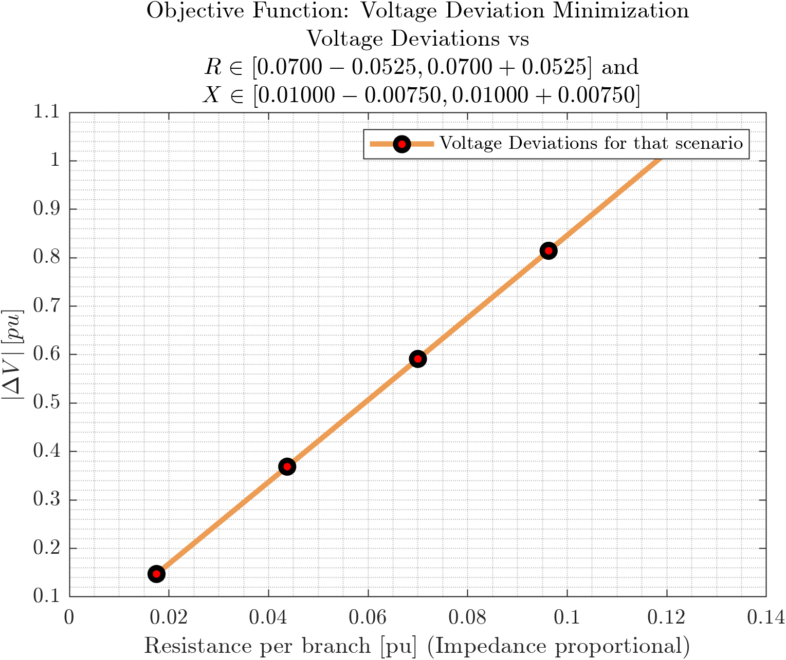
D
Cover
Voltage Deviation vs Branch Impedance
C
Prob
Objective Functions: Loss Minimization, Voltage Deviation Minimization
B
$$P_{Loss}$$
A
$$P_{Subs}$$
$$Q_{DER}$$
$$P_{12}$$
$$Q_{12}$$
$$V_{1}$$
$$ΔV$$

Slide 11
References
[1] Sadnan, R., & Dubey, A. (2022). Distributed Computing for Scalable Optimal Power Flow in Large Radial Electric Power Distribution Systems with Distributed Energy Resources. arXiv, 2211.03920. Retrieved from https://arxiv.org/abs/2211.03920v1

