Slide 1







Cover
Prob
$$P_{Loss}$$
$$P_{Subs}$$
$$Q_{DER}$$
Large Distribution Model Simulations
$$P_{12}$$
$$Q_{12}$$
Aryan Ritwajeet Jha
$$V_{1}$$
Observation of the effect of change in parameter values on Distributed OPF Simulations for the synthetic 1k and 10k Power Distribution networks.
$$ΔV$$

Slide 2
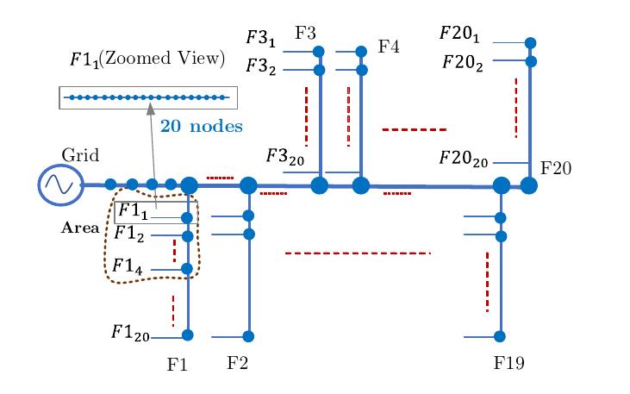
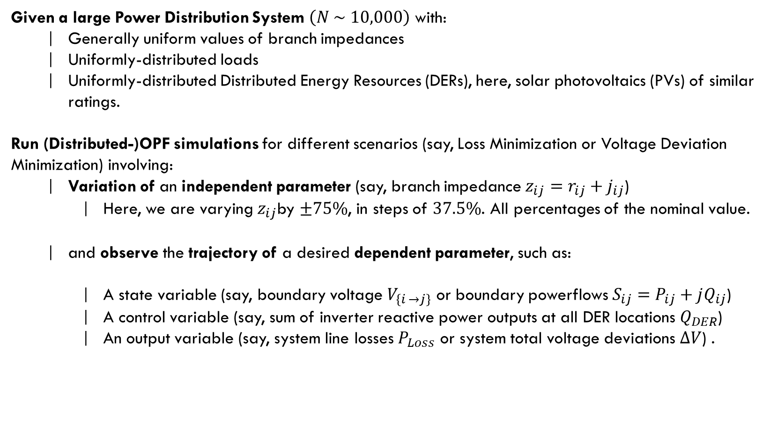
Cover
Prob
C
Problem Statement
Prob
B
$$P_{Loss}$$
A
$$P_{Subs}$$
Given a large Power Distribution System $\left(N \sim 10,000\right)$ with:
Generally uniform values of branch impedances
Uniformly-distributed loads
Uniformly-distributed Distributed Energy Resources (DERs), here, solar photovoltaics (PVs) of similar ratings.
Run (Distributed-)OPF simulations for different scenarios (say, Loss Minimization or Voltage Deviation Minimization) involving:
Variation of an independent parameter (say, branch impedance $z_{ij}=r_{ij}+j_{ij}$)
Here, we are varying $z_{ij}$by $±75\%$, in steps of $37.5\%$. All percentages of the nominal value.
and observe the trajectory of a desired dependent parameter, such as:
A state variable (say, boundary voltage $V_{\left\{i →j\right\}}$ or boundary powerflows $S_{ij}=P_{ij}+jQ_{ij}$)
A control variable (say, sum of inverter reactive power outputs at all DER locations $Q_{DER}$)
An output variable (say, system line losses $P_{Loss}$ or system total voltage deviations $ΔV$) .
Synthetic 10k Distribution Network
$$Q_{DER}$$
$$P_{12}$$
$$Q_{12}$$
$$V_{1}$$
$$ΔV$$

Slide 3
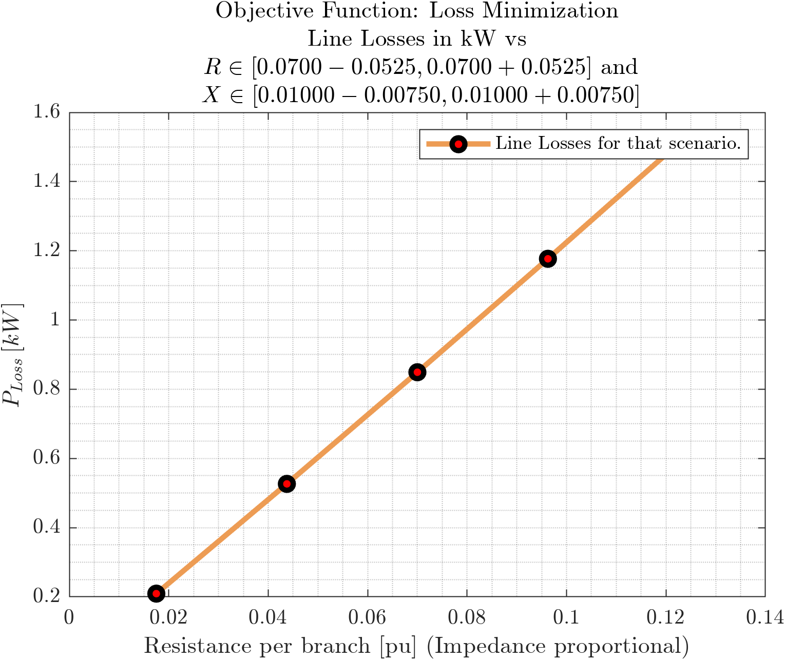
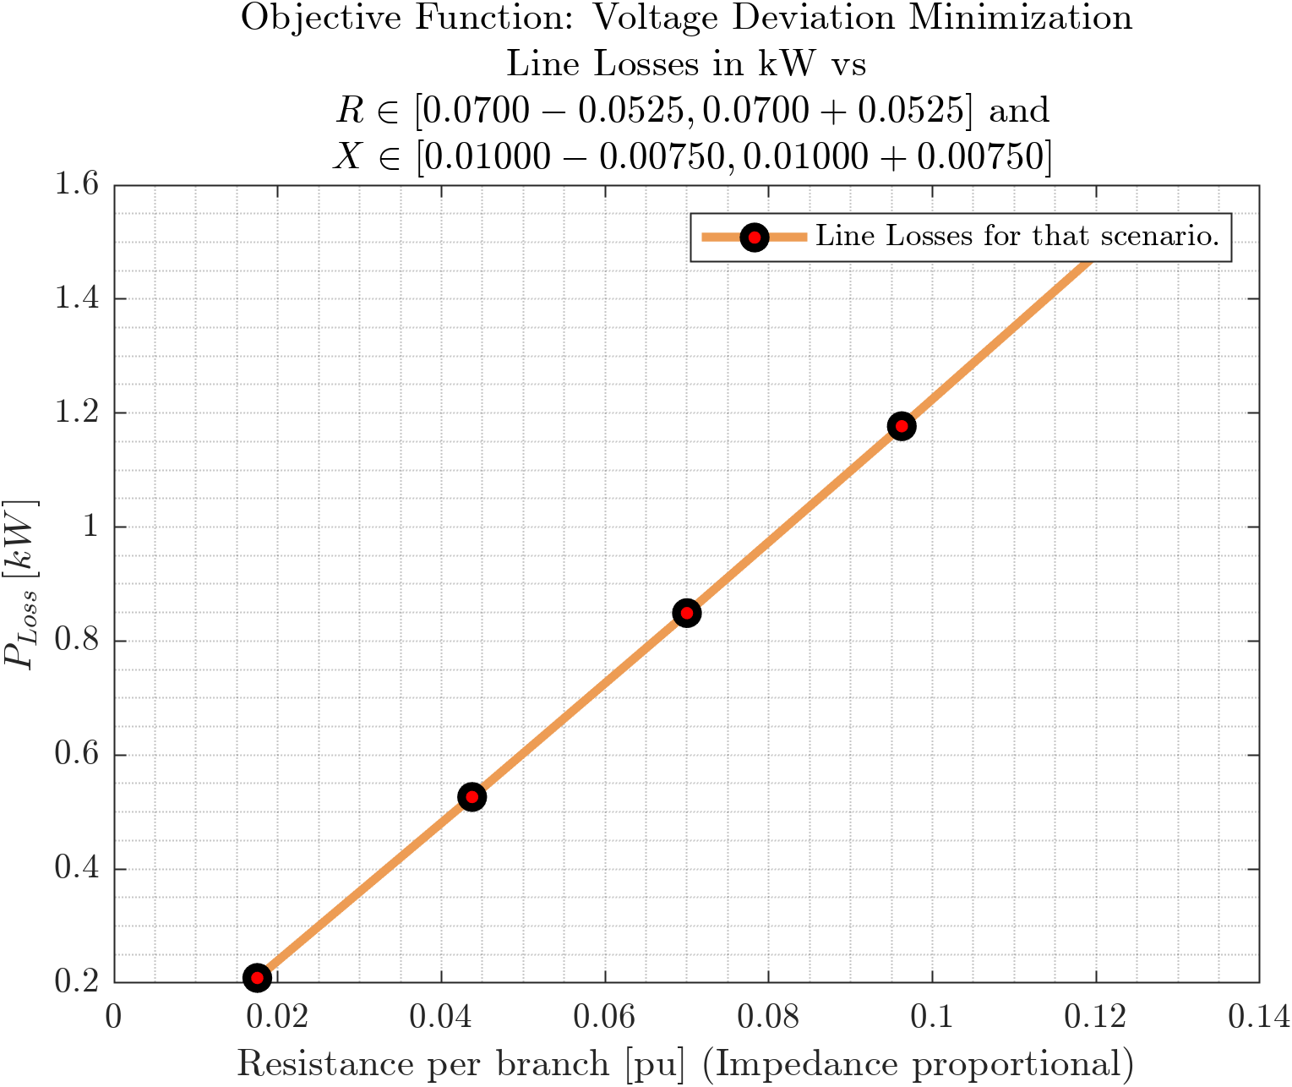
D
Cover
Line Losses vs Branch Impedance
C
Prob
Objective Functions: Loss Minimization, Voltage Deviation Minimization
B
$$P_{Loss}$$
A
$$P_{Subs}$$
$$Q_{DER}$$
$$P_{12}$$
$$Q_{12}$$
$$V_{1}$$
$$ΔV$$

Slide 4
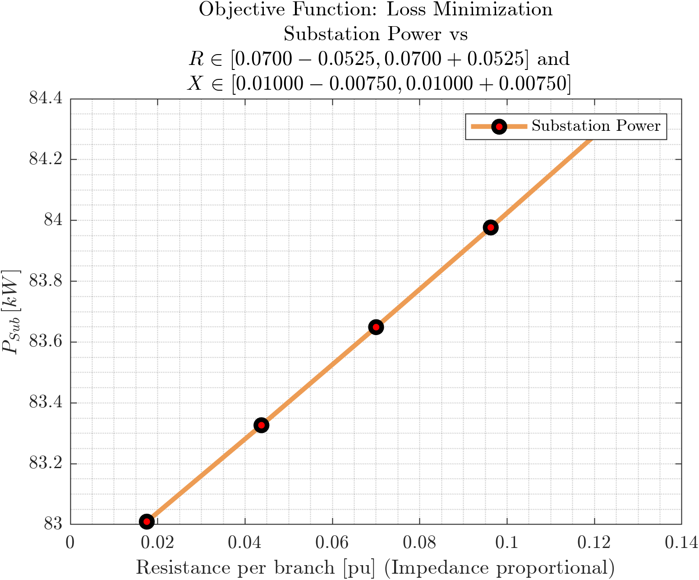
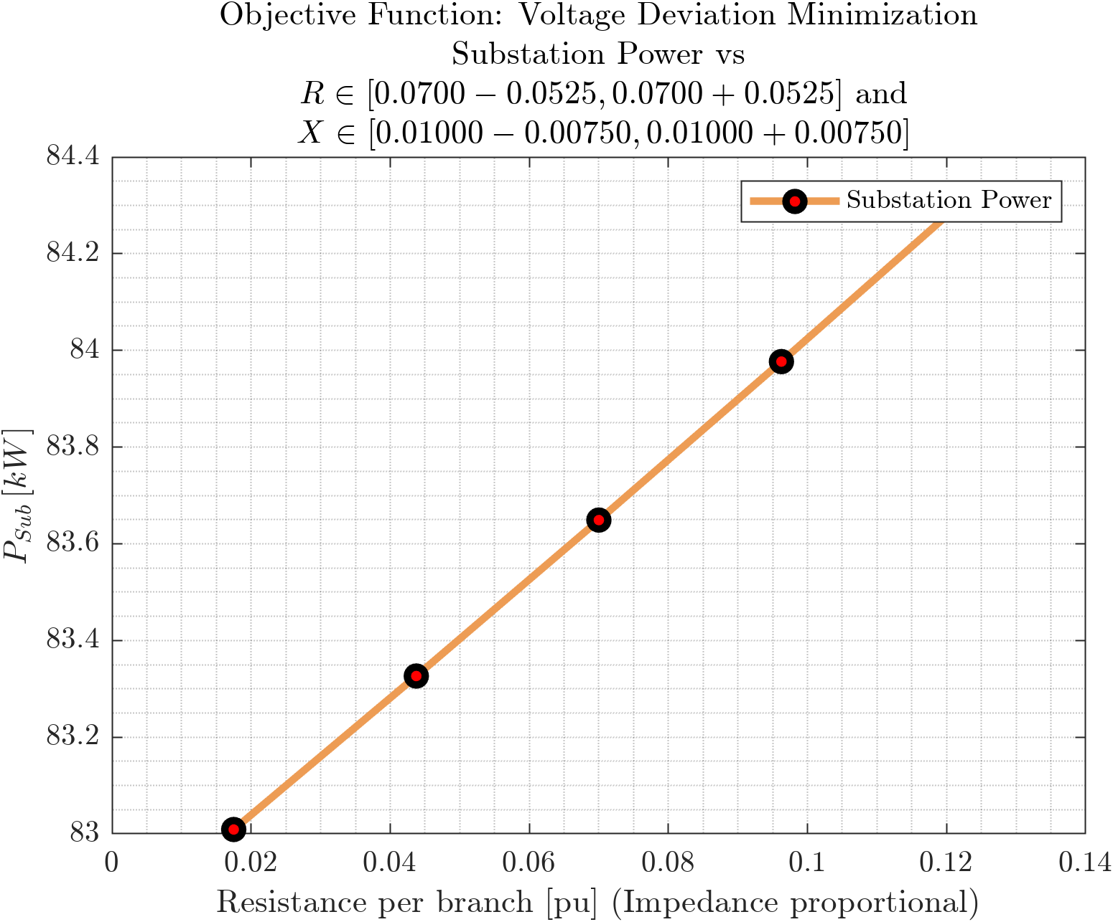
D
Cover
Substation Power vs Branch Impedance
C
Prob
Objective Functions: Loss Minimization, Voltage Deviation Minimization
B
$$P_{Loss}$$
A
$$P_{Subs}$$
$$Q_{DER}$$
$$P_{12}$$
$$Q_{12}$$
$$V_{1}$$
$$ΔV$$

Slide 5
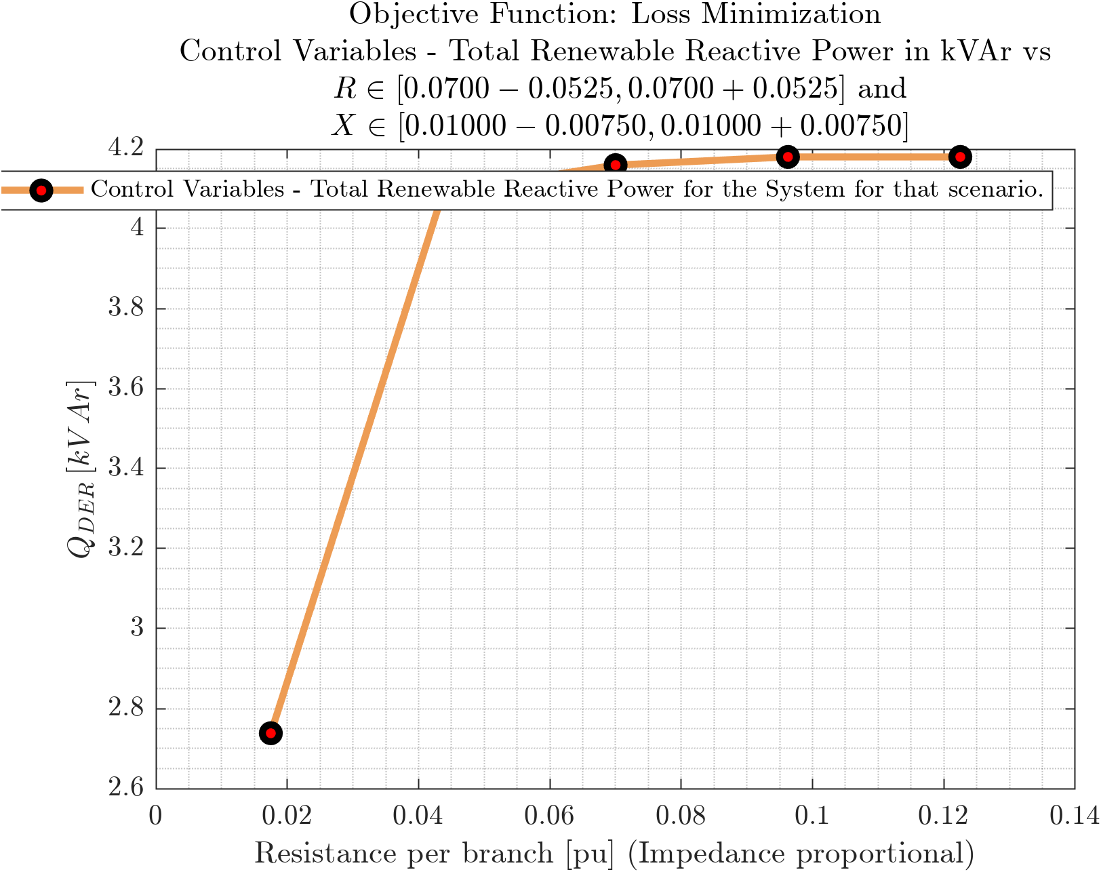
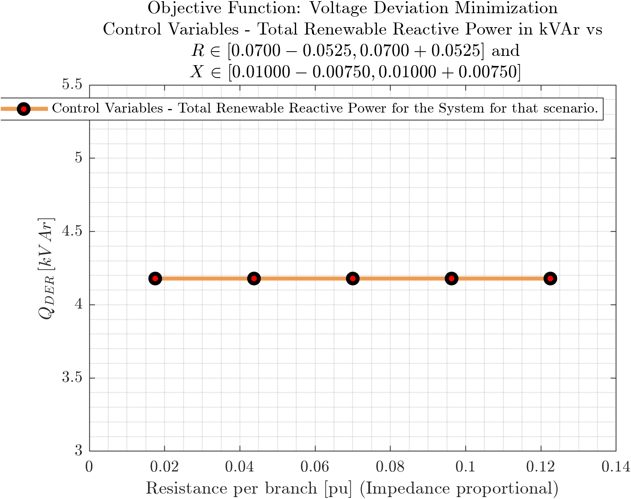
D
Cover
DER Reactive Power vs Branch Impedance
C
Prob
Objective Functions: Loss Minimization, Voltage Deviation Minimization
B
$$P_{Loss}$$
A
$$P_{Subs}$$
$$Q_{DER}$$
$$P_{12}$$
$$Q_{12}$$
$$V_{1}$$
$$ΔV$$

Slide 6
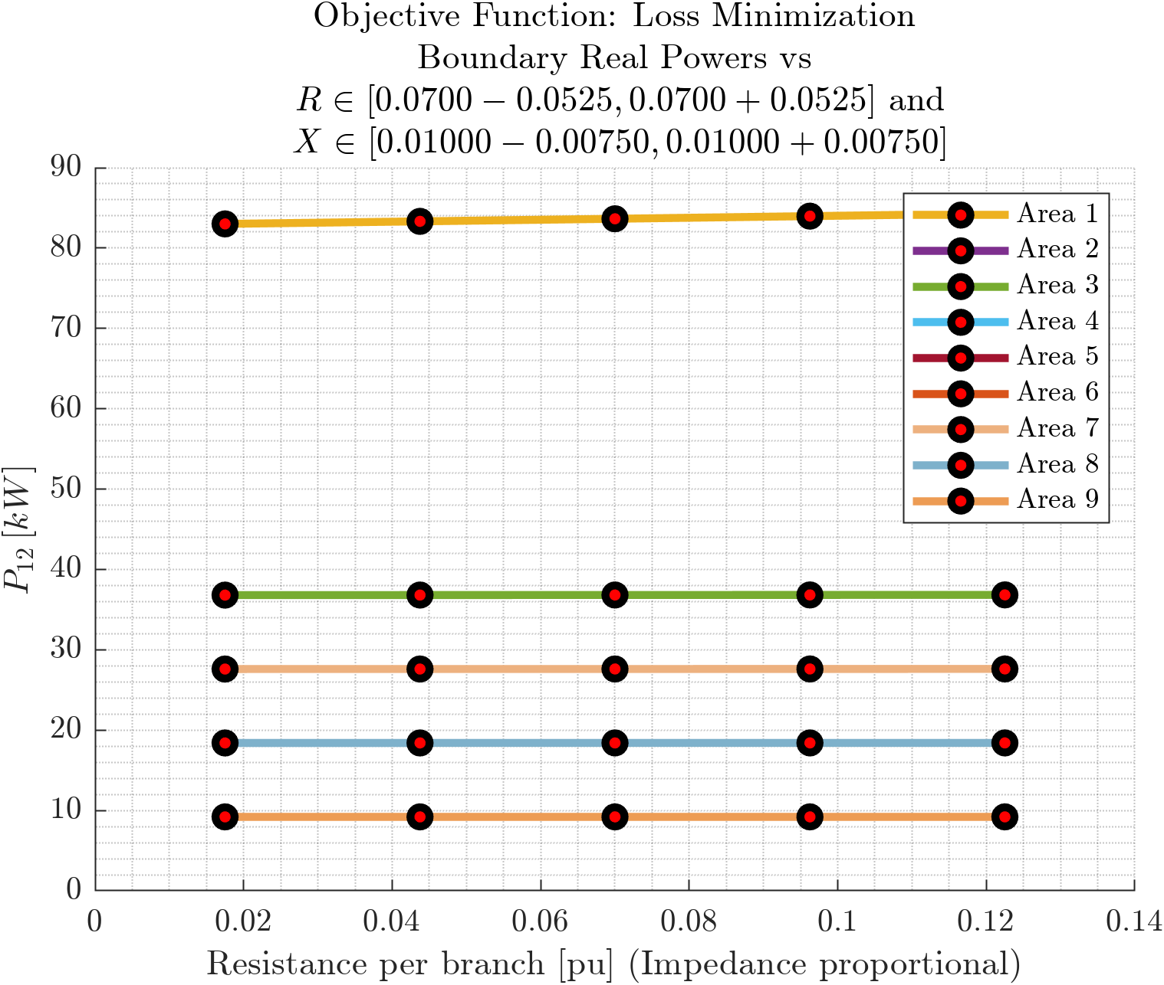
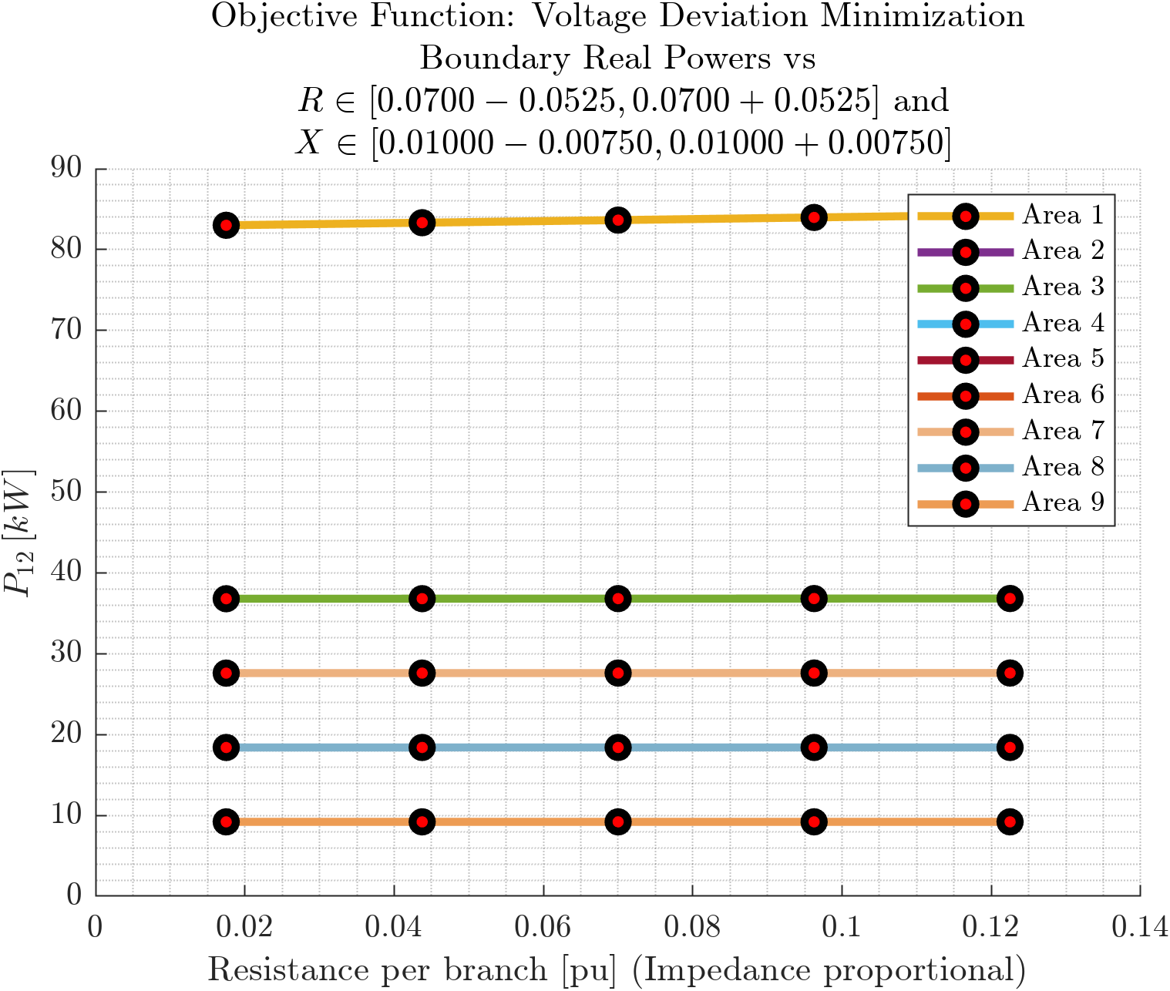
Cover
Real Power at Area Boundaries vs Branch Impedance
Prob
C
Prob
Objective Functions: Loss Minimization, Voltage Deviation Minimization
B
$$P_{Loss}$$
A
$$P_{Subs}$$
$$Q_{DER}$$
$$P_{12}$$
$$Q_{12}$$
$$V_{1}$$
$$ΔV$$

Slide 7
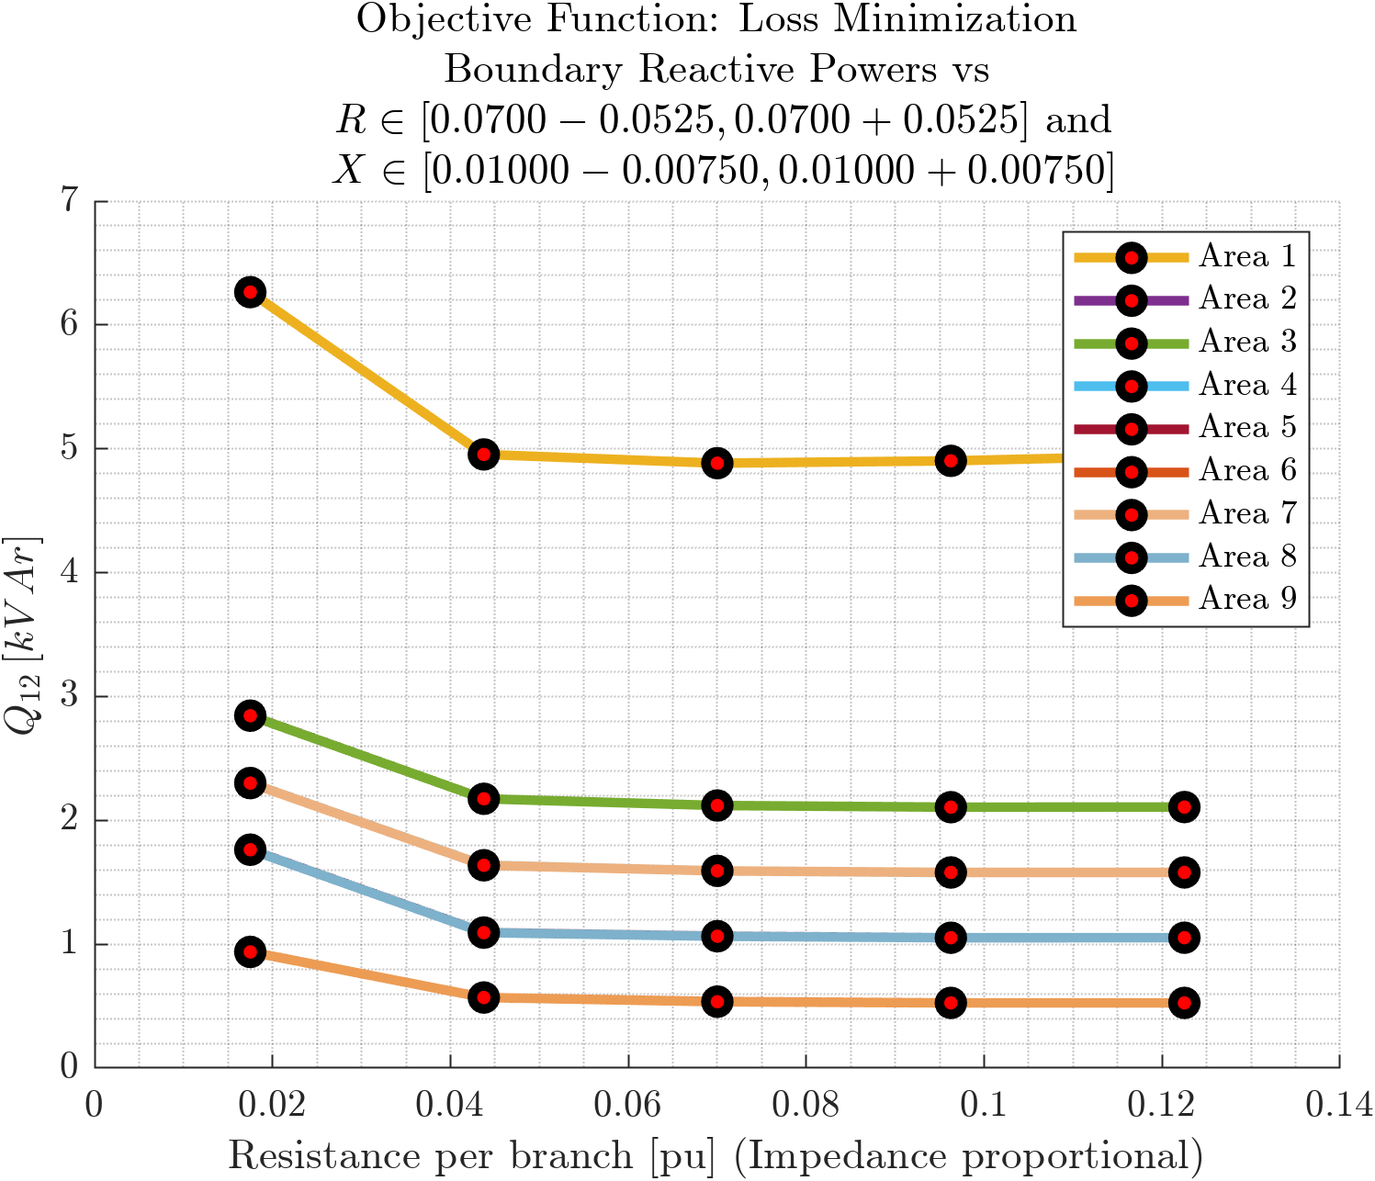
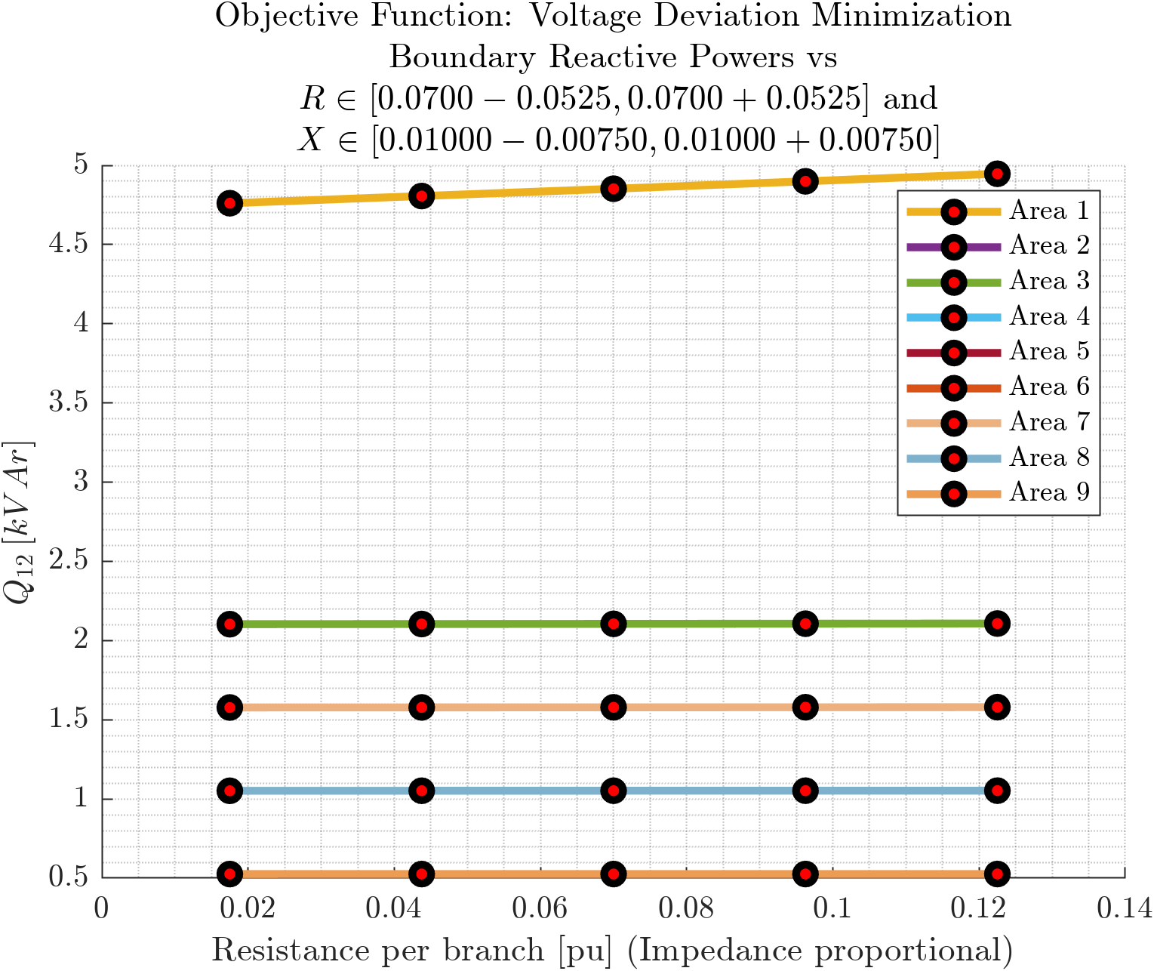
D
Cover
Reactive Power at Area Boundaries vs Branch Impedance
C
Prob
Objective Functions: Loss Minimization, Voltage Deviation Minimization
B
$$P_{Loss}$$
A
$$P_{Subs}$$
$$Q_{DER}$$
$$P_{12}$$
$$Q_{12}$$
$$V_{1}$$
$$ΔV$$

Slide 8
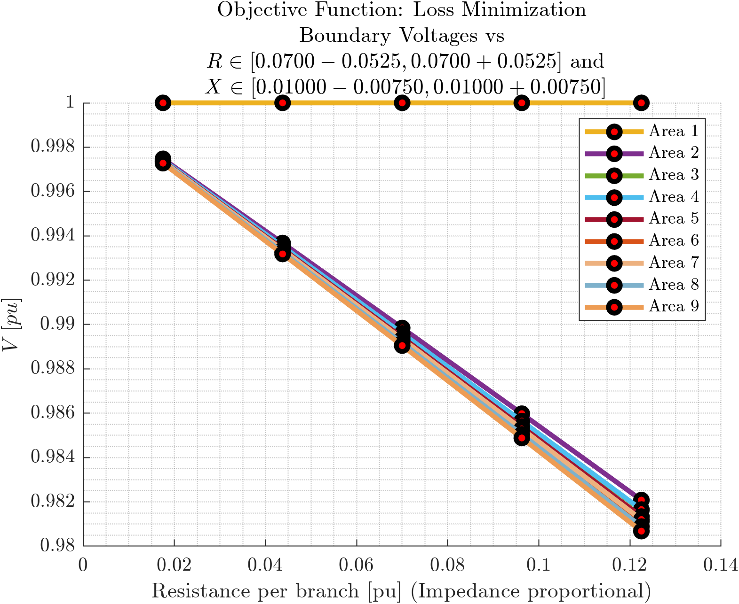
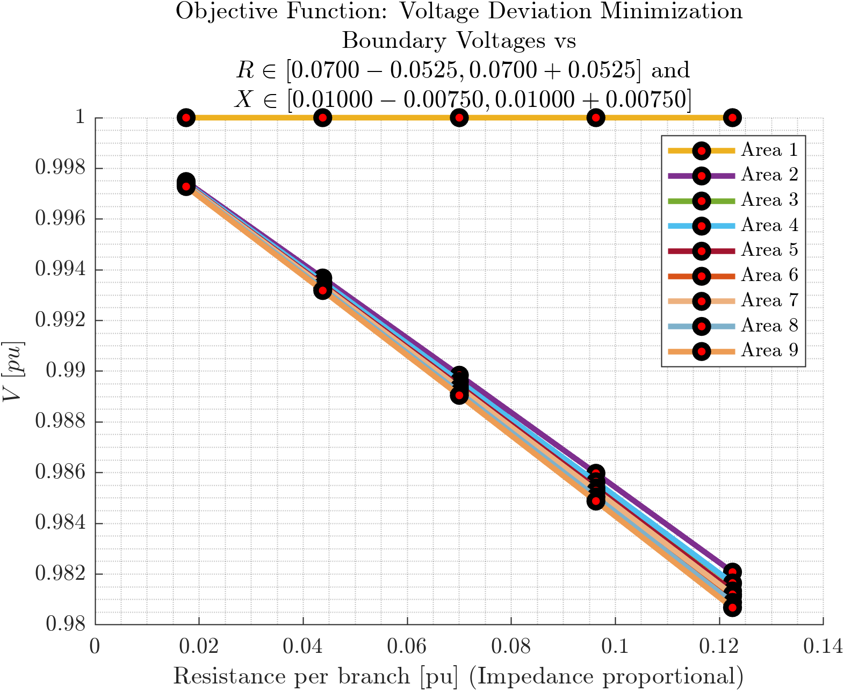
D
Cover
Voltages at Area Boundaries vs Branch Impedance
C
Prob
Objective Functions: Loss Minimization, Voltage Deviation Minimization
B
$$P_{Loss}$$
A
$$P_{Subs}$$
$$Q_{DER}$$
$$P_{12}$$
$$Q_{12}$$
$$V_{1}$$
$$ΔV$$

Slide 9
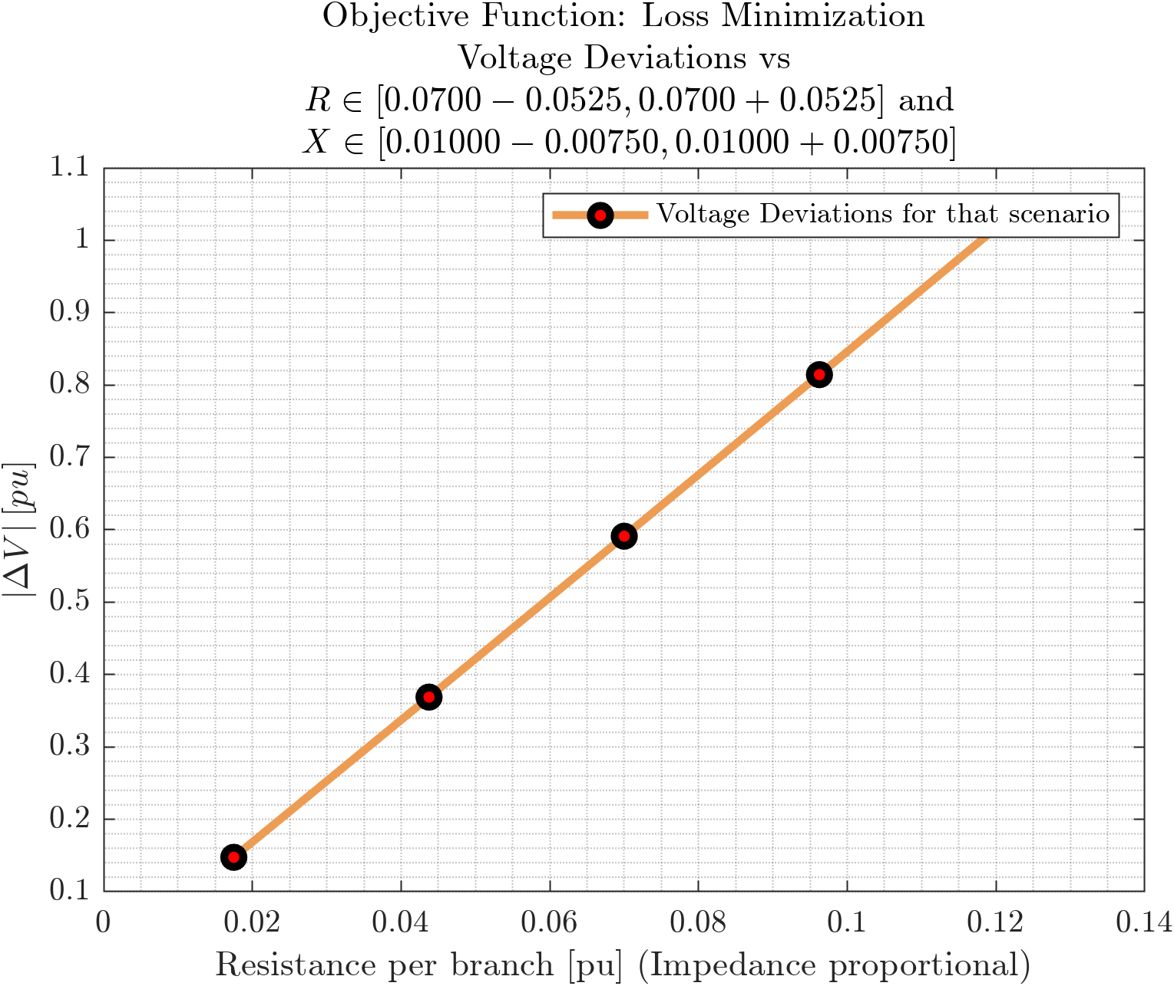
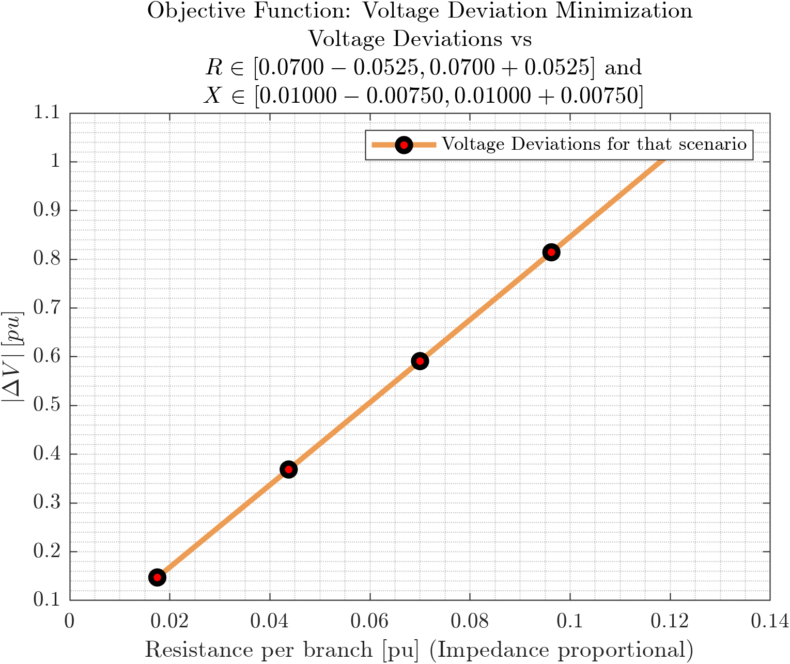
D
Cover
Voltage Deviation vs Branch Impedance
C
Prob
Objective Functions: Loss Minimization, Voltage Deviation Minimization
B
$$P_{Loss}$$
A
$$P_{Subs}$$
$$Q_{DER}$$
$$P_{12}$$
$$Q_{12}$$
$$V_{1}$$
$$ΔV$$

