Slide 1
Prob
C
B
A
Large Distribution Model Simulations
Aryan Ritwajeet Jha
Observation of the effect of change in parameter values on Distributed OPF Simulations for the synthetic 1k and 10k Power Distribution networks.

Slide 2
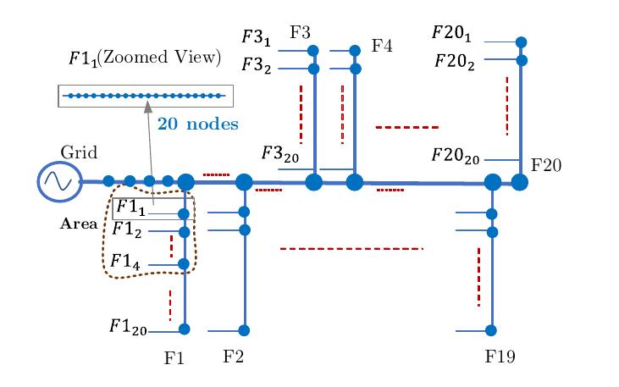
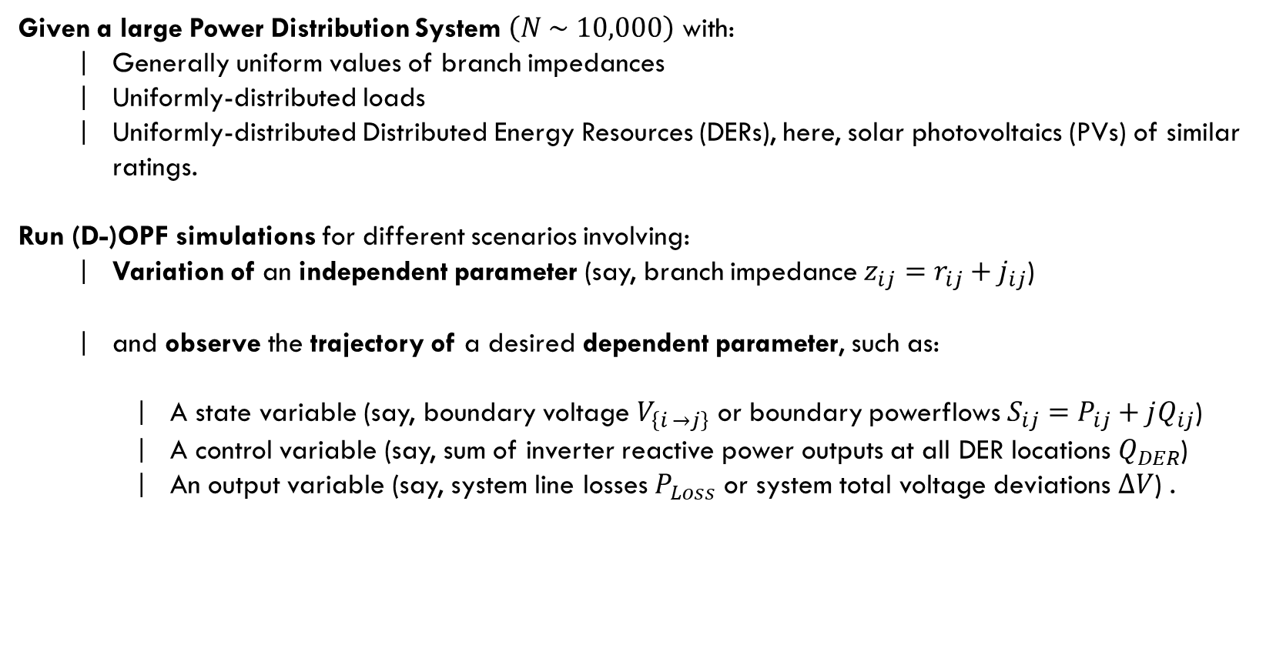
Prob
C
Problem Statement
B
A
Synthetic 10k Distribution Network
Given a large Power Distribution System $\left(N \sim 10,000\right)$ with:
Generally uniform values of branch impedances
Uniformly-distributed loads
Uniformly-distributed Distributed Energy Resources (DERs), here, solar photovoltaics (PVs) of similar ratings.
Run (D-)OPF simulations for different scenarios involving:
Variation of an independent parameter (say, branch impedance $z_{ij}=r_{ij}+j_{ij}$)
and observe the trajectory of a desired dependent parameter, such as:
A state variable (say, boundary voltage $V_{\left\{i →j\right\}}$ or boundary powerflows $S_{ij}=P_{ij}+jQ_{ij}$)
A control variable (say, sum of inverter reactive power outputs at all DER locations $Q_{DER}$)
An output variable (say, system line losses $P_{Loss}$ or system total voltage deviations $ΔV$) .

Slide 3
D
C
B
A

Slide 4
D
C
B
A

Slide 5
D
C
B
A

Slide 6
D
C
B
A
ADD TEXT
ADD TEXT
YOUR CONTENT
ADD TEXT
ADD TEXT
A
B
C

Slide 7
D
C
B
A

