Slide 1

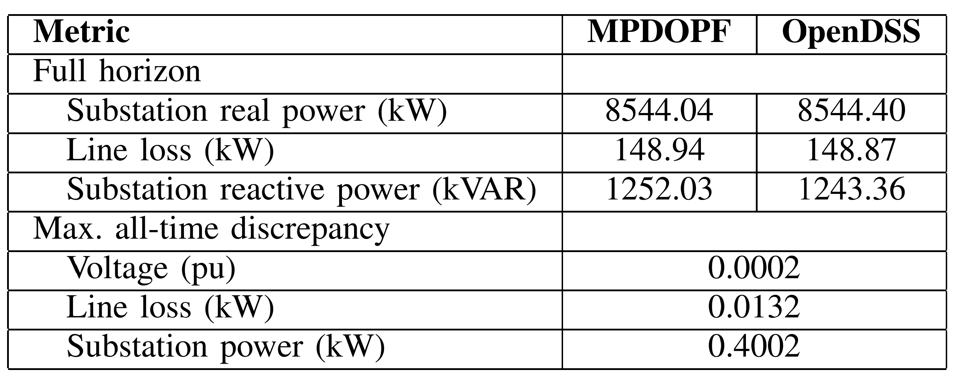
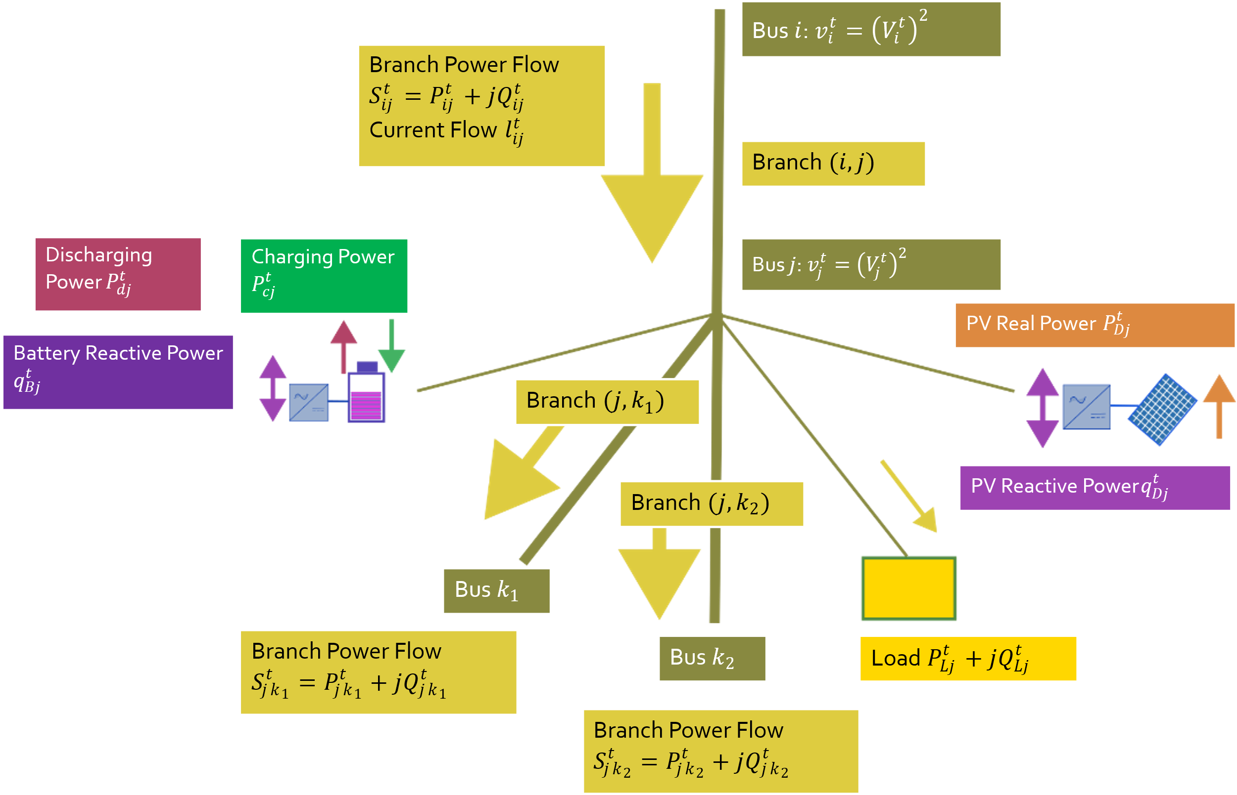
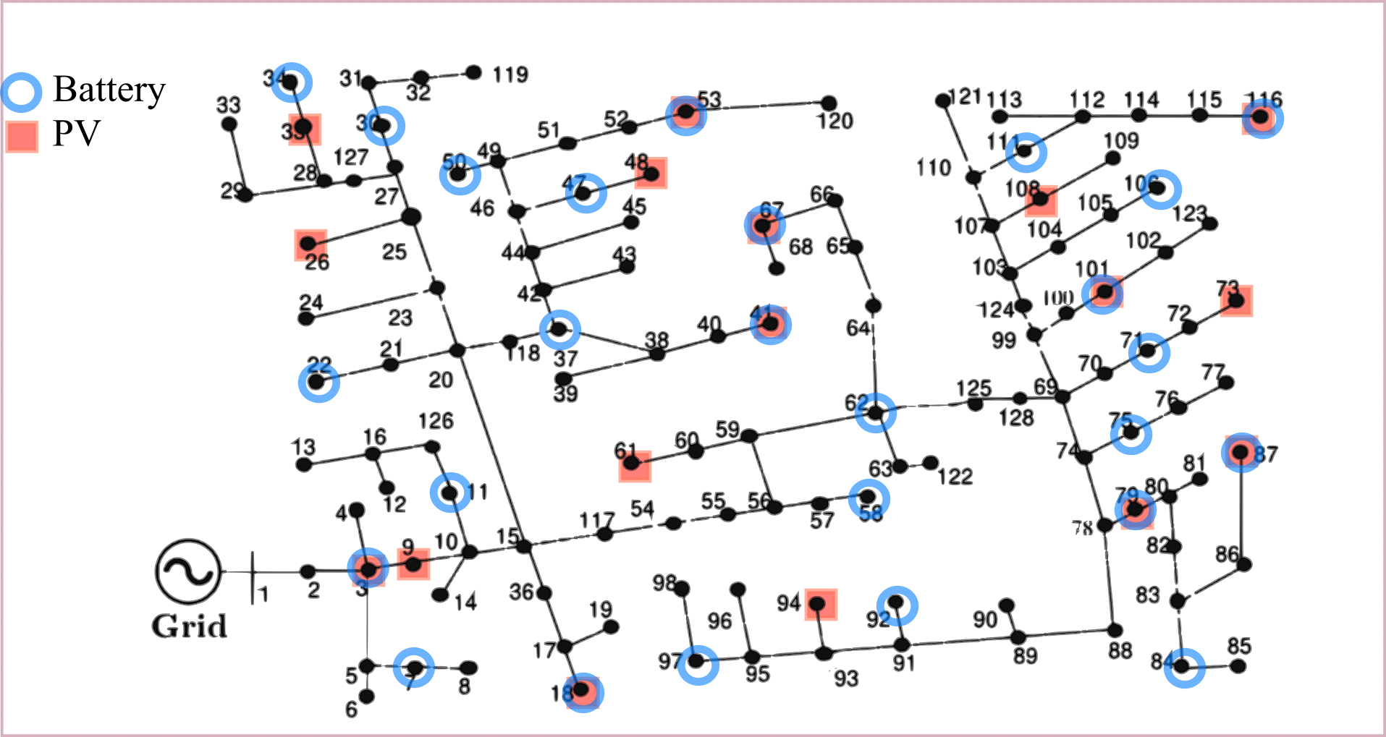
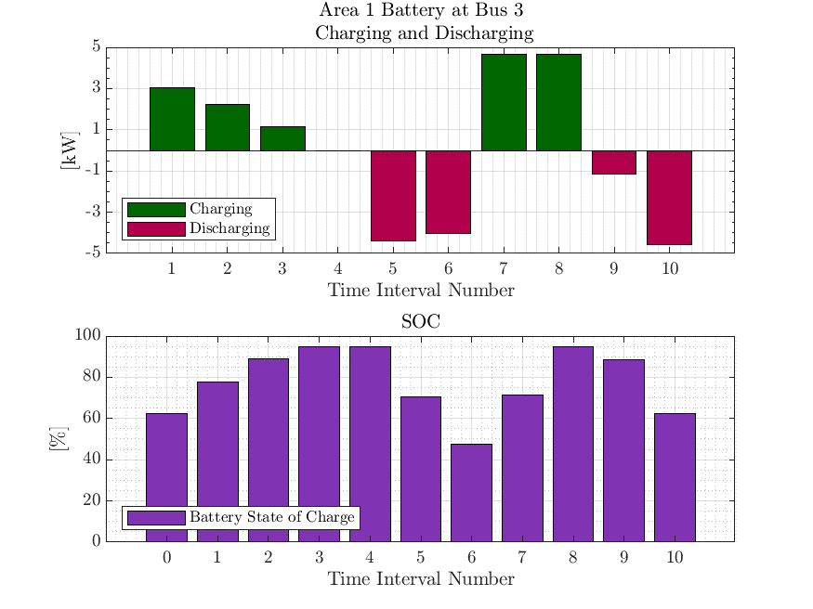
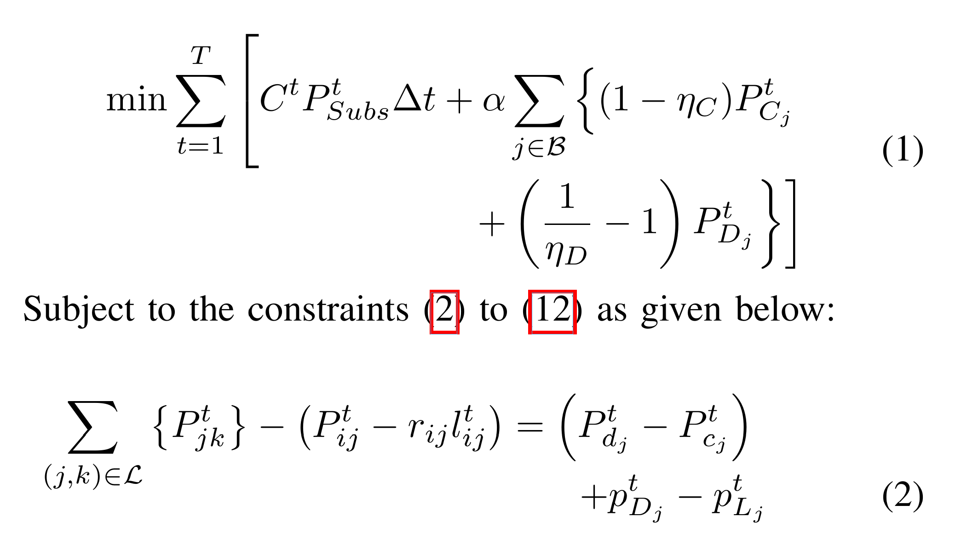
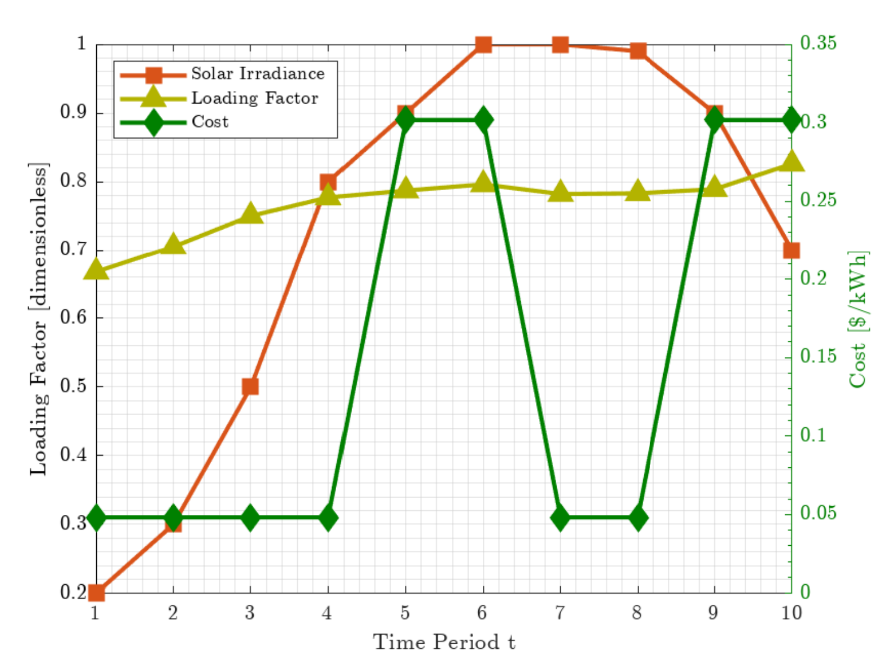
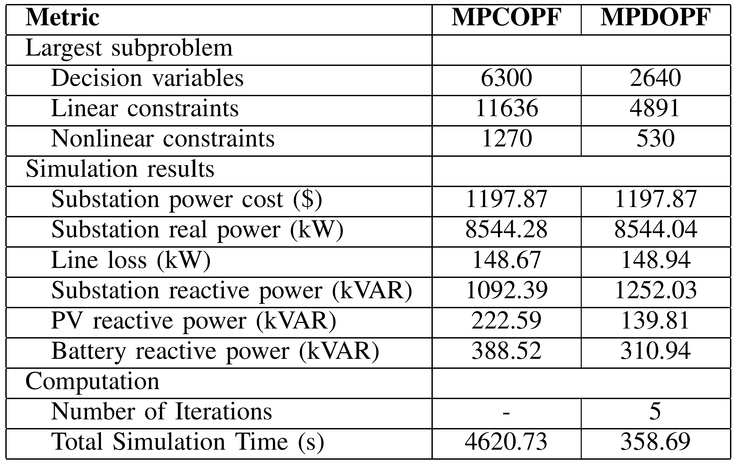
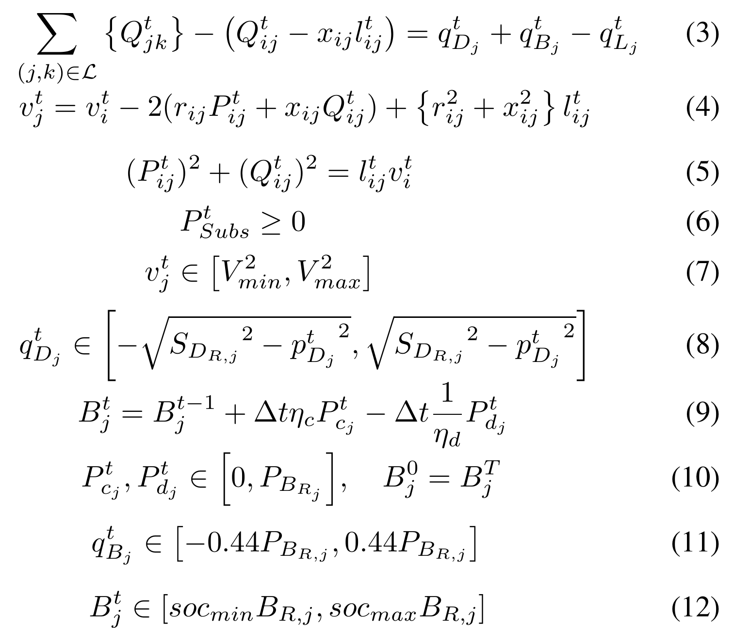

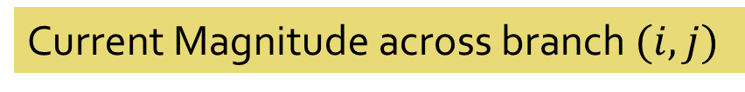
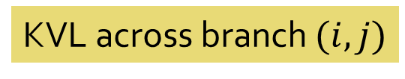
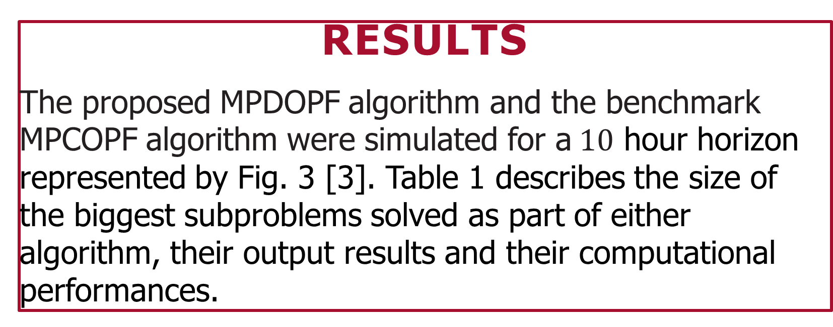


Linear vs Nonlinear Optimal Power Flow Modelling - Tradeoffs and Lessons
Aryan Ritwajeet Jha*, SIEEE, Subho Paul#, MIEEE and Anamika Dubey*, SMIEEE
*School of Electrical Engineering & Computer Sciences, Washington State University, Pullman, WA, USA
#Department of Electrical Engineering, Indian Institute of Technology (BHU) Varanasi, Varanasi, UP, India
KEY Points
A Substation Operator’s key objective when operating a Power Distribution System is minimizing Cost of Operation, subject to safety and reliability limits. This problem of determining an Optimal Control Schedule to achieve the same is called the Optimal Power Flow (OPF) problem. When the problem extends across a horizon of multiple time-steps, it is called the Multi-Period OPF (MPOPF) problem.
Optimization Model
Table 2: ACOPF Feasibility Analysis against OpenDSS – $10$ hour horizon
Table 2 confirms the feasibility of the solution against OpenDSS, while Fig. 4 validates the effectiveness of the extra battery loss term in its goal of ensuring complementarity of charging and discharging actions.
Test System
Fig. 1: IEEE 123 Node System A - $20\%$ PVs $+30\%$ Batteries
As seen in Fig. 1, A Balanced Three-Phase IEEE 123 Node System with $85$ Load Nodes, with $20\% (17)$ PVs and $30\% (26)$ Batteries is used.
Horizon Duration for Comparison: $10$ Hours
For the centralized OPF approach (MPCOPF), the entire system is solved for at once. For the proposed distributed OPF approach (MPDOPF) based on the ENApp algorithm [1], the system is divided into four areas, between which boundary variables will be exchanged.
Fig. 2: A Schematic Representing all the Components in the System
Fig. 4: Optimal Schedule for one of the BESS in the test system.
References
[1] Jha, A. R., Paul, S., & Dubey, A. (2025, July). Analyzing the performance of linear and nonlinear multi-period optimal power flow models for active distribution networks. Paper presented at the 2025 IEEE North-East India International Energy Conversion Conference and Exhibition (NE-IECCE 2025), National Institute of Technology Silchar, Assam, India.
[2] MultiPeriodDistOPF. (2025, July 27). Retrieved from https://github.com/Realife-Brahmin/MultiPeriodDistOPF
[3] Jha, A. R., Paul, S., & Dubey, A. . Spatially Distributed Multi-Period Optimal Power Flow with Battery Energy Storage Systems. 2024 56th North American Power Symposium (NAPS). IEEE. doi: 10.1109/NAPS61145.2024.10741846
Cost of Substation Power and losses due to Battery Actions
From Table 1, It may be seen that the proposed MPDOPF significantly cuts down on the computation time, by reducing the primary computational bottleneck encountered when solving for the OPF for a subproblem. It does so by reducing the size of the largest subproblem solved at any single instance.
The proposed MPDOPF solution reaches virtually the same level of optimality (Substation Power Cost) as the benchmark MPCOPF, in a fraction of the time.
Node $j$ Real Power Balance
Table 1: Comparison between MPCOPF and MPDOPF Results – $10$ hour horizon
Results
The proposed MPDOPF algorithm and the benchmark MPCOPF algorithm were simulated for a$10$ hour horizon represented by Fig. 3 [3]. Table 1 describes the size of the biggest subproblems solved as part of either algorithm, their output results and their computational performances.
Node $j$ Reactive Power Balance
Acknowledgement
The authors acknowledge the financial support provided by the Department of Energy (DOE) for the project named ‘Spokane Connected Communities’ under contract number DE-EE0099775
KVL across branch $(i, j)$
Fig. 2 and (1) to (12) describe the entire system including the DER and BESS Components.
The Battery Loss Term in (1) helps us avoid Integer Constraints, avoiding solution complexity [2]
Current Magnitude across branch $(i, j)$
Fig. 3: Forecast of Demand, Solar and Cost of Substation Power
Voltage Limits
DER Reactive Power Limits
Battery SOC Trajectory
Battery Power Limits
Battery Reactive Power Limits
Battery SOC Limits

