Slide 1

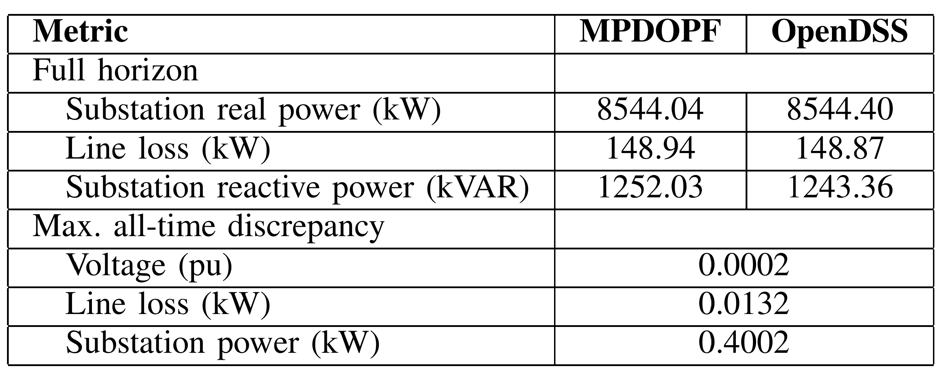
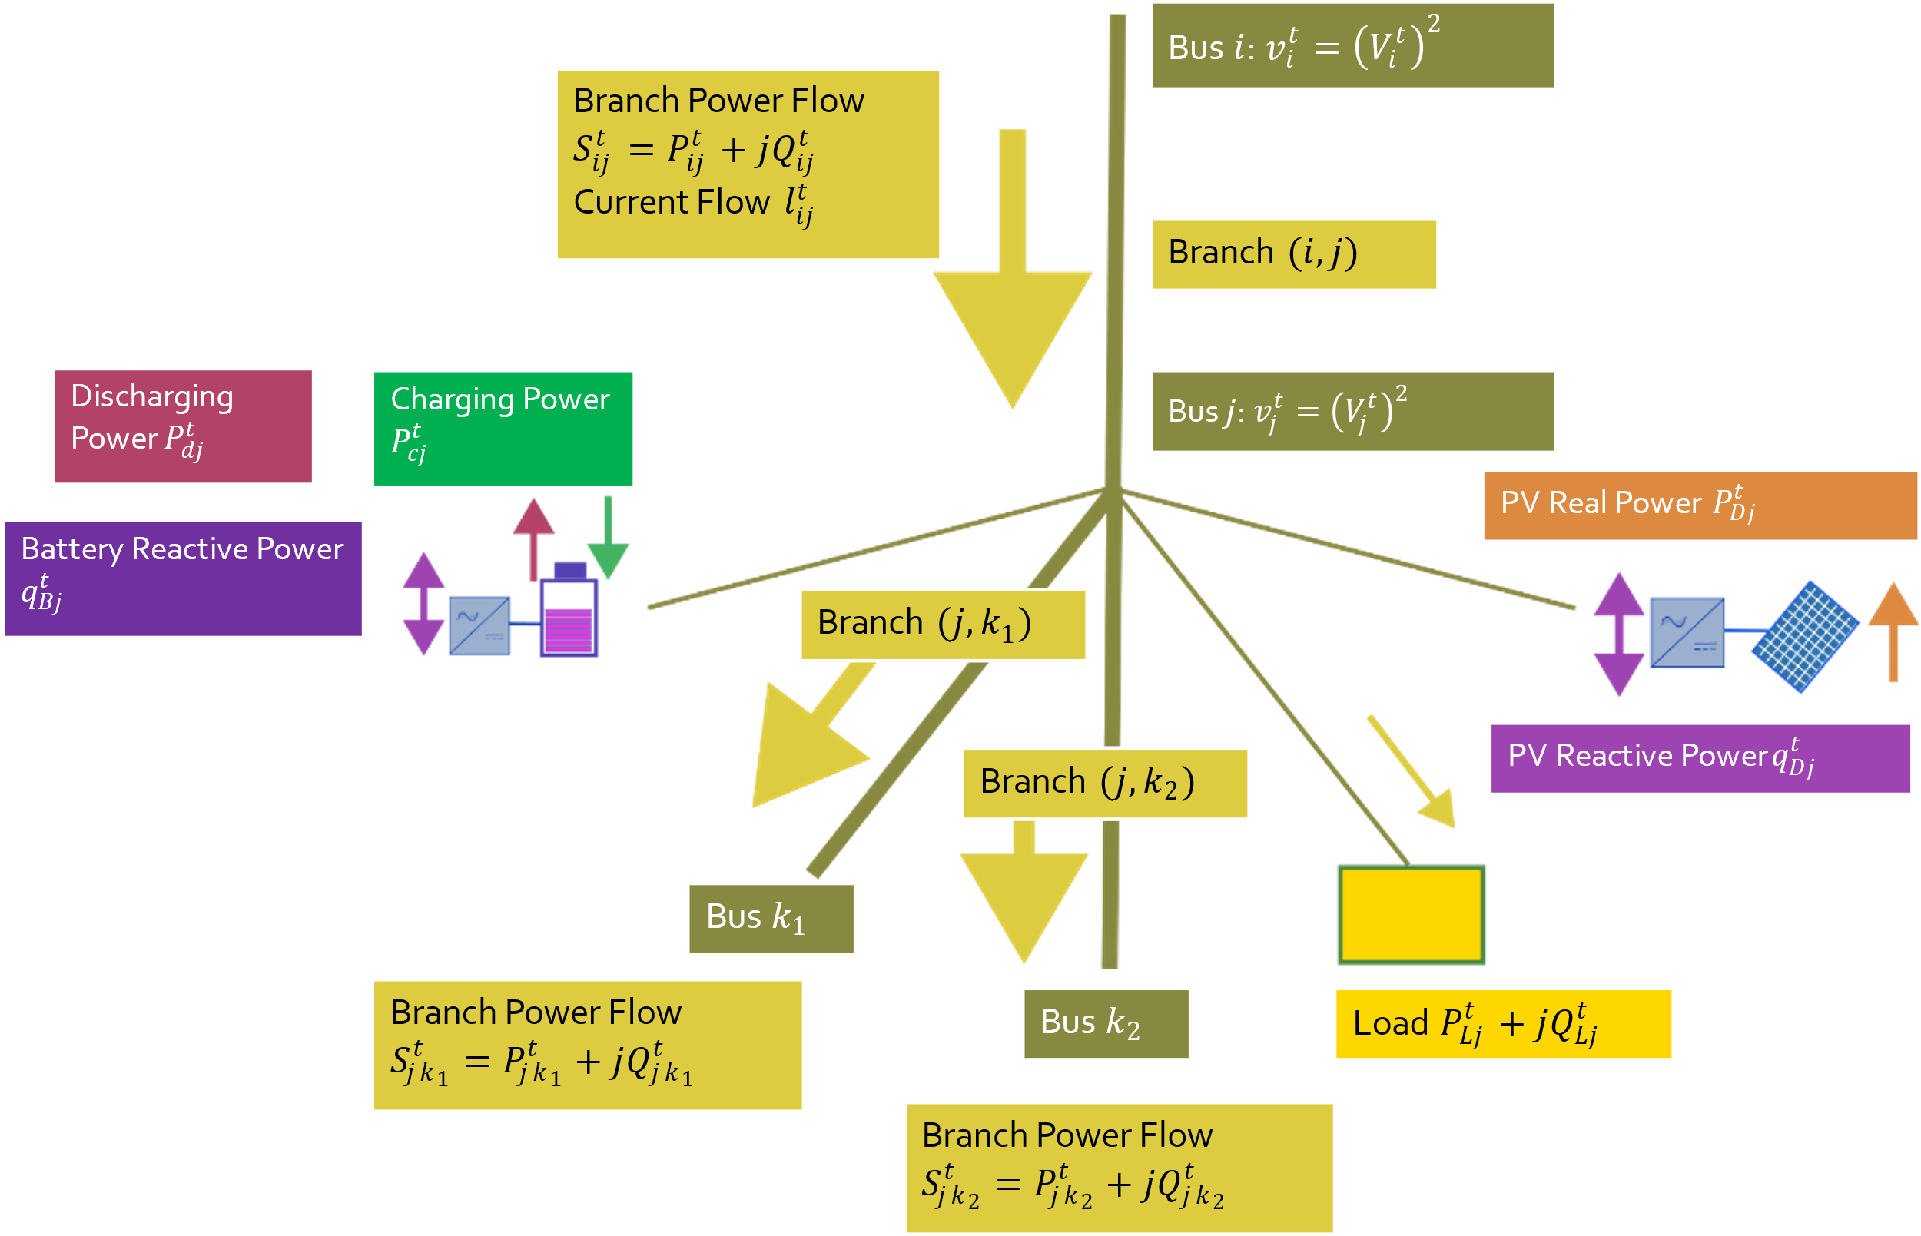
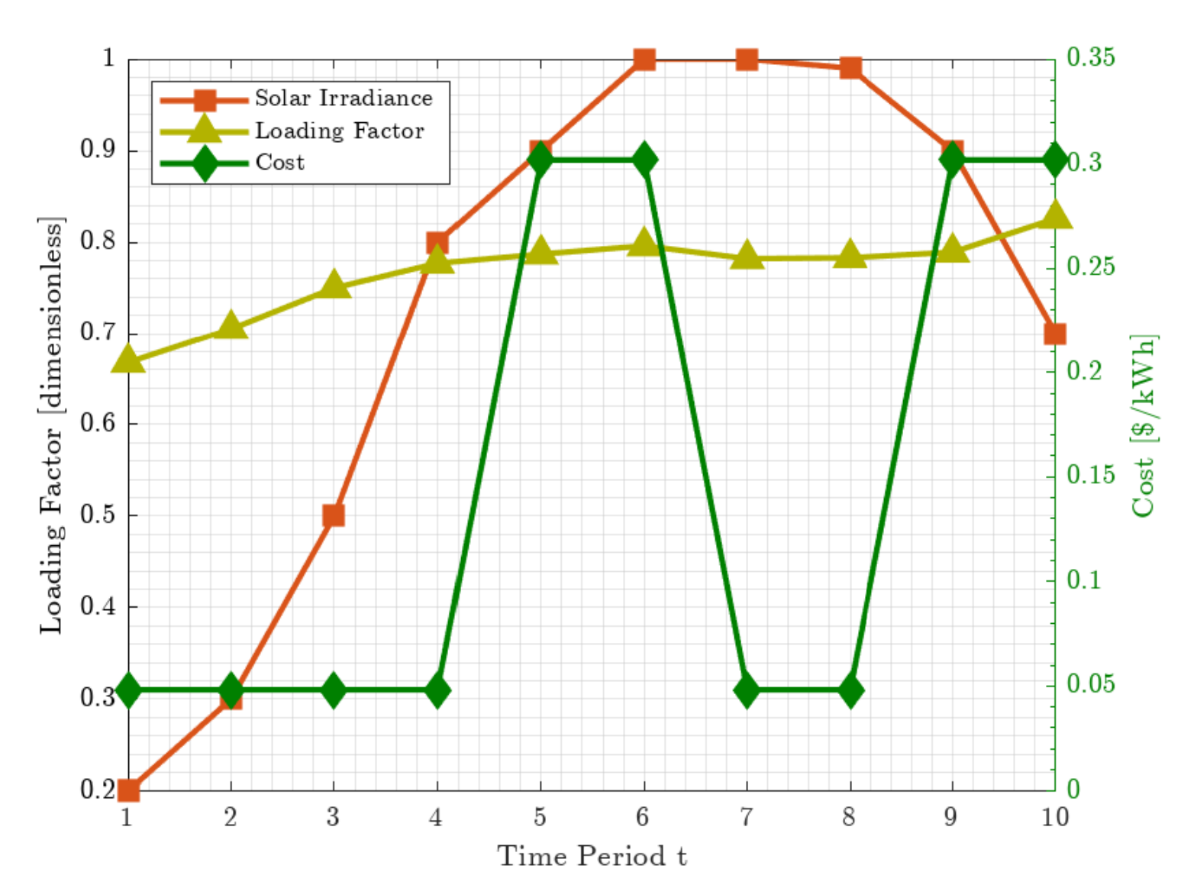
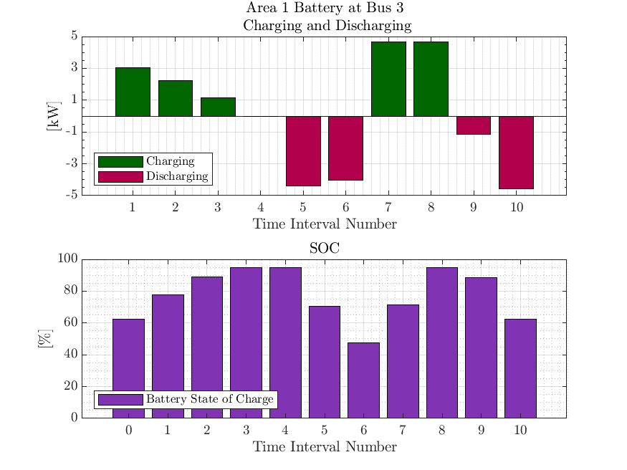
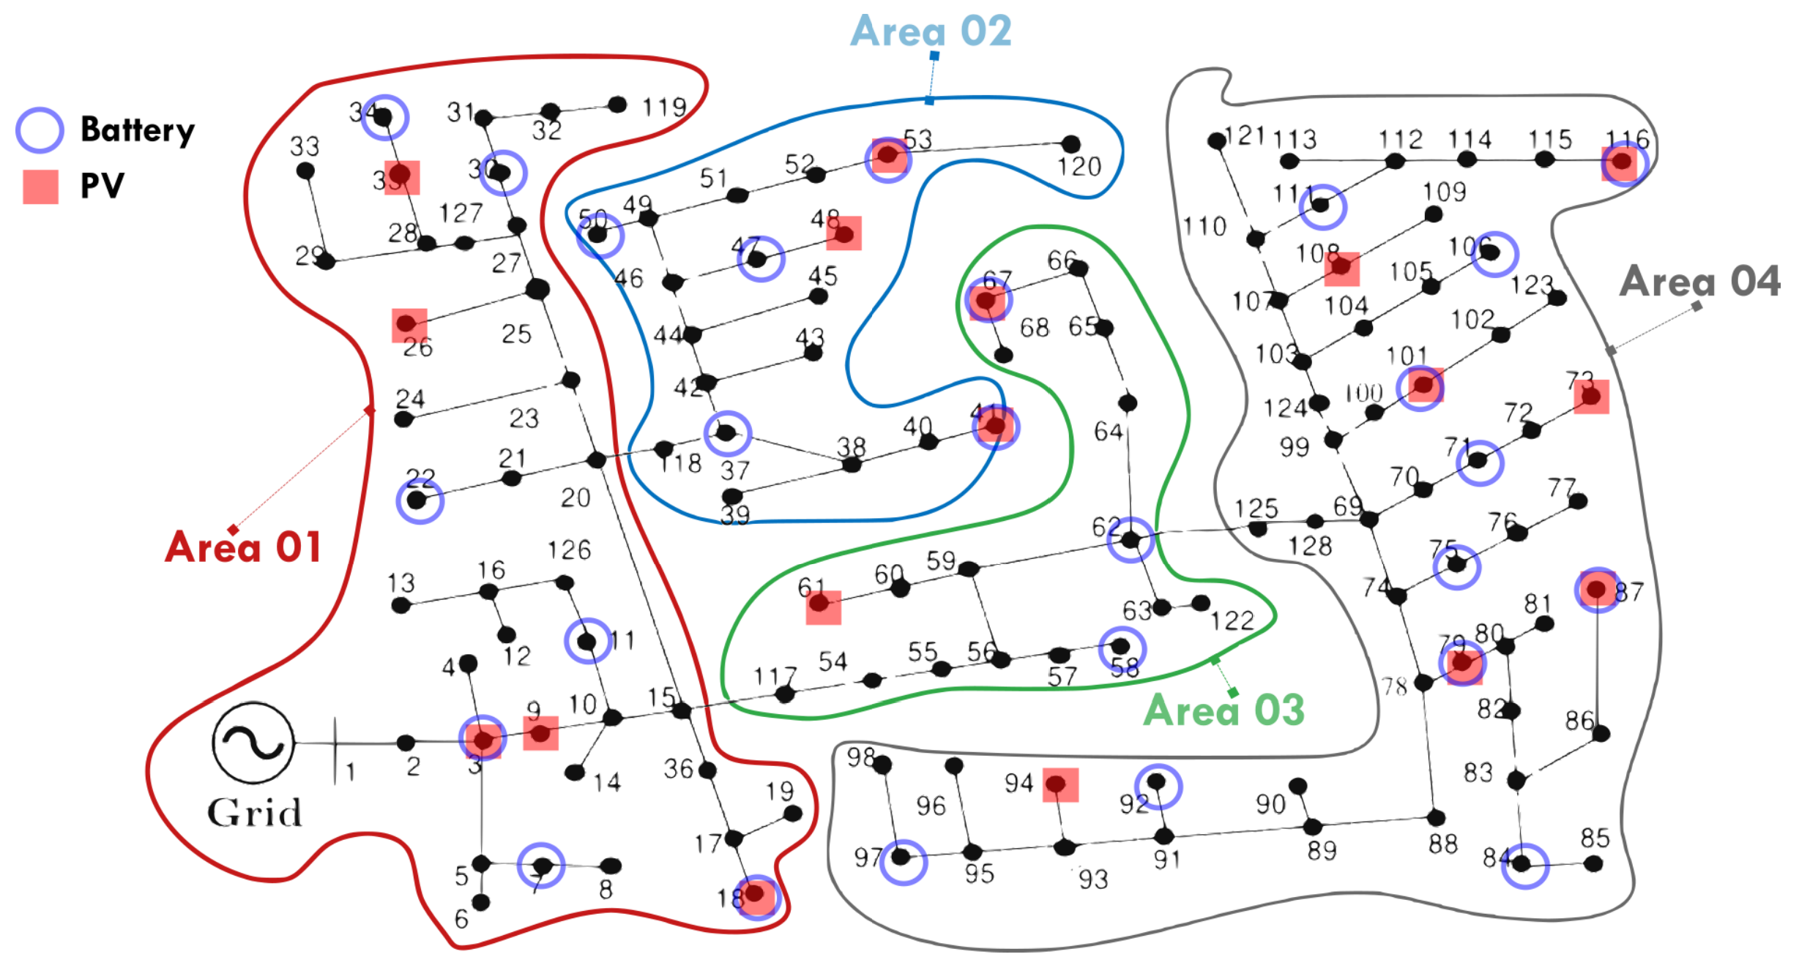
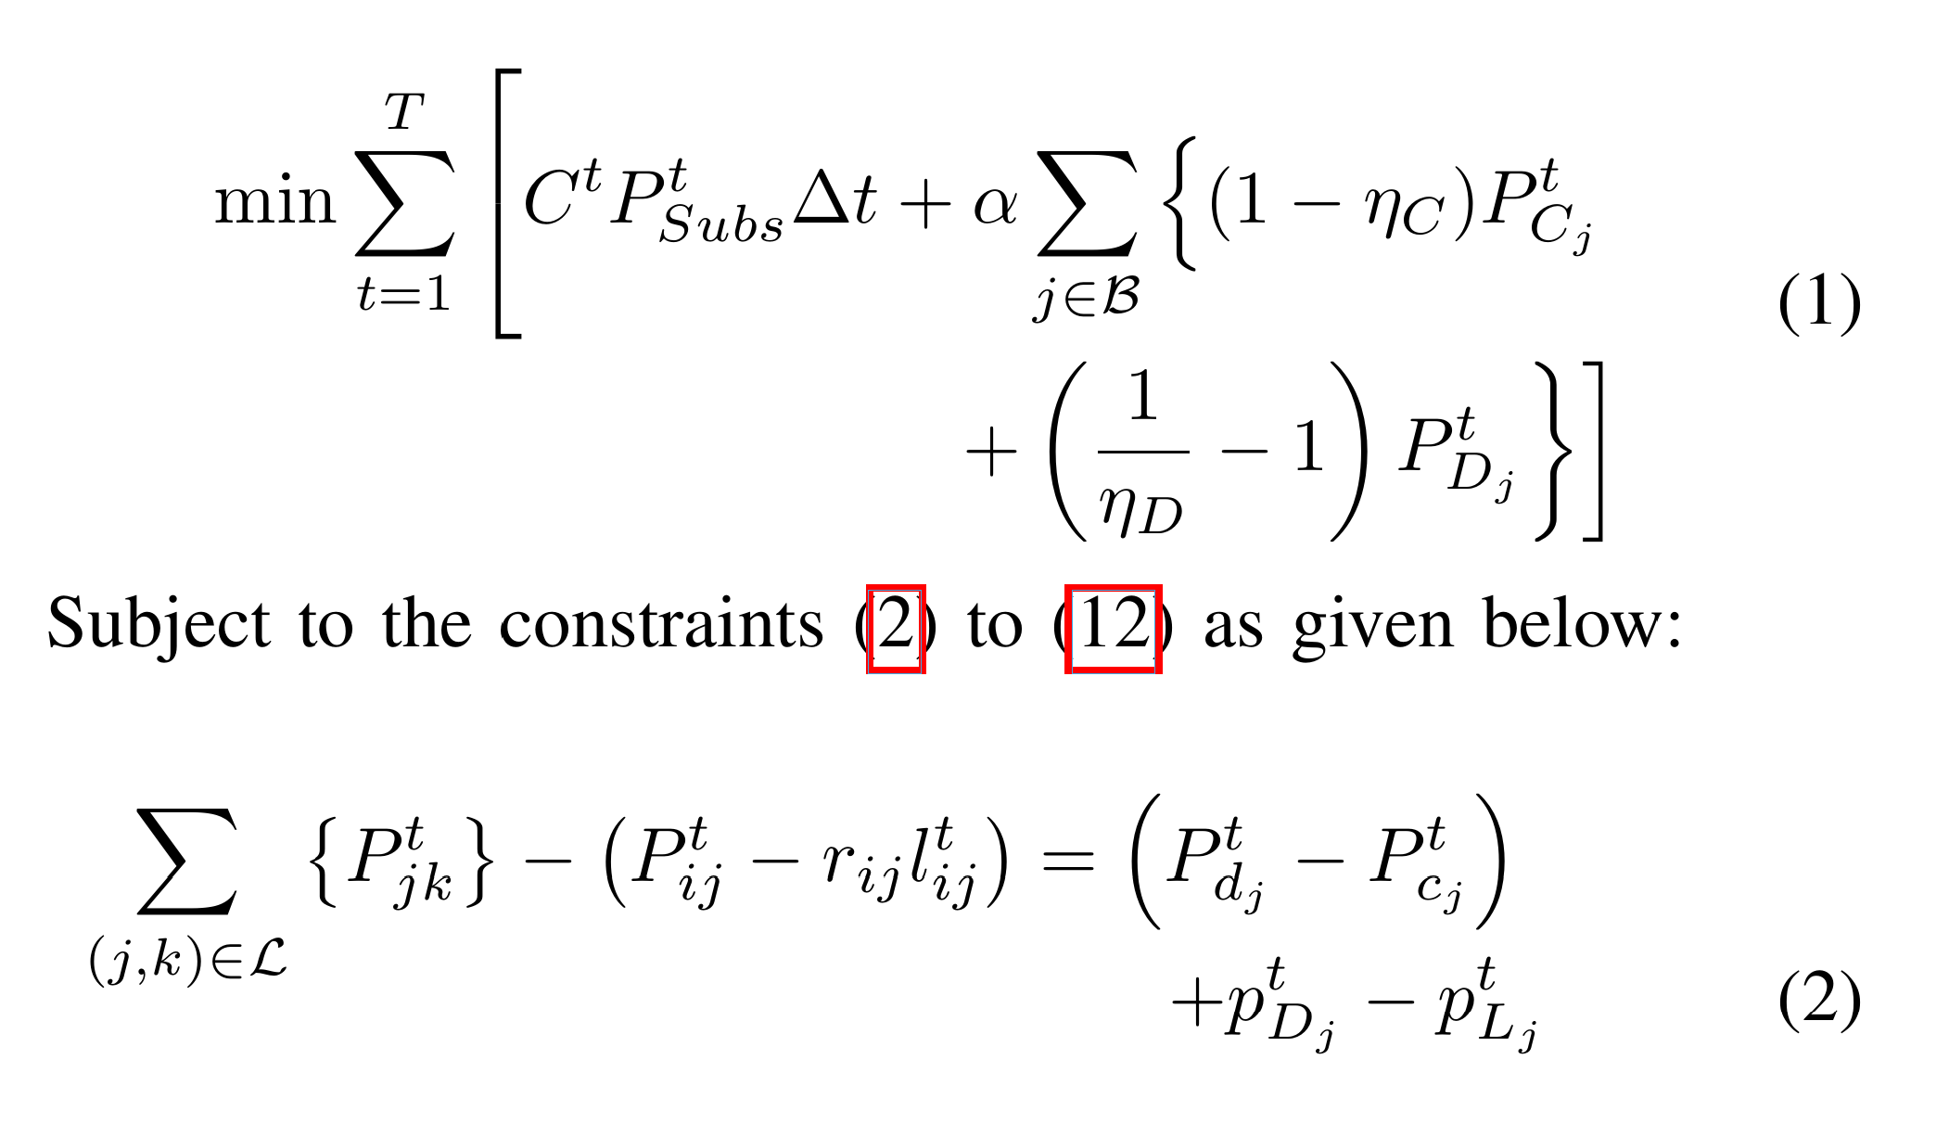
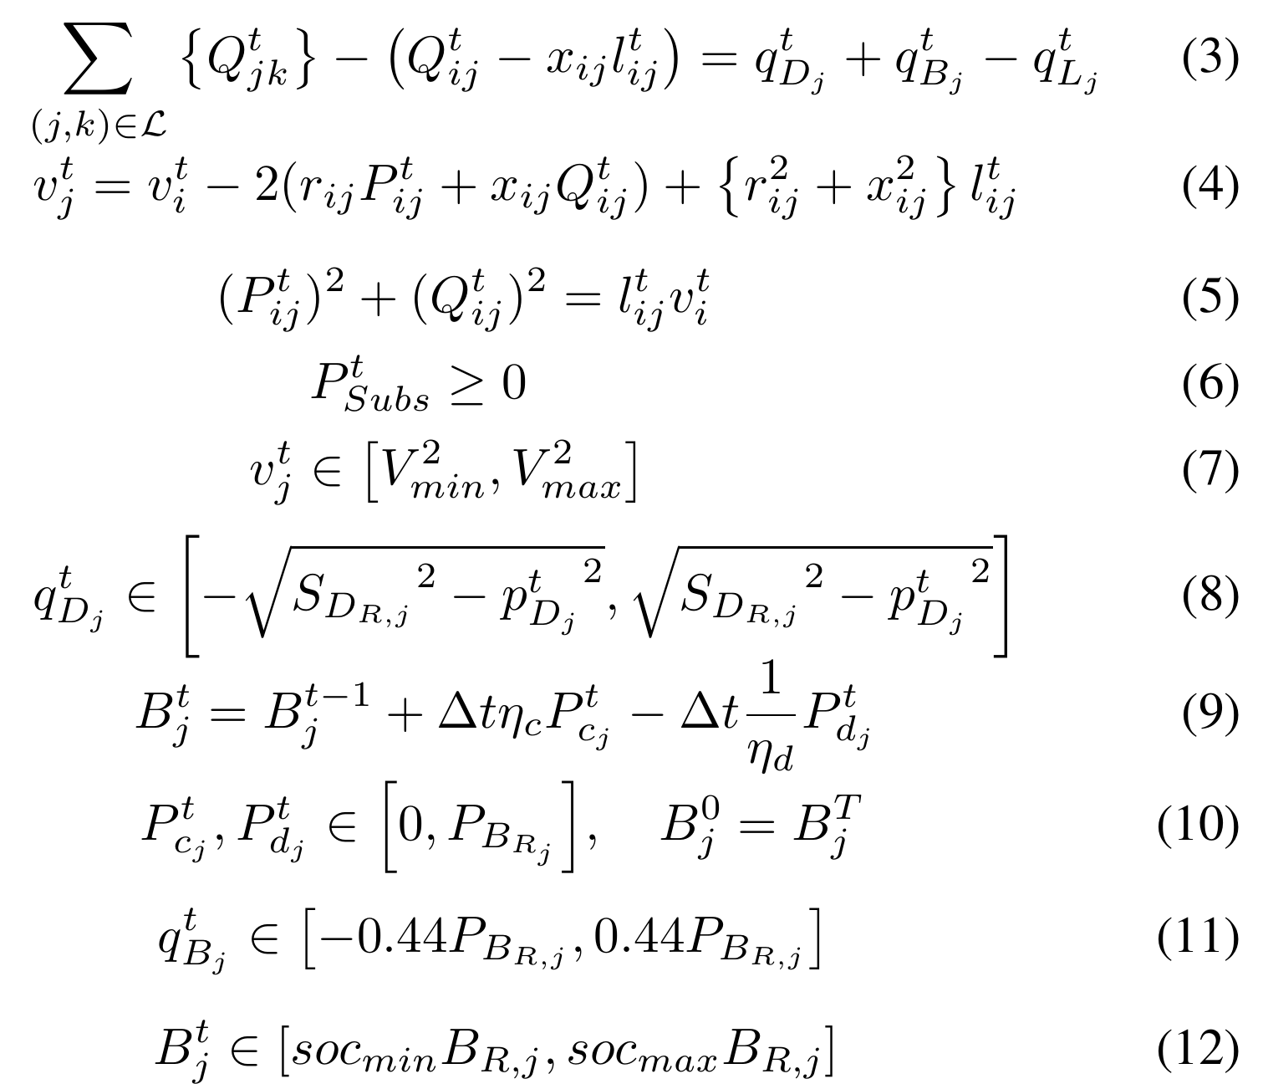
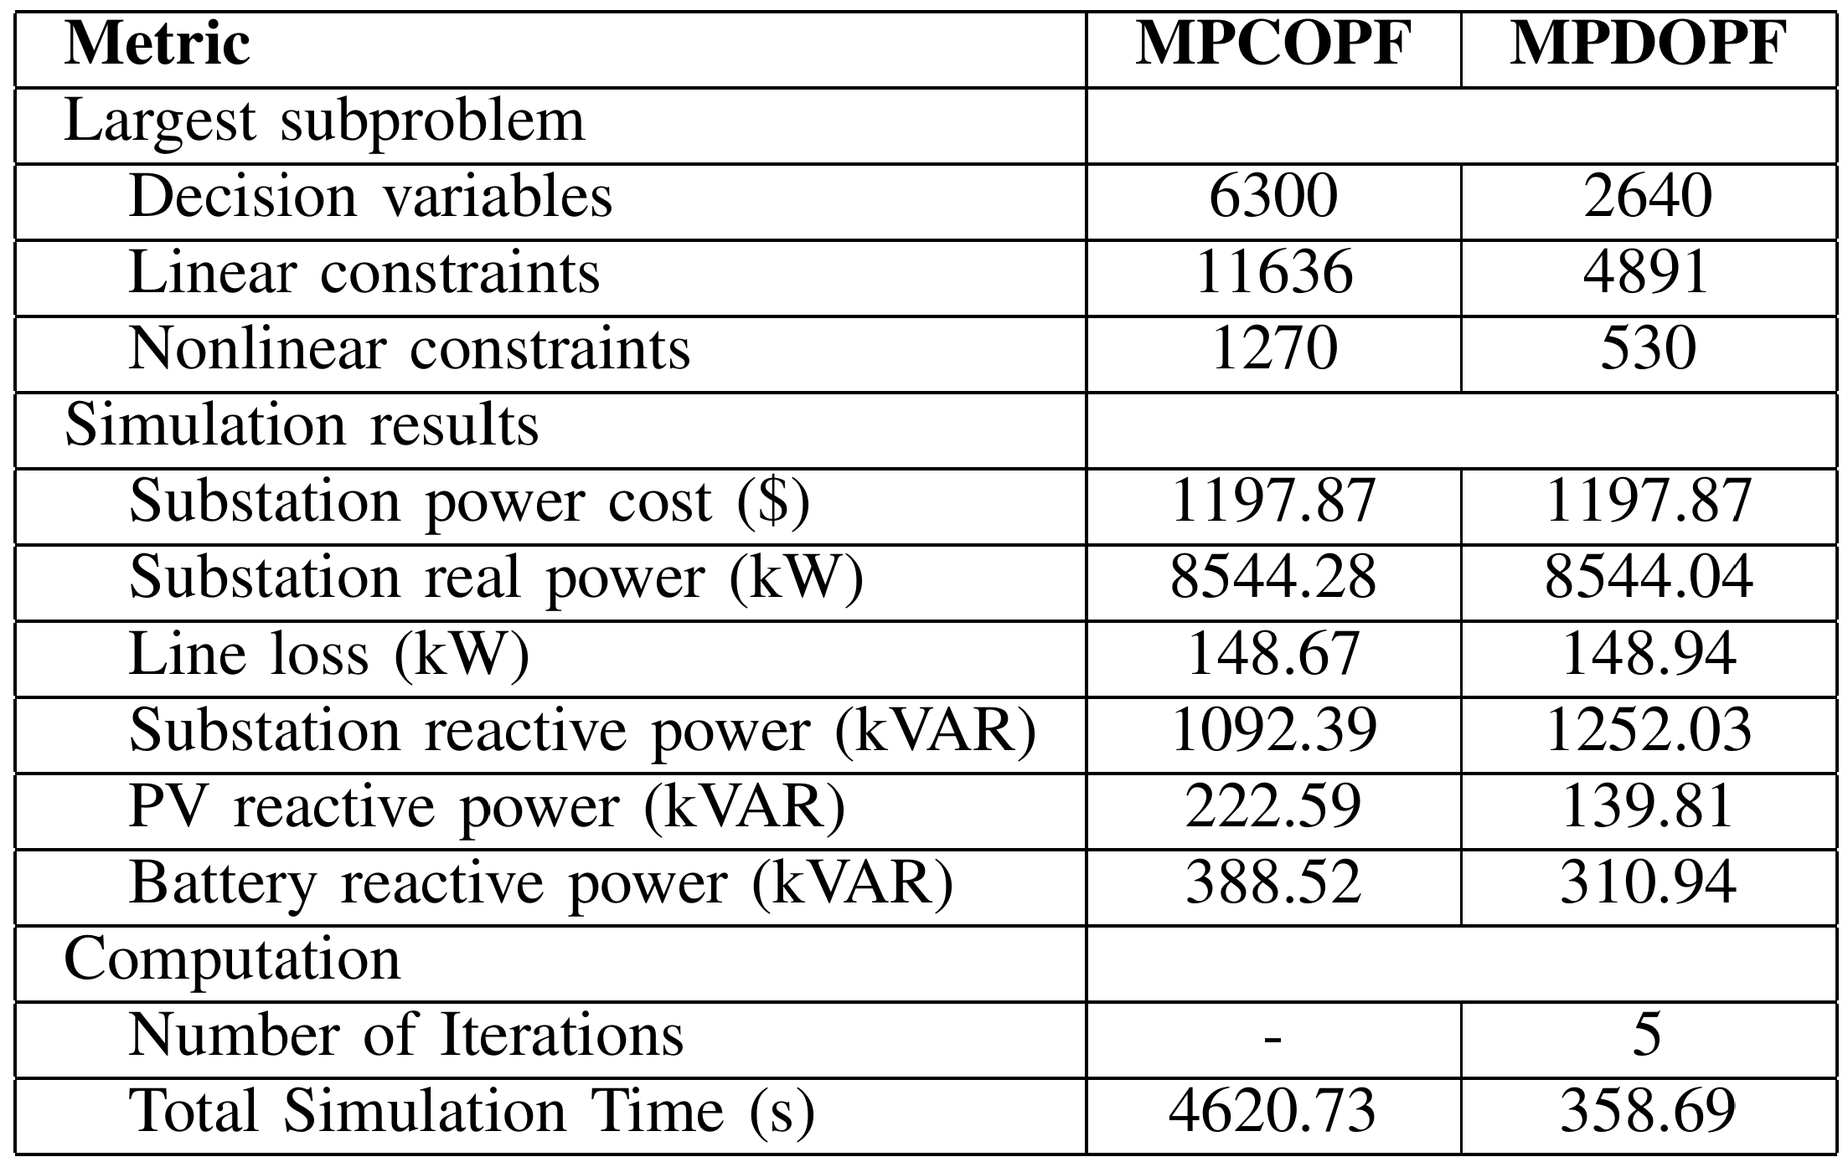


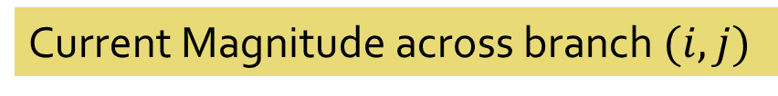
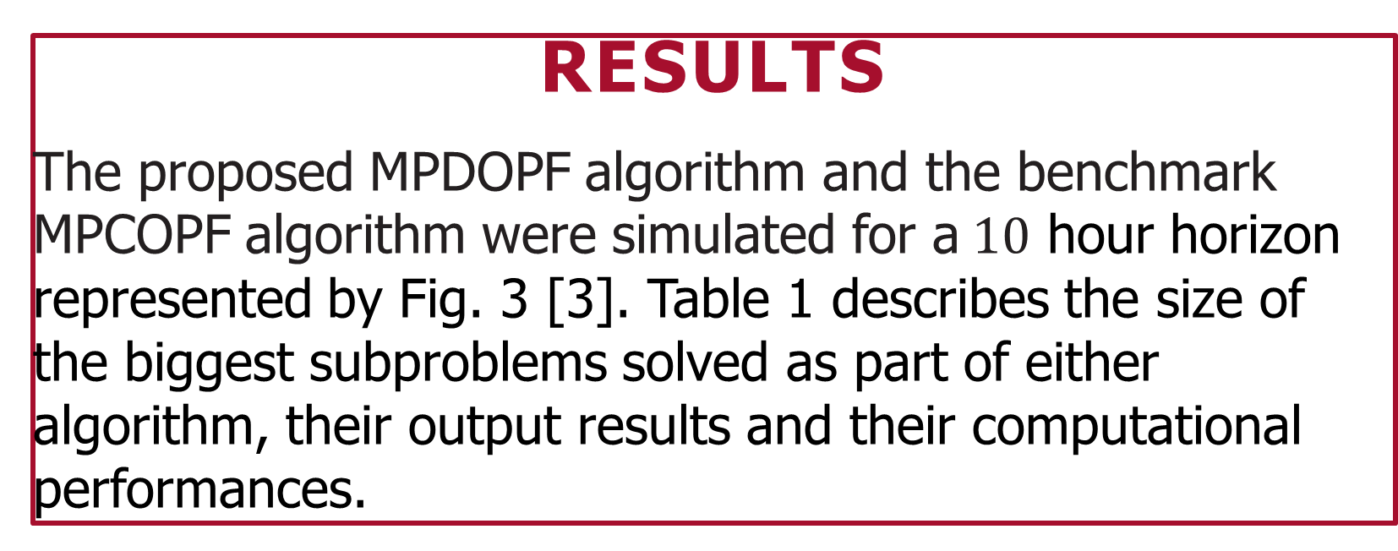
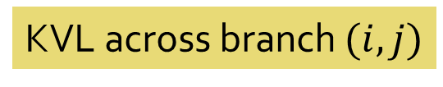
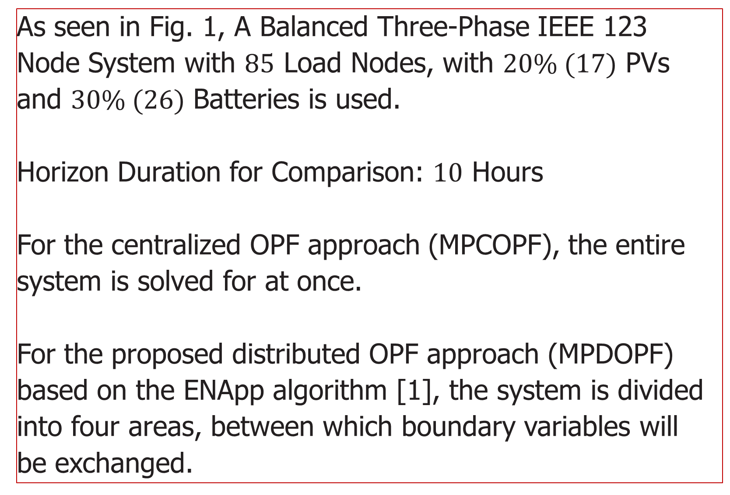
Spatially Distributed Multi-Period Optimal Power Flow with Batteries
Aryan Ritwajeet Jha*, SIEEE, Subho Paul#, MIEEE and Anamika Dubey*, SMIEEE
*School of Electrical Engineering & Computer Sciences, Washington State University, Pullman, WA, USA
#Department of Electrical Engineering, Indian Institute of Technology (BHU) Varanasi, Varanasi, UP, India
KEY Points
A Substation Operator’s key objective when operating a Power Distribution System is minimizing Cost of Operation, subject to safety and reliability limits. This problem of determining an Optimal Control Schedule to achieve the same is called the Optimal Power Flow (OPF) problem. When the problem extends across a horizon of multiple time-steps, it is called the Multi-Period OPF (MPOPF) problem.
As generation share of Distributed Energy Resources (DER) and Battery Energy Storage Systems (BESS) increases, Complexity of solving MPOPF increases as well.
We propose an efficient MPDOPF (Multi-Period Distributed OPF) algorithm to solve for the MPOPF problem by spatially furcating the problem into manageable subproblems which may be solved in parallel.
Substantial speedup (10x) in computation speed with virtually no loss in solution optimality or feasibility.
Optimization Model
Results
The proposed MPDOPF algorithm and the benchmark MPCOPF algorithm were simulated for a$10$ hour horizon represented by Fig. 3 [3]. Table 1 describes the size of the biggest subproblems solved as part of either algorithm, their output results and their computational performances.
Table 2: ACOPF Feasibility Analysis against OpenDSS – $10$ hour horizon
Table 2 confirms the feasibility of the solution against OpenDSS, while Fig. 4 validates the effectiveness of the extra battery loss term in its goal of ensuring complementarity of charging and discharging actions.
Fig. 2: A Schematic Representing all the Components in the System
Fig. 2 and (1) to (12) describe the entire system including the DER and BESS Components.
The Battery Loss Term in (1) helps us avoid Integer Constraints, avoiding solution complexity [2]
Fig. 3: Forecast of Demand, Solar and Cost of Substation Power
From Table 1, It may be seen that the proposed MPDOPF significantly cuts down on the computation time, by reducing the primary computational bottleneck encountered when solving for the OPF for a subproblem. It does so by reducing the size of the largest subproblem solved at any single instance.
The proposed MPDOPF solution reaches virtually the same level of optimality (Substation Power Cost) as the benchmark MPCOPF, in a fraction of the time.
Test System
Cost of Substation Power and losses due to Battery Actions
Fig. 4: Optimal Schedule for one of the BESS in the test system.
Node $j$ Real Power Balance
References
[1] R. Sadnan and A. Dubey, “Distributed optimization using reduced network equivalents for radial power distribution systems,” IEEE Trans. Power Syst., vol. 36, no. 4, pp. 3645–3656, Jul. 2021.
[2] Nazir, N., & Almassalkhi, M. (2021). Guaranteeing a Physically Realizable Battery Dispatch Without Charge-Discharge Complementarity Constraints. IEEE Trans. Smart Grid, 14(3), 2473–2476. doi: 10.1109/TSG.2021.3109805
[3] MultiPeriod-DistOPF-Benchmark. (2024, July 20). Retrieved from https://github.com/Realife-Brahmin/MultiPeriod-DistOPF-Benchmark
[4] Jha, A., Subho, P., & Dubey, A. (2024). Spatially distributed multi-period optimal power flow with battery energy storage systems [Accepted for Publication]. NAPS 2024.
Node $j$ Reactive Power Balance
Fig. 1: IEEE 123 Node System Divided into Four Areas
KVL across branch $(i, j)$
Table 1: Comparison between MPCOPF and MPDOPF Results – $10$ hour horizon
As seen in Fig. 1, A Balanced Three-Phase IEEE 123 Node System with $85$ Load Nodes, with $20\% (17)$ PVs and $30\% (26)$ Batteries is used.
Horizon Duration for Comparison: $10$ Hours
For the centralized OPF approach (MPCOPF), the entire system is solved for at once. For the proposed distributed OPF approach (MPDOPF) based on the ENApp algorithm [1], the system is divided into four areas, between which boundary variables will be exchanged.
Current Magnitude across branch $(i, j)$
Voltage Limits
DER Reactive Power Limits
Battery SOC Trajectory
Acknowledgement
The authors acknowledge the financial support provided by the Department of Energy (DOE) for the project named ‘Spokane Connected Communities’ under contract number DE-EE0099775
Battery Power Limits
Battery Reactive Power Limits
Battery SOC Limits

