Slide 1


EE 521 Analysis of Power Systems In Julia
Aryan Ritwajeet Jha
Ninad Kiran Gaikwad
Sajjad Uddin Mahmud

Slide 2
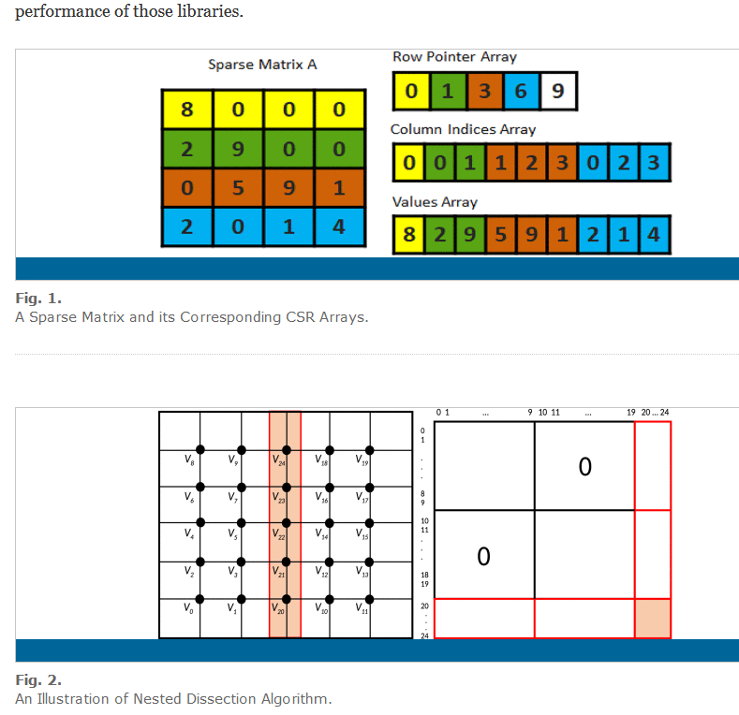
Need to explain our Sparse Data Structure like this.

Slide 3
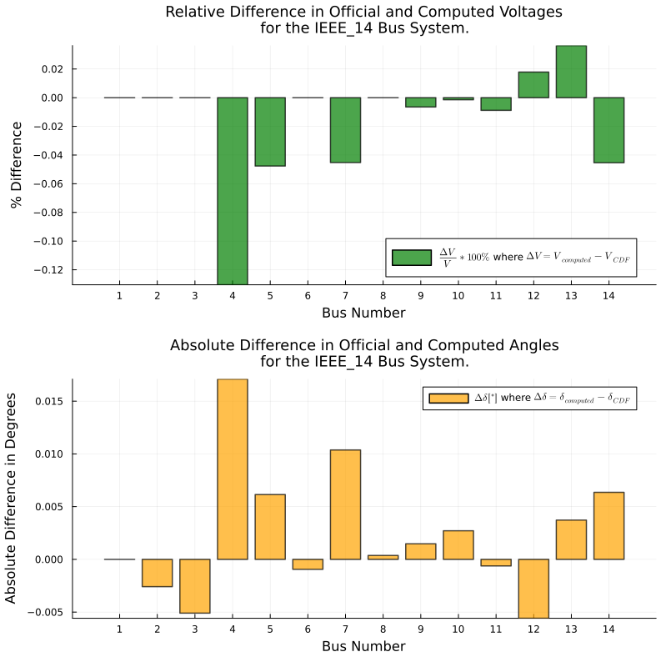
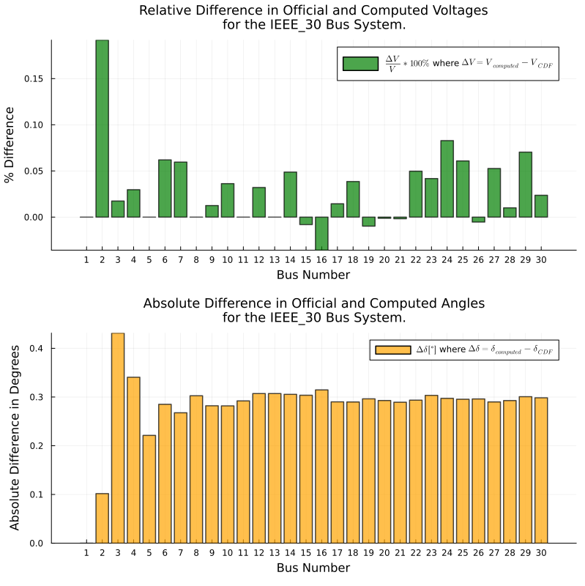
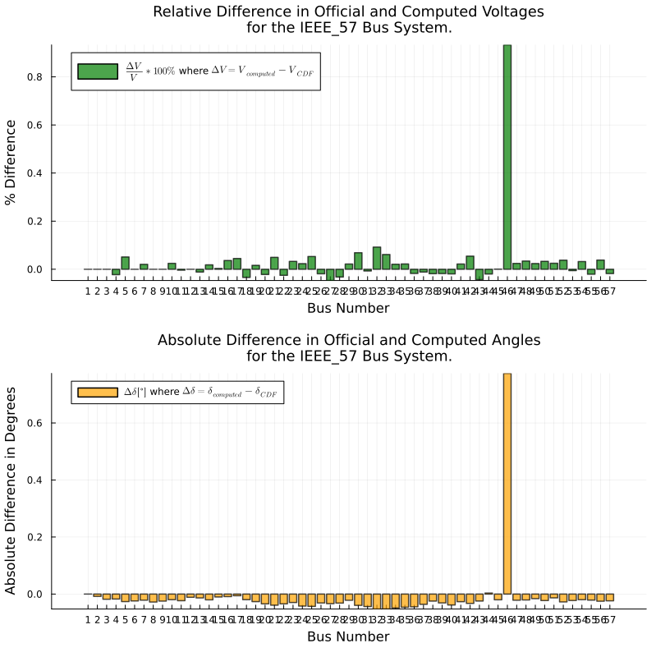
Sparse Power Flow Results

Slide 4
Presenting PowerEdu.jl in a paper
We’re doing useful, innovative work.
Need to convince the reviewers that our work is useful and innovative.
Need to read up on papers presenting packages in Power Systems.

Slide 5
Presenting PowerEdu.jl in a paper
Need to read up on papers presenting packages in Power Systems.
PowerModels.jl: An Open-Source Framework for Exploring Power Flow Formulations from PSCC 2018. Link
PowerSystems.jl — A power system data management package for large scale modeling from SoftwareX 2021. Link
PyPSA: Python for Power System Analysis from Journal of Open Research Software, 2018 Link
PowerModelsDistribution.jl: An Open-Source Framework for Exploring Distribution Power Flow Formulations from Electric Power Systems Research 2020. Link

Slide 6
Presenting PowerEdu.jl in a paper
Contents to cite:
Symbolics.jl paper
ForwardDiff.jl paper
Every package we’re using
Every package we’re comparing against

Slide 7

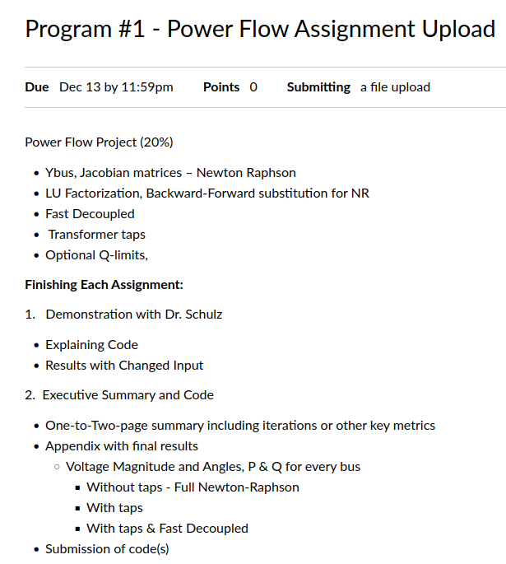
Goal 1: Present Noel with P1, with all the bells and whistles
When?
Sub-goal:
P1 is evaluation-worthy.
Has running NRPF, FDPF for 14 bus.

Slide 8
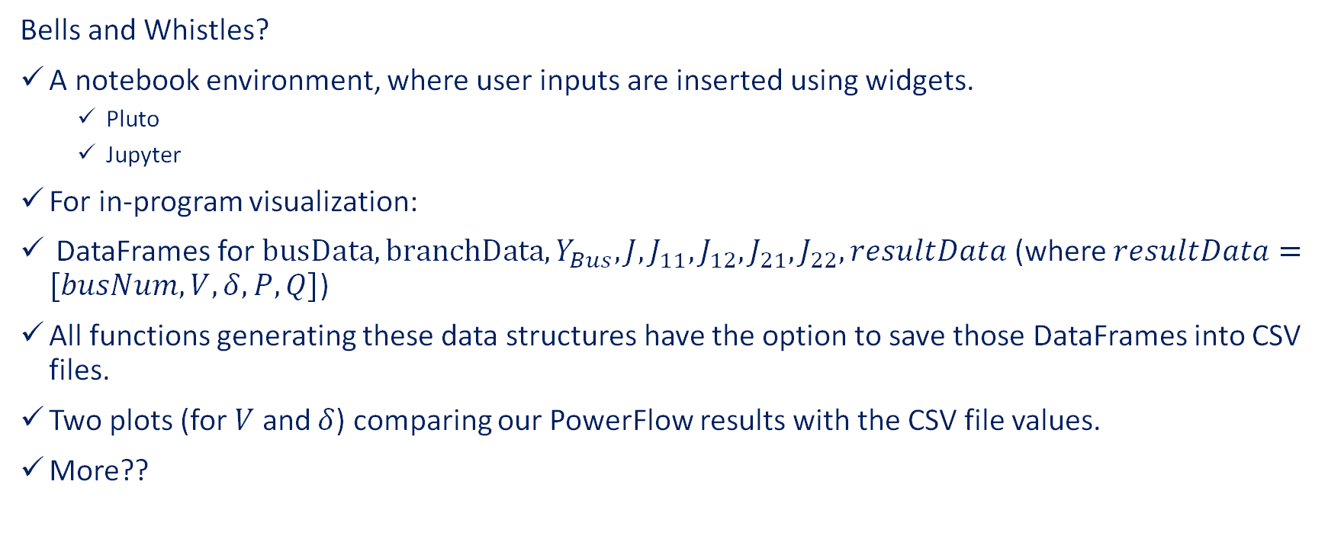
Goal 1: Present Noel with P1, with all the bells and whistles
Bells and Whistles?
A notebook environment, where user inputs are inserted using widgets.
Pluto
Jupyter
For in-program visualization:
DataFrames for $busData, branchData, Y_{Bus}, J, J_{11},J_{12}, J_{21}, J_{22}, resultData$ (where $resultData=[busNum, V, δ, P, Q]$)
All functions generating these data structures have the option to save those DataFrames into CSV files.
Two plots (for $V$ and $δ$) comparing our PowerFlow results with the CSV file values.
More??

Slide 9
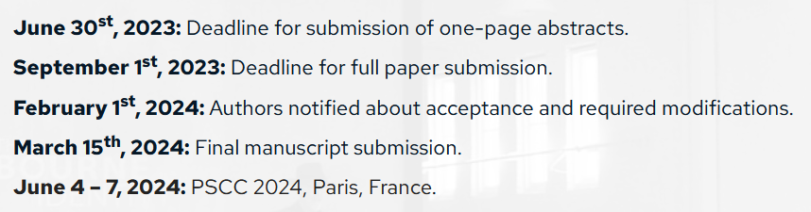

Current Objective: Develop a One-Page Abstract for the proposed Julia Package

Slide 10
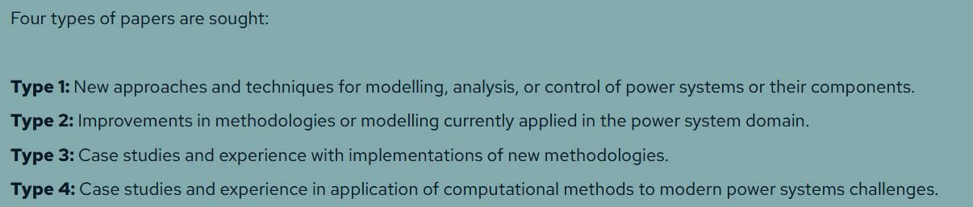

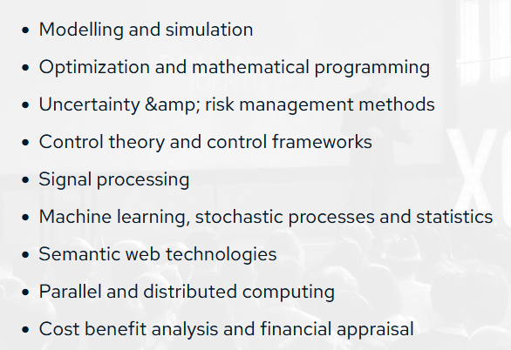




Current Objective: Develop a One-Page Abstract for the proposed Julia Package
Need to have him on-board.

Slide 11
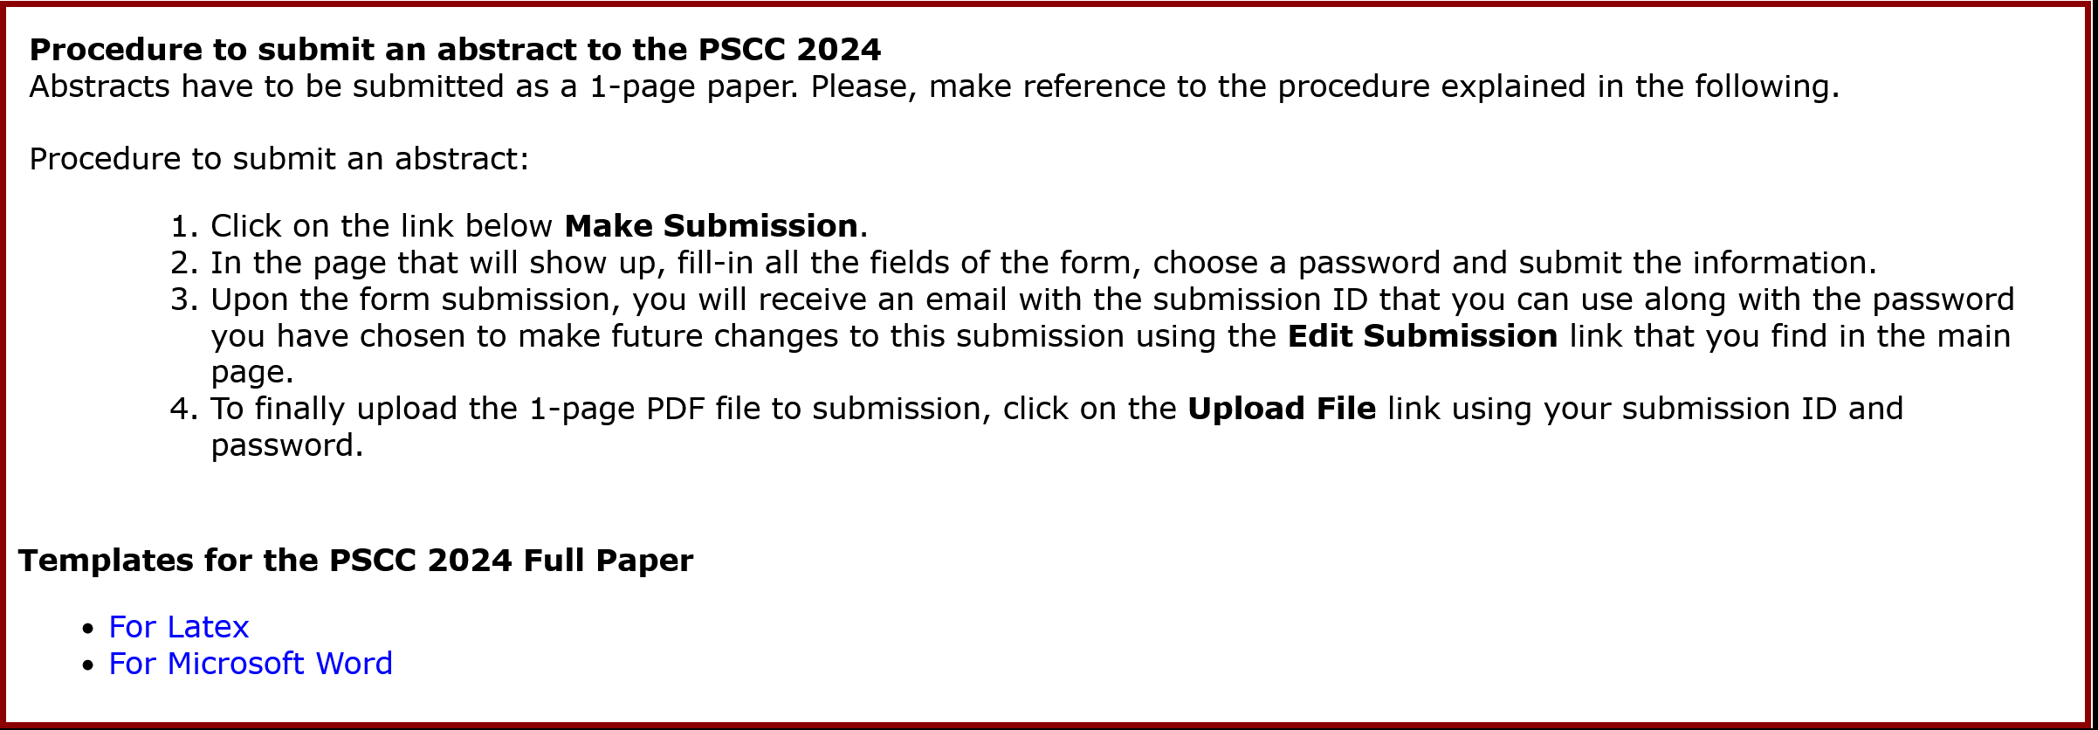
Current Objective: Develop a One-Page Abstract for the proposed Julia Package

Slide 12

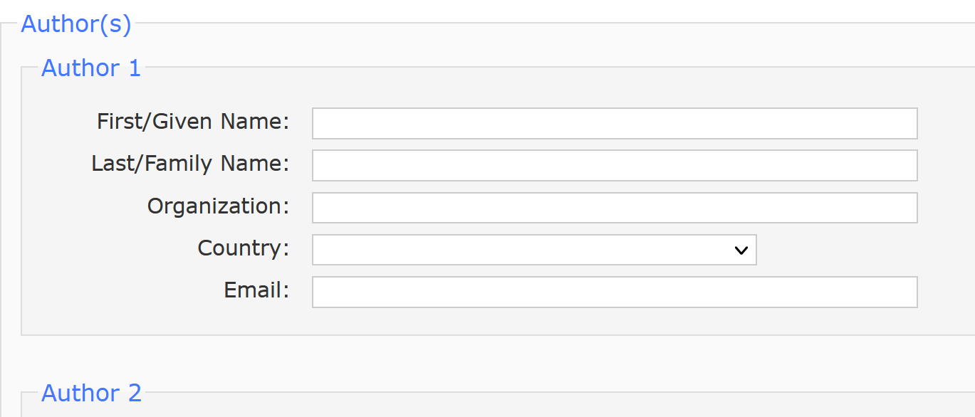
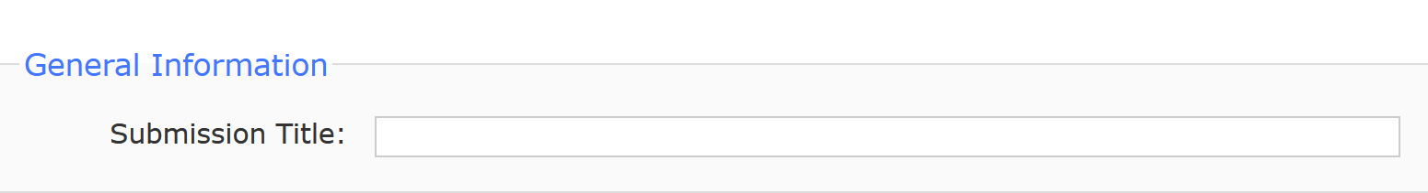
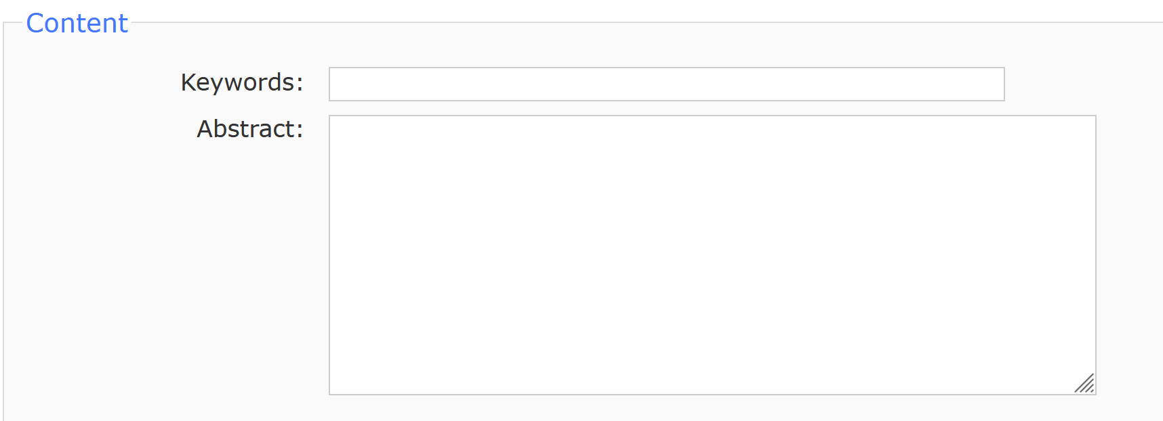
Current Objective: Develop a One-Page Abstract for the proposed Julia Package
We should be giving the package a name, right?
Submission Title?
Author List? Can authorship order be changed during the actual submission?
Can new people be added during the actual submission?

Slide 13

Current Objective: Develop a One-Page Abstract for the proposed Julia Package
I have checked three items in the full list (denoted by a green 'check' symbol).
The next two pages contain the 33 items given on the PSCC website, once the user enters Submission mode.
Do you agree with my checked items?

Slide 14
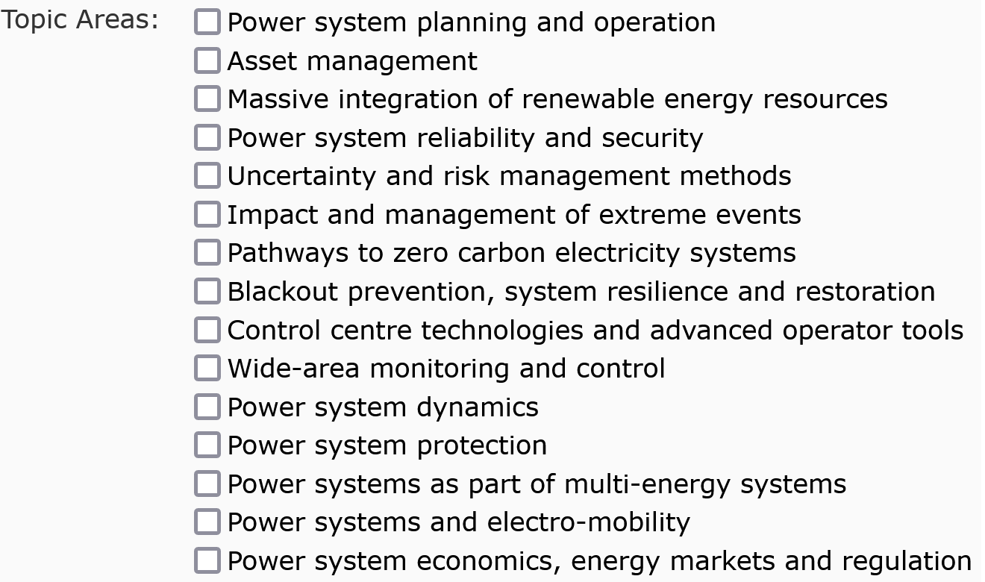
Current Objective: Develop a One-Page Abstract for the proposed Julia Package: Page 1 of 2.
‘Power system planning and operation’ contains Power System Analysis, right?

Slide 15
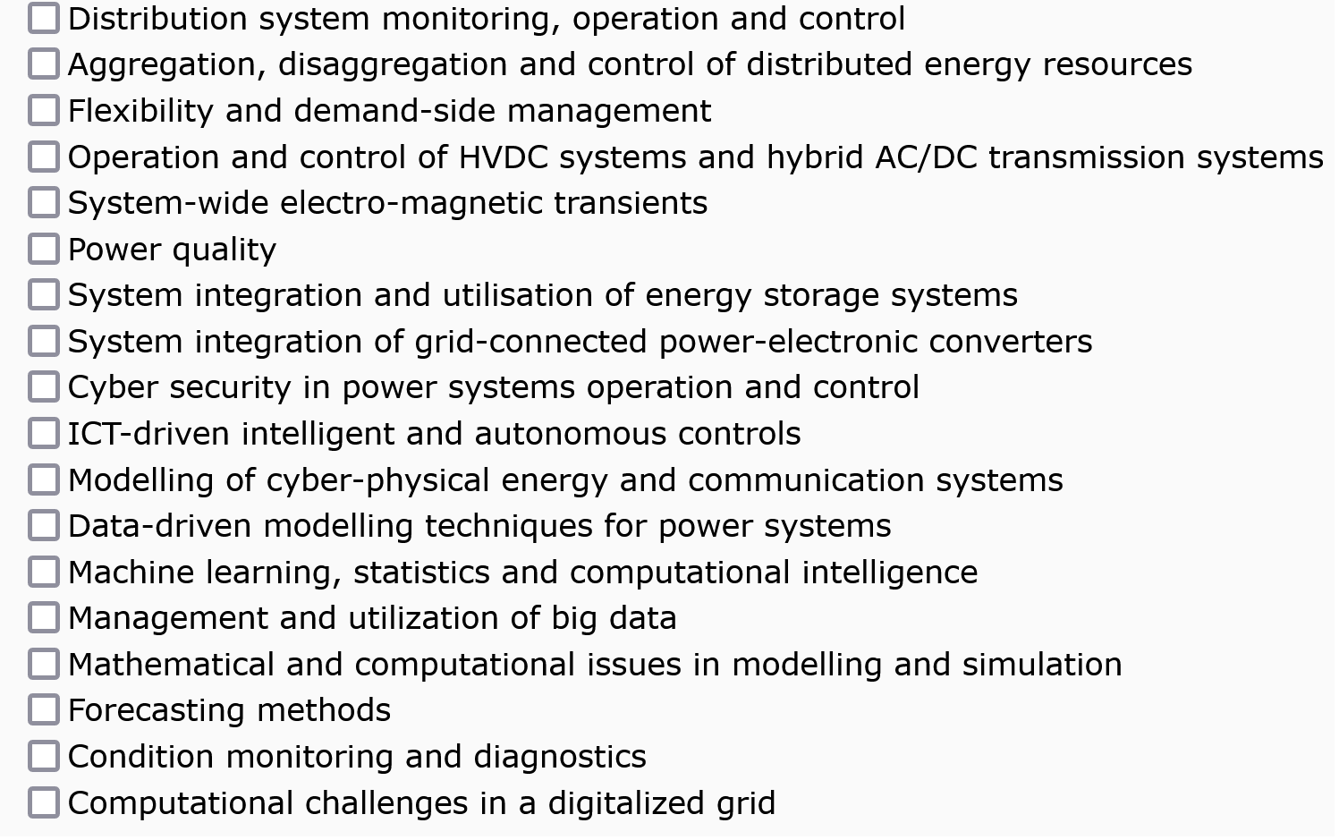
Current Objective: Develop a One-Page Abstract for the proposed Julia Package: Page 2 of 2.

Slide 16
Collaboration in GitHub
My knowledge of GitHub is very rudimentary.
Before starting to work on a new function in your branch, check that your branch is up to date with the latest functionalities of the main branch. You can use Branch->Update with main branch for the same.
Accepting a Pull Request (which means adding stuff from your branch to the main branch) best works when there are little to no conflicts.
To make sure that there are little to no conflict:
Use your dedicated test file for testing the functions you’re creating.
Write your functions in a separate module.
Once you’re able to ascertain that your functions actually work, move them from that temporary module into the required module.
If your function was NOT present in the required module, there will likely be no conflicts for merging.
If your function has altered the state of the previous module, it will likely be the only conflict for merging, in which case you can confidently overwrite the previous code in th main branch, knowing that you’re the only one working on that function.
If all else fails, we can always revert to a previous, working version of the main branch.

Slide 17
Objective: Deploy a Julia package for Power System Analysis and possibly Power System Stability and Control too.
What will be its contents?
Same as the requirements of EE 521 (Analysis of Power Systems), which are:
Power Flow (Newton Raphson Power Flow, Decoupled Power Flow, Fast Decoupled Power Flow).
Sparse Power Flow
Continuation Power Flow
State Estimation in Power Systems
Optimal Power Flow
Possibly also the requirements of EE 523 (Power System Stability and Control):
Power System Dynamic Initialization
Small-Signal Stability Analysis
Transient Stability Analysis
A IEEE Common Data Format (CDF) parser in Julia, for reading the system data.

Slide 18
Objective: Deploy a Julia package for Power System Analysis and possibly Power System Stability and Control too.
Why deploy this package?
Two of us have to finish working on EE 521 projects anyway.
Working on a large project like this is the best way to truly gain expertise in a new language, here Julia.
We realized that codes written by the students, and codes available to the faculties are kind of outdated, generally with little to no scope of scalability, and therefore no scope of deployment.

Slide 19
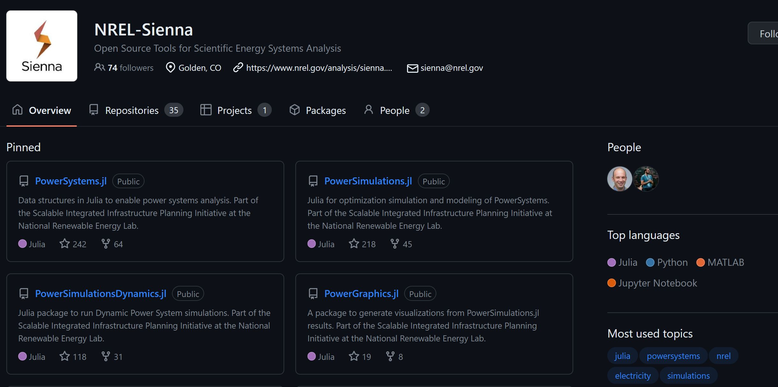
A dedicated team at NREL has already been continuously working on Julia Power System packages for a few years.
We do not intend to compete (and cannot compete) with these packages.
We have however identified a couple of niches.

Slide 20
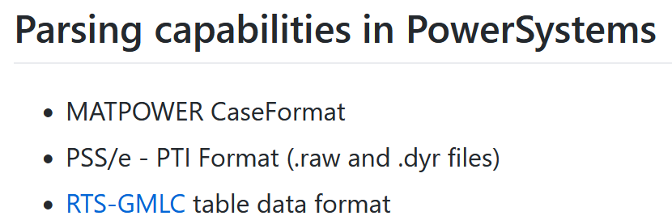
Niches fulfilled by our Julia package.
Our package (exclusively) works with IEEE Common Data Format files or IEEE CDF files, which PowerSystems.jl does NOT support.

Slide 21
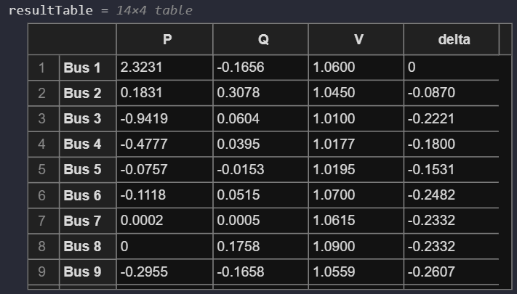
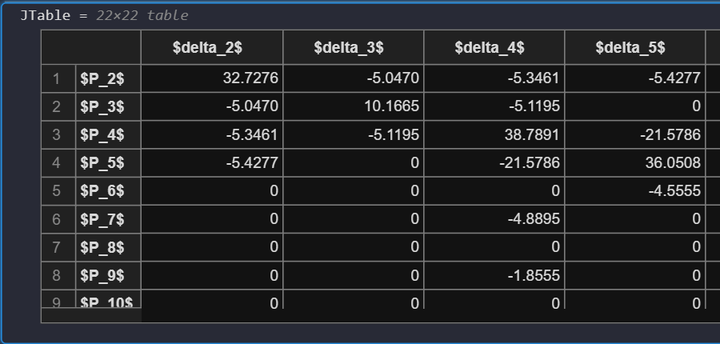
Niches fulfilled by our Julia package.
Our package makes good usage of the DataFrame data structure of Julia (which is like the table data structure in MATLAB), which gives a user easy insight into key inputs, outputs and intermediate data for a given algorithm.
We expect this to be helpful for usage by instructors and teaching assistants for teaching grad level courses in Power System Analysis (like WSU’s EE 521) and Power System Stability and Control (like WSU’s EE 523).

Slide 22
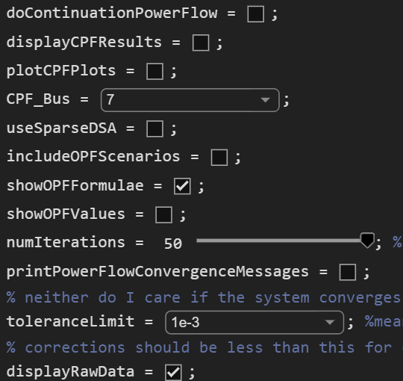
Niches fulfilled by our Julia package.
Users will be able to easily control the algorithm inputs, algorithm types and hyperparameters in a notebook environment (probably will be Pluto or Jupyter).

Slide 23

Niches fulfilled by our Julia package.
Most importantly, our functions are robust, yet user friendly.
For example, all three function calls below are calling the same function.
In the first call, the user just wants to extract a $Y_{Bus}$ from system data.
In the latter two calls, the user is specifying optional arguments as well as demanding additional outputs depending on their needs.

Slide 24
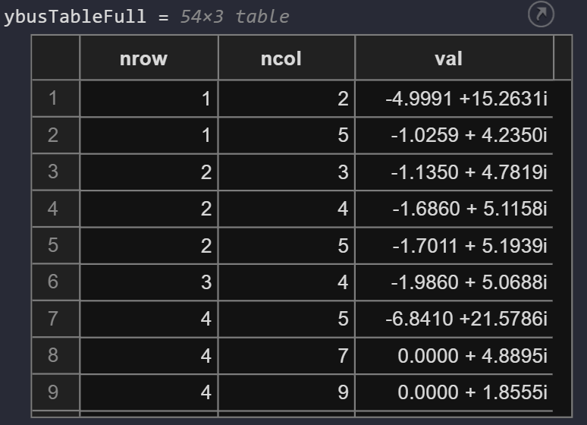
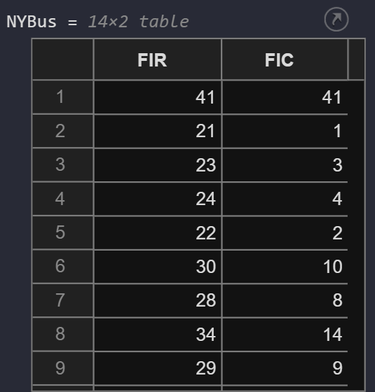
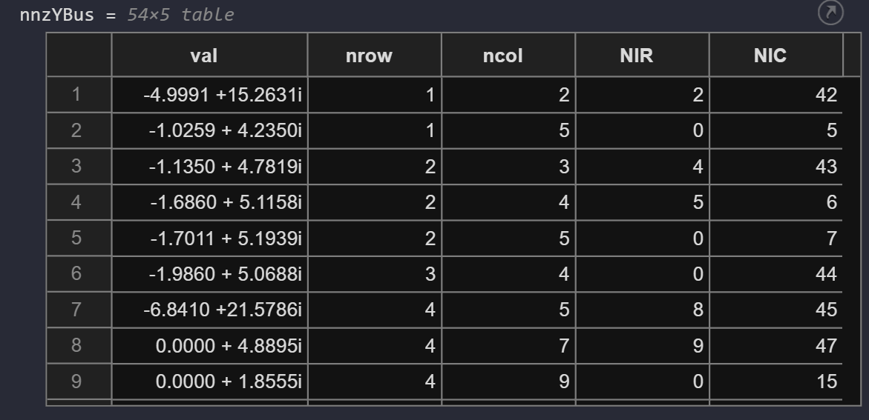
Niches fulfilled by our Julia package.
With the objective of implementing sparse techniques for power flow analysis, ours is probably the only Julia package implementing Mariesa L. Crow's vector-based implementation for mimicking linked-lists.

Slide 25
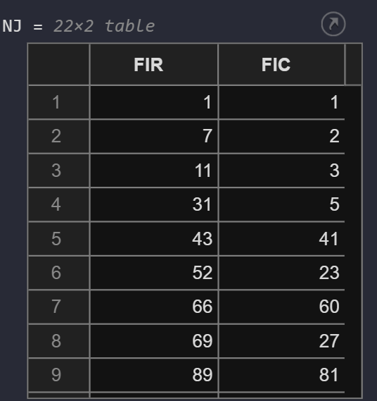
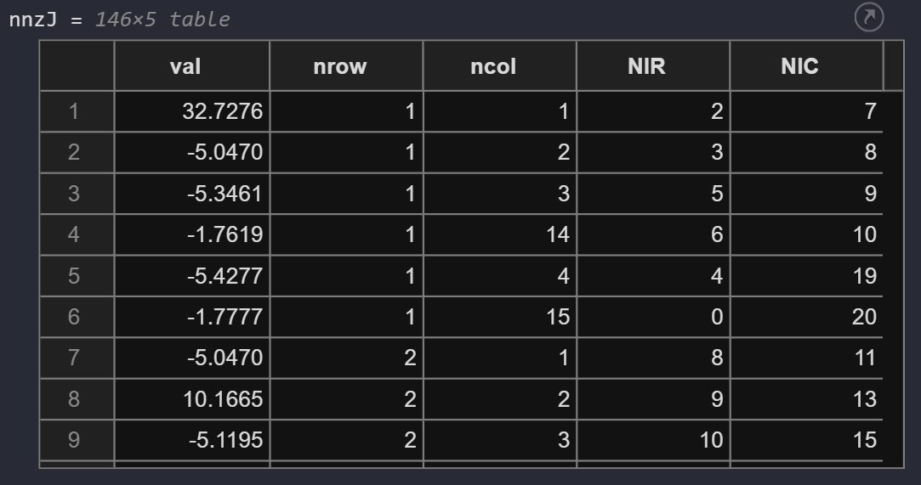
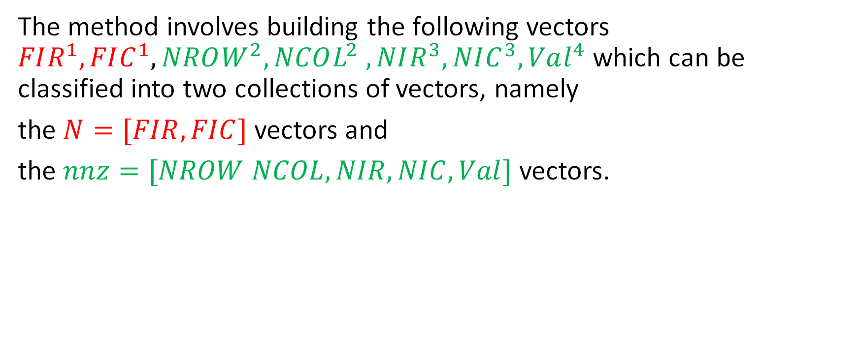
Niches fulfilled by our Julia package.
The method involves building the following vectors $FIR^{1}, FIC^{1}, NROW^{2}, NCOL^{2} ,NIR^{3}, NIC^{3}, Val^{4}$which can be classified into two collections of vectors, namely
the $N=[FIR, FIC]$ vectors and
the $nnz=[NROW NCOL, NIR, NIC, Val]$ vectors.

Slide 26
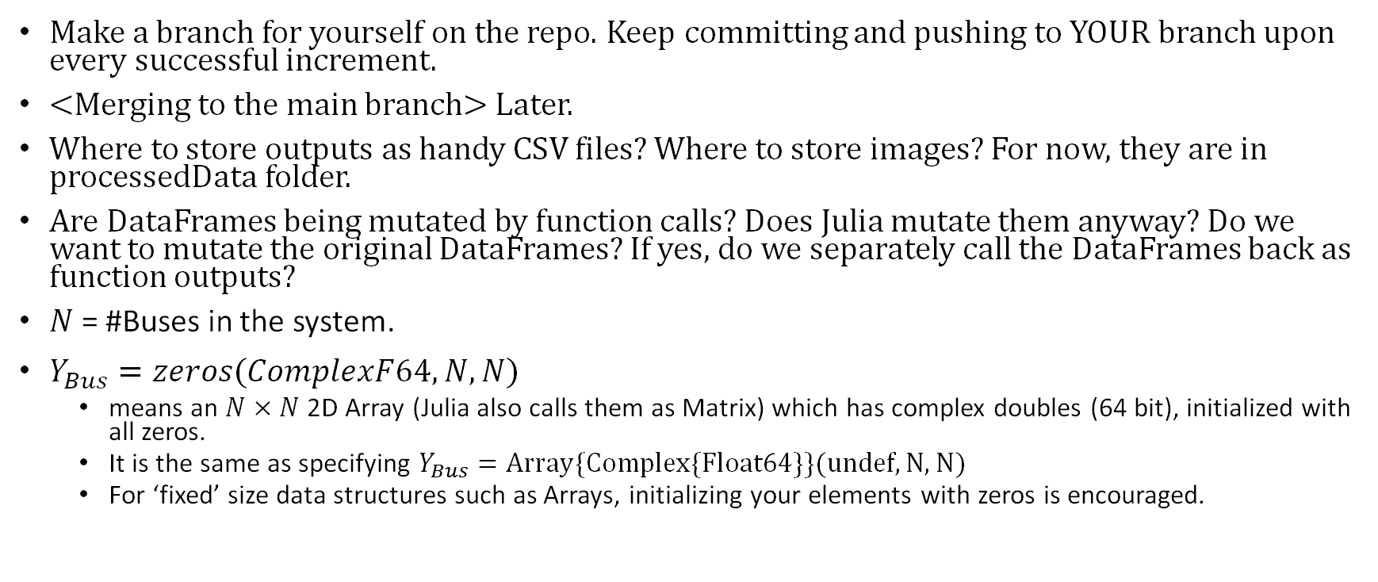
Meeting Notes: 22 May 2023
Make a branch for yourself on the repo. Keep committing and pushing to YOUR branch upon every successful increment.
<Merging to the main branch> Later.
Where to store outputs as handy CSV files? Where to store images? For now, they are in processedData folder.
Are DataFrames being mutated by function calls? Does Julia mutate them anyway? Do we want to mutate the original DataFrames? If yes, do we separately call the DataFrames back as function outputs?
$N$= #Buses in the system.
$Y_{Bus}=zeros(ComplexF64, N, N)$
means an $N×N$ 2D Array (Julia also calls them as Matrix) which has complex doubles (64 bit), initialized with all zeros.
It is the same as specifying $Y_{Bus}=Array\{Complex\{Float64\}\}(undef, N, N)$
For ‘fixed’ size data structures such as Arrays, initializing your elements with zeros is encouraged.

Slide 27
Starting Workflow – Project Interdependencies
Having a working P1: PowerFlow code is a prerequisite for a couple of other tasks: (P4: StateEstimation, P5: OptimalPowerFlow). NRPF only though.
P3: ContinuationPowerFlow does NOT require the full implementation of P1 solveForPowerFlow, and can be done in parallel. Some functions from P1, including construction of Jacobian, are required though.
Only P2: SparsePowerFlow is a completely independent task, and can be done in parallel. In fact it is not permissible to use any assets from the other projects.
Once P1 is completed ALL other projects can be completed in parallel, i.e P2, P3, P4 and P5 do NOT have any interdependencies.

Slide 28
Starting Design Decisions
A SINGLE main file, from where Dr. Noel can be shown all five projects with just a few clicks. This file should only contain meta information, like user defined variables. E.g. whether to plotResults, show yBus, save Jacobians, plotCPF curves, which is the chosen CPF bus, showing some symbolic formulae, saving tables, etc.
Use DataFrames (tables) for busData, branchData (and a handful of other results). For convenient data retrieval, good visualization.
Write functions in modules. Modules can be NKGPowerFlow, NKGSparsePowerFlow, NKGContinuationPowerFlow, NKGStateEstimation and NKGOptimization. Unlike MATLAB where it is standard to write a single function in a single .m/.mlx file and just addpath the address of all the functions.

Slide 29
Starting Design Decisions
NO Global Variables – Anything required by a function should either be defined in the function OR be packed into the function as an argument.
Clearly define the data structures going into and out of a function. It is important that we agree on the same data structures (2d-arrays or DataFrames, strings or numerals, etc.) for maximum compatibility and code reusability.
Document those data structures. In Julia it is easy to do so just by putting your documentation in triple grave accents (```). Your documentation will show up whenever a developer hovers their mouse over a function call.

Slide 30
Starting Design Decisions
Many (smaller) functions instead of grand scripts.
If you have to scroll too much to check for a bug in your script, your script could probably use some refactoring.
Reuse your functions as much as possible.
Try to commit and push your code whenever you feel that your code is:
1) Even slightly, but tangibly different in its current state compared to its previous state*
2) It runs correctly and hasn’t altered any previous correct results*.
* It’s not possible to follow these rules every time, but do minimize such exceptions.

Slide 31
Starting Design Decisions
Question: Numerical parameters specific to an algorithm, like toleranceLimit, maxIterations for NRPF in P1, CPFItrMax, SectionItrMax, sigma1, 2 and 3 for P3, and so on.. which are NOT gonna be changed or altered by a Dr. Noel: Should they be
1. hidden from a user away in the function?
Pros:
Cleaner, more scrollable main file, functions have reduced input arguments.
Cons:
Can get annoying to change parameter values every time by going into a specific function/module during initial development
Or 2. should they be tinkerable in the main file itself? (this is what I did)
Pros:
Highly tinkerable code making way for easier development time.
The user operating the code via the main file feels truly powerful.
Cons:
Number of function arguments gets nasty for some complex algorithms
Bigger main file. Parameters can feel out of place if the user is NOT interested in running a particular project at the time.

Slide 32
Sample functions in modules
P1: NKGPowerFlow
constructYBus
solveUsingPowerFlow: NRPF/FDPF We can make it work for both powerFlowMethods: “NRPF” or “FDPF”.
initializeVectors: Handy function which reads [busData, branchData] and can retrieve highly used parameter values like listOfPVBuses, nPQ (#PQ Buses), PSpecified, etc.
computeBusInjections: calculate P_i and Q_i
computeMismatches: NRPF/FDPF a simple function which calculates mismatches (for every Powerflow iteration) by first computing power injections. Helpful in creation of diagonal Jacobian elements too.
constructJacobian: NRPF/FDPF Compute J11, J22 (and J12, J21 and J in case of NRPF)
solveUsingLU: Using given Jacobian (J11/J) and mismatch vector (delP/[delP; delQ]), compute correction vector (delDelta/[delDeltas; delV]).
solveUsingForwardSubstitution
solveUsingBackwardSubstituion

Slide 33
Sample functions in modules
P1: NKGPowerFlow (contd.)
displayPowerFlowResults: A neat table containing [V, delta, P, Q] with easy to see rows called as ‘Bus 01’, ‘Bus 02’ …
plotPowerFlowResults: Compare your own results to the results in the CDF file, via two plots:
Relative percentage difference in pu Voltages
absolute difference in delta values.
Caveat: Bus Switching is optional for evaluation, though in general not implementing it for bigger systems will lead to incorrect outcomes or even divergence.

Slide 34
Sample functions in modules
P2: NKGSparsePowerFlow
Need to rethink all implementations (check Caveat).
function [nnzYBus, NYBus] = makeSparseYBus(busData, branchData)
[iYBus, jYBus, valYBus] = constructSparseYBusTable(busData, branchData)
[nnz, N] = sparmat([i, j, val])
function [deltaP, deltaQ] = computeMismatchesViaSparseYBus(nnzYBus, NYBus, ..)
function [nnzJ, NJ] = constructSparseJacobian(nnzYBus, NYBus, …)
[nnzL, NL, nnzU, NU] = factorizeSparseLU(nnzJ, NJ)
updateSparseMatrix
computeSparseTriangularProduct
Caveat: My own implementations were awkward. They were not adaptive to new inputs (i.e. they required all of the sparse inputs to be stated up front, no mechanism to make updates to existing sparse data structures). This later led to complications for performing even simple algorithms like LU Factorization (which is the last requirement as far as evaluation is concerned).

Slide 35
Sample functions in modules
P3: NKGContinuationPowerFlow
Dependencies: NKGPowerFlow: initializeVectors, computeBusInjections, solveUsingLU
A few more functions, like PredictorFunction and CorrectorFunction (I just refactored a whole script by my project team mate, so for me it’s still in just one script, not too long.)
plotCPFPlots
displayCPFResults

Slide 36
Sample functions in modules
P4: NKGStateEstimation
(My project partner completely did it.)
Requires Powerflow results from P1 for branch currents.
Likely requires using a lot of symbolic variables. Although he did it by literally writing out all of the derivative equations.
Then some addition of noise to the currents.
Then formation of H matrix, to be used in an iterative computation.

Slide 37
Sample functions in modules
P5: NKGOptimalPowerFlow
Dependencies: NKGPowerFlow: initializeVectors, constructJacobian, solveForPowerFlow
Note: Usage of symbolic variables recommended for computation of derivatives and jacobians.
solveForEconomicDispatch for the first two scenarios
solveForOPF for the next two scenarios
generateSymoblicPowerFlowEquations

Slide 38
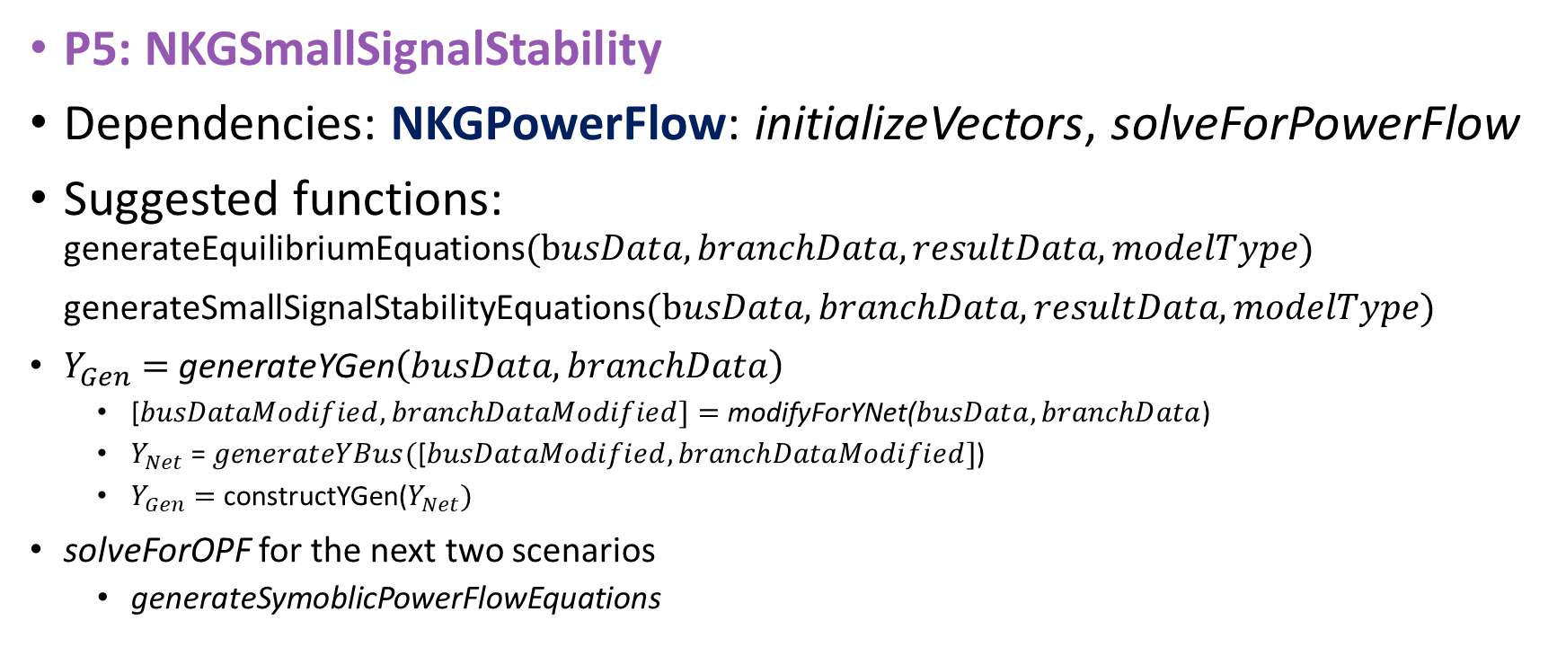
Sample functions in modules
P5: NKGSmallSignalStability
Dependencies: NKGPowerFlow: initializeVectors, solveForPowerFlow
Suggested functions: generateEquilibriumEquations$(busData, branchData, resultData, modelType)$
generateSmallSignalStabilityEquations$(busData, branchData, resultData, modelType)$
$Y_{Gen}=$generateYGen$\left(busData, branchData\right)$
[$busDataModified, branchDataModified]=$modifyForYNet($busData, branchData$)
$Y_{Net}$ = $generateYBus(\text{[}busDataModified, branchDataModified]$)
$Y_{Gen}=$constructYGen($Y_{Net})$
solveForOPF for the next two scenarios
generateSymoblicPowerFlowEquations

Slide 39
Goal X: Show Mani P6 and P7
Required steps:
Dynamic Initialization (DynInit)
Small-Signal Stability Analysis (SSSA) P6
Transient Stability Analysis (TSA) P7
Sub-goal: Get Type 3 aka Classical Model for ieee11 to for all three steps. Implement Type 2 and Type 1 for P6

Slide 40
Expected Time for Completion ~ 135 hours You think we can do it faster?
Project Number | Project Name | Encountered or Perceived Toughness | Expect Time for Completion [hours] | Remarks | Prerequisites
1 | PowerFlow | Hard | 25 |  | -
2 | SparsePowerFlow | Very Hard | 50 | Most of the time spent in ideation. | -
3 | ContinuationPowerFlow | Medium | 10 |  | P1
4 | StateEstimation | Hard | 25 | Was never implemented by me. | P1
5 | OptimalPowerFlow | Hard | 25 | Has an easy part and a head-banging part. | P1
6 | SmallSignalStability | Hard | 20 | Clean, scalable setup requires time. Hard to get correct. | P1
7 | TransientStability | Hard | 20 | Type 2 (easy to model, assuming good P6) and Type 1 (more involved) never done by me. | P6

Slide 41
Help yourself to my implementations Easy high-level overview of all projects can be obtained just through a quick glance at my implementations.
Have the GitHub Desktop app installed.
Have MATLAB 2023a installed. It helps to visualize desired outputs and check for function input arguments and outputs.
Clone my repo. It is fast and easy, plus I can help you if you haven’t done it before.
Run ee521_main.mlx and visualize required outputs, check out the functions and their arguments, etc. and save time.

Slide 42
May our package be glorious!

