Slide 1

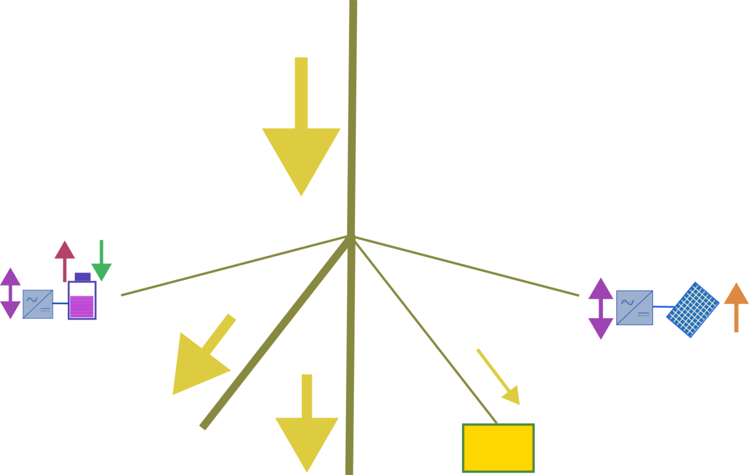
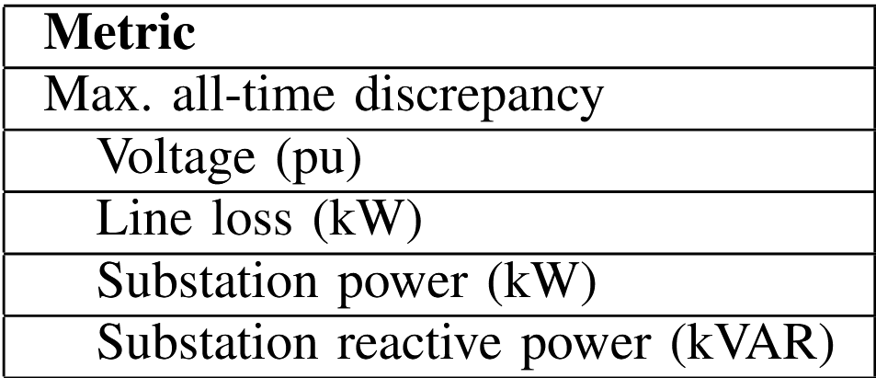
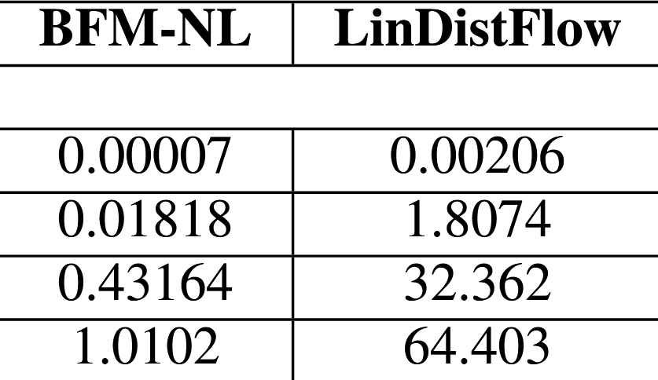



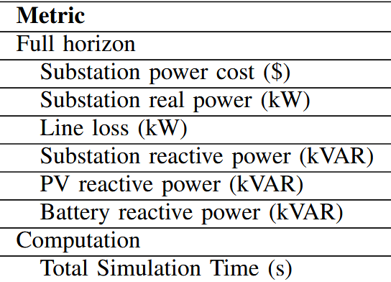
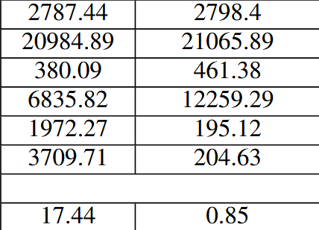
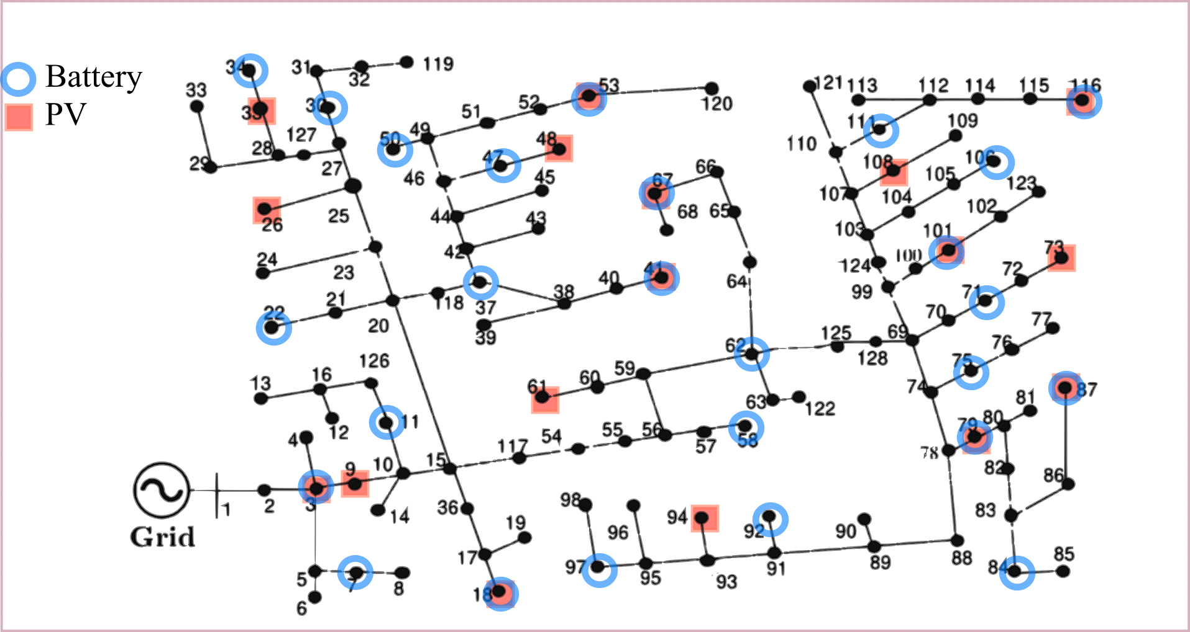
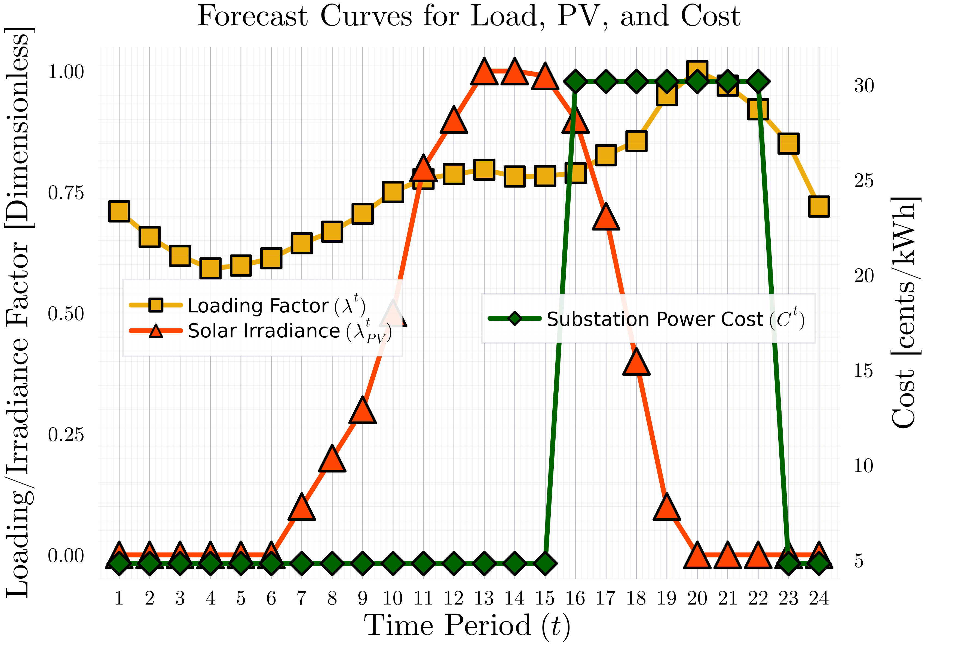
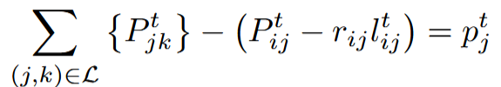

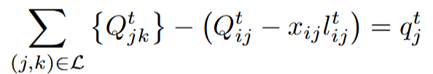
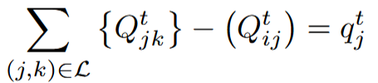


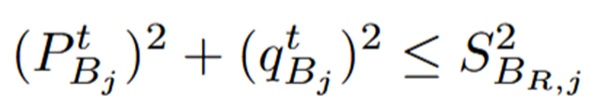
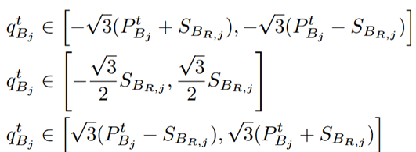
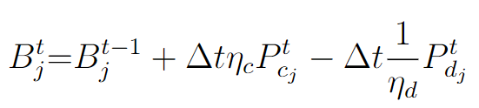
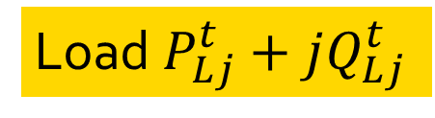

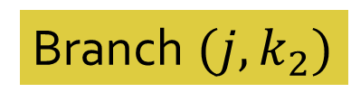


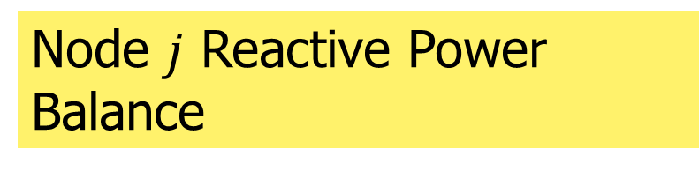


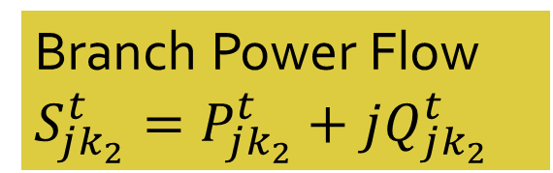

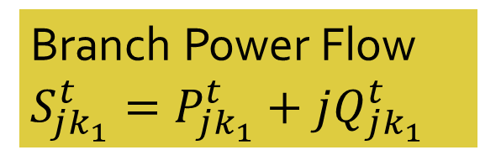
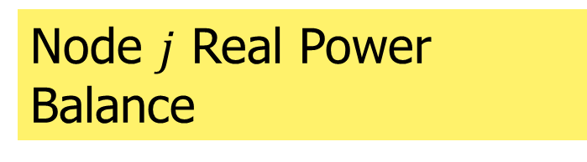





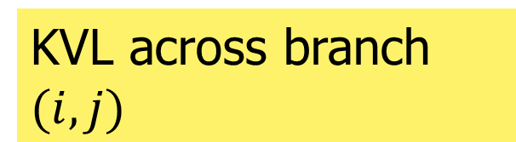



Linear vs Nonlinear Optimal Power Flow Modelling - Tradeoffs and Takeaways
Aryan Ritwajeet Jha*, SIEEE, Subho Paul#, MIEEE and Anamika Dubey*, SMIEEE
*School of Electrical Engineering & Computer Sciences, Washington State University, Pullman, WA, USA
#Department of Electrical Engineering, Indian Institute of Technology (BHU) Varanasi, Varanasi, UP, India
KEY Points
Optimization Model
Results
A Substation Operator’s key objective when operating a Power Distribution System is minimizing Cost of Operation, subject to safety and reliability limits. This problem of determining an Optimal Control Schedule to achieve the same is called the Optimal Power Flow (OPF) problem. When the problem extends across a horizon of multiple time-steps, it is called the Multi-Period OPF (MPOPF) problem.
In our paper [1], we compared a nonlinear model (Branch Flow Model – Nonlinear) and a linear model (LinDistFlow) on several optimization benchmarks for the MPOPF problem.
Bus $i$:$v_{i}^{t}={\left(V_{i}^{t}\right)}^{2}$
Table 1: Discrepancy comparison between linear and nonlinear models for IEEE123 for 24h
Branch Power Flow $S_{ij}^{t}=P_{ij}^{t}+jQ_{ij}^{t}$
Current Flow $l_{ij}^{t}={\left|I_{ij}\right|}^{2}$
Branch $(i, j)$
Significant Deviation from true values of Substation Real and Reactive Powers for Linear Approximation
Table 2: Performance Comparison between linear and nonlinear models for IEEE123 for 24h
Discharging Power $P_{dj}^{t}$
Charging Power $P_{cj}^{t}$
Bus $j$:$v_{j}^{t}={\left(V_{j}^{t}\right)}^{2}$
Branch $(j, k_{1})$
PV Real Power $P_{Dj}^{t}$
Test System
Branch Power Flow $S_{jk_{2}}^{t}=P_{jk_{2}}^{t}+jQ_{jk_{2}}^{t}$
Branch $(j, k_{2})$
Battery Reactive Power $q_{Bj}^{t}$
Branch Power Flow $S_{jk_{1}}^{t}=P_{jk_{1}}^{t}+jQ_{jk_{1}}^{t}$
PV Reactive Power $q_{Dj}^{t}$
Reactive Power allocated by linear model somewhat arbitrary, under-utilizing PV and BESS reactive powers
Bus $k_{1}$
Bus $k_{2}$
Load $P_{Lj}^{t}+jQ_{Lj}^{t}$
Low Optimality Gap and Fast Computation Time for Linear Model
Fig. 3: A Schematic Representing all the Components in the System
Takeaways
Fig. 1: IEEE 123 Node System A - $20\%$ PVs $+30\%$ Batteries
BFM-NL
LinDistFlow
Higher BESS and PV penetration or Bigger System Size $→$ Higher optimality gap of Linear approximation
Simulation Profile
Linear approximation control variables need to be passed through a true nonlinear simulator such as OpenDSS for correct state variables
Node $j$ Real Power Balance
Node $j$ Reactive Power Balance
Thus, depending on the use case (real-time constraints and infeasibility tolerance limits) a hybrid approach could be employed for best results
KVL across branch $(i, j)$
References
Only BFM-NL
Current Magnitude across branch $(i, j)$
[1] Jha, A. R., Paul, S., & Dubey, A. (2025, July). Analyzing the performance of linear and nonlinear multi-period optimal power flow models for active distribution networks. Paper presented at the 2025 IEEE North-East India International Energy Conversion Conference and Exhibition (NE-IECCE 2025), National Institute of Technology Silchar, Assam, India.
[2] MultiPeriodDistOPF. (2025, July 27). Retrieved from https://github.com/Realife-Brahmin/MultiPeriodDistOPF
[3] Jha, A. R., Paul, S., & Dubey, A. . Spatially Distributed Multi-Period Optimal Power Flow with Battery Energy Storage Systems. 2024 56th North American Power Symposium (NAPS). IEEE. doi: 10.1109/NAPS61145.2024.10741846
Battery Reactive Power Limits
Fig. 2: Forecast of Demand, Solar and Cost of Substation Power
Optimization SETUP
Horizon Duration: 24h
Time Period: 1h
Programming Language: Julia
Optimization Modelling Language: JuMP [2]
Optimization Solver: Ipopt
Plant Simulator: OpenDSS
Decision Variables: Upto 17k
Linear Constraints: Upto 30k
Nonlinear Constraints: Upto 14k
Battery SOC Equation
Common
Common
Remaining constraints are identical..

