Slide 1
Mapping GADS (Generation)
and TADS (Transmission)
Using Velocity Suite for Extreme Weather Resiliency Planning
Aryan Ritwajeet Jha
Intern for Summer 2024
Assisting Svetlana Ekisheva and Christopher Claypool
as part of
Advanced System Analytics & Modelling (ASAM)
NERC

Slide 2
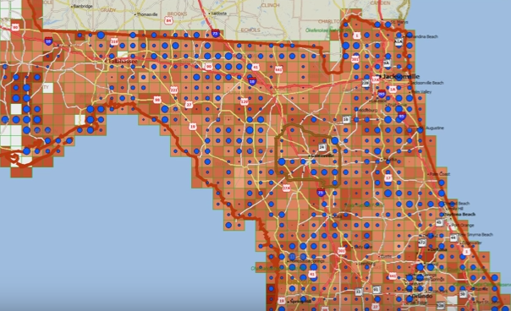
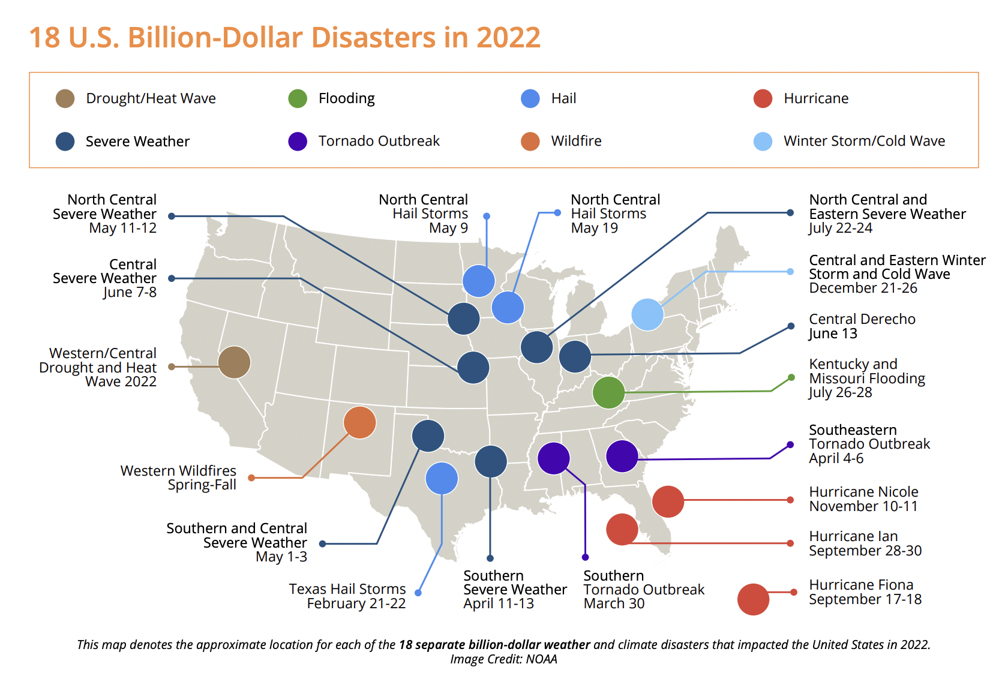
Objective for Mapping GADS and TADS
We wish to identify the transmission lines and generators most susceptible to extreme weather events
Doing so would enable us to make better planning recommendations to Transmission Owners (TOs) and Generator Owners (GOs).
Example: Mapping Energy Infrastructure Risk in Florida.
Retrieved from Prof. Thrall’s YouTube Video
Billion Dollar Weather Climate Disasters
Image from Unison Energy

Slide 3
Objective for Mapping GADS and TADS
Transmission Data
Geographical Mapping (Weather)
Generator Data
Extreme Weather Resiliency Studies
NERC has data on Bulk Power System (BPS) components including Transmission Lines (via [TADS]) and Generators (via [GADS])
By Mapping these BPS components to their geographical location we have knowledge of weather events and climate data near those locations.
GADS: Generating Availability Data System
TADS: Transmission Availability Data System

Slide 4
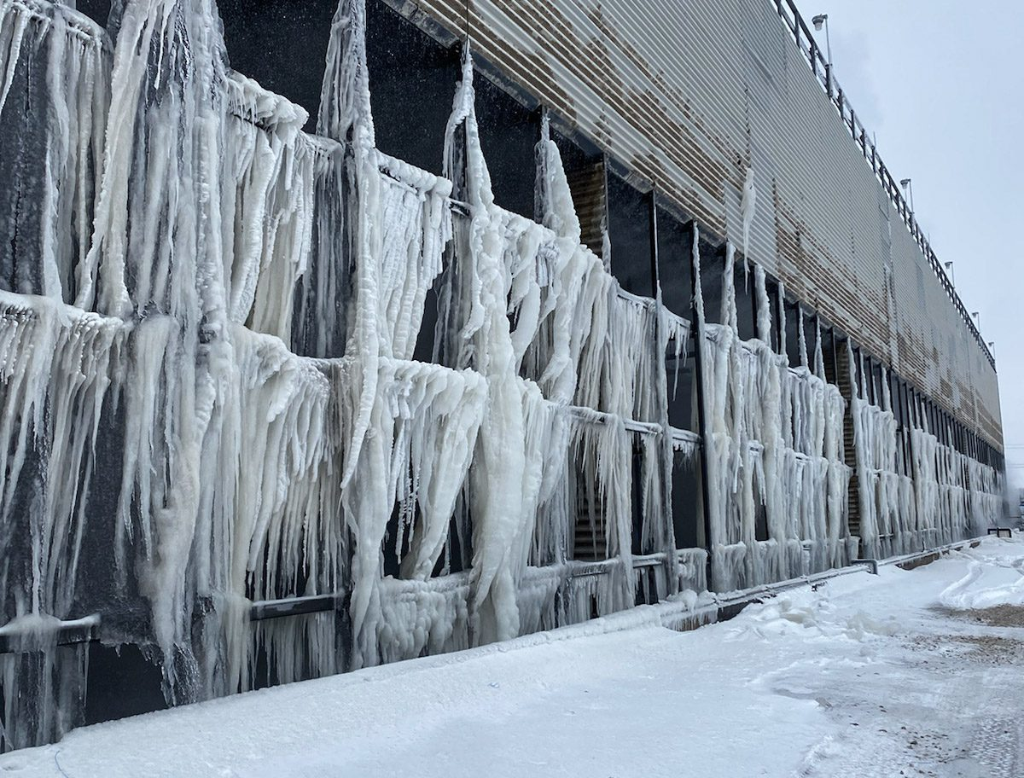
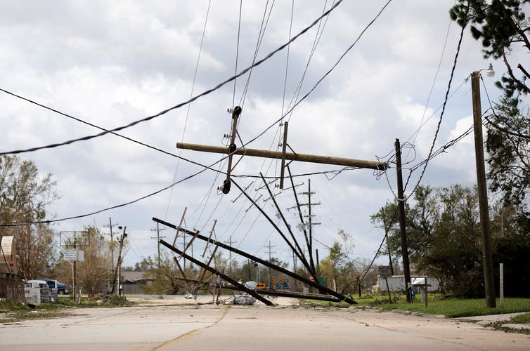
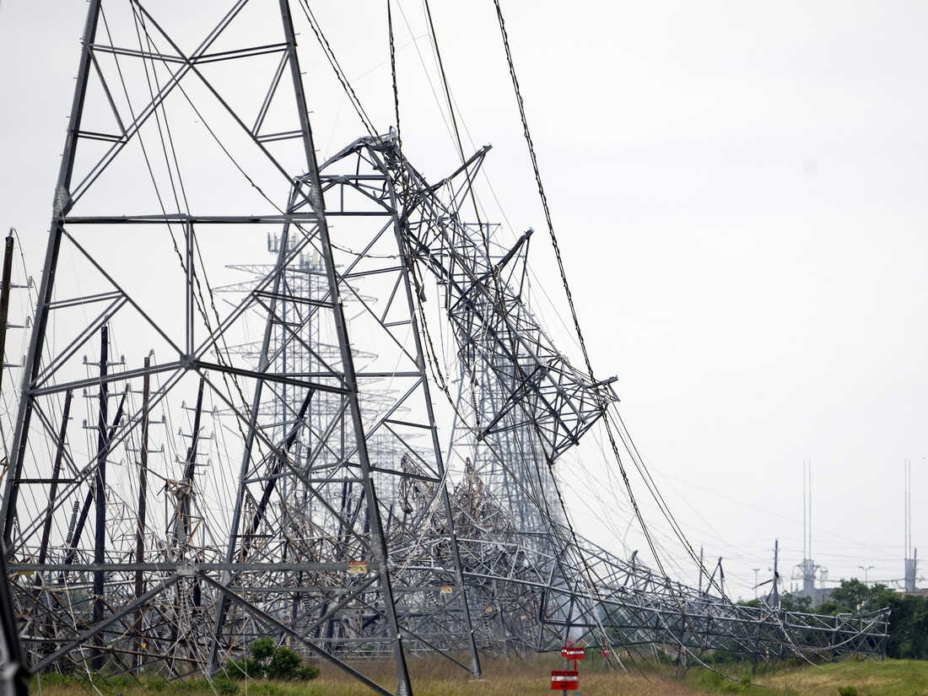
Objective for Mapping GADS and TADS
With the weather data near those BPS components, we can then determine if any outages were primarily caused due to extreme weather events.
A study correlating the extreme weather around a BPS component to the outages could be done, on similar lines as [ekisheva2024, ekisheva2023]
TADS:
Transmission Line retired that day
Local Weather:
Exceptionally high winds that day
TADS:
Generator taken off the grid that day
Local Weather:
Heavy blizzard that day
Reality (correlated)
Reality (correlated)

Slide 5




The Problem at Hand
From GADS
From Weather Stations
Generator Units
From TADS
Geographical Mapping
Weather Data
Transmission Lines
Missing Link!

Slide 6
The Workaround: Using Velocity Suite
From Velocity Suite, get a list of components which are already close to a particular weather station.
This way, both component data and its mapping is taken care of in one go.
From GADS
From Velocity Suite
Generator Units
Generator Units
From TADS
Geographical Mapping
Transmission Lines
Weather Data
Transmission Lines
Since geographical data is not collected in GADS/TADS, the generators/transmission lines are being indirectly mapped using Velocity Suite [VelocitySuite]

Slide 7
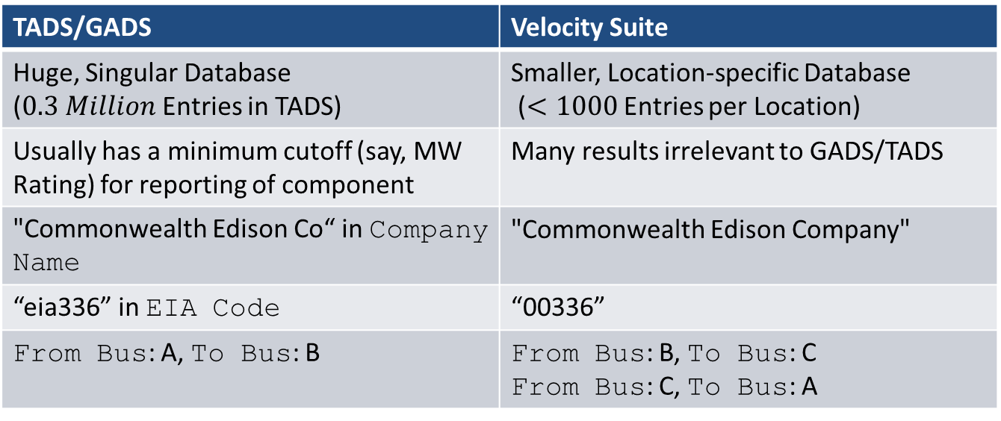
The Resulting Problem at Hand:
How to Match Components between the Two Databases?
From GADS
From Velocity Suite
Many discrepancies in reporting of data between the two databases!
Generator Units
Generator Units
Transmission Lines
Geographical Mapping
Weather Data
From TADS
TADS/GADS | Velocity Suite
Huge, Singular Database ($0.3 Million$ Entries in TADS) | Smaller, Location-specific Database ($<1000$ Entries per Location)
Usually has a minimum cutoff (say, MW Rating) for reporting of component | Many results irrelevant to GADS/TADS
"Commonwealth Edison Co“ in Company Name | "Commonwealth Edison Company"
“eia336” in EIA Code | “00336”
From Bus: A, To Bus: B | From Bus: B, To Bus: C From Bus: C, To Bus: A
Transmission Lines

Slide 8

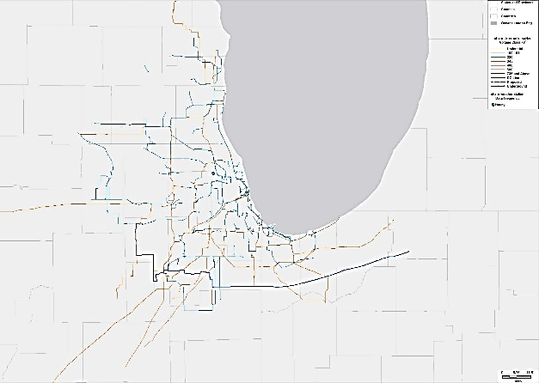
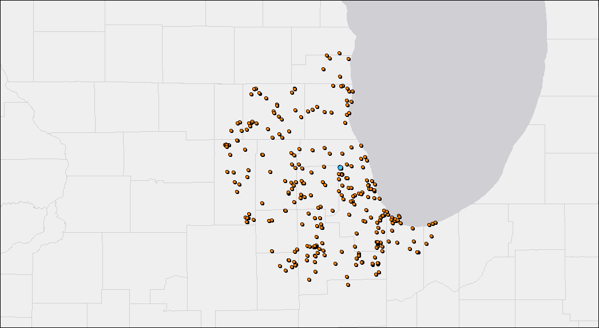
Workflow
API Calls are made to Velocity Suite along the lines of:
“List and Map all Transmission Lines which are <specific distance> from <specific weather station>*”
which will then output the qualifying transmission lines on a map and can export the TO data as an excel file.
* Weather Stations at Airports are ideal for extreme weather studies as they have the most granularity when it comes to time-series measurements related to the weather
Similarly, output if the API Call was made for Generator Units instead
An API Call for Transmission Lines rated higher than 100kV which are within 50 miles of Chicago O'Hare Weather Station
An API Call for Generator Plants which are within 50 miles of Chicago O'Hare Weather Station

Slide 9
Workflow:
Key Columns to Match
Python scripts parse the excel files from Velocity Suite, as well as GADS/TADS and attempt to make ‘matches’ (i.e. the same component represented by both GADS/TADS and Velocity Suite) based on various heuristics.
If a ‘match’ is ascertained, the Rec_ID from Velocity Suite is ‘attached’ to the GADS/TADS data, so that for future cases, we have an approximate geographical location (nearest weather station) of that BPS components
From GADS
From Velocity Suite
Rec_ID
Rec_ID
EIA Code
EIA Code
State
Generator Units
Plant Name
State
Plant Name
Generator Units
From TADS
Geographical Mapping
Weather Data
FromBus, ToBus
Rec_ID
Company Name
kV Rating
FromBus, ToBus
Transmission Lines
Company Name
Transmission Lines
kV Rating

Slide 10

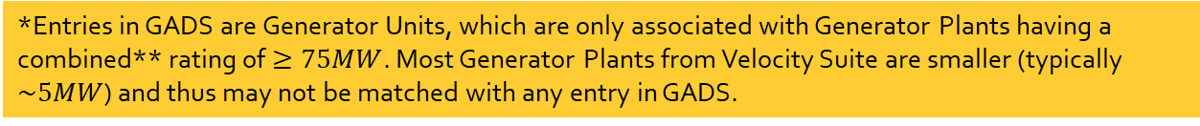
High-level Workflow for Mapping GADS
via Velocity Suite Generator Plants
Location 1: Chicago O’Hare
*Entries in GADS are Generator Units, which are only associated with Generator Plants having a combined** rating of $≥75MW$. Most Generator Plants from Velocity Suite are smaller (typically $\sim 5MW$) and thus may not be matched with any entry in GADS.
Parse Velocity Suite Data (Generator Plants)
Ascertain US States
Remove entries without EIA Codes [eia]
Parse GADS Data
Filter based on the US States from Velocity Suite
Remove entries without EIA Codes
Create a Table of Matches
Match between GADS and VS based on same EIA Code values
Attach the `Rec_ID` from VS into the table.
Now we have a table of generators whose geographical location we know
Data
Generator Plants from GADS mapped** | 25
Generator Units from GADS mapped | 126
Location 2: New York JFK
Data
Generator Plants from GADS mapped** | 66
Generator Units from GADS mapped | 266
Performing the same analysis for a different location is as easy as changing a single line of code.
** Combined Rating here is taken as the sum of Cancelled/Mothballed/Operating/Planned/Retired Cap MW ratings. Several plants have been found to have their only non-zero values in the Cancelled/Retired categories (i.e. they are basically out of operation).

Slide 11
High-level Workflow for Mapping GADS
via Velocity Suite Generator Units
On similar lines as the Generator Plants from Velocity Suite, Generator Units from Velocity Suite were also matched with the GADS Units, with some small adjustments in the workflow, and identical results were obtained.
Parse Velocity Suite Data (Generator Plants)
Ascertain US States
Remove entries without EIA Codes [eia]
Parse GADS Data
Filter based on the US States from Velocity Suite
Remove entries without EIA Codes
Create a Table of Matches
Match between GADS and VS Units based on same EIA Code values
Attach the Rec_ID from VS into the table.
Now we have a table of generators whose geographical location we know
Parse Velocity Suite Data (Generator Units)
Match Plant Names between VS Plants and VS Units
Map the EIA and Rec_ID entries from VS Plants onto the VS Units

Slide 12
High-level Workflow for Mapping TADS
via Velocity Suite Transmission Lines
Location 1: Chicago O’Hare
Entries in TADS are for transmission lines rated at a voltage $≥100kV$.
Parse Velocity Suite Data (Transmission Lines)
Ascertain Company Names
Parse TADS Data (Transmission Lines)
(Ideally) Filter based on the Company Names from Velocity Suite
Create a Table of Matches
Match between TADS and VS based on same unordered pair of (fromBus, toBus)
Attach the `Rec_ID` from VS into the table.
Now we have a table of transmission lines whose geographical location we know
Filter transmission lines below rating of $100kV$
Filter transmission lines below rating of 100𝑘𝑉
Data
Transmission Lines from TADS mapped** | 127
Location 2: New York JFK
Data
Transmission Lines from TADS mapped** | 111
** Mapping was done based on exactly matching unordered (fromBus, toBus) tuples. Many potential matches were lost because of inconsistent naming of transmission lines and even operating companies between the two databases. Overall careful manual labour (in mapping company names and bus names) required for mapping more TADS transmission lines.

Slide 13
Summary and Future Work: Automated the process of mapping BPS components. The output can now be used for extreme weather resiliency analysis when coupled with weather data. A little manual effort (such as ensuring consistency in company names) goes a long way in the analysis. So far only ‘exact’ matches were made. Future work could include making inexact, ‘fuzzy’ matches to capture potential matches left out due to data entry inaccuracies. If GADS/TADS data collection could also include some sort of approximate geographical index, it would greatly assist in this analysis.

Slide 14
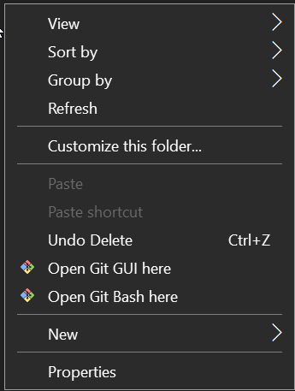
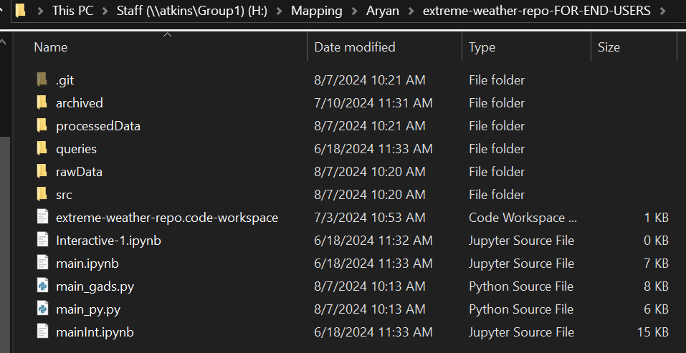
Workflow
Repo Handling if You Prefer Version Control like GitHub
The codebase including input and output excel files may be found in the NERC Staff Directory: H:\Mapping\Aryan
Have Git Bash [GitBash] installed (for running terminal commands)
Navigate to the directory H:\Mapping\Aryan\extreme-weather-repo-FOR-END-USERS
Open Git Bash in the directory (<Right Click in the directory> -> Open Git Bash here)
2
3

Slide 15
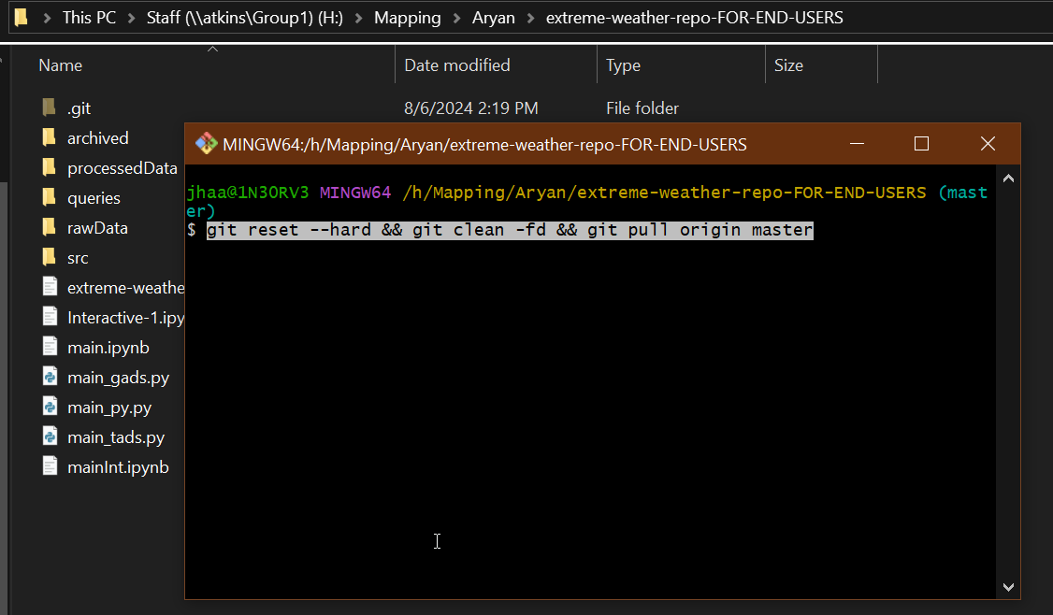
Workflow
Repo Handling if You Prefer Version Control like GitHub
Run the command: git reset --hard && git clean -fd && git pull origin master
After several minutes*, your directory is now up to date with the latest uploaded changes (Note that the actual directory with all the changes is the ‘bare’ repository extreme-weather-repo, even if it may look mostly empty). Running the command ‘extracts’ the contents of extreme-weather-repo into extreme-weather-repo-FOR-END-USERS
4
* It takes that long because of NERC VPN.

Slide 16
References
[TADS] Transmission Availability Data System (TADS). (2024, June 17). Retrieved from https://www.nerc.com/pa/RAPA/tads/Pages/default.aspx
[GADS] Generating Availability Data System (GADS). (2024, August 07). Retrieved from https://www.nerc.com/pa/RAPA/gads/Pages/GeneratingAvailabilityDataSystem-(GADS).aspx
[ekisheva2024] Svetlana Ekisheva, Christopher Claypool, Marilyn Jayachandran, Mark G. Lauby, Weather resilience of transmission system in Florida measured and tracked with detailed outage and weather data, the 18th International conference on Probabilistic Methods Applied to Power Systems (PMAPS), 2024 (to be published).
‪[ekisheva2023] Ekisheva, S., Pratt, D. K., Kachadurian, M., Martin, W. G., Norris, J., & Dobson, I. . Grid Restoration After Extreme Weather Events. 2023 IEEE PES Innovative Smart Grid Technologies Europe (ISGT EUROPE). IEEE. doi: 10.1109/ISGTEUROPE56780.2023.10407350
[VelocitySuite] Velocity Suite: The premier analytical source for energy information. (2024, January 22). Retrieved from https://www.hitachienergy.com/us/en/products-and-solutions/energy-portfolio-management/market-intelligence-services/velocity-suite

Slide 17
References
[GitBash] Git - Downloading Package. (2024, August 07). Retrieved from https://git-scm.com/download/win
[eia] Homepage - U.S. Energy Information Administration (EIA). (2024, August 07). Retrieved from https://www.eia.gov

Slide 18
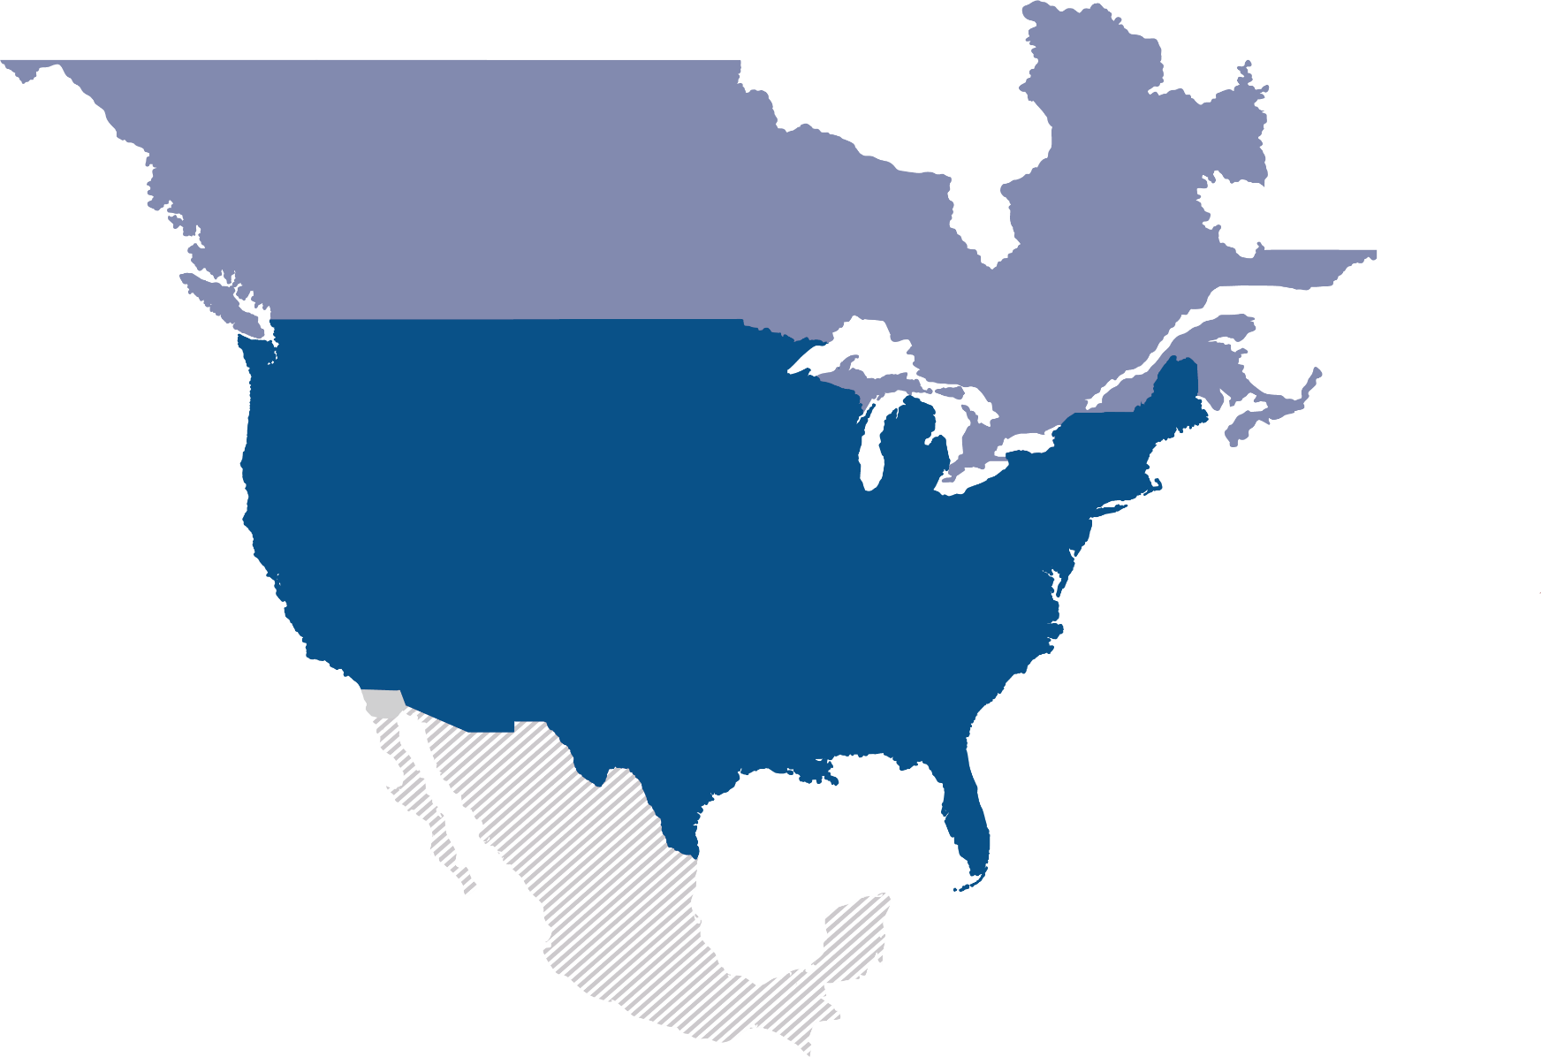
Questions and Answers

