Slide 1
Use GitHub for Everything
Aryan Ritwajeet Jha

Slide 2
Version Control
Git
GitHub

Slide 3
GitHub is NOT for
(Large Sized) File Storage
1000 MB of high quality cat pictures (I like looking at them from time to time and sharing them with my loved ones) - Use something else
1000 MB of high quality cat pictures (I perform state of the art image processing algorithms on them and generate new files every time) – Do you modify (mutate) the pictures while doing so? No? Store the images on your local machine/organization server and git only the other working files.
The above two examples are of large static assets - Not meant for GitHub.
GitHub is for work and working files (which either are directly modified by you, e.g. a script you wrote or indirectly modified by other files you modified, e.g. an image saved via a script you wrote). Any static assets should be small.

Slide 4
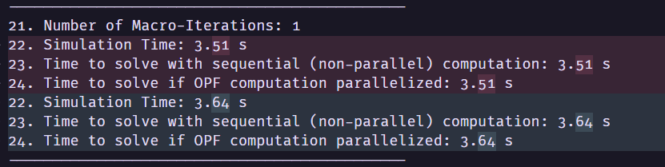
Easy Perusal of ‘change’ in results when used in conjunction with good logging

Slide 5
Easier exchange of files

Slide 6

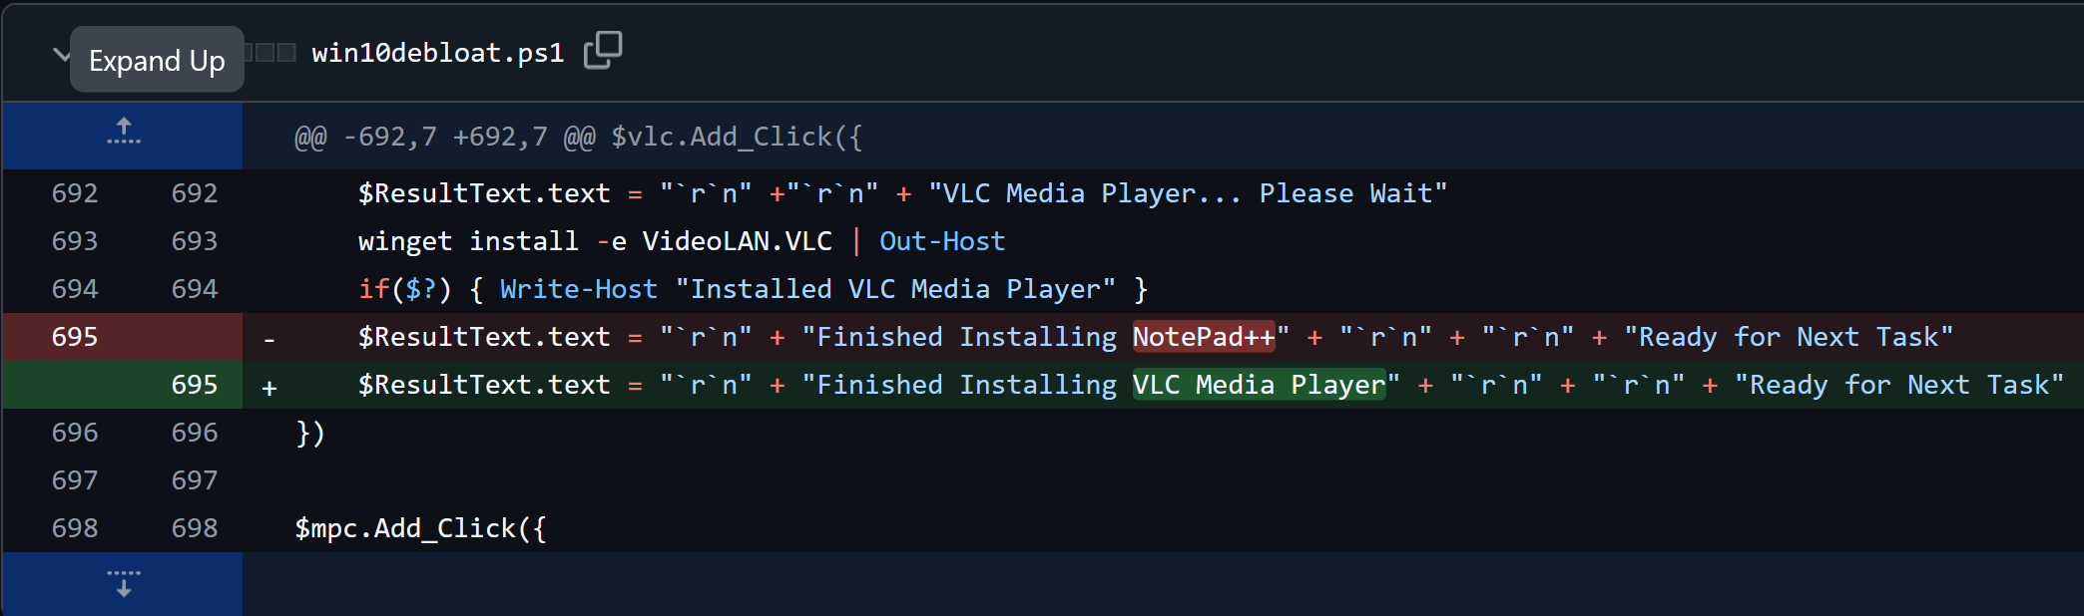
Let other people using your repo make it better.
  Remember that the difference between your repo and a better repo is in most cases, infinitesimally small.
Someone else realized that an incorrect message was printed out. This bug is so trivial that instead of asking the repo owner to fix it, they themselves fixed it and made a Pull Request (PR). The owner sees the PR, and was happy to merge it to the repo.

Slide 7
Avoid unintended file changes/code changes

Slide 8
GitHub is insurance against your newest changes completely breaking your repo.
  I deleted key files from my system and unknowingly pushed it.
  I tried making my algorithm implementation more general but now even the specific case isn’t working.
  You can always revert to a previously working state of the repo.

Slide 9
References
[Titus2021] Tech, C. T. (2021, December 04). How to Use GitHub. Youtube. Retrieved from https://www.youtube.com/watch?v=v_1iqtOnUMg

