Slide 1

Making Analysis of Power Systems Scalable through Distributed Computing
Aryan Ritwajeet Jha

Slide 2
My interest in Distributed Computing
Have always worked in Power System Control and Stability domain
Transmission Systems are well-behaved, homogeneous

Slide 3
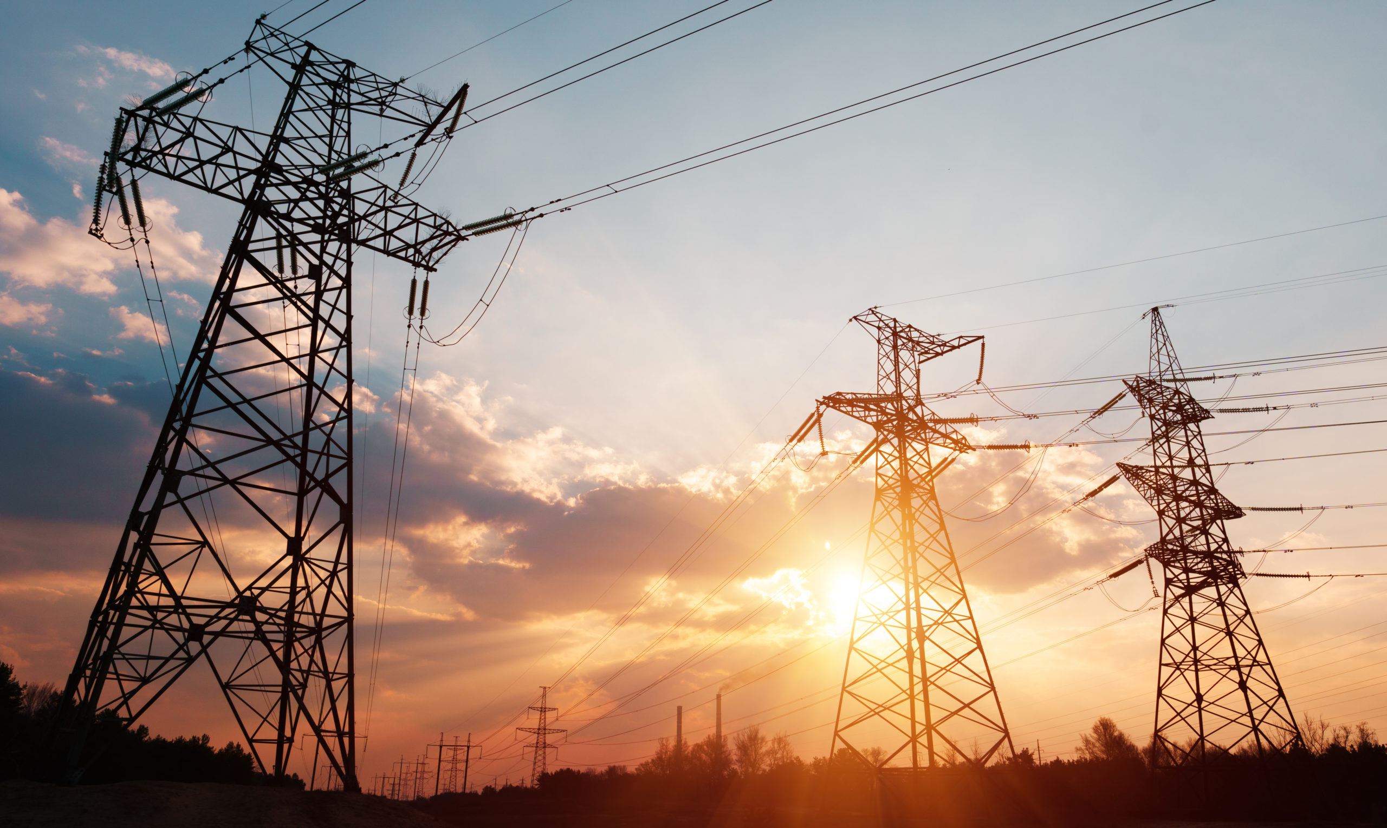
The Average Transmission Line.

Slide 5
My interest in Distributed Computing
Have always worked in Power System Control and Stability domain
Transmission Systems are well-behaved, homogeneous
Low R/X ratio.
Good Jacobians
Easy computations due to low variance in system components.

Slide 6
My interest in Distributed Computing
Now have been assigned to work on Distribution Systems.
These lines are NOT homogeneous!

Slide 7
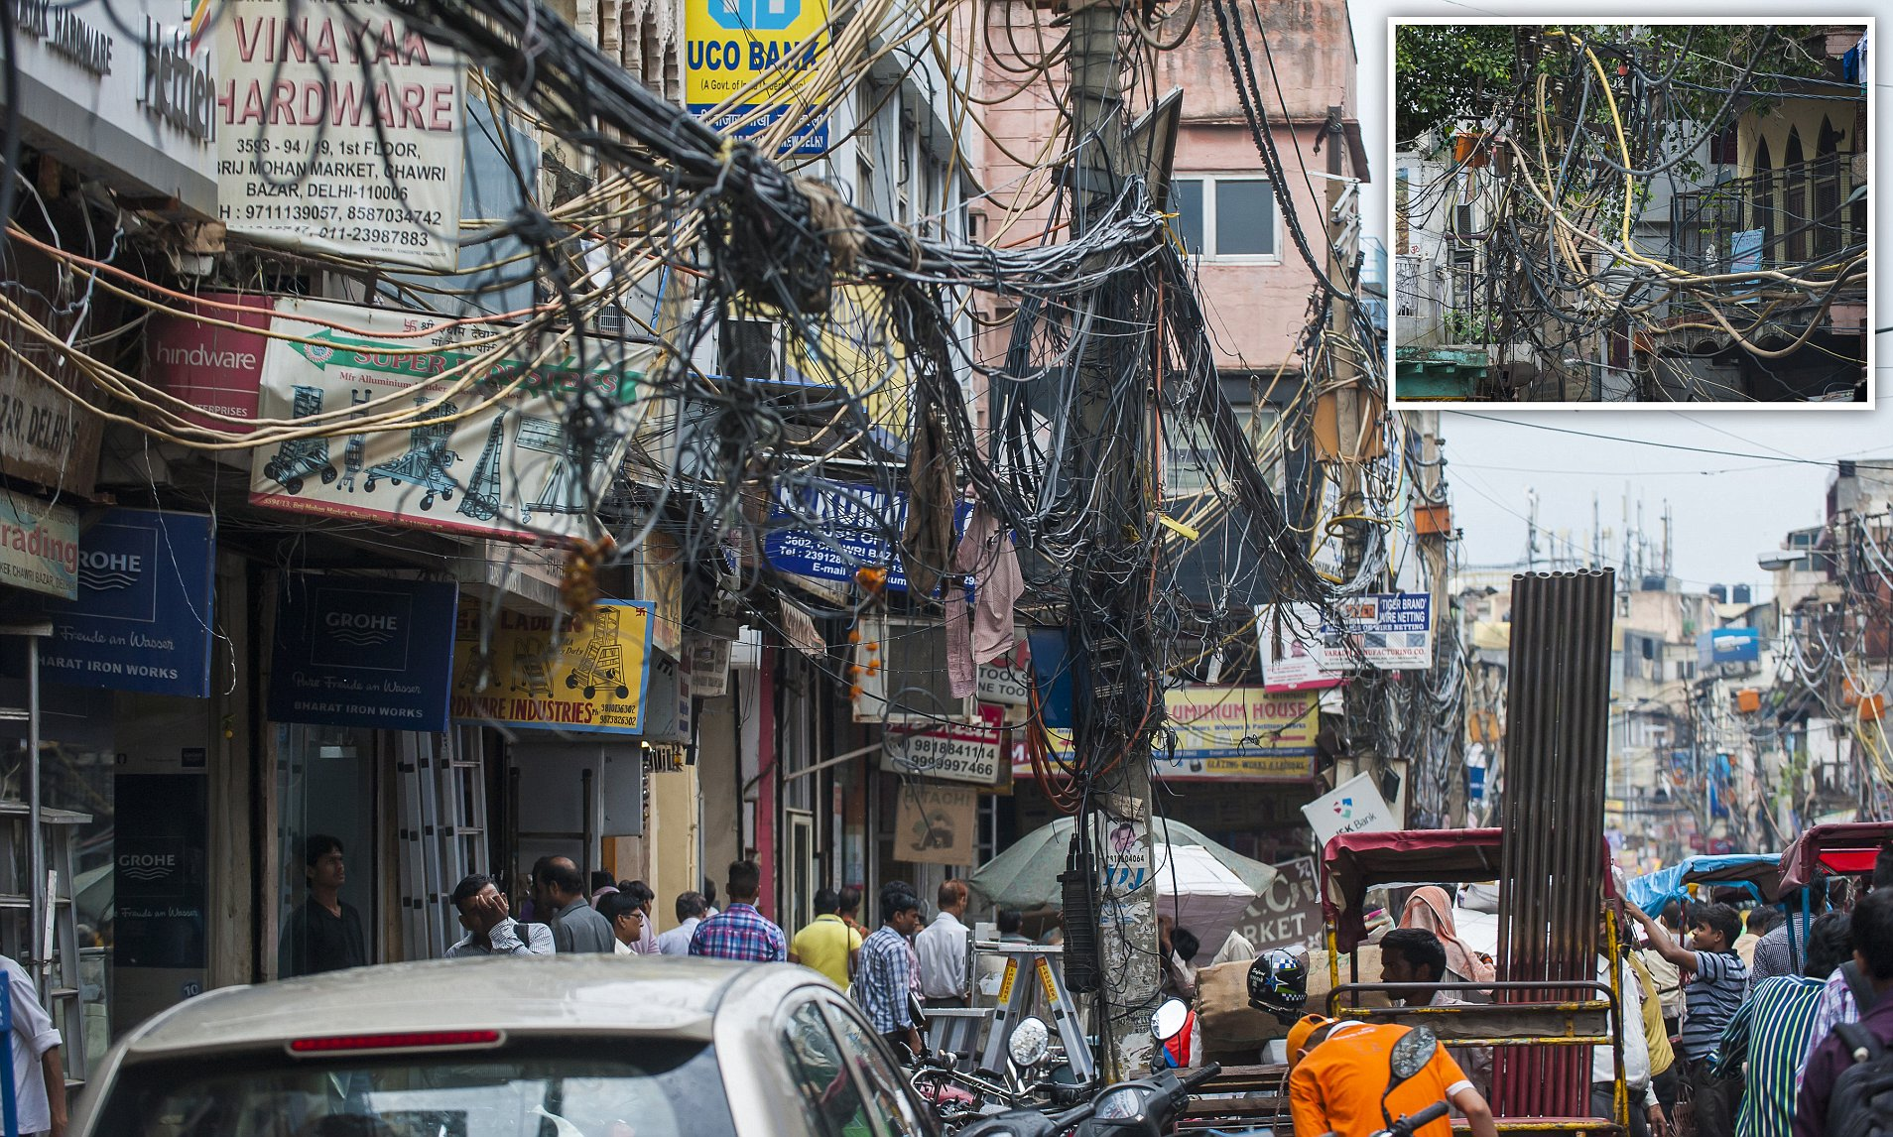
The Average Distribution System at a feeder level substation in the subcontinent.

Slide 8
My interest in Distributed Computing
Now have been assigned to work on Distribution Systems.
Highly heterogeneous!
High R/X ratio
NOT well-behaved Jacobians, YBus, etc.
Unbalanced phases
Our usual analysis methods will NOT work for these systems.
Distributed Computing might help.

Slide 9
What do I NOT mean by Distributed Computing?

Slide 10
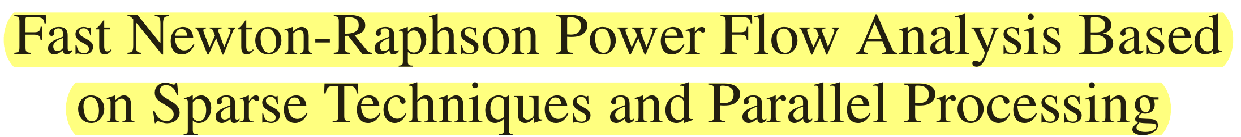
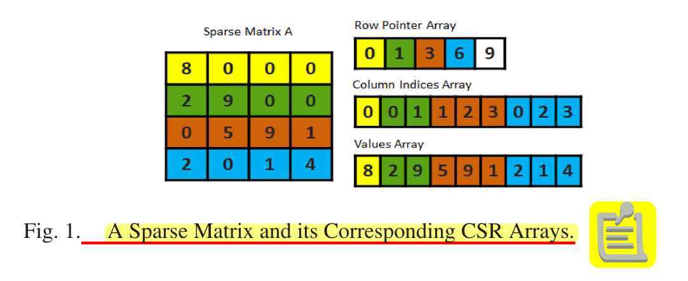
Lorem
Ipsum
Sparsification reduces the data computation overhead and makes our analysis more scalable.

Slide 11
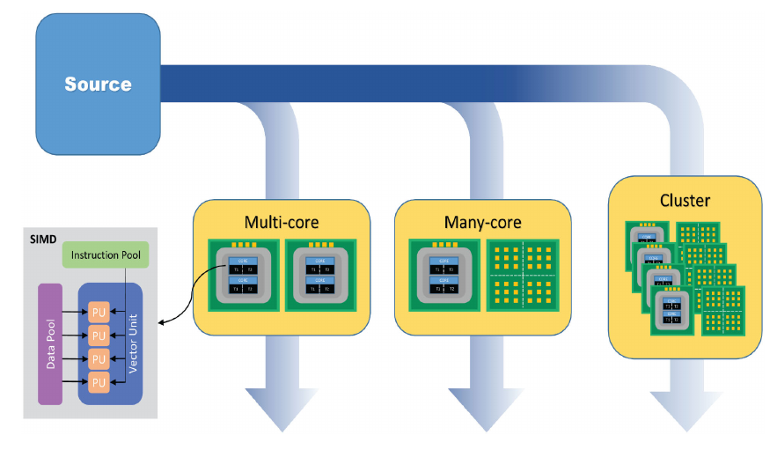
Lorem
Ipsum
Parallel Processing of Data using mutli-core CPUs, GPUs and SMIDs is also referred to as distributed computing.

Slide 12
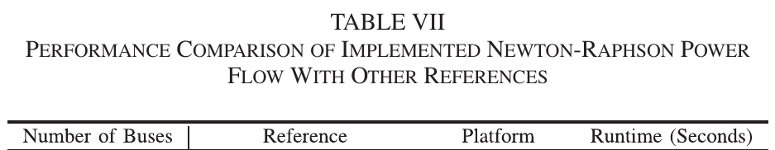
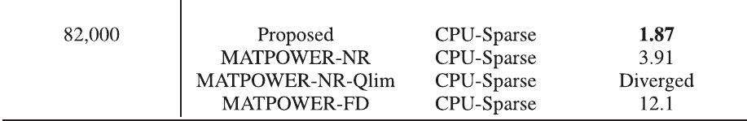
Lorem
A speedier execution of data processing is certainly a desired output for a scalable algorithm.
But none of these methods refer to the usage of Distributed Computing here.

Slide 13
Alright.. then what do I mean by Distributed Computing?

Slide 14
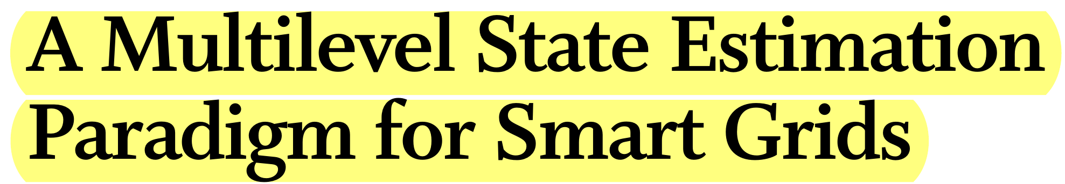
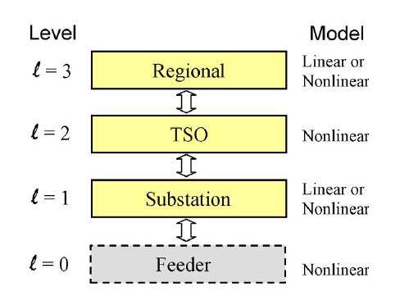
Heirarchial data computation and data reporting

Slide 15
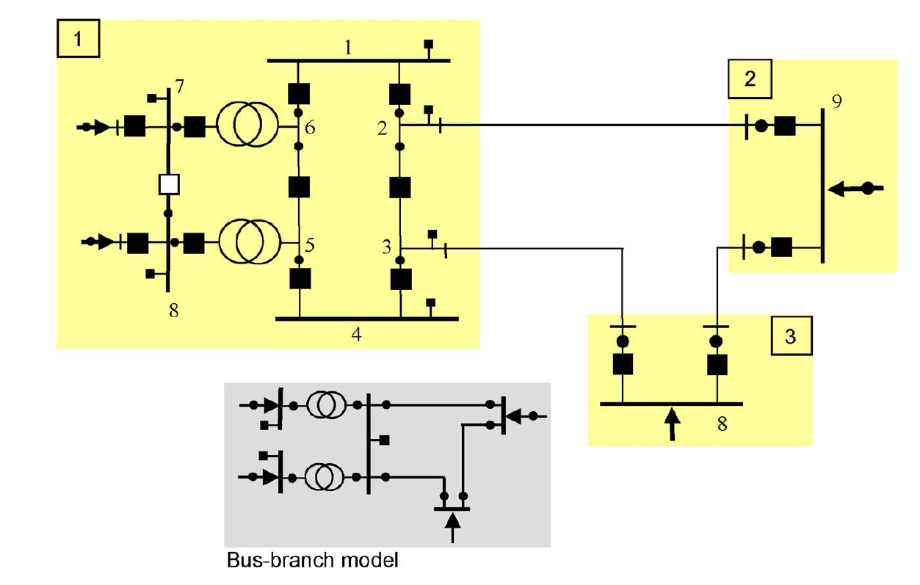
Dividing a central system into several subsystems and analyzing them all in parallel.

Slide 16
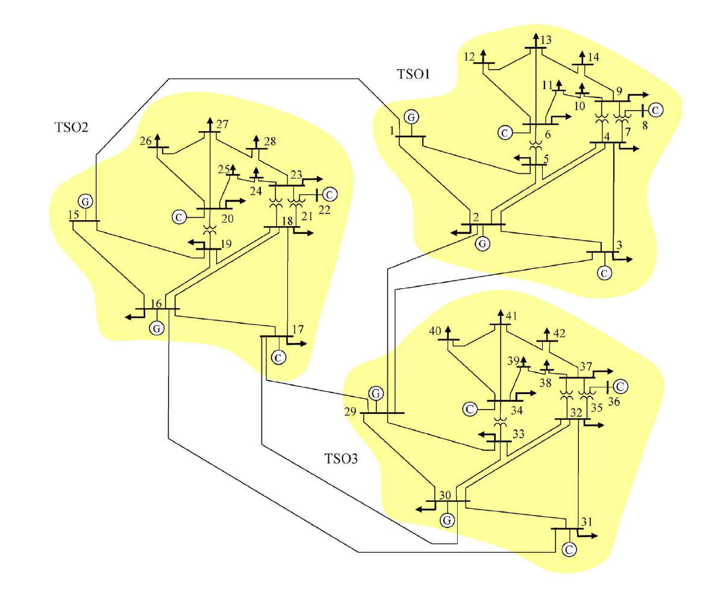
Dividing a central system into several subsystems and analyzing them all in parallel. Here: Transmission Systems.

Slide 17
Use Distributed Computing because you should.

Slide 18
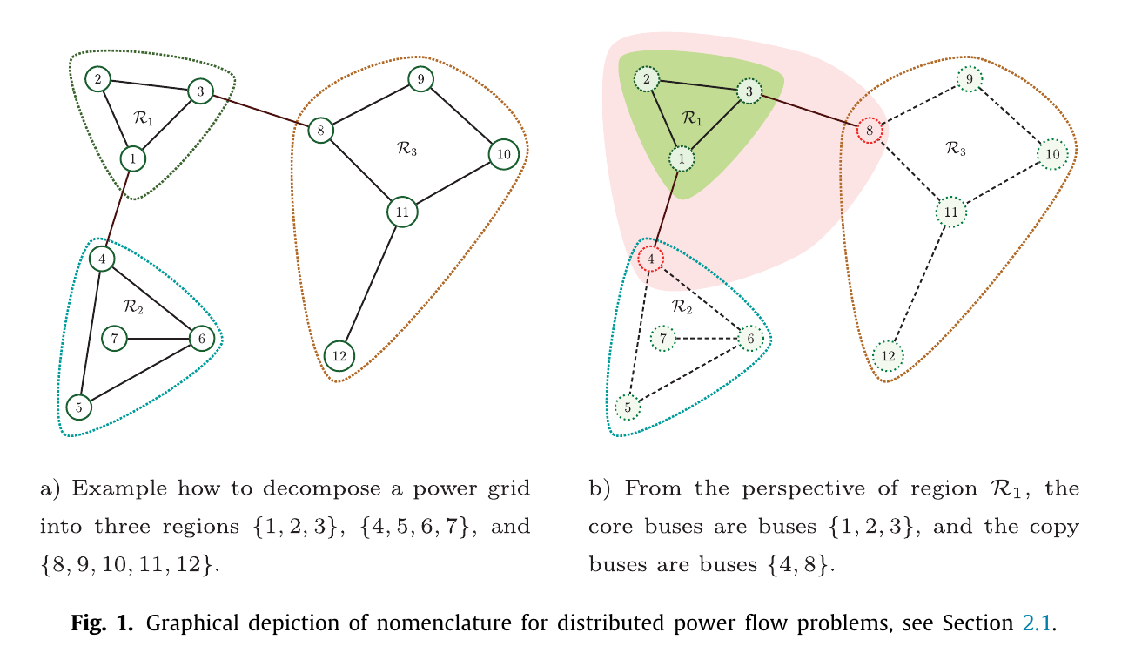
Data privacy issues due to oversharing between different TSOs. How to counter that?

Slide 19
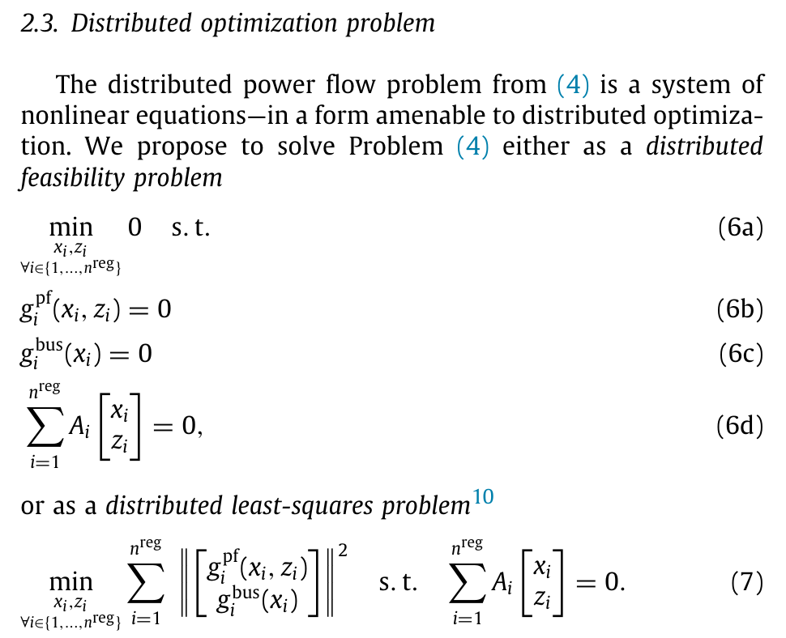
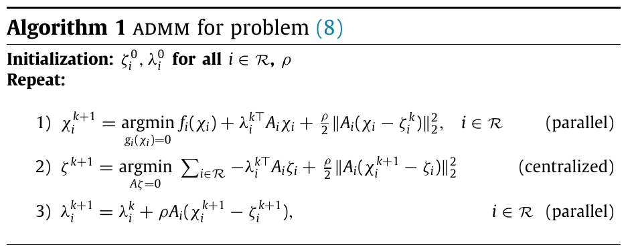
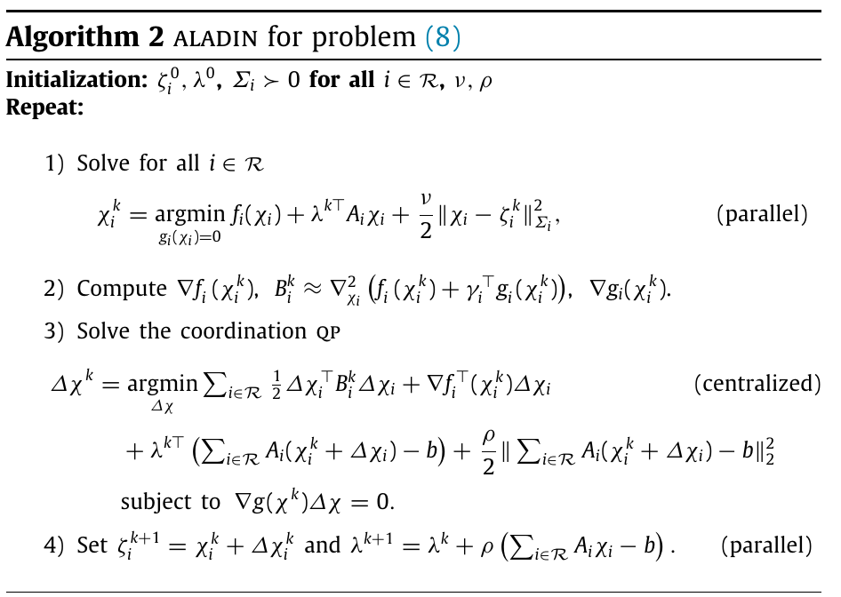
Solve for OPF separately for every single sub-system.

Slide 20
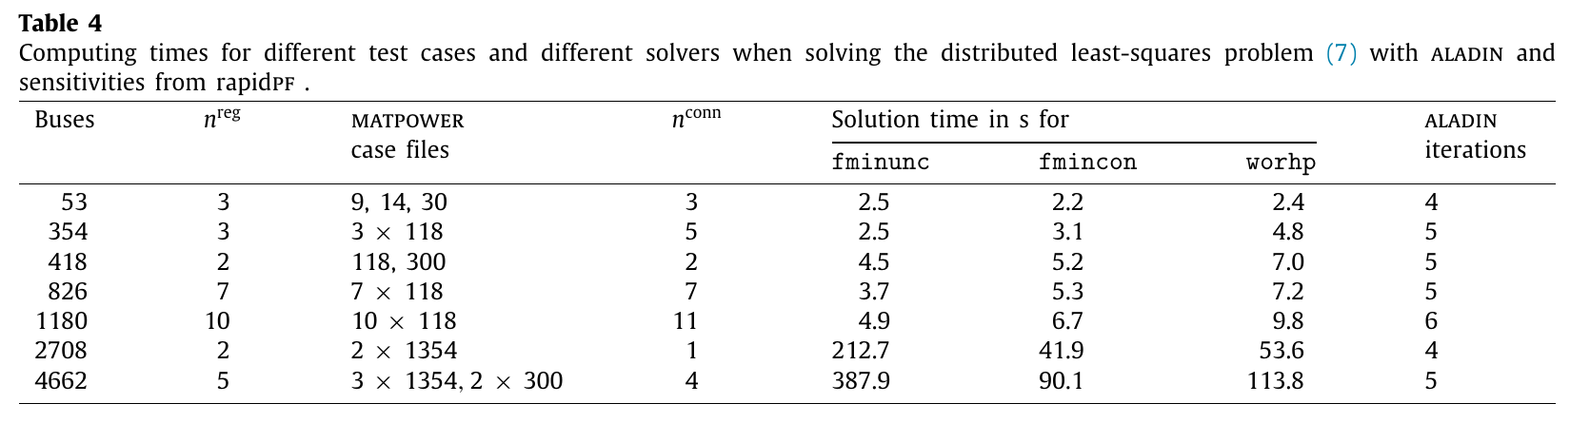
The authors designed an in-house algorithm acronymized ALADIN which performed

Slide 21
Use Distributed Computing because you MUST.

Slide 22
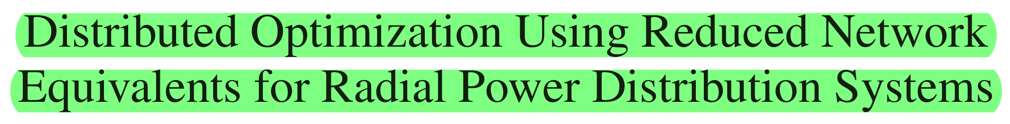
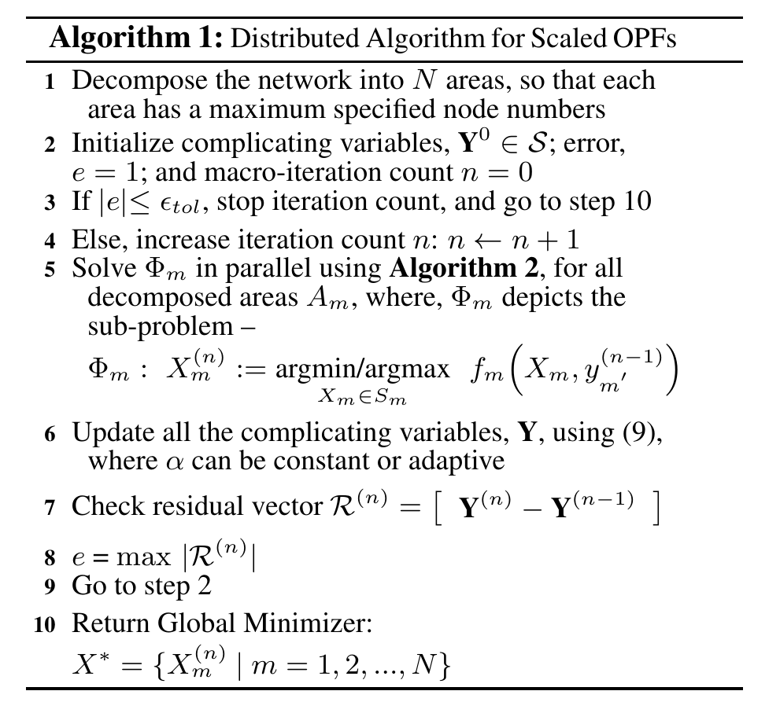
The authors wanted to test Distributed algorithms against Centralized algorithms for Optimal Power Flow for large distribution system with significant renewable penetration.

Slide 23
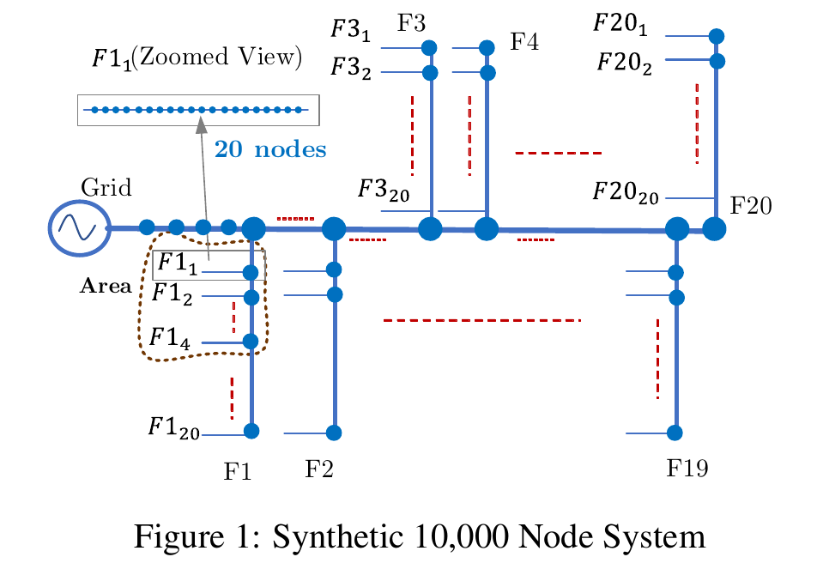
They used synthetic feeder-level distribution systems with significant DER penetration and applied their grid decomposition algorithm before applying their Distributed OPF algorithm.

Slide 24
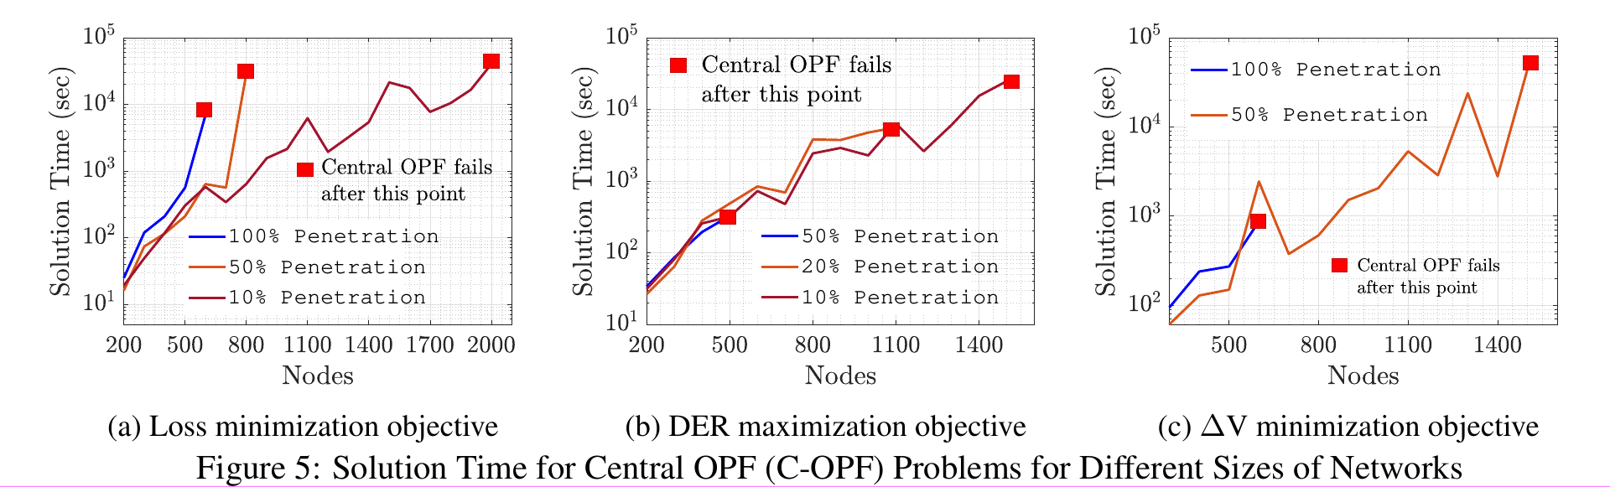
Centralized OPF algorithms are not only being slower, they are failing to converge!

Slide 25

What did we do today? A super short summary of the contents of the papers.

Slide 26
Paper 1: Clarification on the term Distributed Computing
01
03
Papers 4 and 5: A dire need for Distributed Computing
Parallel processing is a part of Distributed Computing, but NOT the concept itself!
Larger systems with significant DER penetrations would simply NOT converge for Centralized OPF algorithms. Must use Distributed OPF algorithms.
02
Papers 2 and 3: Need for Distributed Computing
Privacy.
Computational attractiveness.

Slide 27
Where does all of this fit with the course work?

Slide 28


In our EE 521 Classes, we learnt..
Lagrangian and Dual Problem Formulation
LP
Simplex Method
Interior Point Method
NLP
Quadratic Programming
Course work covered algorithms designed for Centralized Computation.
All of these methods are JUST as valid in Distributed Computing .. provided some adjustments are made.
Very effective for homogeneous systems which are NOT large. Robust control.

Slide 29
Thank you.
Making Analysis of Power Systems Scalable through Distributed Computing
Aryan Ritwajeet Jha

