Slide 1
Weekly Summary by Aryan Ritwajeet Jha
This week’s contents:
Problem: Solving for a power flow snapshot by decomposing a meshed grid into two radial grids and solving their individual power flows in parallel
Problem provided by Rabayet Sadnan

Slide 2
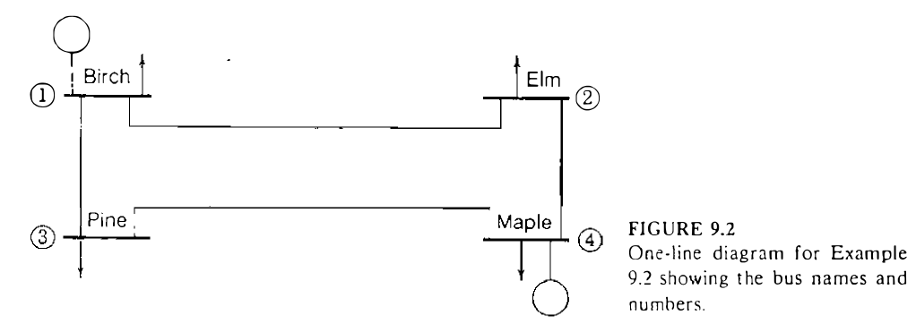
The Test Case
A variation of the 4-bus system available in Grainger and Stevenson was used.
Original System

Slide 3
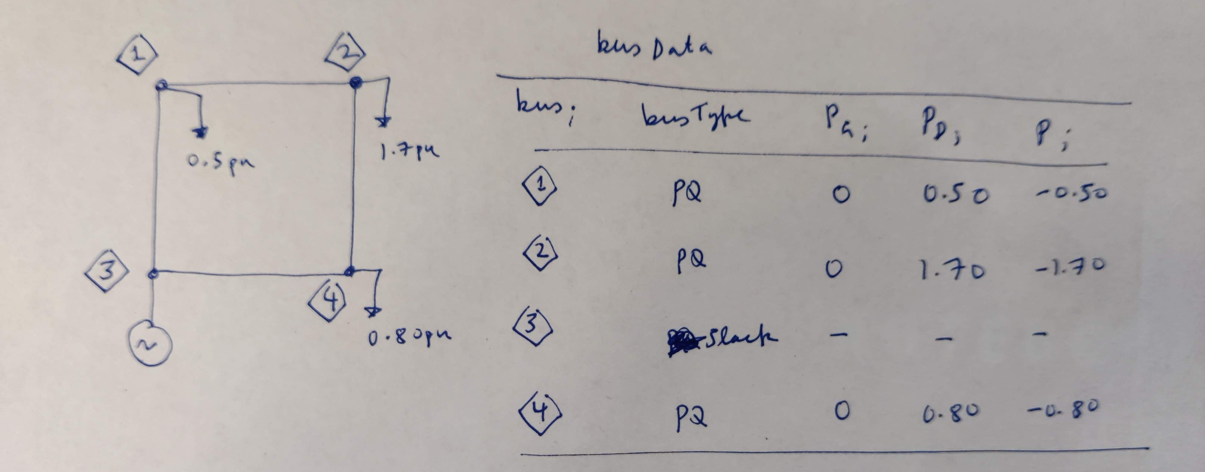
The Test Case
Instead of two generators at buses 1 and 4, the modified system has only one generator at bus 3.
Modified System with Bus Data

Slide 4
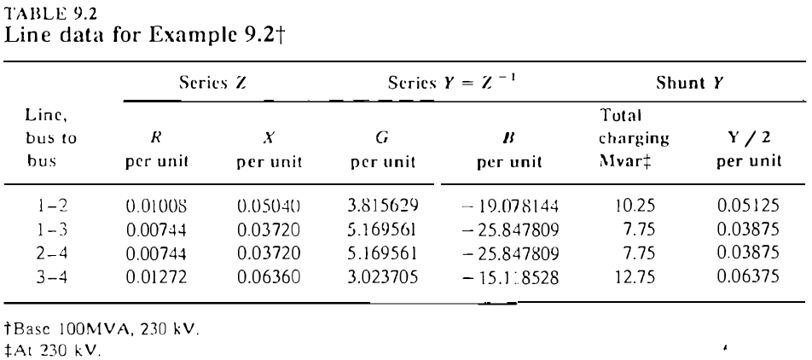
The Test Case
The branch data used is the same.
Branch Data for the Modified 4 Bus System.

Slide 5
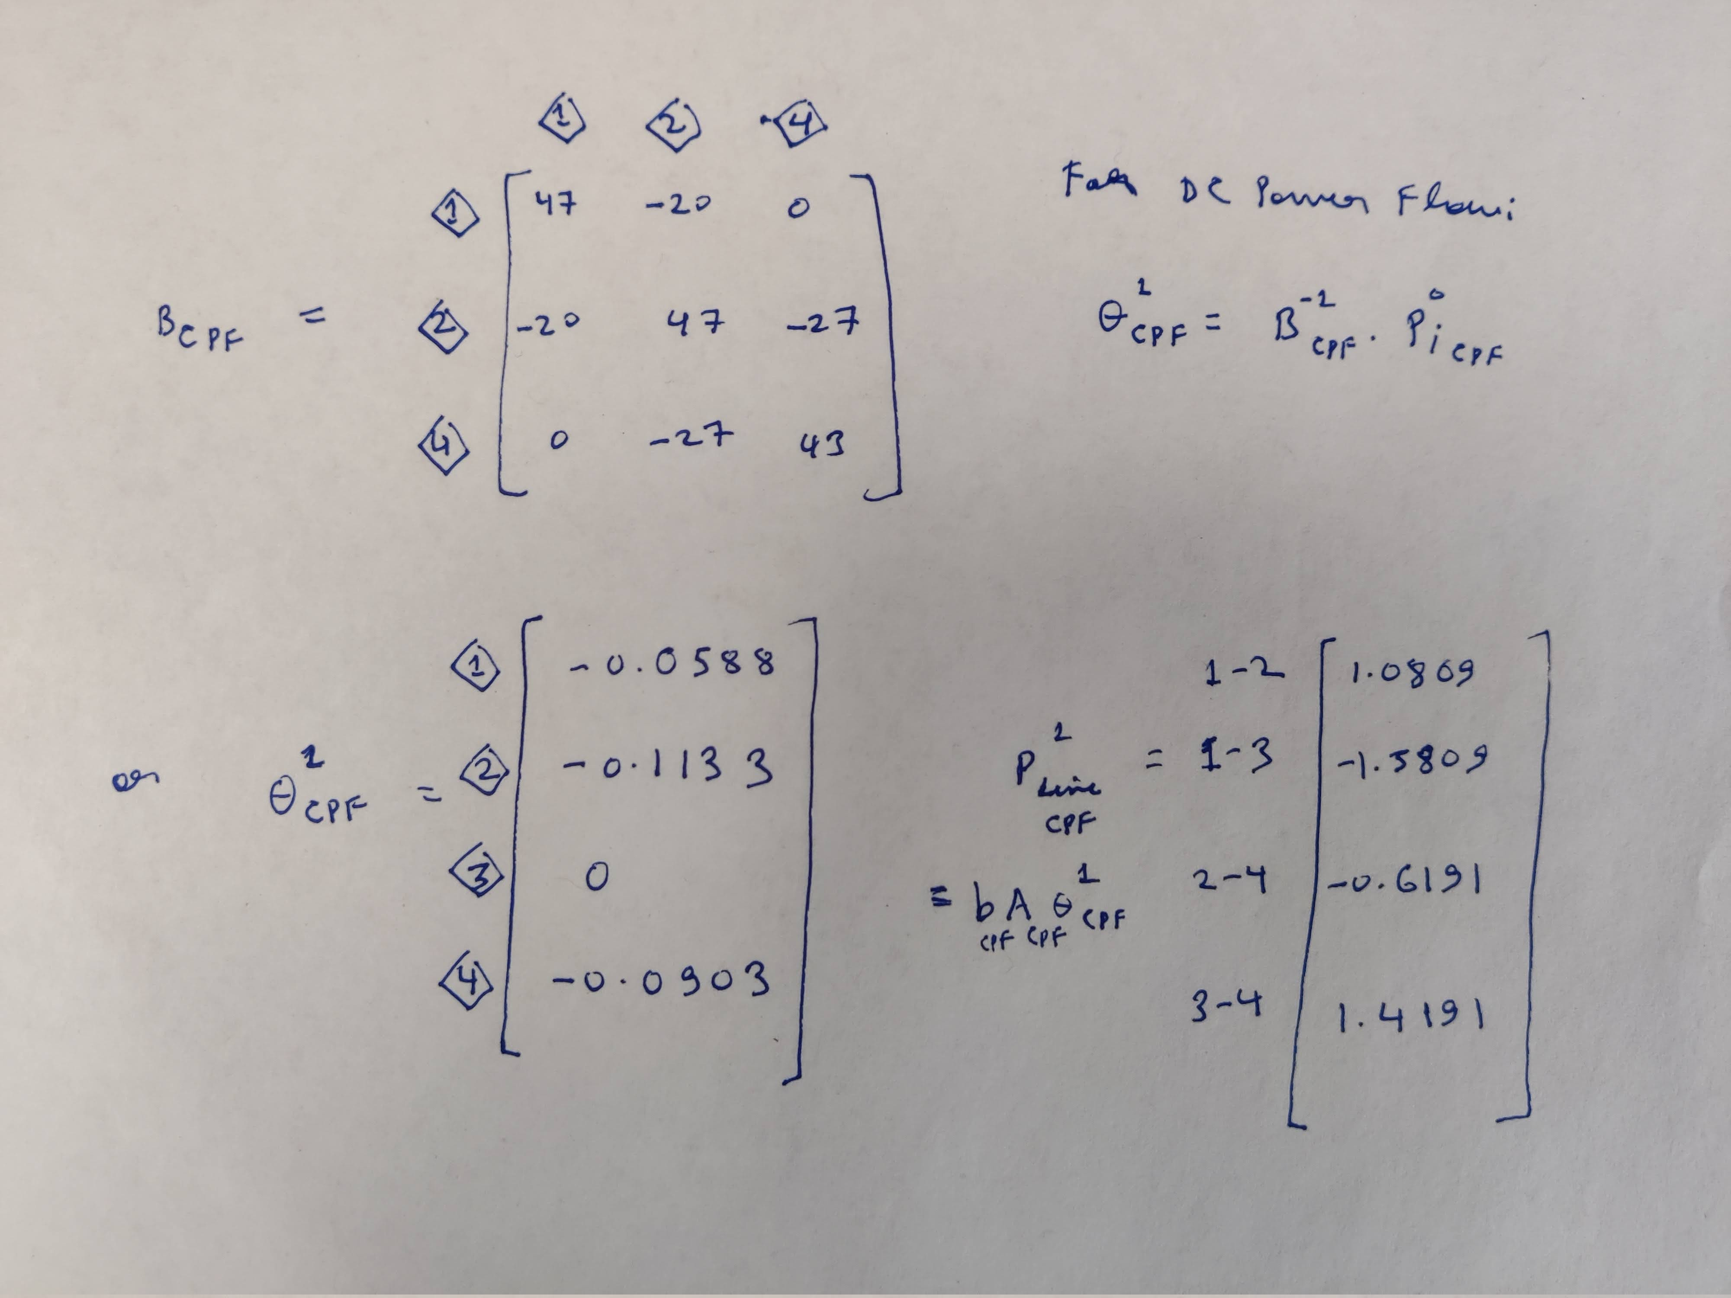
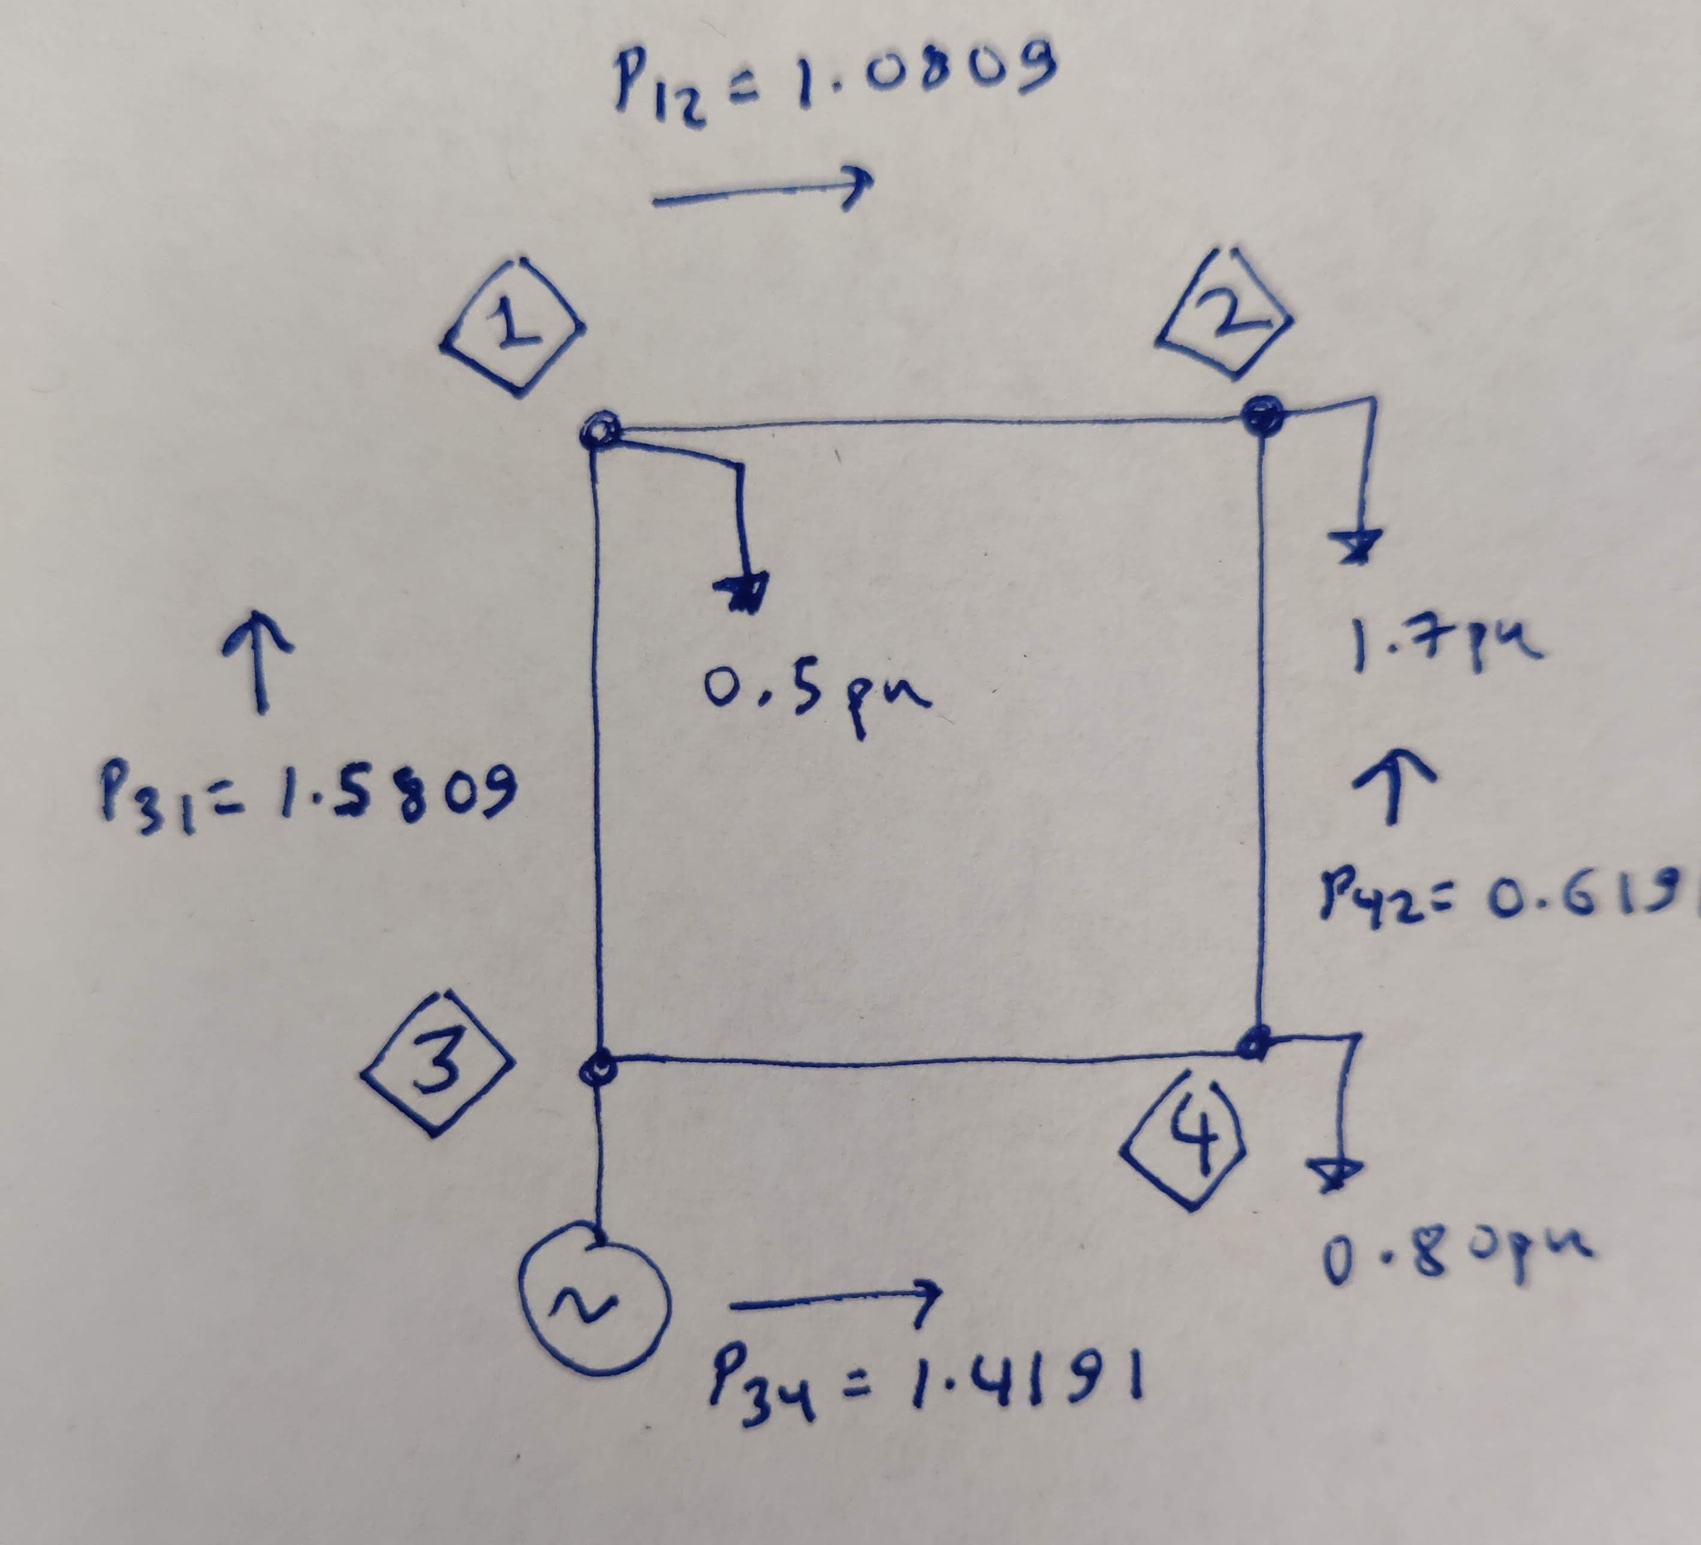
Centralized Power Flow using DC Power Flow
For a reference, the bus modified 4 bus system was solved using DC Power Flow.
DC Power Flow Snapshot for the Modified 4 Bus System.

Slide 6
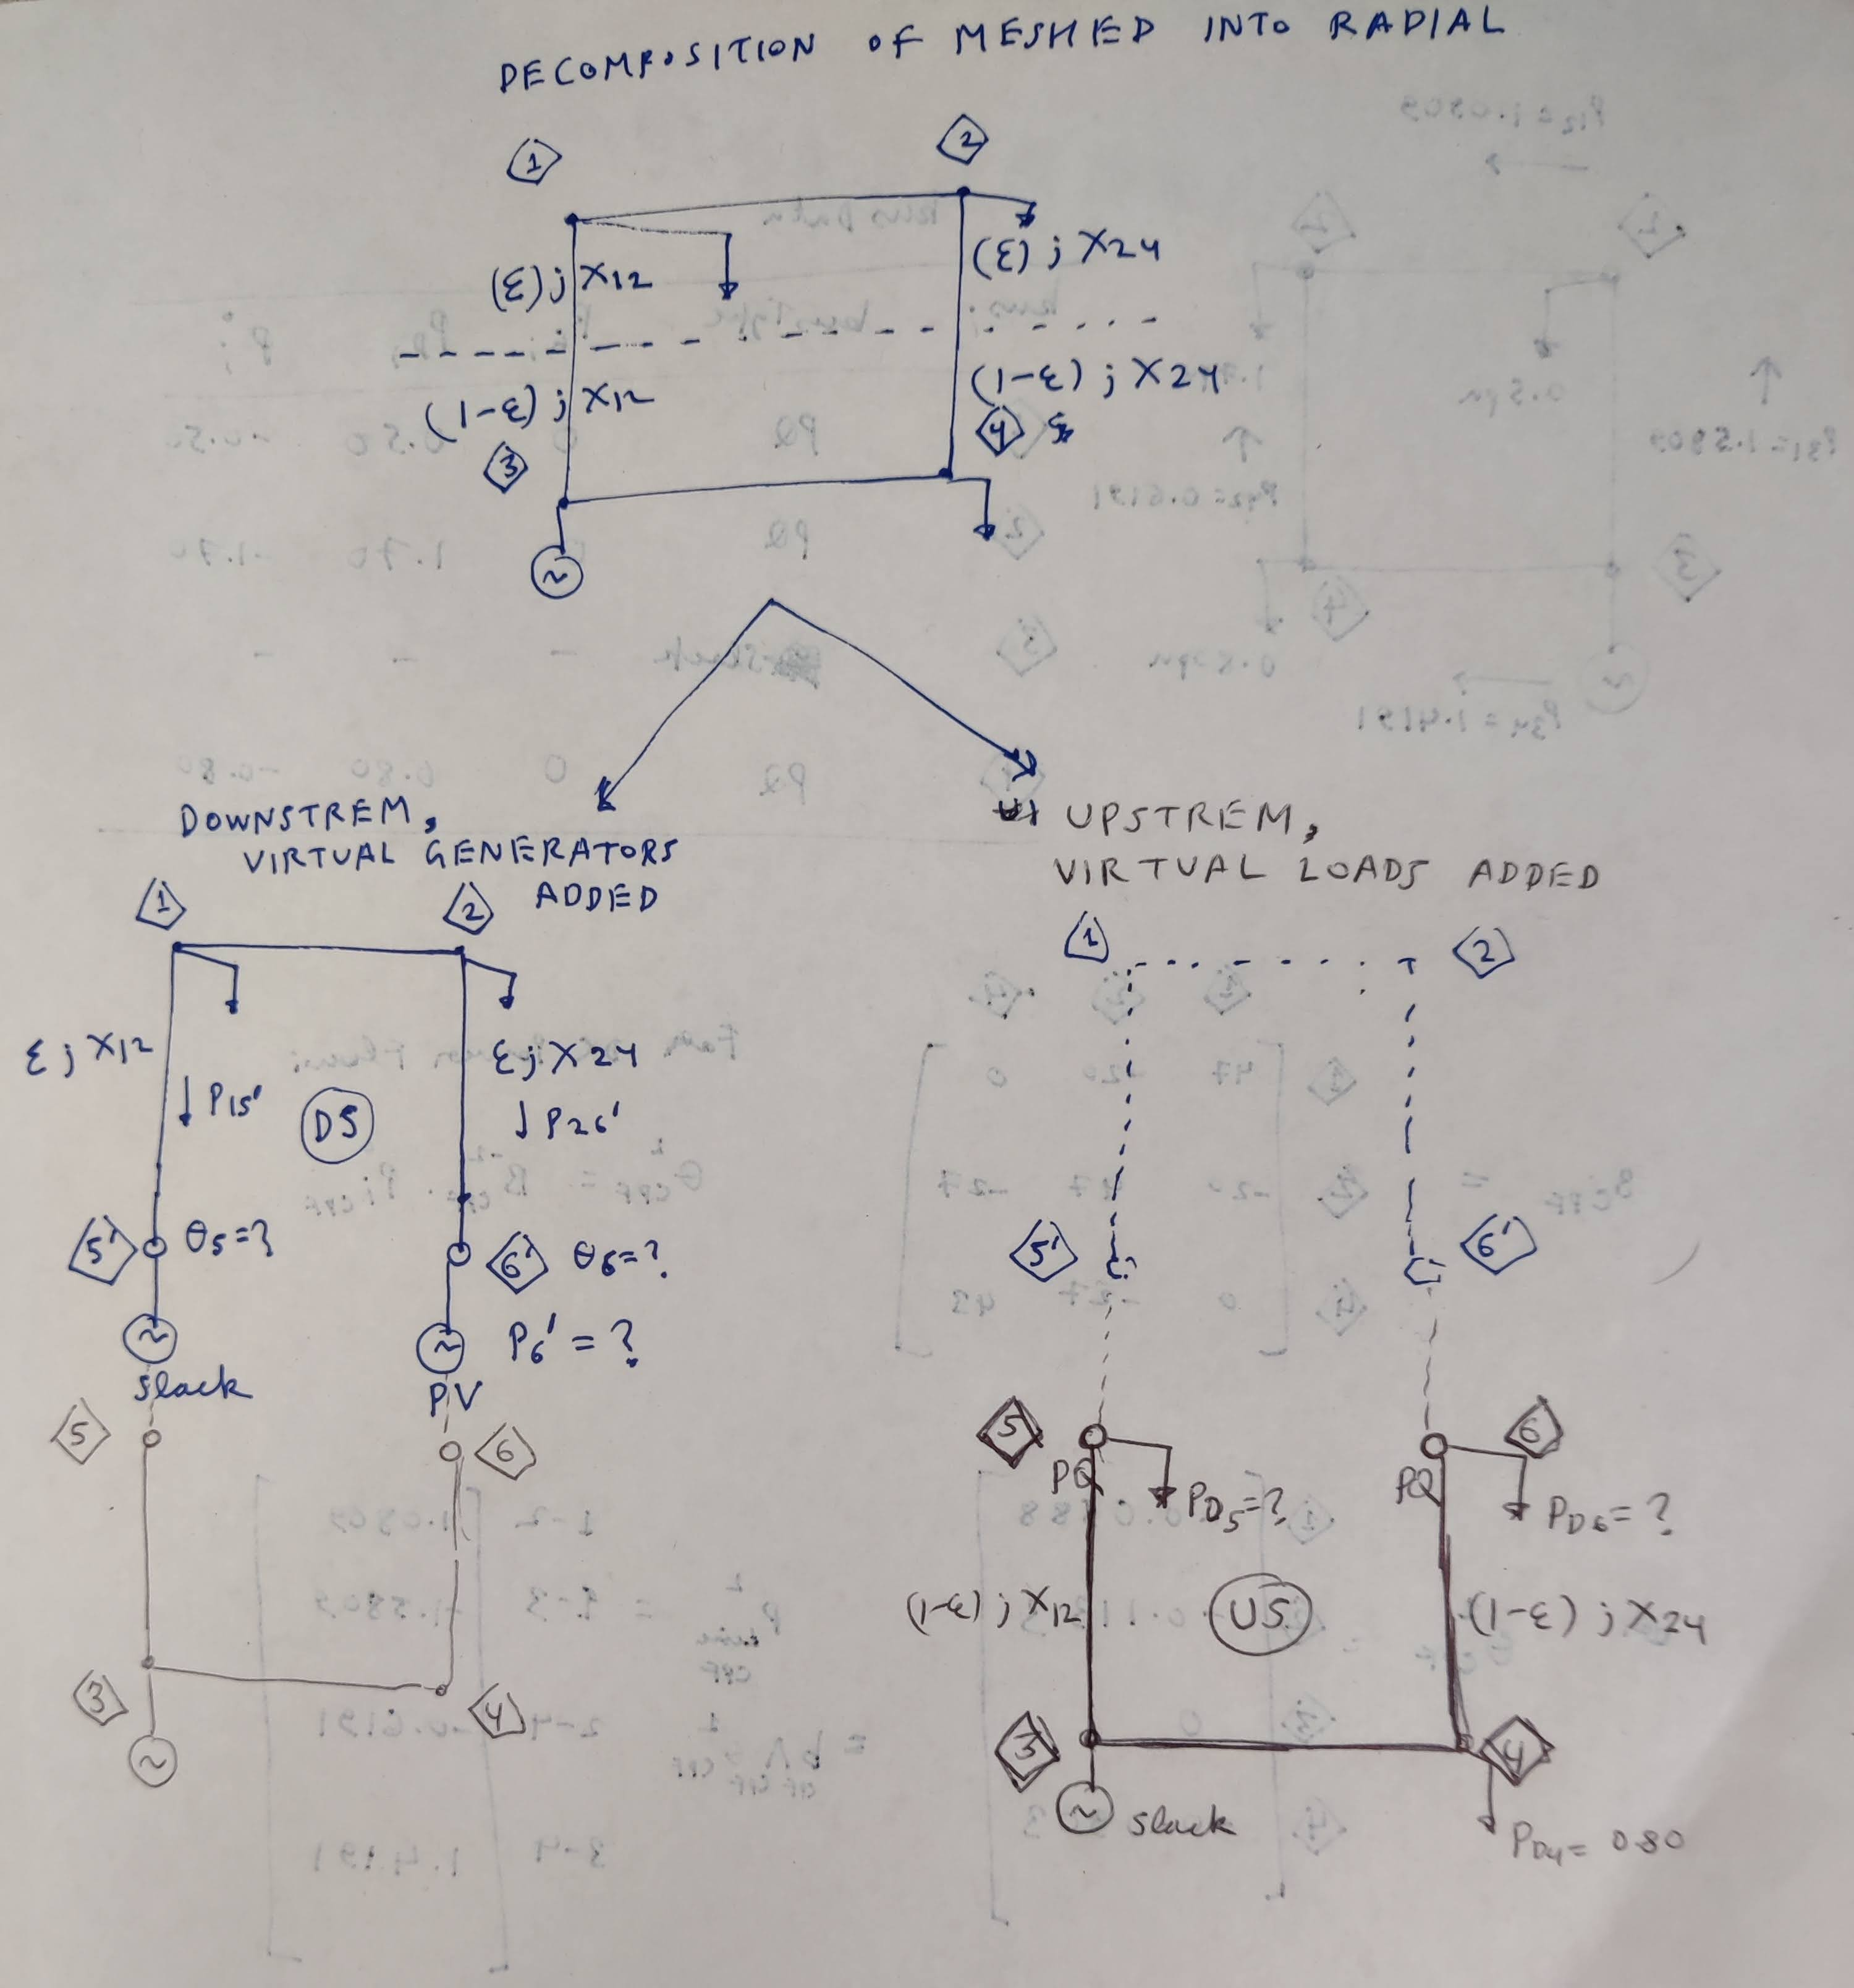
Decentralized Power Flow
The Idea: Instead of solving power flow for the whole meshed system, we can decompose the grid into two radial subsystems (with suitable adjustments) and solve for their individual power flows in parallel.
System bifurcated into two subsystems at branches 1-3 and 2-4, which led to creation of virtual nodes 5, 5’ and 6, 6’. One one pair of virtual nodes (5’, 6’), virtual generators were added, whereas on the other pair of virtual nodes (5, 6), virtual loads were added.

Slide 7
Decentralized Power Flow
In theory, the virtual generation at virtual node 5’ should match the virtual loads at virtual node 5. And similarly for 6’ and 6.
This is because no new power can be generated or demanded at the virtual nodes.
Sub-systems called ‘Donwstream’ (only loads) and ‘Upstream’ (with real generator at bus 3)

Slide 8
Decentralized Power Flow
For DC Power flows, we require:
B Matrix (known for both subsystems, given that we can decide the place at which branches 1-3 and 2-4 are ‘cut’).
Real Powers injected into the grid by bus i: Pi (NOT known for every bus). Here we know the Pi values for buses 1, 2, 4 only.
  We need to find a way to know the Pi values for buses 3, 5’, 5, 6’ and 6.

Slide 9
Running a bit short on time, so the rest will be explained in person.

Slide 10
End of This week’s contents.

Slide 11
Weekly Summary by Aryan Ritwajeet Jha
This week’s contents:
Distributed Computing for Scalable Optimal Power Flow in Large Radial Electric Power Distribution Systems with Distributed Energy Resources
by Rabayet Sadnan and Anamika Dubey
PowerModelsDistributions.jl: An Open-Source Framework for Exploring Distribution Power Flow Formulations
By David M Fobes, Sander Claeys, Frederik Geth and Carleton Coffrin from LANL, KU Leuven

Slide 12
Weekly Summary by Aryan Ritwajeet Jha
This week’s contents:
Network-Level Optimization for Unbalanced Power Distribution System: Approximation and Relaxation
by Rahul Ranjan Jha and Anamika Dubey
Distributed Optimizations Using Reduced Network Equivalents for Radial Power Distribution Systems
By Rabayet Sadnan and Anamika Dubey

Slide 13
Network-Level Optimization for Unbalanced Power Distribution System: Approximation and Relaxation
Non-Linear Programming (NLP) to solve Distribution Level – Optimal Power Flow (D-OPF) poses convergence issues and not scalable for unbalanced power distribution systems (upds).
Existing scalable solutions to D-OPF problem either use approximations that are not valid for upds or relaxation techniques not guaranteeing feasible power flow solution.

Slide 14
Network-Level Optimization for Unbalanced Power Distribution System: Approximation and Relaxation
The authors scalable D-OPF algorithms have been proposed that simultaneously achieve optimal and feasible solutions by solving multiple iterations of approximate, or relaxed, D-OPF subproblems of low complexity.
Algorithm 1 is based on successive linear approximation of Nonlinear Power Flow equations around the current operating point, where the D-OPF solution is obtained by solving multiple iterations of a linear programming problem.
Algorithm 2 is based on the relaxation of the nonlinear power flow equations as conic constraints together with directional constraints, which achieves optimal and feasible solutions over multiple iterations of a second-order cone programming (SOCP) problem.

Slide 15
Network-Level Optimization for Unbalanced Power Distribution System: Approximation and Relaxation
Applications of OPF algorithms:
  Loss minimization
  Volt-Var Optimization
  Effective Management of DERs
Need for Advanced Distributed Management Systems (ADMS)
  Increasing penetration of DERs
  Proliferation of Proactive loads
  Interest in Demand Response Programmes

Slide 16
Distributed Optimizations Using Reduced Network Equivalents for Radial Power Distribution Systems
Centralized Optimization Methods have limitations.
Existing D-OPF algorithms not viable as they require a large number of macro-iterations (10^2 to 10^3 iterations of communication rounds) between computing agents to solve one instance of the optimization problem.
So in the paper, the authors propose a new scalable D-Optimization method based on Equivalent Network Approximation (ENApp) to solve D-OPF for a balanced power distribution system (bpds).
Specifically, the bpds’s radial topology is leveraged to reduced the decomposed systems into upstream and downstream network equivalents.
Validated on IEEE 123 and IEEE 8500 systems and checked against the solution of a centralized optimal power flow (C-OPF) model.

Slide 17
Distributed Optimizations Using Reduced Network Equivalents for Radial Power Distribution Systems
Typically C-OPF (which uses NLP) used to determine a pds’s operation == computational challenges and susceptibility to single point failure.
In such a case D-O methods have these advantages:
  Less computation load on a single machine
  Less susceptibility to single-point failure due to multiple interacting agents
  Relax the need between communication between a central controlling machine and connected controllable/non-controllable assets.

