Slide 1
CptS 421 : Senior Design (Capstone)
Course Intro & Warmup
Notes:
Template-WSU Hrz 201.ppt

Slide 2
Today’s Topics
Review:
  Course space
  Syllabus
  Project Abstracts
  Coursework and grading
  Forming teams
  Effort expectations
Notes:
Template-WSU Hrz 201.ppt

Slide 3
Course Space and Syllabus
Canvas
Syllabus
Notes:
Template-WSU Hrz 201.ppt

Slide 4
Coursework
Team forming and inventory
Project Report (submit on Canvas and upload to Github)
  Seven deadlines
Sprints (upload to Github):
  Three sprints, one every month: due 5th of every month
    Code and associated items
      issues, to-do boards, branches, pull requests, …
    Sprint report
    Sprint demo video
Peer assessment and Client assessment
In-class presentation (3 to 5 minutes): late November
Client presentation (25 to 30 minutes): early December
Notes:
Template-WSU Hrz 201.ppt

Slide 5
Forming Teams
Read the Abstract of Projects carefully
Bidding survey is live (end date on Canvas)
Teams will be setup before class on Tuesday
Notes:
Template-WSU Hrz 201.ppt

Slide 6
Project Abstracts
Terminology
  Client (varies by project)
  Mentor (varies by project, sometimes same as Client/Coach)
  Coach (PK)
Service-learning projects
  Service hours can be earned to fulfill community service requirements
Notes:
Template-WSU Hrz 201.ppt

Slide 7
Project Bidding
Fill the form to bid
  Ratings from 1 to 5 are used for each project
    1: lowest preference; 5: highest preference
  Need at least three 5s, 4s, and 3s from each student
Goal:
  Pick projects that you like
  Give feedback or notes about your skills/preferences/conflicts etc.
    Helps me in assigning teams
Bidding end-date on Canvas
Preferences are not guaranteed to be assigned, I’ll try my best
Notes:
Template-WSU Hrz 201.ppt

Slide 8
Forming Teams
Post-Tuesday:
  Elect a team lead (important!)
  PK will connect teams to clients & mentors
  Teams will contact clients & mentors with Team Inventory
  Check the schedule for coaching meetings with PK
    On Canvas
Notes:
Template-WSU Hrz 201.ppt

Slide 9
Capstone Team Leader Responsibilities
  1. Serve as an interface between the team and the project stakeholders, including the course instructor. Involves coordinating communication channels and scheduling meetings, presentations, among other things.
  2. Ensure that the team is on track with respect to the team’s project tasks. Involves driving the team to achieve project and course deliverables on time.

Slide 10
Capstone Team Leader Responsibilities
3. Takes an initiative in starting the discussion regarding dividing project tasks and assigning the tasks to team members.
4. Other leadership tasks for the team, as appropriate.
Time taken for providing the team lead service can be counted as a contribution towards the minimum required out of classroom effort for the course, which is 9 hours per week.

Slide 11
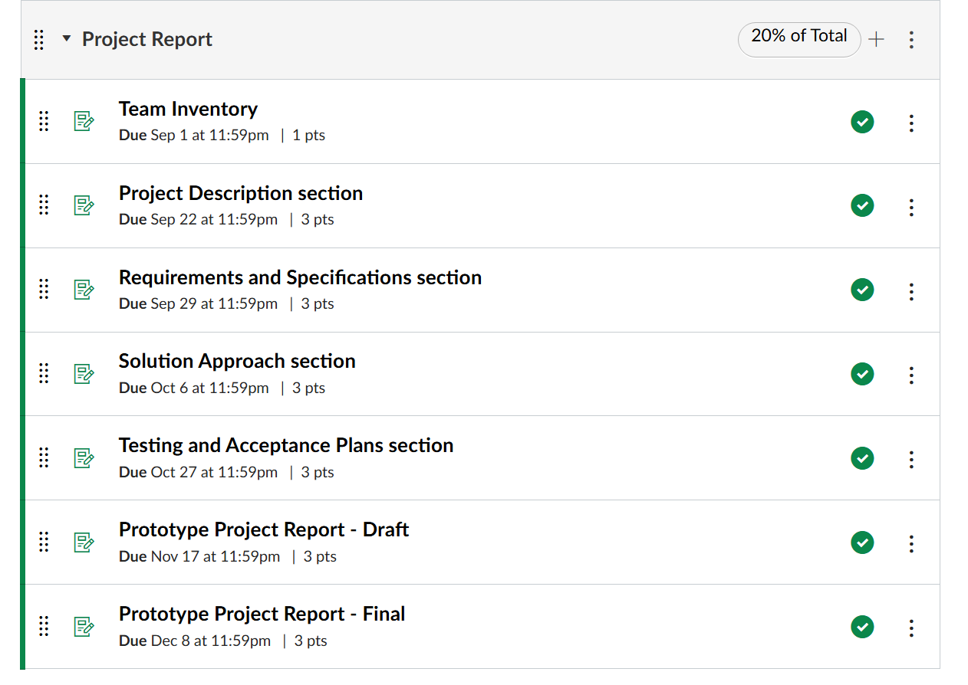
Project Report

Slide 12
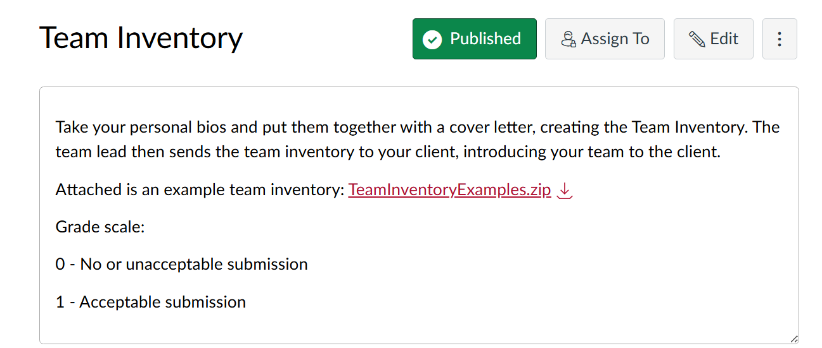
Team Inventory

Slide 13
Sprints (Weightage 30%)
Agile Based Development Process
Sprints (upload to Github):
  Three sprints, one every month: due 5th of every month
    Code and associated items
      issues, to-do boards, branches, pull requests, …
    Sprint report
    Sprint demo video
    Rubrics Sprint 1 (instructure.com)

Slide 14
Sprints (Weightage 30%)
Each team must upload a brief demo video to their Github repo once every Sprint. The demo video should showcase the activities performed by the team for a given sprint. The demo video need not be long, 15 minutes long at most.
No submission needed on Canvas for the Sprints. Please upload all your code, videos, and reports to your Github repo.

Slide 15
Course Meetings
    We will have 6 to 8 lecture in the semester
    What to do in class time?
      Teams will meet with PK for coaching; schedule on Canvas
      When you are not meeting PK, use class time for team/client meetings
    No separate ‘lab’ meeting times or activities
Notes:
Template-WSU Hrz 201.ppt

Slide 16
Grading
Scale of 0 to 3
  0: missing work
  1: unsatisfactory
  2: satisfactory
  3: outstanding
For each sprint: peer and client evaluation
  Lowest of: mean of all averages OR most recent average
Final grade: assignments + sprints + peer grading + client grading
Notes:
Template-WSU Hrz 201.ppt

Slide 17
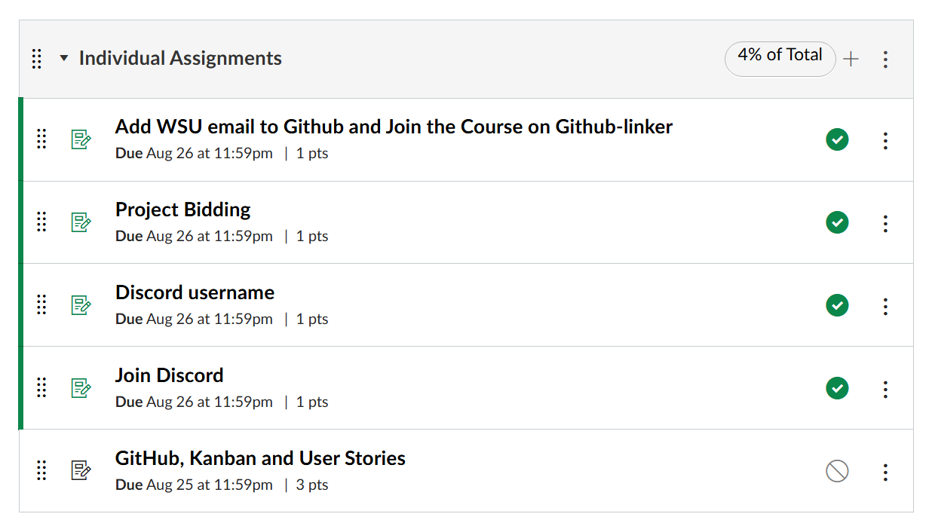
Grading Breakup

Slide 18
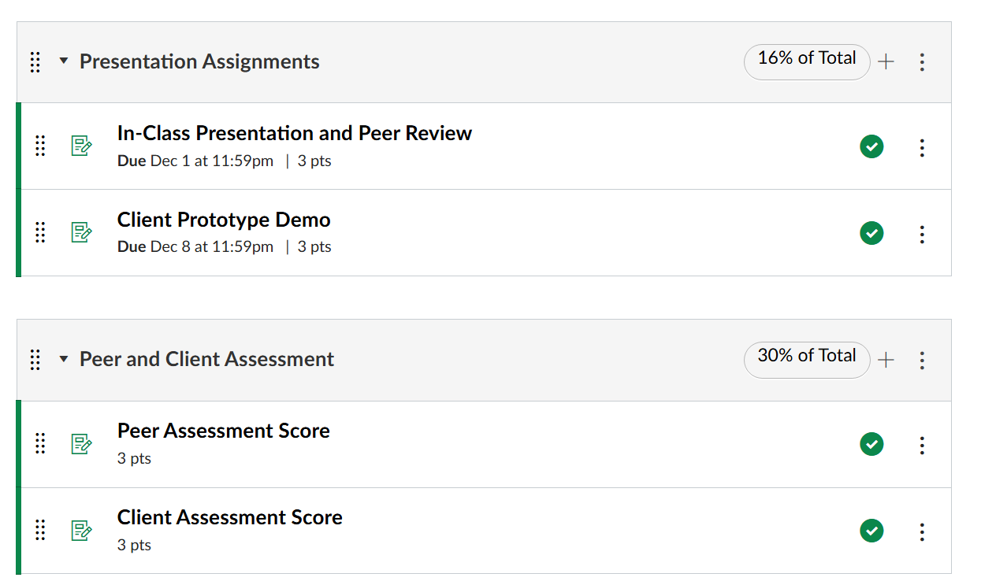
Grading Breakup

Slide 19
Grading Breakup
Activity | Percentage
Individual Assignments | 4
Presentation Assignments | 16
Sprints | 30
Peer and Client Assessments | 30
Project Report | 20

Slide 20
Coursework
Team forming and inventory
Project Report (submit on Canvas and upload to Github)
  Seven deadlines
Sprints (upload to Github):
  Three sprints, one every month: due 5th of every month
    Code and associated items
      issues, to-do boards, branches, pull requests, …
    Sprint report
    Sprint demo video
Peer assessment and Client assessment
In-class presentation (3 to 5 minutes): late November
Client presentation (25 to 30 minutes): early December
Notes:
Template-WSU Hrz 201.ppt

Slide 21
Class Schedule
Tuesday and Thursday 12:05PM - 1:20PM
Cleveland Hall 30

Slide 22
Tips for Success
Contribute to your team
Put in effort
  9 hrs/week: including all course-related work such as meetings
Be pro-active in communication and coding
  Interact regularly with your clients & mentors
  Communicate frequently with your team, ideally daily
  Be on-time for documentation, both code docs and course reports
  Weekly team standup meetings
  Weekly client communication (meetings preferred but if not at least email)
    Seek client feedback on everything, including project report sections
Ultimate goals
  Meet project requirements
  Ensure client satisfaction
Notes:
Template-WSU Hrz 201.ppt

Slide 23
Pitfalls to avoid
Do not wait for assignments or weekly tasks from your client
  Take initiative
Team leads
  Act quickly if a team member isn’t contributing
    Reach out to the inactive member
    Report the occurrence to instructor immediately
    Do not wait or give second chances
No time to take it easy, things cascade quickly
No code → No commits → No degrees
Notes:
Template-WSU Hrz 201.ppt

Slide 24
Any questions?
Email parteek.kumar@wsu.edu
Notes:
Template-WSU Hrz 201.ppt

